Slide 1



Machine-detectors interface and
Applications of particle accelerators
ED PHENIICS
Understanding basic principles of particle accelerators
Nicolas Delerue
LAL (CNRS and Université de Paris-Sud)

Slide 2
Machine detector interface

Slide 3
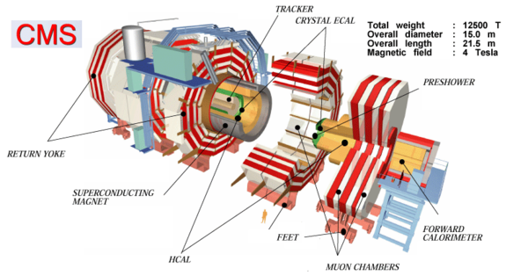
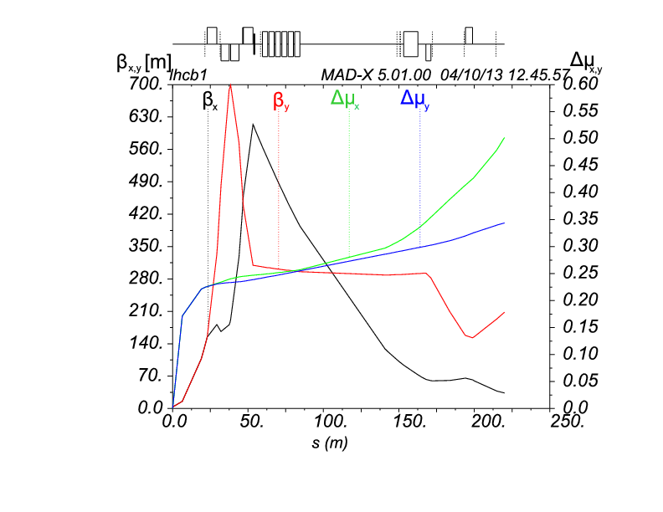
How easy is it to add an experiment on an accelerator?

Slide 4
Adding a detector in an accelerator
The detector is not transparent for the accelerator.
- For example it often comes with limited apertures and a large magnet.
The accelerator will also have side effects on the detector: for example by creating backgrounds and large RF fields.
The interface between the detector and the machine need to be studied carefully.

Slide 5
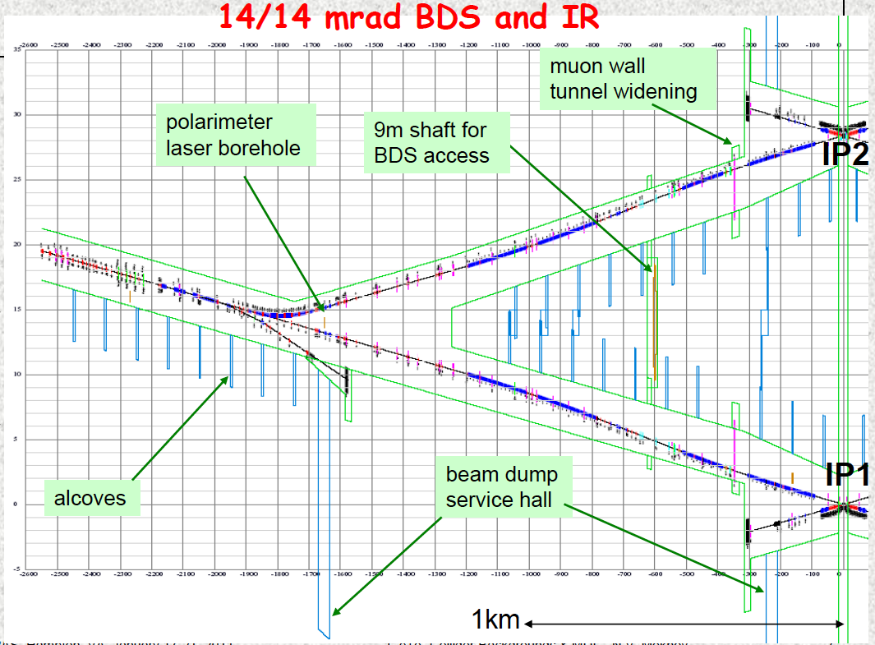
Interaction point at the ILC

Slide 6
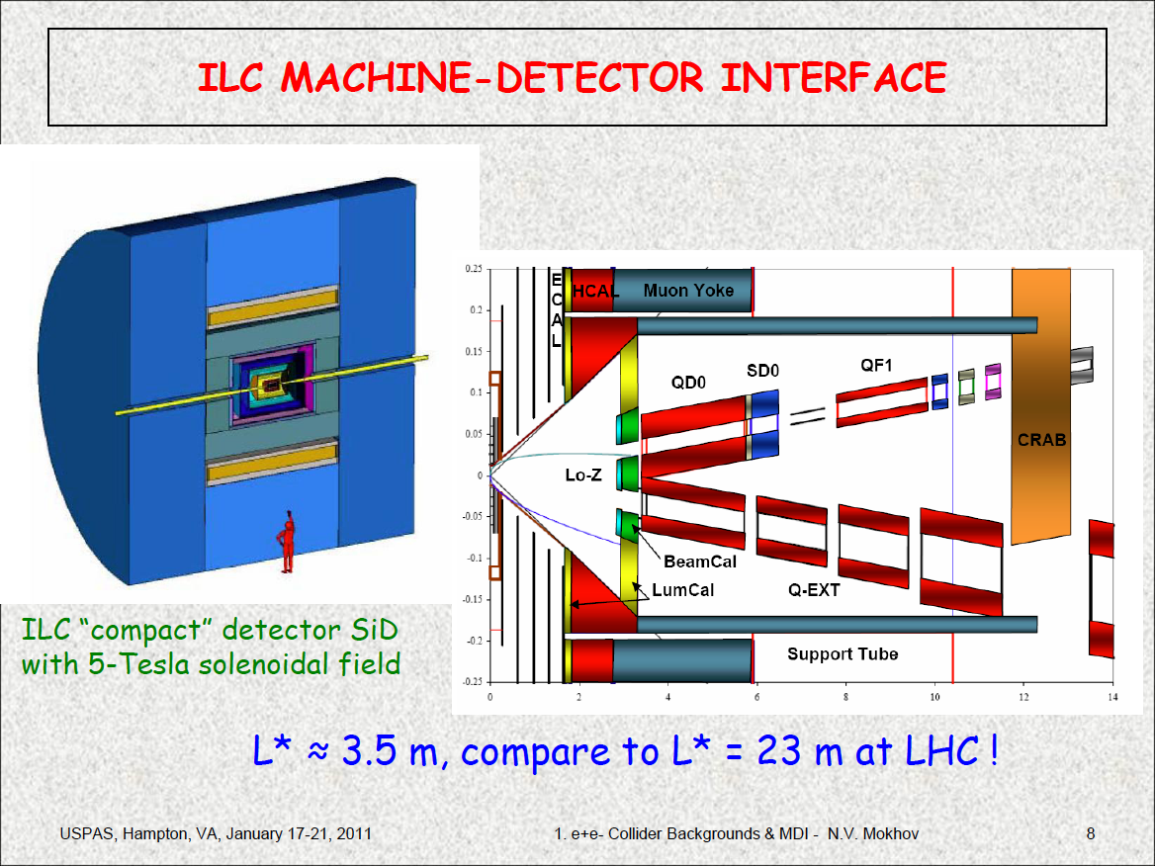

Slide 7
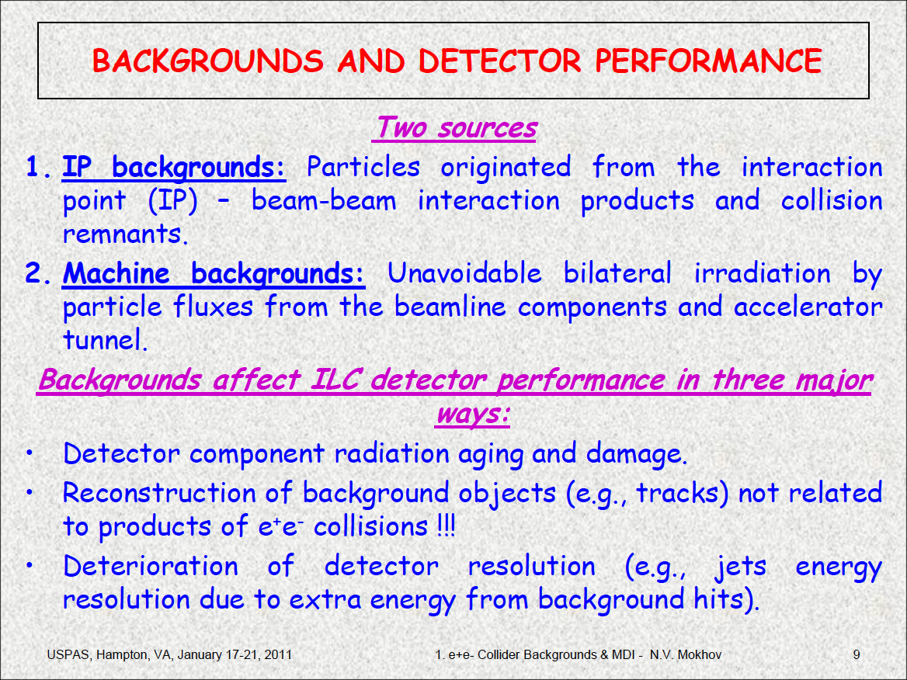

Slide 8
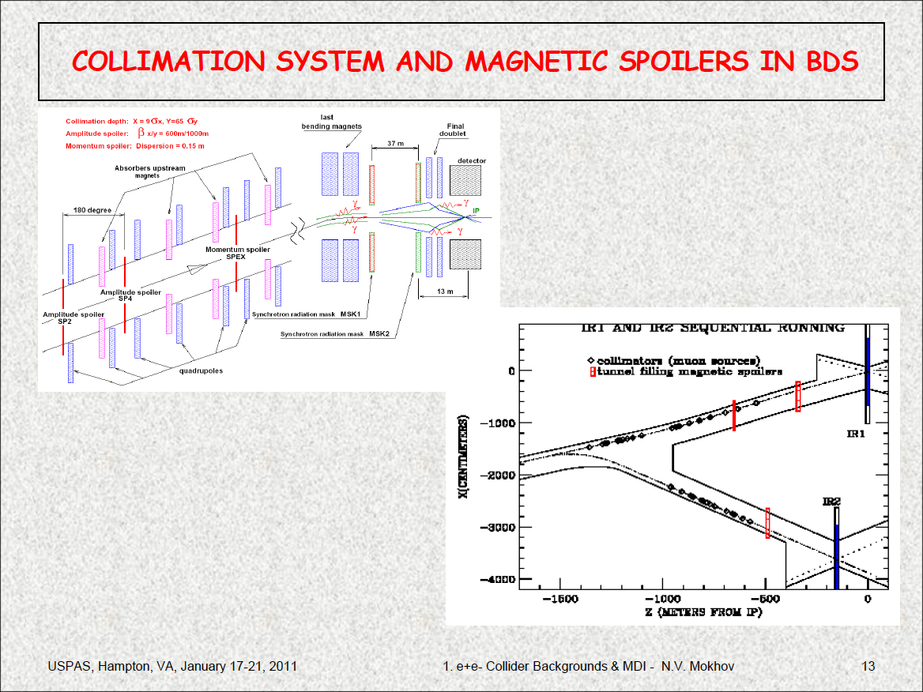

Slide 9
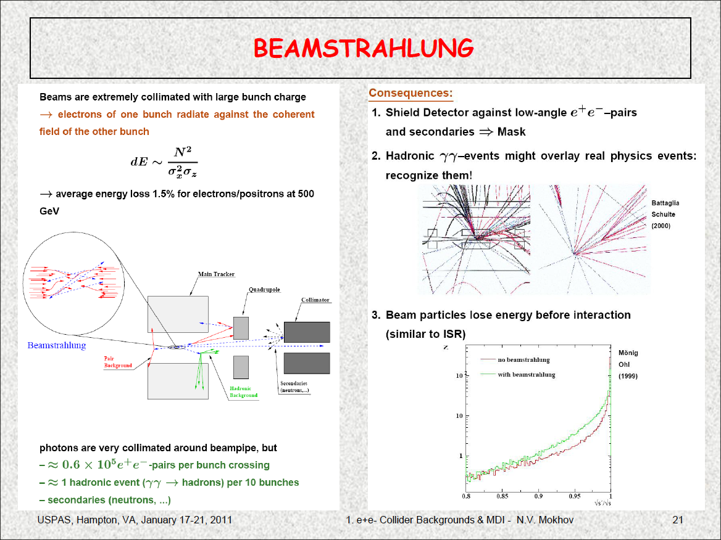

Slide 10
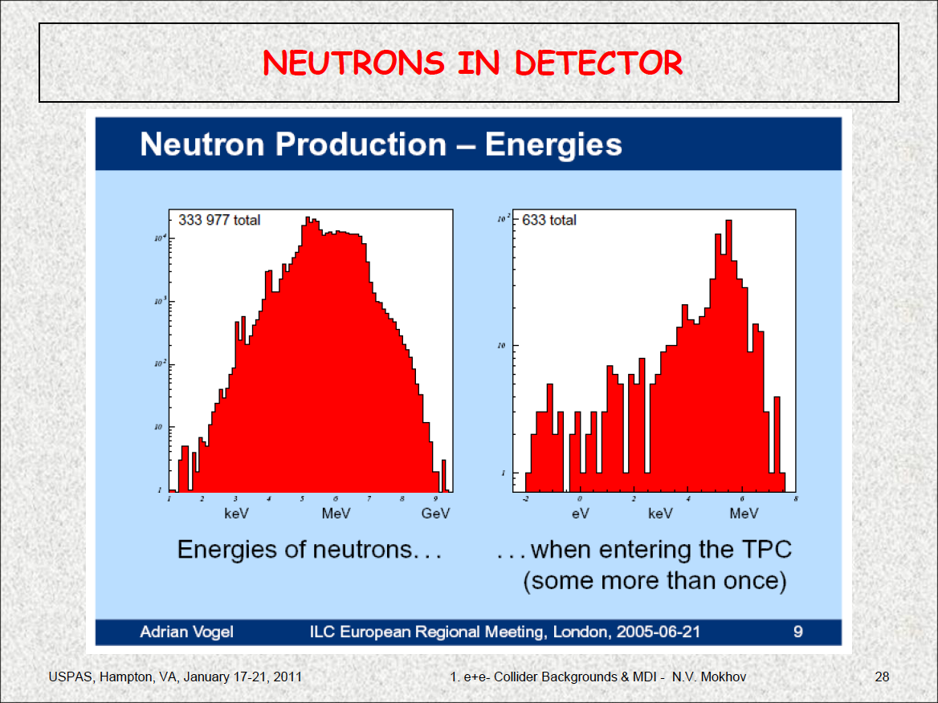

Slide 11
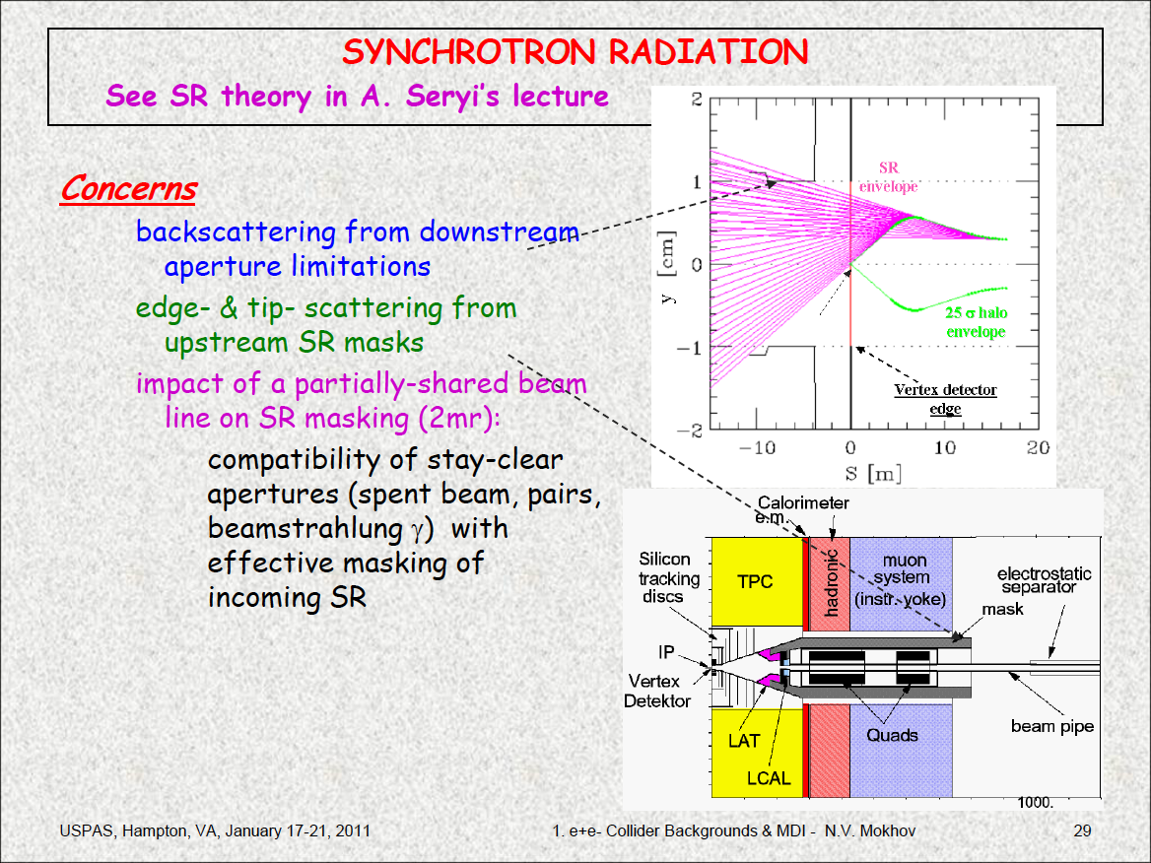

Slide 12
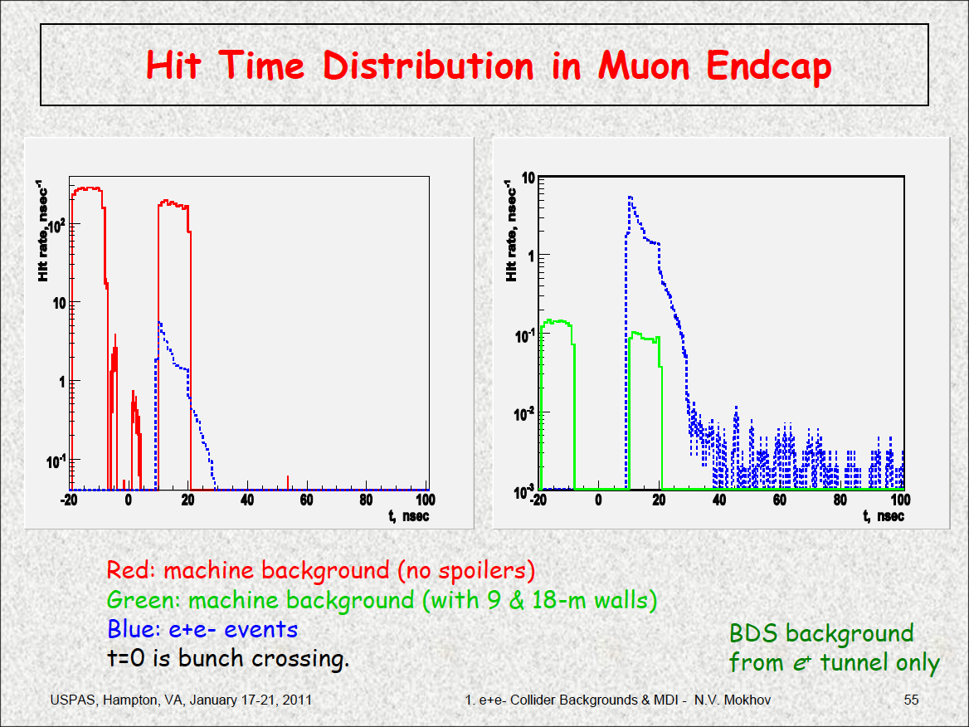

Slide 13
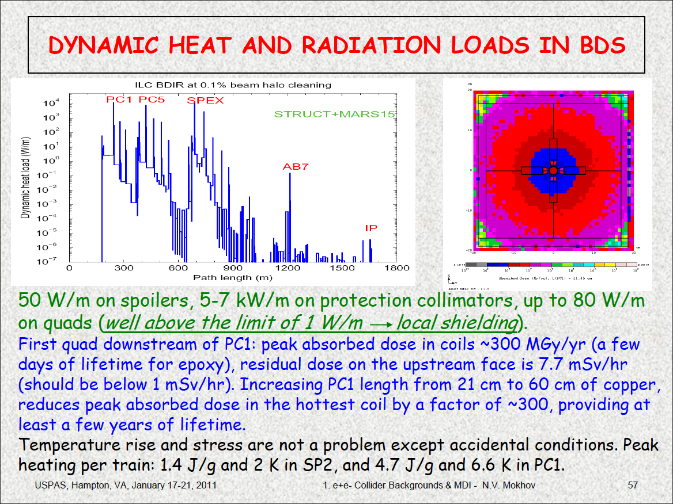

Slide 14
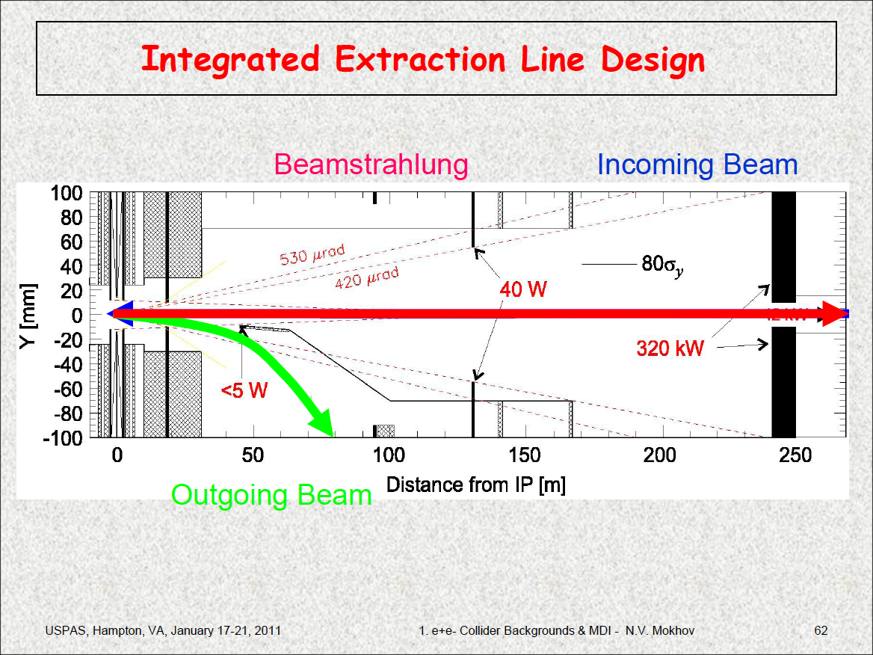

Slide 15
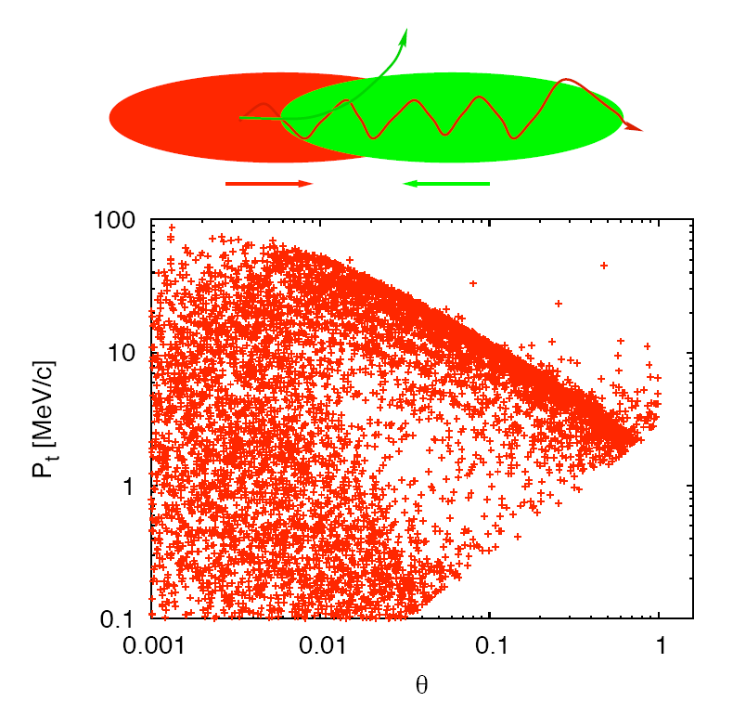
Beam beam effects (1)
In a collider the two beams feel each other's electric field well before and well after colliding.
Given that the particles come very close to each other, this lead to very intense forces.
These forces lead to significant disruption of the beam.

Slide 16
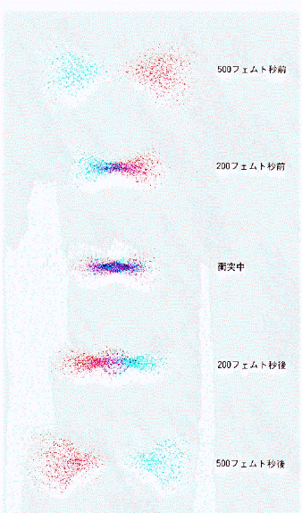
Beam beam effect (2)
At the interaction point the two beams self-focus onto each other.
If the self focussing is too strong this can lead to a large emittance growth.
If the two beam are not perfectly aligned this will also lead to large transverse deflection.
This is a strong limitation on the size of the beams and therefore the luminosity, especially in a ring.

Slide 17
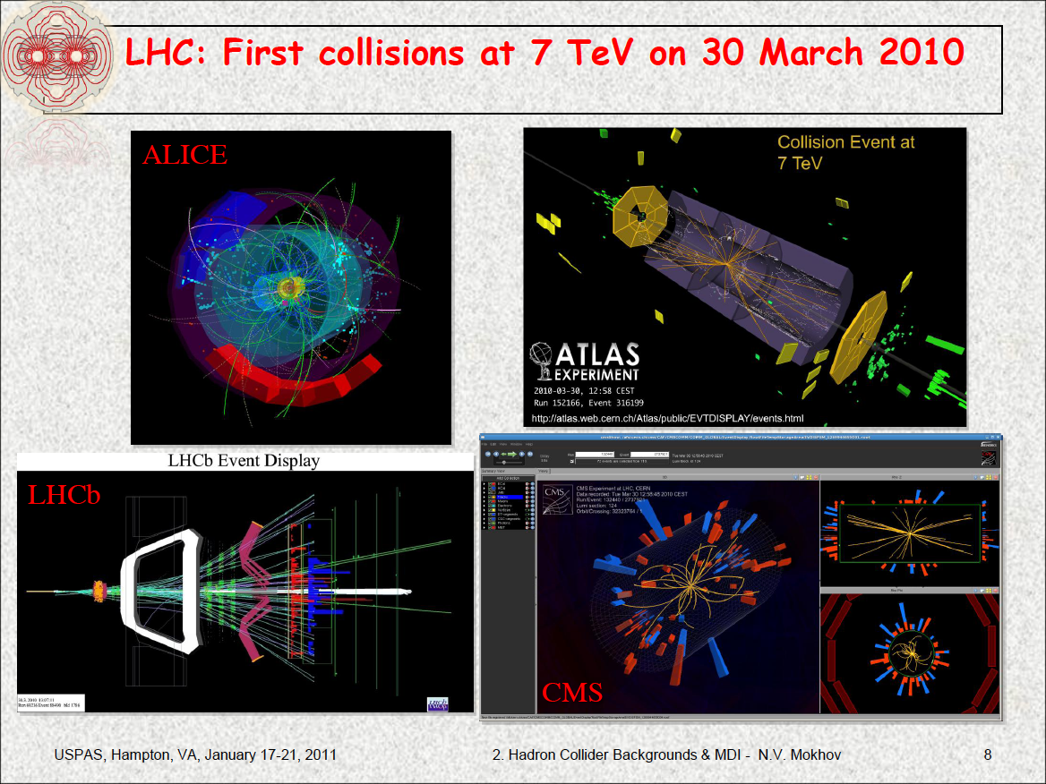

Slide 18
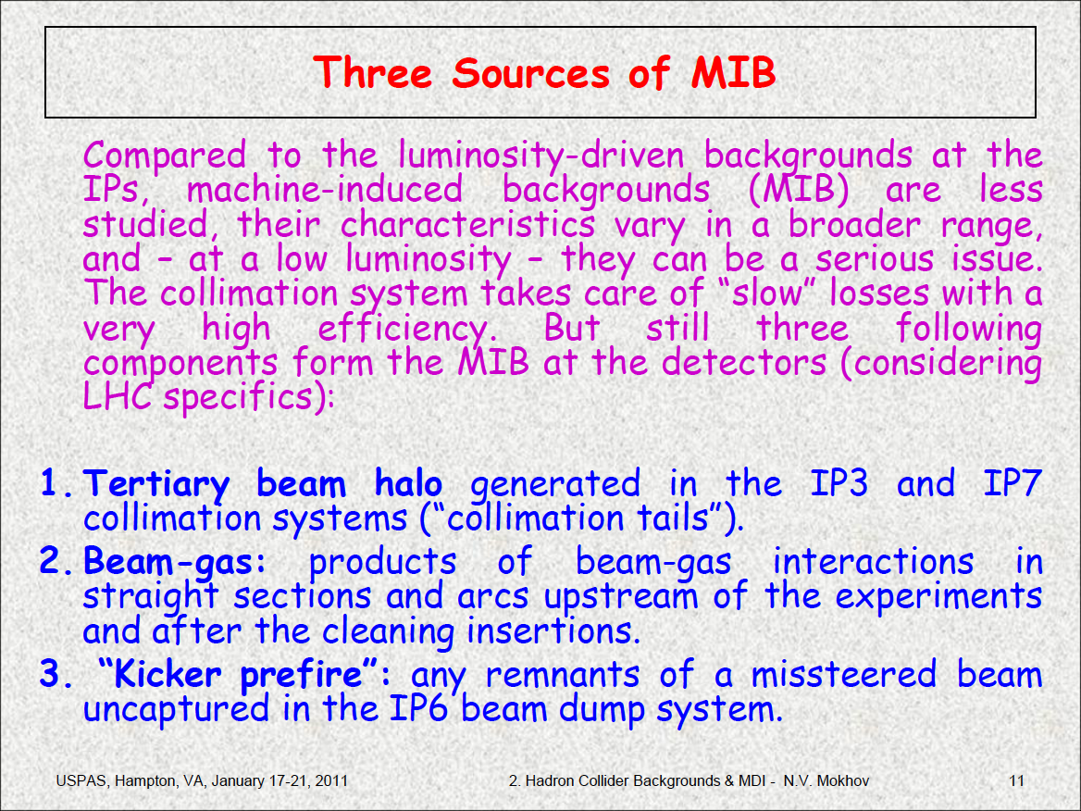

Slide 19
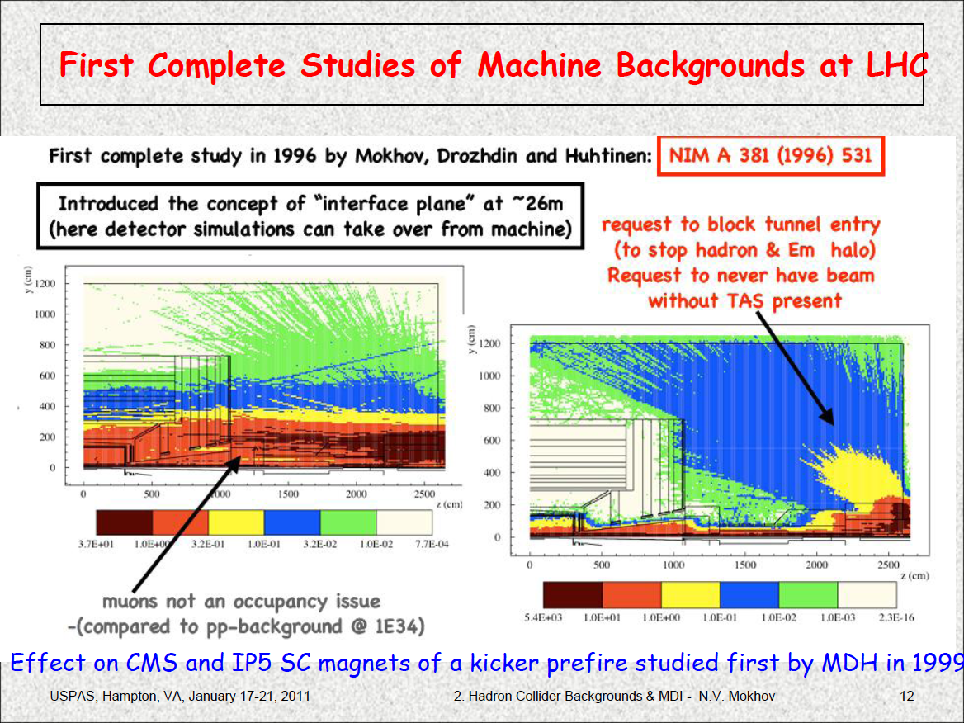

Slide 20
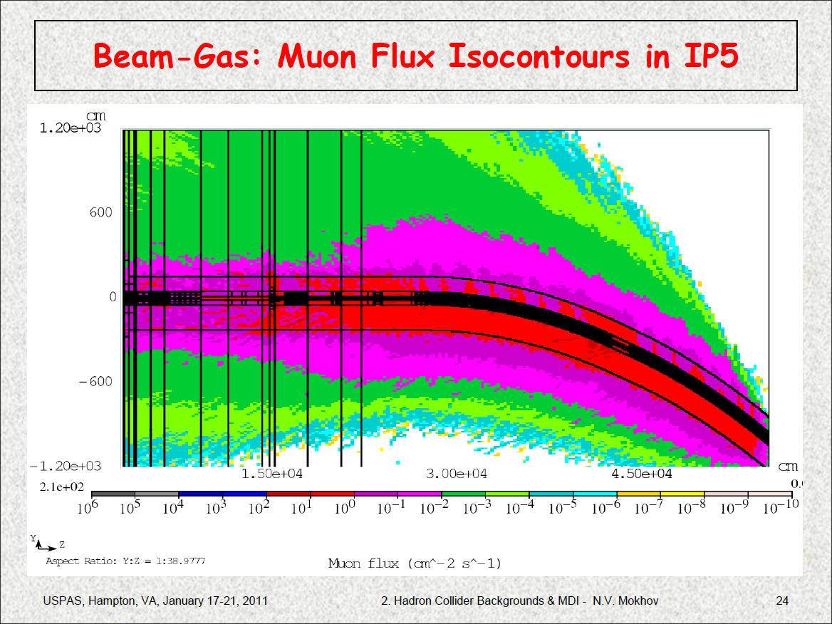

Slide 21
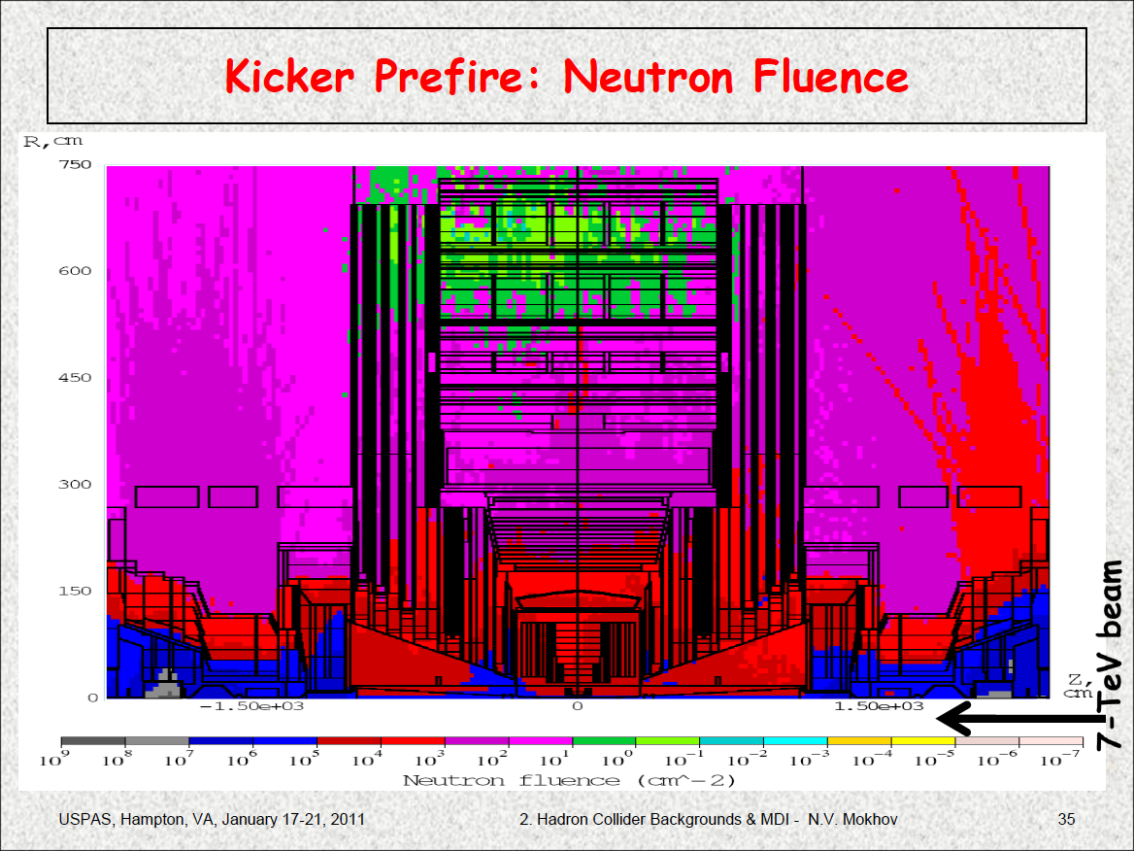

Slide 22
Applications

Slide 23
Quizz
Particle accelerators are not used only for HEP, they have many other applications.
In which kind of institutions are there the more particle accelerators in the world?
(a) HEP lab
(b) Other physical sciences labs (non HEP)
(c) Museums
(d) Hospitals
(e) Other

Slide 24
Answer (d)
HEP labs use the biggest particle accelerators in the world but there are only a few of them.
Non HEP physical science labs use accelerators to produce X-rays. Every large country has 1 or 2 of such accelerators (SOLEIL and ESRF in France).
Large museums like Le Louvres in Paris use particle accelerators to study cultural artefacts.
Large hospitals use particle accelerators to treat cancer
=> a single hospital may have several accelerators!
Most particle accelerators in the world are used for medical applications.

Slide 25
HEP applications of accelerators
Most of the physics we are studying this week relies on particle accelerators.
The LHC is the largest of these accelerators.
Tevatron is (was) the second largest
Others include B-factories (KEKB, PEP-II), c-factories, heavy ions accelerators (BNL, GANIL, Darmstadt,…),…
Between 10 and 50 machines in the world…
To ensure maximum luminosity, a low emittance, a low beta function and a flat beam are necessary.

Slide 26
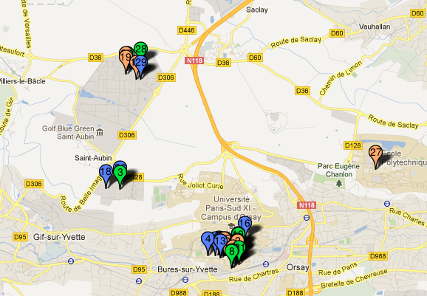
Accelerators around Orsay
There are 29 accelerators within 10km radius of LAL. Only few of theme dedicated to HEP.

Slide 27

Accelerators in England & Scotland
There are more than 150 accelerators.
Only 1 of them is used to teach HEP, all others are used for non HEP applications!

Slide 28
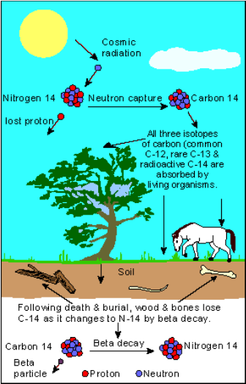
Non HEP applications
Dating old artefacts
  Radiocarbon dating is allows to measure the age of ancient artefacts.
  The ratio C13 vs C14 can be measured by using an accelerator.
  This technique is called “Accelerator Mass spectroscopy”.

Slide 29
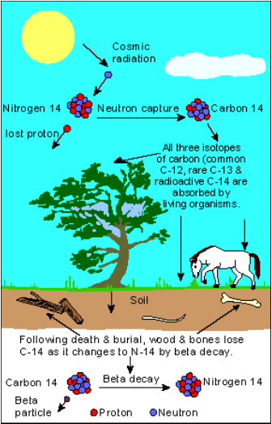
Accelerator Mass Spectroscopy (1)
  In an AMS device the C12, C13 and C14 beams need to be separated to allow an accurate counting.
  An energy of 10-15MV is sufficient.
  Beam stability is very important to ensure good accuracy.
  What type of source would you recommend?
  What type of accelerator?
  RF or electrostatic?
  Does the emittance matter?
  How would you count the charge of the ion beams with a good accuracy?

Slide 30
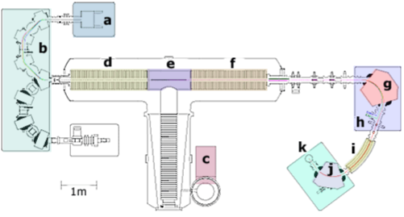
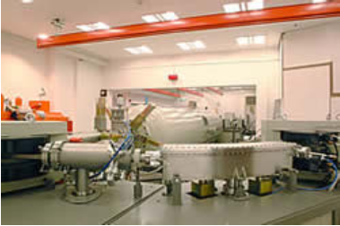
Accelerator Mass Spectroscopy (2)
  AMS machines use a sputtering ion source producing C- ions.
  A tandem Van de Graff is then used to accelerate the ions and strip then to C³⁺.
  A DC accelerator offer a better stability than a RF accelerator.
  A Faraday cup is used to measure the beam charge.

Slide 31

Example of AMS application
Vinland map
  AMS was used to date ashes found in Newfoundland in a European-type settlement. These ashes were dated back to the XIth century.
  A viking map featuring Newfoundland was shown to be older than Columbus trip to America.
  AMS has contributed to establish that North America was visited by Vikings well before other European nations.

Slide 32
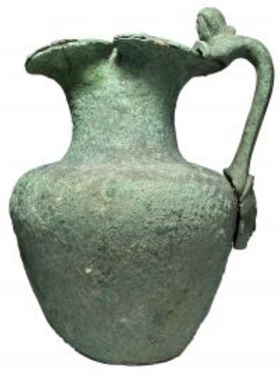
Dating old artefacts...
  There are many other accelerator based dating techniques which I do not have time to cover.
  Proton, Neutron and light sources can all be used to investigate some properties of old artefacts.
  Left:
  Roman Jug dated by ISIS.

Slide 33
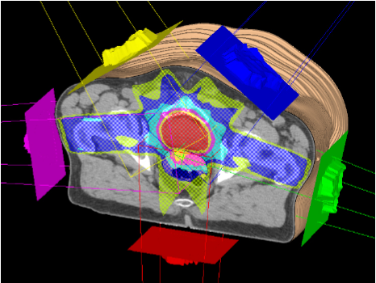
Treating Cancer
  Some type of cancer tumors are located at places difficult to reach by Surgery.
  X-rays can be used to kill such tumors.
  This is called Radiotherapy.
  Radiotherapy need 10-15 MeV electrons for a few seconds.
  The accelerator needs to be compact so that it fits in an hospital room and fields can be contained.
  What type of cathode do suggest to use? Thermionic or Photocathode?
  What type of accelerators do suggest to use?

Slide 34
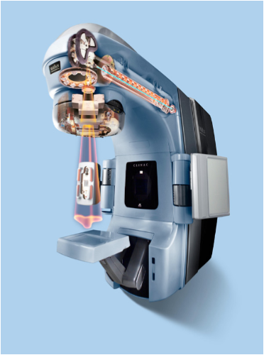
Medical linac
  Radiation therapy uses small 15MeV “linacs”.
  It is safer to produce a low current over several pulses rather than a high peak current over a few pulses, hence a thermionic gun is used (such gun are also more reliable and easier to maintain).
  To reach 15 MeV with a large electrostatic accelerator would require a large installation likely to frighten the patients.
  A short RF accelerator is used to reach the required energy.

Slide 35
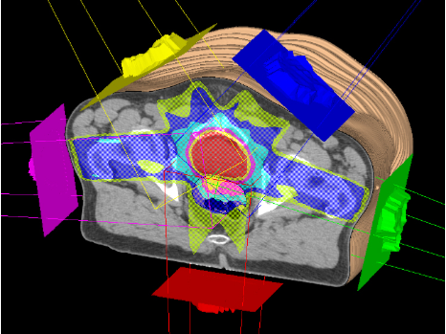
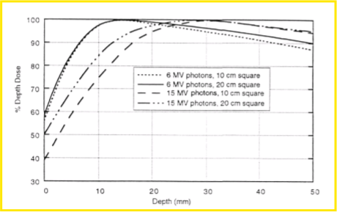
Radiotherapy
  X-rays are used to kill a tumour.
  To minimize the dose sent on healthy tissues several X-ray beams are sent in turn from different directions.
  However this technique is not ideal due to its impact on healthy tissues.

Slide 36
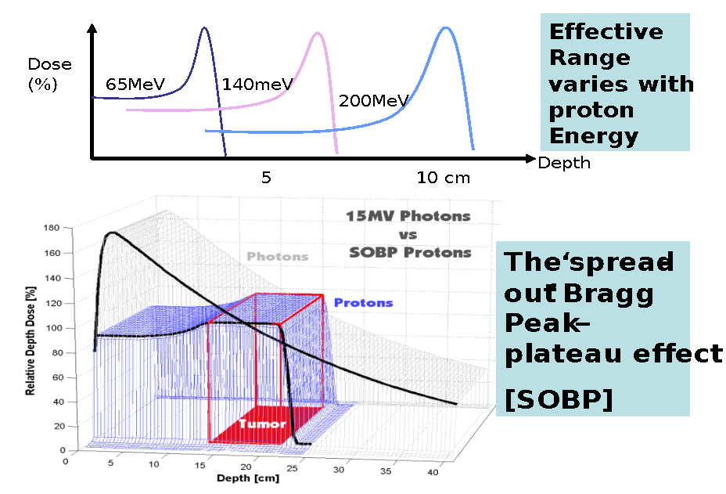
Proton and ion therapy
Source: Bleddyn Jones, JAI graduates lectures
What gun and what machine shall we use for proton and ion therapy?

Slide 37
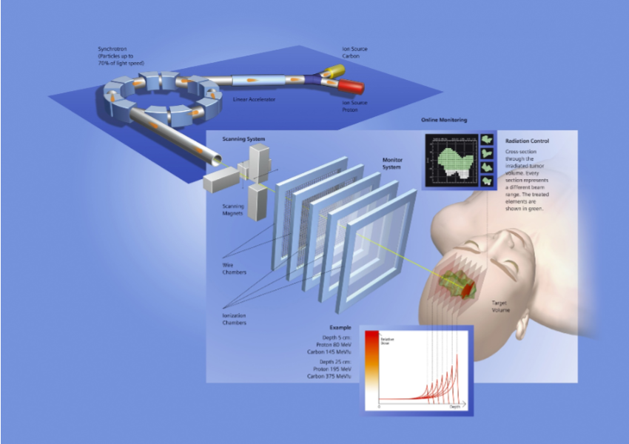
A possible solution...
Source: Bleddyn Jones, JAI graduates lectures

Slide 38
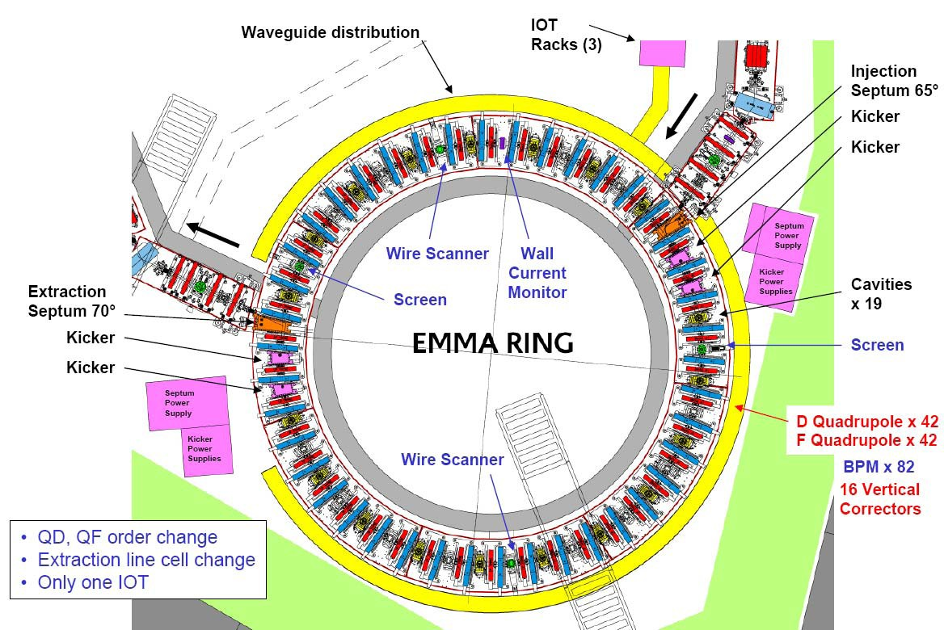
Fast protons rings
At the moment accelerating protons in rings is slow due to resonances crossing.
R&D is ongoing to avoid that problem.

Slide 39
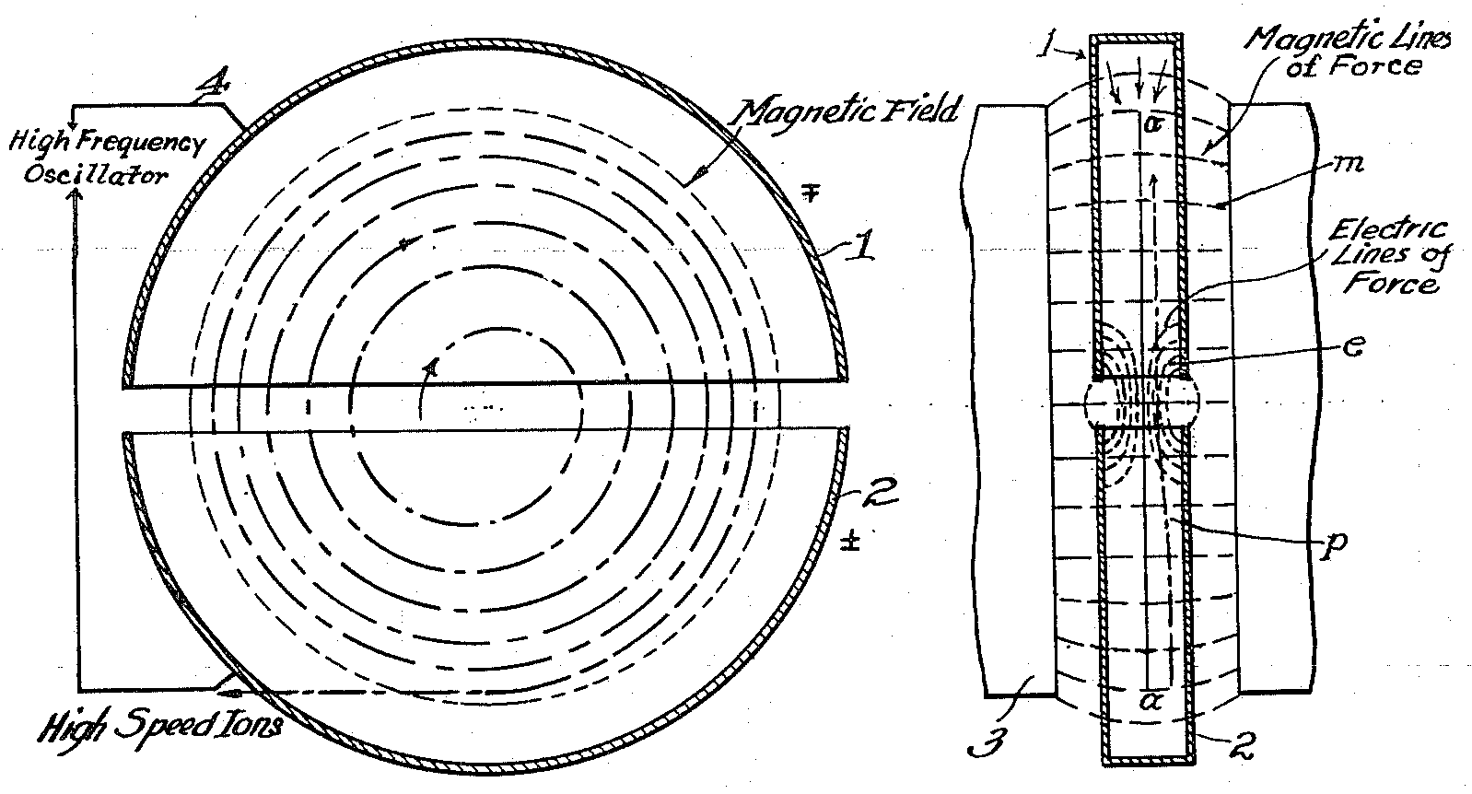
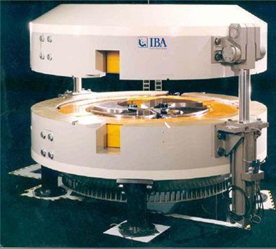
Medical cyclotron
Cyclotron are well suited to accelerate ions.
Several hospitals or universities are equipped with cyclotrons to produce radioactive isotopes used as markers in drugs.
Such cyclotron is a commercial product.

Slide 40
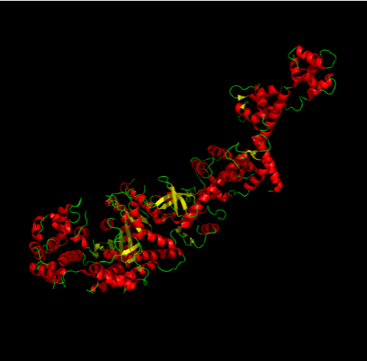
Pharmaceutical drugs
  To be efficient a drug need to target the correct molecule.
  This can only be achieved by studying the diffraction of intense on the molecule.
  What type of machine (gun, accelerator, ...) is best suited to deliver an intense stable beam of
  X-rays?

Slide 41
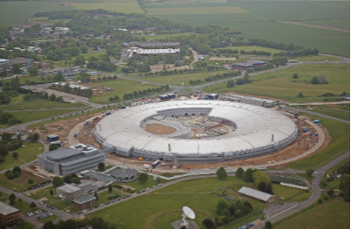
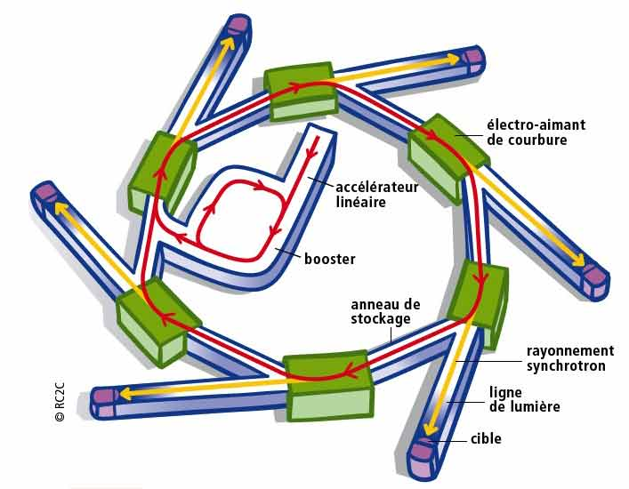
A source of intense X-rays
  Synchrotrons are best suited to deliver intense beams of X-rays.
  Although synchrotrons operate at ultra low emittance the gun can be thermionic as radiation damping reduces the transverse emittance.
  A RF accelerator is then used to accelerate the particles up to the ring energy. A booster may be used to reduce the length of the linac.
Source: Diamond
Source: SOLEIL

Slide 42
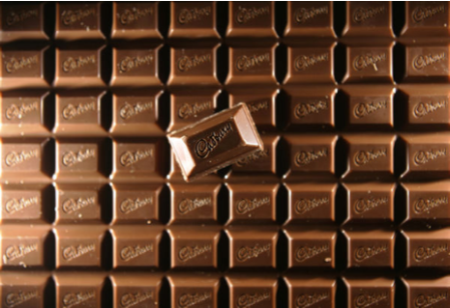
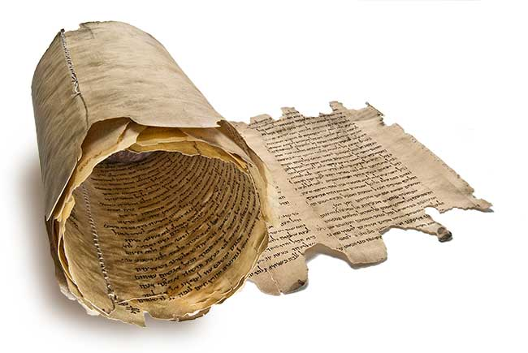
Applications of synchrotrons
  Light sources have a wide range of applications.
  A light source in England has been used to improve the quality of chocolate!
  Diamond is being used to study old manuscripts too precious to be opened!
  Protein imaging, drugs, material studies,...
  GMR (the phenomena that allows dense magnetic storage in your ipod) has been studied with light sources.

Slide 43
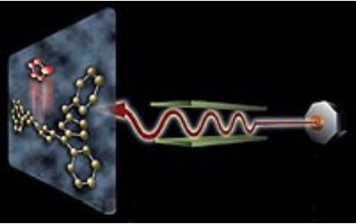
The next generation of light sources
  The drawback of using radiation damping to reach ultra-low emittance is that the beam is stretched longitudinally.
  This means that the X-ray pulse have a long (ps) duration.
  Some applications require fs long high brightness X-ray pulses...
  How can this be achieved?

Slide 44
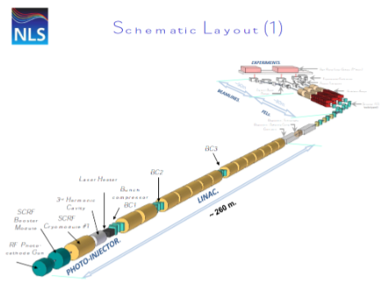
Next generation:
Linac based Free electron lasers
  Only linac based accelerators can deliver ultra-short pulses.
  Ultra-short pulses are necessary to get coherent emission of X-rays.
  Hence the emittance must be ultra-low from the start.
  This requires a photo-cathode RF gun.
  With an ultra-low emittance it is possible to achieve lasing in the undulators (and thus an even higher light output).

Slide 45
How to make short bunches?
RF guns can be used to make short pulses.
To have even shorter pulses one needs to use a compression scheme.

Slide 46
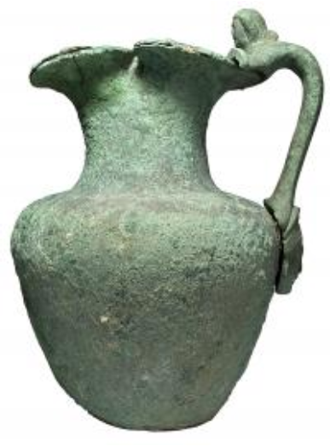
Neutron crystallography
  X-ray crystallography can only be used on matter that is rather transparent to X-rays.
  Other objects such as this Roman vase or the materials used to build an aircraft need a probe that penetrate deeper in the material: Neutrons.
  How can we produce neutrons?

Slide 47
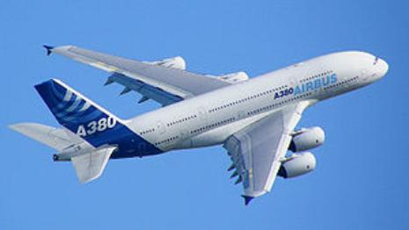
Neutrons sources
  It is not possible to directly accelerate neutrons.
  However neutrons are produced when a target is bombarded with protons.
  The ISIS neutron source requires 800 MeV protons.
  How to build this?

Slide 48
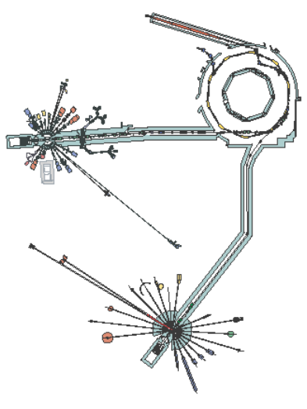
A neutron source: ISIS
  A proton synchrotron can be used to bring the protons to the right energy.
  Emittance is not a challenge at the target location but a low emittance beam helps minimizing the losses in the accelerator (and hence the activation).
  Note that it is easier to accelerate H- than H+.

Slide 49
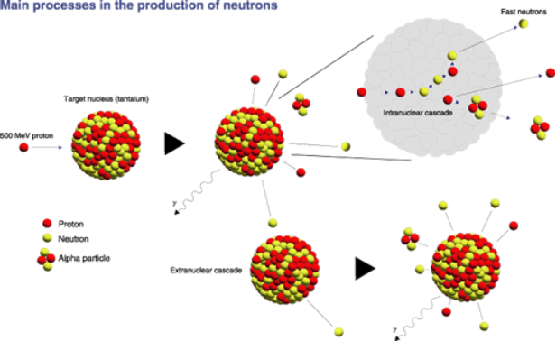
Spallation
  Spallation is a process in which fragments (protons, neutrons,...) are ejected from a target atom hit by a high energy proton.
  Such target is very challenging as most of the proton power is deposited in the target.

Slide 50
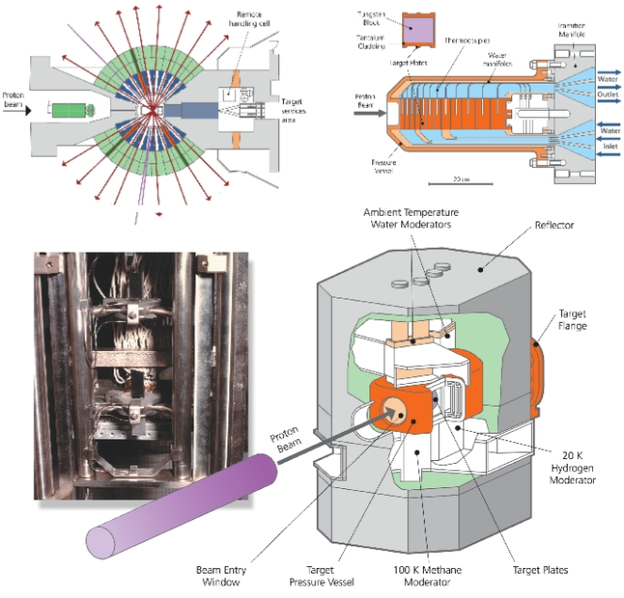
Spallation target

Slide 51
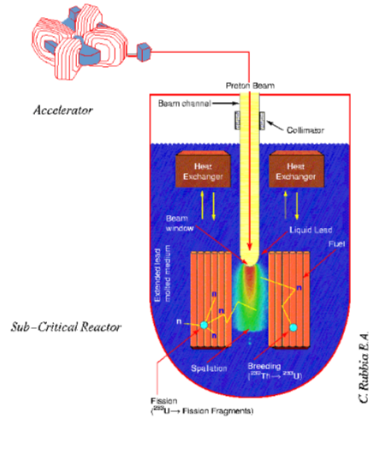
Accelerator Driven sub-critical reactor (ADSR)‏
  An intense source of protons could be used to produce an intense flux of neutrons.
  After moderation these neutrons would trigger nuclear reactions in some nuclear material.
  Advantage the reactor can operate in sub-critical mode (if the accelerator stops the nuclear reactions die automatically).
  The nuclear fuel could be made of isotopes that can not sustain a chain reaction (such as Thorium).
  => no risk of proliferation.

Slide 52
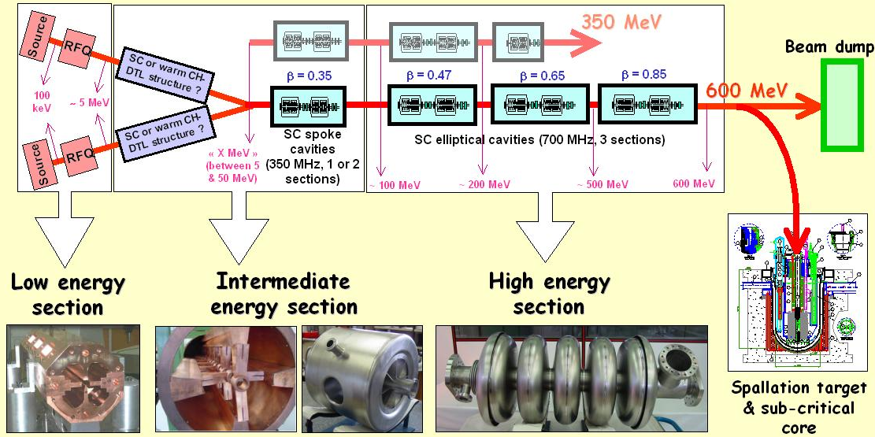
Need for high redundancy
Even if they do not like it, HEP experiments can cope with an unreliable accelerator.
In a nuclear reactor a sudden stop of the driver will cause a thermal shock.
To many thermal shocks might damage the containment vessel
=> The accelerator has to have a high level of reliability.

Slide 53
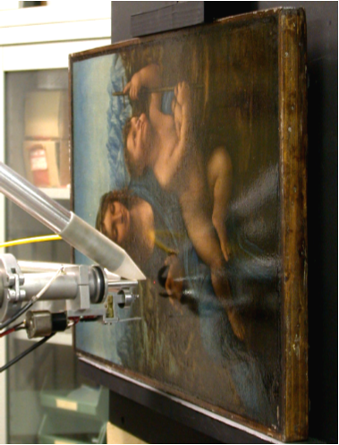
... and much more
  There are many more applications to accelerators.
  Although HEP is driving the progress other communities have now their types of accelerators.
  As new generations are built, new potentials and new possibilities are discovered.
Nicolas Delerue – University of Oxford – S19

Slide 54
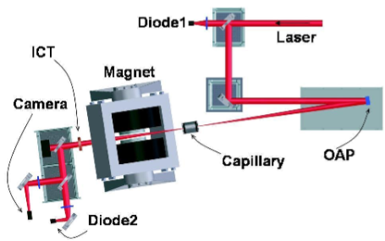

Ultra compact sources:
Laser-driven plasma acceleration (1)
  An intense laser pulse shot in a plasma can accelerate electrons to very high energy: 1GeV over 33mm
  Such electron source could produce high energy low emittance electron beam over very short distances.
  This could be used to drive a compact FEL.
Leemans et al, doi:10.1038/nphys418

Slide 55

Ultra compact sources:
Laser-driven plasma acceleration (2)
  If a similar laser is shot onto a target, medium energy ions can be produced.
  This could be used for ion therapy.
Cold return
currents
solid target
plasma sheath
-
-
e⁻
+
-
-
-
+
-
+
-
-
CPA pulse
+
-
-
ions
+
-
-
+
-
+
-
+
-
+
-
-
+
-
-
+
-
-
Contaminant layer

Slide 56
ThomX
ThomX is an accelerator being built at Orsay

Slide 57







Costs
  Small accelerators can be operated by single institutions.
  Large accelerators need to be built as part of international collaborations.

Slide 58

Progress of accelerators
Accelerators have made tremendous progress over the past 50 years.
They drove part of the developments of HEP.
However they have also become very large and expensive.

Slide 59


Summary
Particles accelerators use principles for several fields of physics to accelerate beams of particles.
The more challenging the requirements of the users are, the more complex phenomena will appear:
You can build a very crude accelerator in a University lab in a few days…
but it took several years to build the LHC!
Accelerators have a wide range of applications across many scientific fields reaching all the way to archaeology…

Slide 60
Overall summary of the lectures

Slide 61



Particle sources & acceleration
Particles are extracted from matter either using ionisation or by creating a plasma.
There are accelerated using RF fields.
They are controlled using magnets.

Slide 62




Basic concept (RF)
Figure of merit of EM design:
$$E_{peak}$$
: minimize peak surface electrical field in order to reduce field emission (normalized to E_{acc})
$$B_{peak}$$
: minimize peak magnetic field to maximize achievable accelerating voltage (normalized to E_{acc})
$${\left(R/Q\right)}_{n}=\frac{V_{acc}^{}²}{ω_{n}W_{n}}$$
: maximize R/Q to produce more accelerating voltage V_{acc} for a given stored energy W in the cavity
$$G=QR_{s}$$
: maximize the geometry factor to increase the cavity effectiveness of providing accelerating voltage (shape alone)
Regarding the accelerated particle and the materials (NC or SC), the optimization of RF structures will focus on these parameters

Slide 63



WHY SUPERCONDUCTIVITY for MAGNETS ?
Superconducting magnets is required for high energy or high current applications
    Reduction of radius of curvature and power consumption
    With room temperature magnets, the LHC circumference would be 120 km and the power consumption impossible to handle
    Bigger aperture as B ∝ I₀/aperture for dipole , I₀/aperture² for quadrupoles
    Bigger transverse acceptance
    Less beam losses, Less contraints for alignment.
http://www.lhc-closer.es/1/4/6/1

Slide 64




WHY SUPERCONDUCTIVITY for ACCELERATION ?
Superconducting RF is compulsory for CW high-current operations :
    for NC, P_{RF} ∝ ω^{-1/2} , for SC, P_{RF} ∝ ω
    Lower frequency ⇒ Larger longitudinal acceptance
    Larger structure ⇒ Larger transverse acceptance
          Reduced beam losses
    Energy efficiency is better : P_{cryo} + P_{RF-SC} < P_{RF-NC}
    For SC cavities P_{RF-SC} ~ 10W (Qo ~ 5E9) @ 6.4 MV/m
    For Spoke section : P_{RF-SC} ~ 400 kW, Pcryo ~ 600 kW
    For NC cavities P_{RF-NC} ~ 185kW (Qo ~ 3e5) @ 6.4 MV/m
    For Spoke section : P_{RF-NC} ~ 9 MW
    Higher accelerating gradient achievable in CW
    (in practice… not in theory) as P_{RF} ∝ Eacc².
          Reduced linac length
Spoke cavity, 352 MHz
Quarter Wave Resonator, 88 MHz
NC = Normal conducting
SC = Superconducting
NLC, 11.4 GHz
Elliptical cavity, 1.3 GHz

Slide 65

MAIN COMPONENTS in a CRYOMODULE
Vacuum vessel
  Thermal Insulation
  Interface
Cryogenic piping (supply and exhaust)
Cavities + (focusing element)
Vacuum vessel
Supporting components
  Supporting and positioning
Beam
Thermal shields
  Thermal Insulation
MAIN COMPONENTS
Cryogenic piping
  Cryogenic environment
Thermal shield
Magnetic shield
  Magnetic protection
Magnetic
shield
Supporting components : support + alignment
Cold mass (cavities, magnets)
Frequency tuning system
RF power coupler
ESS Spoke Cryomodule

Slide 66



Dynamics & diagnostics
There are many physical phenomena that act on and in the beam.
Understanding them is important to control and improve beam quality.
Tools are necessary to be able to visualise them.

Slide 67


Transverse Beam Dynamics : SummarY
  Charged particle in electromagnetic field : $\vec{\frac{dp}{dt}}=q\left(\vec{E}+\vec{v}×\vec{B}\right)$
  Cyclotron frequency : $ω=\frac{qB}{m}$ Magnetic Rigidity $Bρ=\frac{P}{q}$, Electric rigidity $Eρ=βc×Bρ$
  Maxwell equations : $div \vec{E}=\frac{ρ}{ε_{0}}$, $div \vec{B}=0$, $\vec{rot}\vec{E}=−\left(\frac{∂\vec{B}}{∂t}\right)$, $\vec{rot}\vec{B}=μ_{0}\vec{J}+\frac{1}{c^{2}}\frac{∂\vec{E}}{∂t}$
  Maximum B achievable in iron at room temperature ~1.8T, for high B need supra !
  In bending magnet : Ampère-turn $NI≈g\frac{B}{μ_{0}}$, in quadrupole : $NI≈\frac{R^{2}}{2}\frac{G}{μ_{0}}$
  Quadrupole focal length : $f=\frac{Bρ}{GL}$

Slide 68






Transverse Beam Dynamics : SummarY
  General development of magnetic field around the reference trajectory:
  Field index : $n=−\frac{ρ}{B_{z0}}{\left(\frac{∂B_{z}}{∂x}\right)}_{0}$
  Sextupolar : $β=\frac{ρ^{2}}{2B_{z0}}{\left(\frac{∂^{2}B_{z}}{∂x^{2}}\right)}_{0}$
  Particles motion : Hill’s equation $y"+K_{x}\left(s\right)y=f\left(s\right)$ with $y=x \text{or} z$
  1st order Bend Matrix (with $L=ρθ$) $T=\left(\begin{matrix}\cos{θ} & ρsin{θ} & ρ\left(1−\cos{θ}\right) \\ −{\sin{θ}}/ρ & \cos{θ} & \sin{θ} \\ 0 & 0 & 1\end{matrix}\right)$
  1st order Quadrupole matrix (with $K=\frac{G}{Bρ}$ et $φ=\sqrt{K}L$) $T_{x}=\left(\begin{matrix}\cos{φ} & {\sin{φ}}/{\sqrt{K}} \\ −\sqrt{K}\sin{φ} & \cos{φ}\end{matrix}\right)$ et $T_{x}=\left(\begin{matrix}\cosh{φ} & {\sinh{φ}}/{\sqrt{K}} \\ \sqrt{K}\sinh{φ} & \cosh{φ}\end{matrix}\right)$
  Beam envelop and emittance : $γ_{y}y^{2}+2α_{y}y^{′}y+β_{y}y^{′2}={ε_{y}}/π$
    Liouville theorem : $ε_{y norm}=βγε_{y geom}=constante$
    Beam Matrix $σ=\frac{ε_{y}}{π}\left(\begin{matrix}β_{y} & {−α}_{y} \\ {−α}_{y} & γ_{y}\end{matrix}\right)$ with $β_{y}γ_{y}−{α_{y}}^{2}=1$
    Transformation : $σ_{1}=Tσ_{0}T^{t}$

Slide 69


Longitudinal dynamics:
Trajectories in the longitudinal phase space (3)
Trajectories for a 60° synchronous phase (sinus « ring-convention ») and η>0
(-30° in cosinus « linac-convention »)
Size of the bucket
ϕ_{s} =60°

Slide 70
Longitudinal dynamics:
Filamentation in longitudinal phase space
All the beam particles are thus traveling on the H = Cst curves in the (φ,w) space
= trajectories at frequency k₀ if the forces are linear (inner bucket)
= trajectories at lower frequency when the forces become non-linear (outer bucket)
Iso-hamiltonian curves
=> If the beam is not correctly matched to H=cte curves, filamentation is quickly observed
Beam particles
The beam longitudinal rms emittance is then increasing

Slide 71
peak performance through the years
 | 2010 | 2011 | 2012 | Nominal
bunch spacing [ns] | 150 | 50 | 50 | 25
no. of bunches | 368 | 1380 | 1380 | 2808
beta* [m] ATLAS and CMS | 3.5 | 1.0 | 0.6 | 0.55
max. bunch intensity [protons/bunch] | 1.2 x 10¹¹ | 1.45 x 10¹¹ | 1.7 x 10¹¹ | 1.15 x 10¹¹
normalized emittance [mm-mrad] | ~2.0 | ~2.4 | ~2.5 | 3.75
peak luminosity [cm⁻²s⁻¹] | 2.1 x 10³² | 3.7 x 10³³ | 7.7 x 10³³ | 1.0 x 10³⁴
>2x design when scaled to 7 TeV!
M. Lamont, IPAC’13

Slide 72

And wednesday…
The first physics events of run 2 were recorded!

Slide 73


L’installation SPIRAL2 @GANIL
The ISOL method (Isotope On-Line) to produce Rare Isotope Beams

Slide 74


Slide 75


Slide 76
Applications of accelerators

Slide 77

Outlook
Accelerators have a very wide range of applications both for research but also for the industry and medical treatment.
They range in size from a few meters to several kilometers.
Their operation and development requires skills from several different fields.

