Slide 1
Acceleration of particles in a plasma
Nicolas Delerue
IJCLab (CNRS and Université de Paris-Sud)

Slide 2
Course outline
Last lecture:
  Electron sources
  Ion sources (part)
Today:
  Ion sources (part)
  Acceleration in a plasma

Slide 3
Plasma acceleration:
Content
Motivation
Acceleration of electrons in a plasma wakefield
  Laser driven
  Beam driven
Acceleration of ions with a high power laser
  The TNSA mechanism
  Shock acceleration
Most of the material shown here comes from the CAS School 2019 about plasma acceleration.

Slide 4
Motivations:
Limits of conventional technology
Until 1995 the centre of mass energy of lepton colliders trebled every 6 years!
Until 1989 lepton colliders doubled their circumference every 2 years!
Since the start of LEP II in 1995 this trend has stopped.
Conventional technologies no longer allow significant increases of colliders’ centre of mass energy at the same pace.

Slide 5
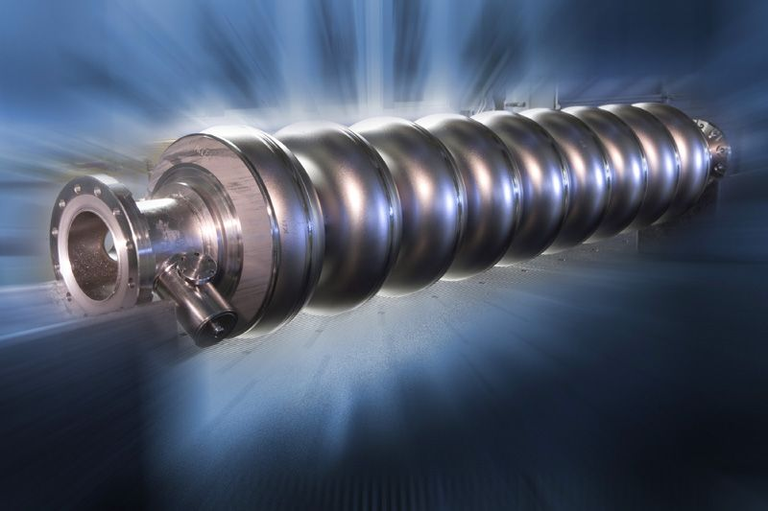
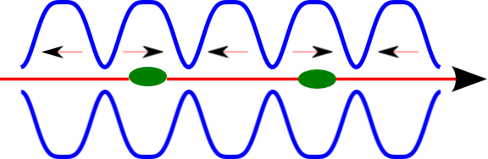
Acceleration and RF frequency
The highest the RF frequency, the higher the accelerating gradient will be.
The ILC (and XFEL) operate in L-band at 1.3 GHz. Typical gradient ~20MV/m (maximum ~35MV/m).
This corresponds to a wavelength of 23 cm.
The LEP injector Linac (LIL) and several conventional accelerators operated in S-band at a frequency of 3 GHz. Typical gradient (now) ~30-40 MV/m. This corresponds to a wavelength of 10 cm.
CLIC considers operating in X-band at 12 GHz. Typical gradient ~100MV/m.
This corresponds to a wavelength of 2,5 cm.
Mechanical realisation becomes more and more difficult.
Can we do without a cavity with high frequency RF waves?

Slide 6
Quizz
What is the frequency of optical light (500nm)?
(a) 12GHz
(b) 100 MHz
(c) 600THz
(d) 3 THz

Slide 7
Quizz
Answer: (C)
What is the frequency of optical light (500nm)?
(a) 12GHz
(b) 100 MHz
(b) 3GHz => 10cm, 50mm => 6GHz,
50nm => 6PHz, 500nm=>600THz

Slide 8
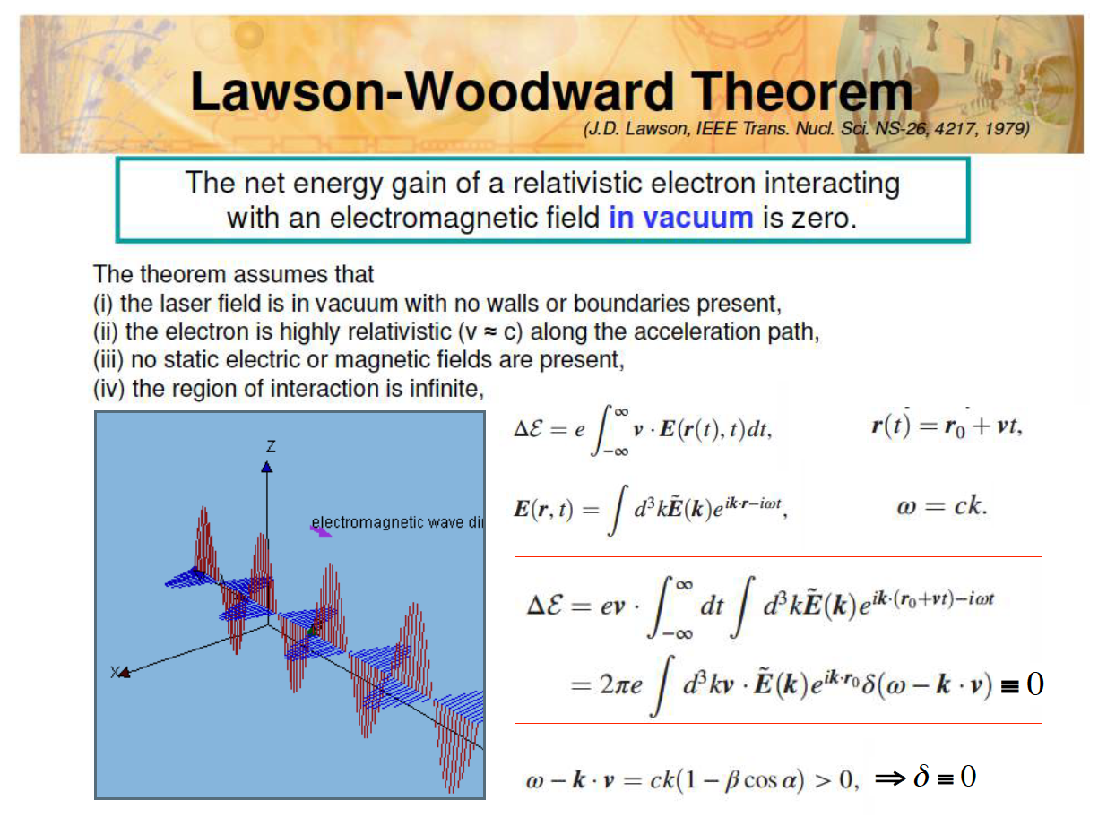

Slide 9
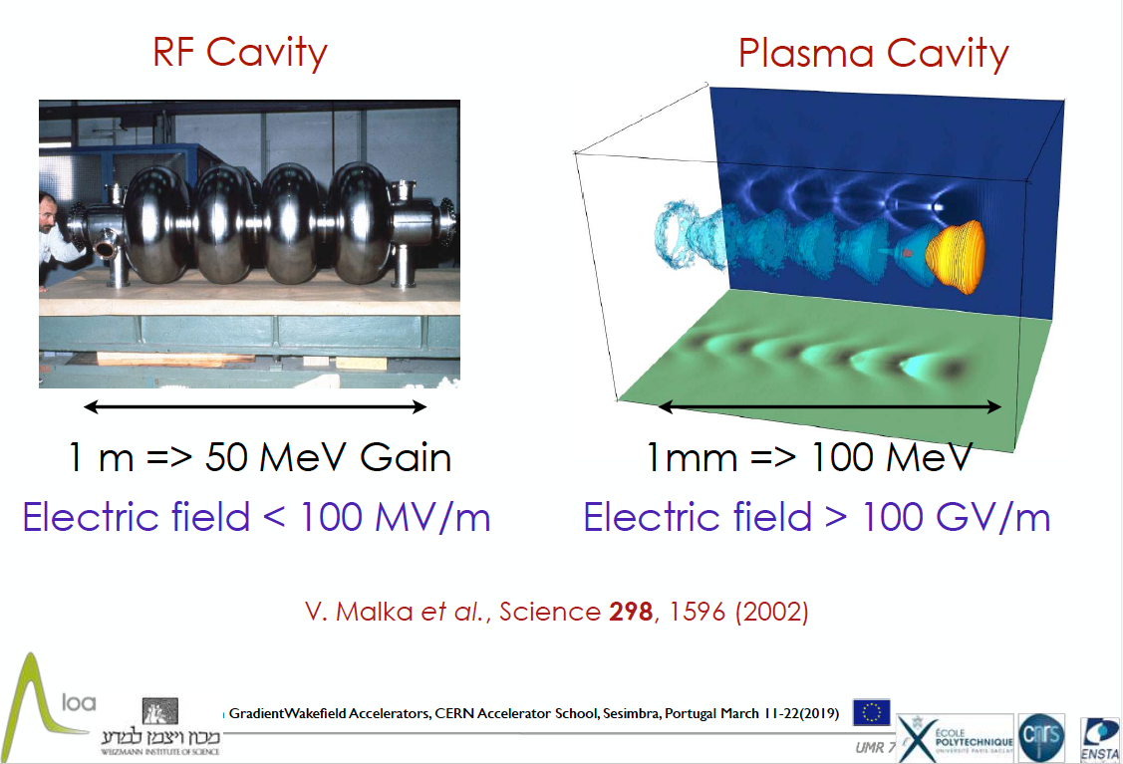

Slide 10
Frequency in plasma
Remember the characteristic oscillation frequency in a plasma:
For 10¹⁷ e-/cm³ this gives ~ 3THz
Wavelength ~100um
In an under dense plasma higher frequencies can be reached
=> higher accelerating gradients.

Slide 11
Quizz:
Frequency in plasma
What is the optical wavelength corresponding to 3 THz?
500nm
100um
500um

Slide 12
Quizz:
Answer (b)
What is the optical wavelength corresponding to 3 THz?
500nm
100um (3GHz ⬄ 100mm => 3THz ⬄ 100um)
500um

Slide 13
Are laser-plasma accelerators the answer?
Laser-plasma accelerators double the maximum energy reached every two years!
Beware: this is the maximum energy of some particles in the beam, not the beam energy and not the energy available for HEP collisions.
This doubling is (mostly) driven by increases in laser-power.
Such beams are still rather unstable. They have a low charge and high dispersion with respect to what can be achieved in conventional accelerators.

Slide 14
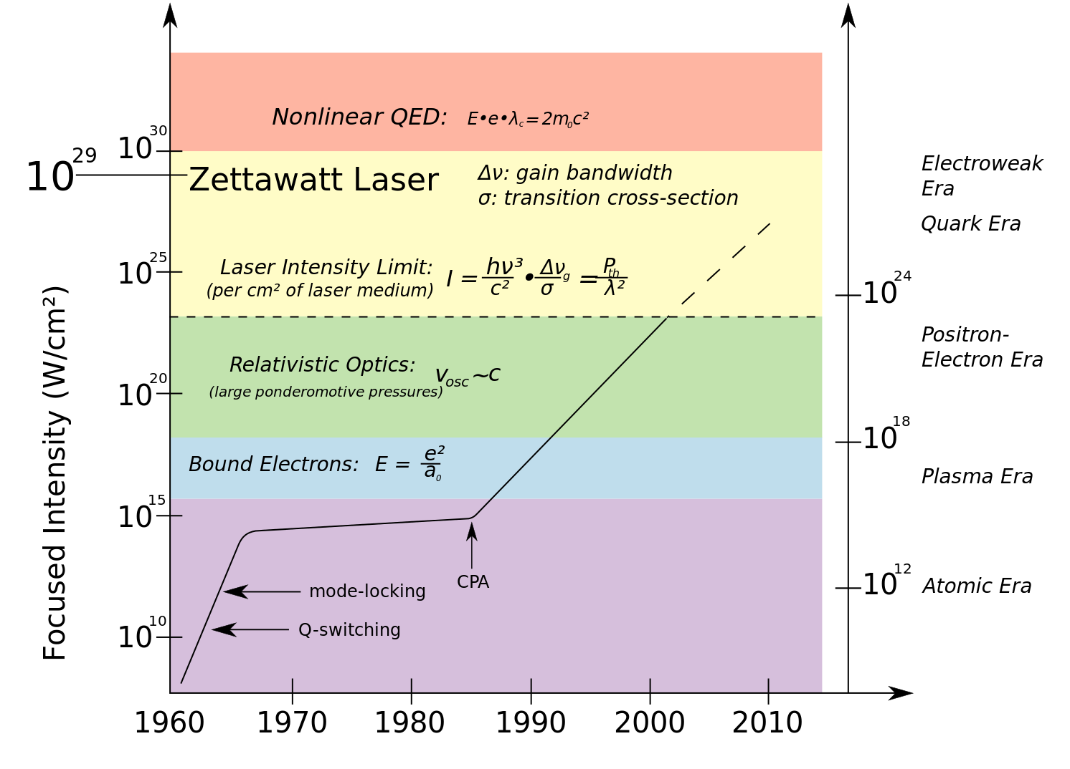
Lasers still have a significant margin for improvement.
Laser technology is still improving significantly.
Fibre lasers have more and more applications with a good efficiency and they have not yet reached the “high power” range.

Slide 15

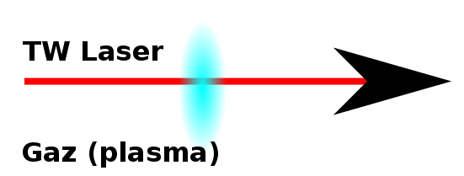
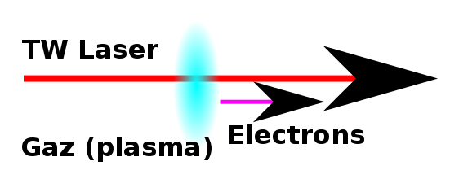
Principe of an experiment of electron acceleration in a plasma
A gas volume (at low density/pressure: ~mbar) will be used to create the plasma.
This volume is ionised by a beam (laser, particles) at high power and ultra-short (duration: ps, fs).
Electrons coming either from the plasma or from an external source will be captured and accelerated.
The size of the “cavities” is of the order of a few hundred micrometres.

Slide 16
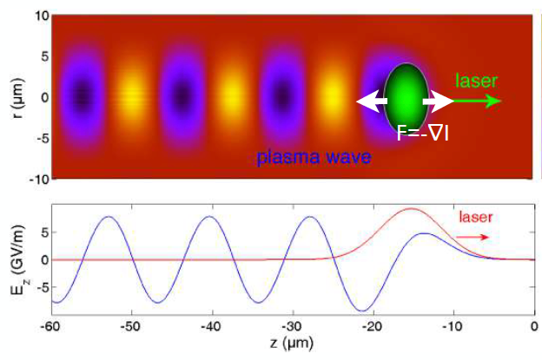
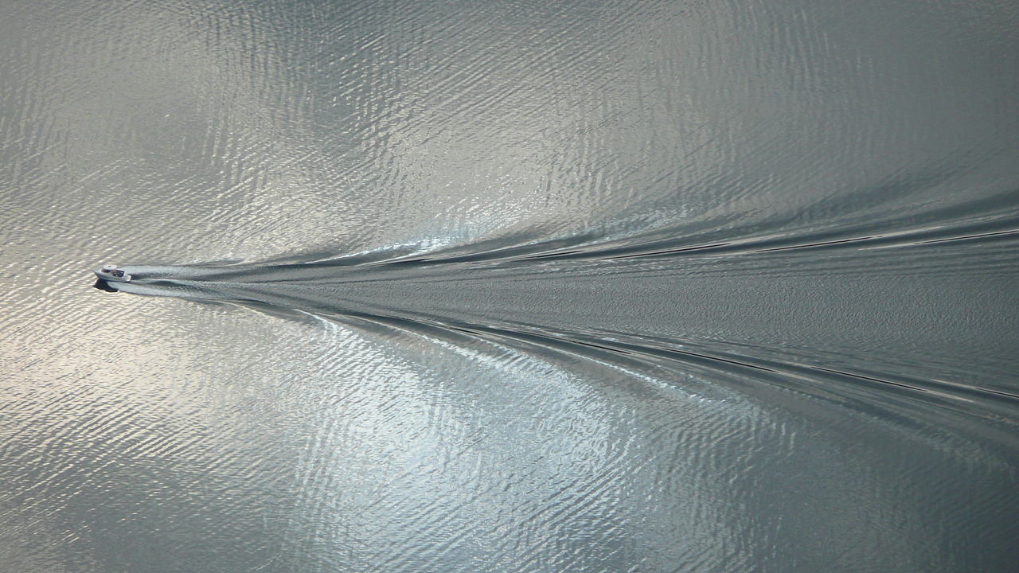
Principle of an experiment of electron acceleration in a plasma
A gas volume (at low density/pressure: ~mbar) will be used to create the plasma.
This volume is ionised by a beam (laser, particles) at high power and ultra-short (duration: ps, fs).
Electrons coming either from the plasma or from an external source will be captured and accelerated.
The size of the “cavities” in the wake of the laser is of the order of a few hundred micrometres.
GV/m gradients can be reached with ~10¹⁸ e-/cm³(~20 mbar).

Slide 17
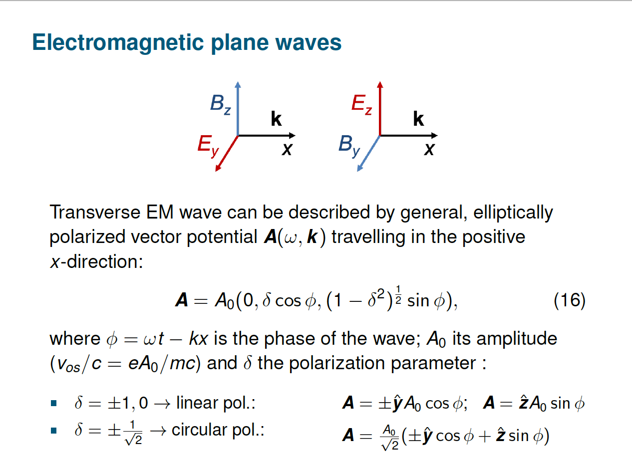
Electron dynamics in a plasma
Courtesy of Paul Gibbon, CAS 2019

Slide 18
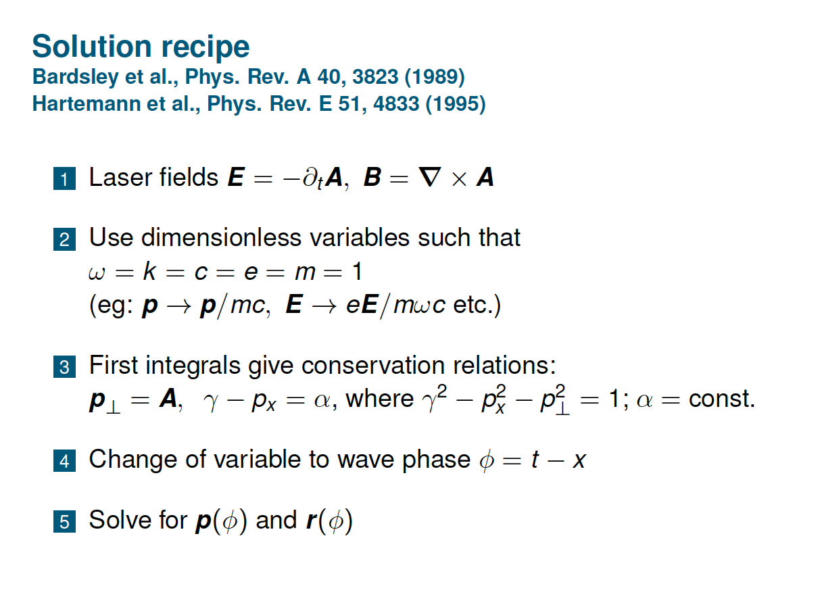
Electron dynamics in a plasma
Courtesy of Paul Gibbon, CAS 2019

Slide 19
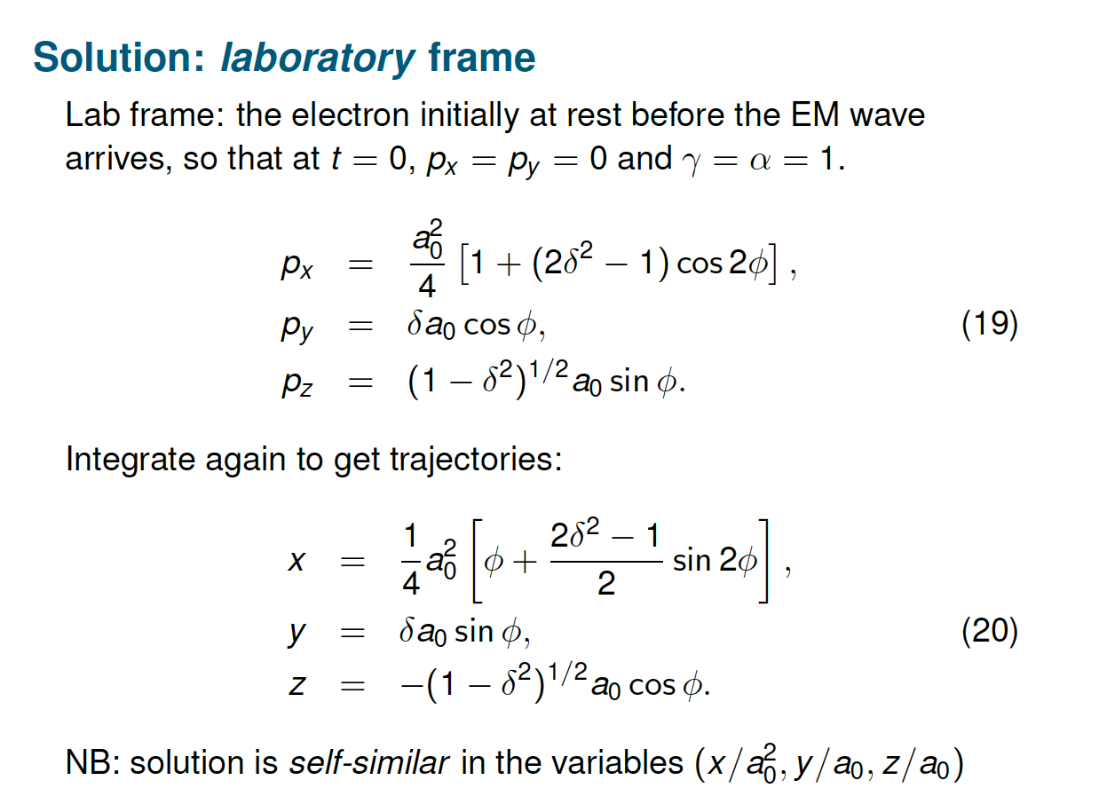
Electron dynamics in a plasma
Courtesy of Paul Gibbon, CAS 2019

Slide 20
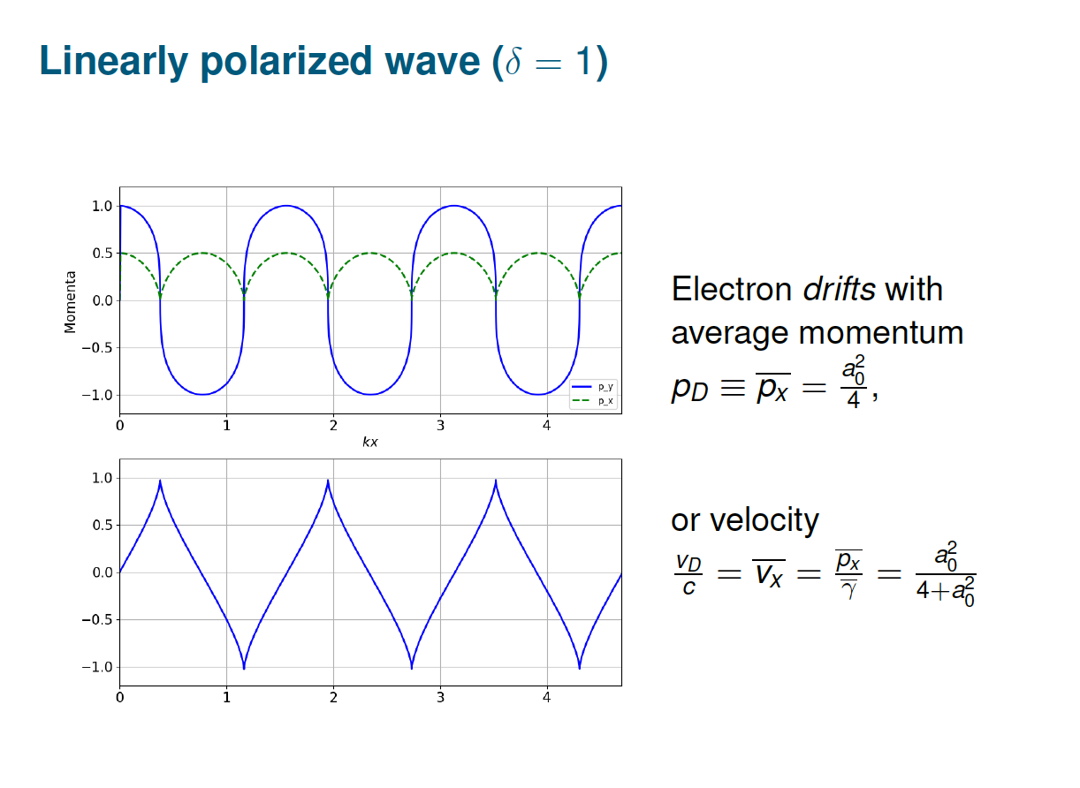
Electron dynamics in a plasma
Courtesy of Paul Gibbon, CAS 2019

Slide 21
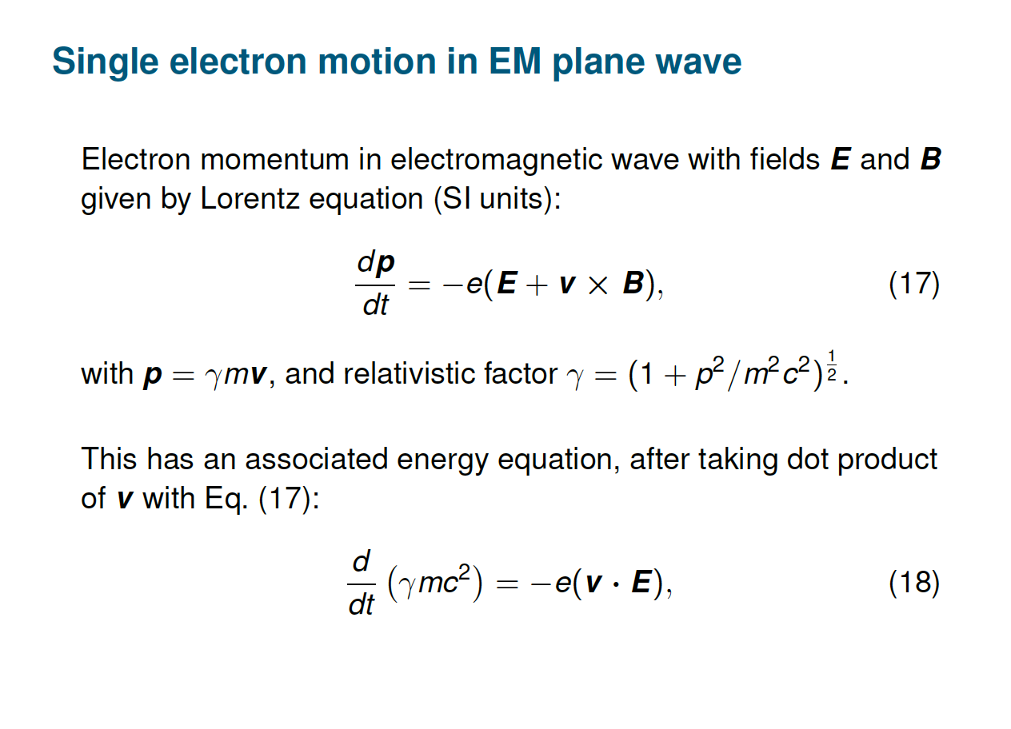
Electron dynamics in a plasma
Courtesy of Paul Gibbon, CAS 2019

Slide 22
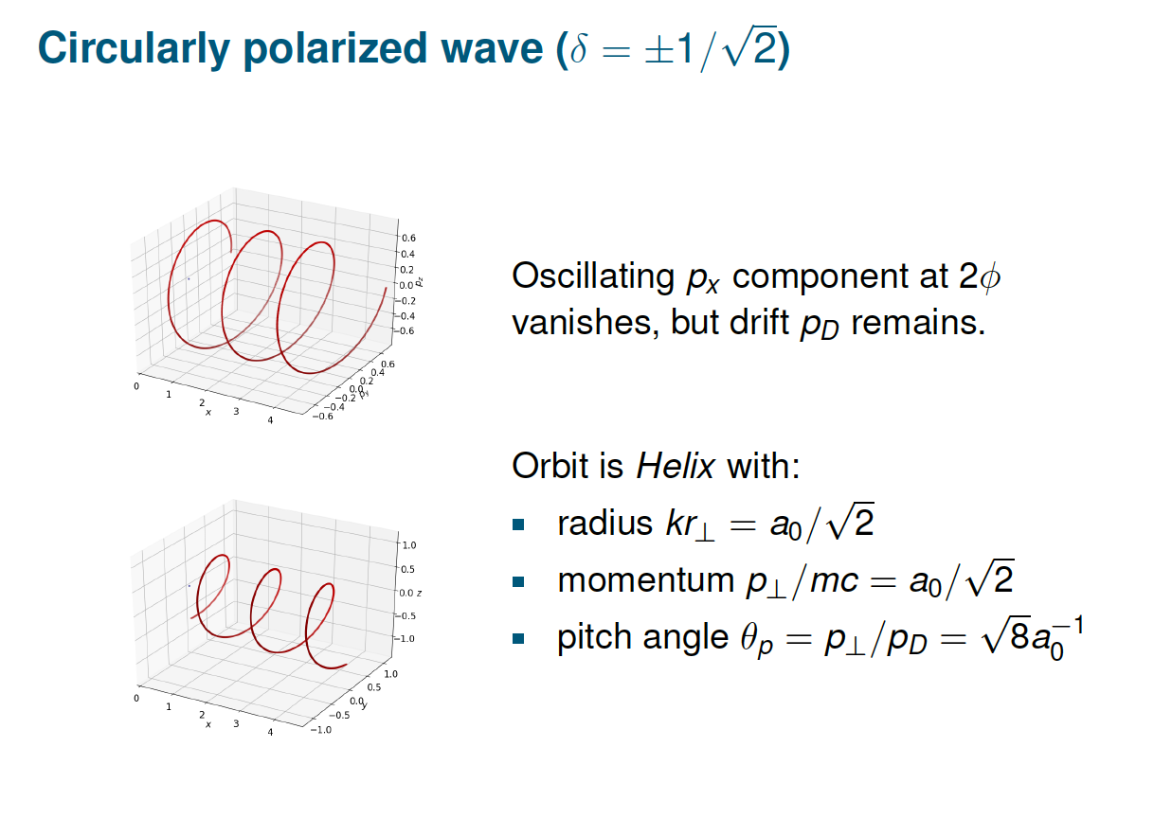
Electron dynamics in a plasma
Courtesy of Paul Gibbon, CAS 2019

Slide 23
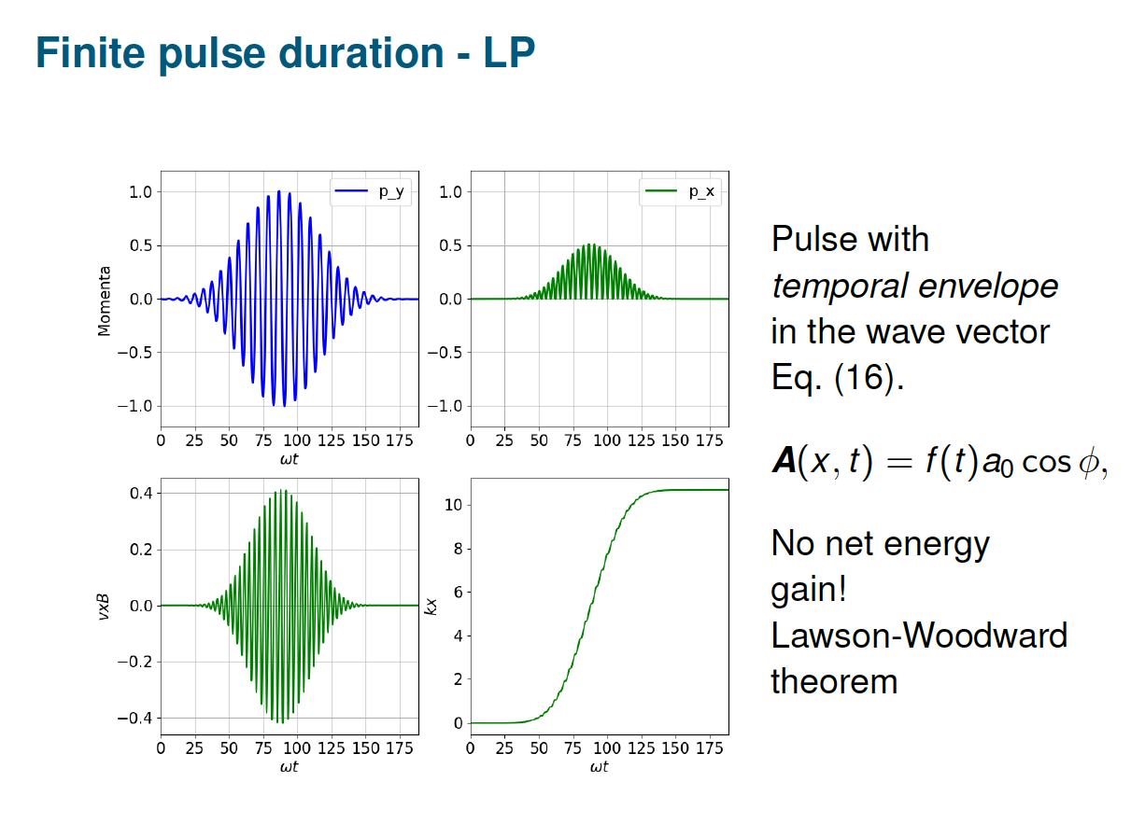
Electron dynamics in a plasma
Courtesy of Paul Gibbon, CAS 2019

Slide 24
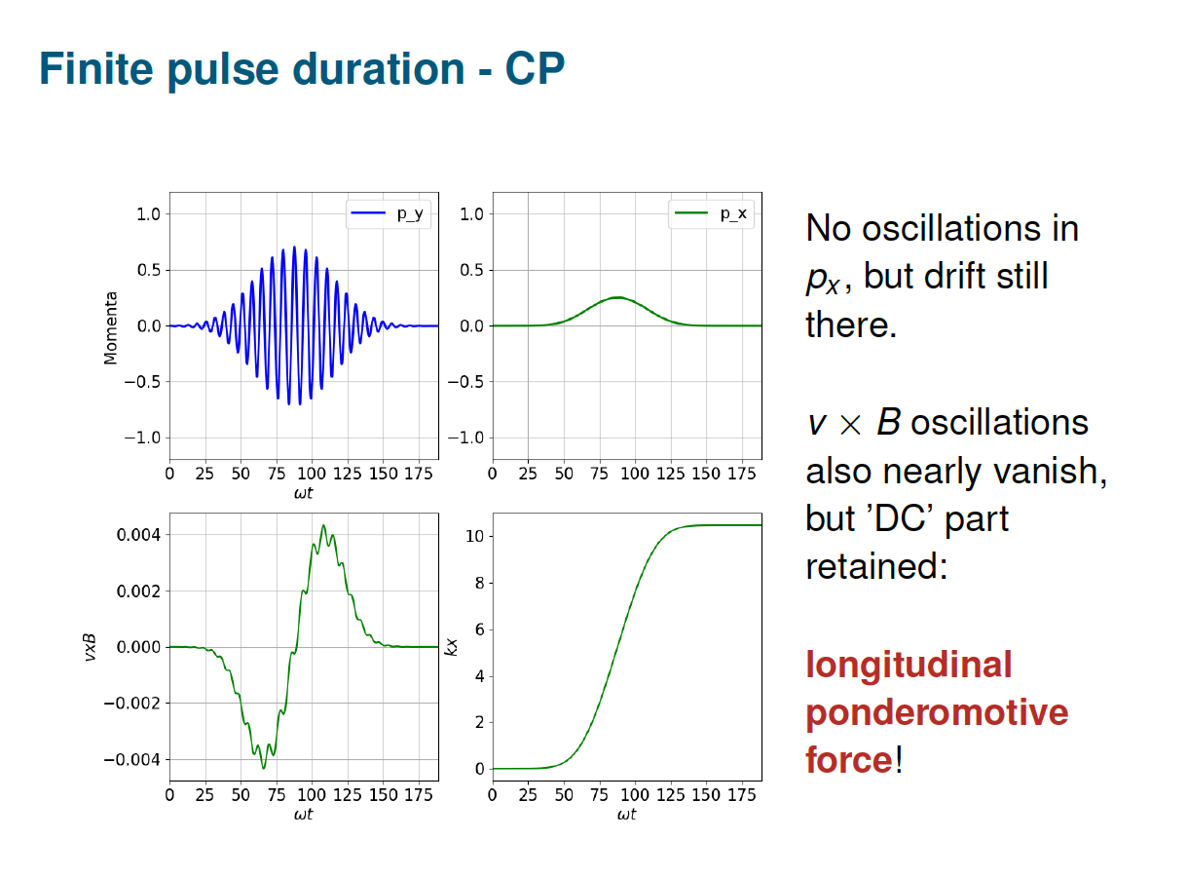
Electron dynamics in a plasma
Courtesy of Paul Gibbon, CAS 2019

Slide 25
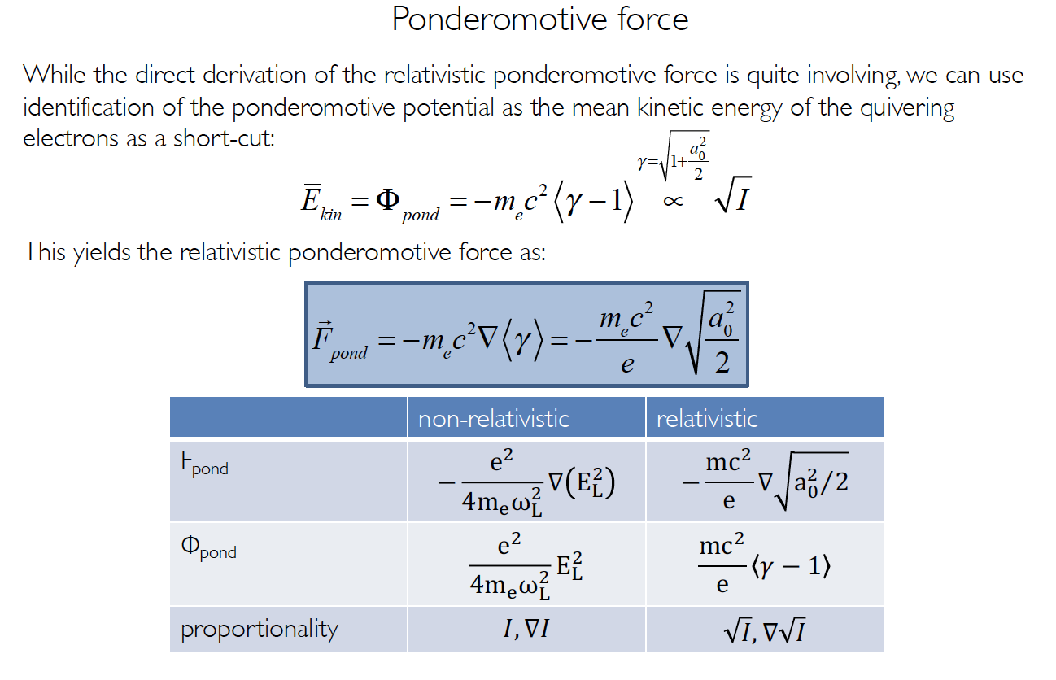
Ponderomotive force
Courtesy of Stephan Karsch, CAS 2019

Slide 26
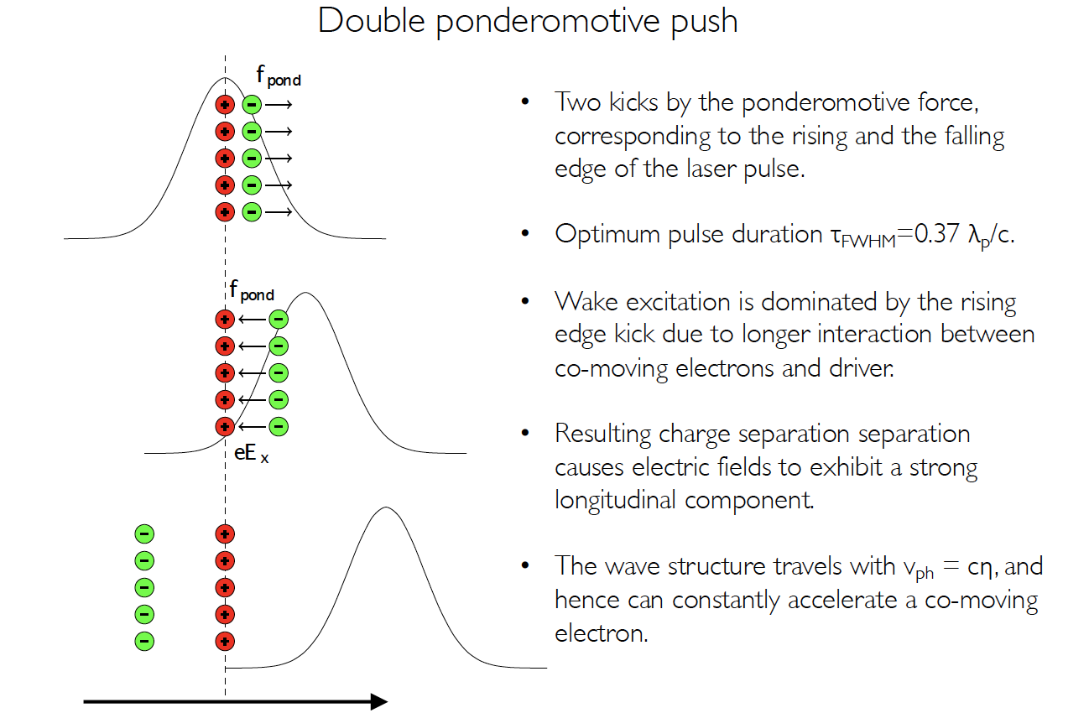
Ponderomotive force
Courtesy of Stephan Karsch, CAS 2019

Slide 27
Quizz:
Increasing the pressure
What happens if the gas pressure is increased?
Nothing
The number of electrons creating the field will be higher and hence there will be a higher accelerating gradient
Proportionally fewer electrons will be displaced and hence the gradient will be lower.

Slide 28
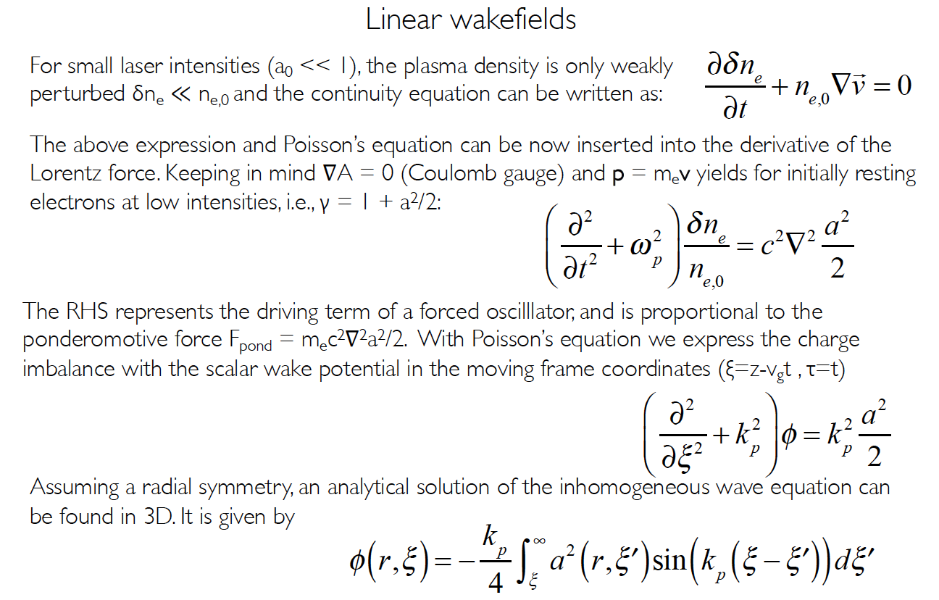
Linear wakefield
Courtesy of Stephan Karsch, CAS 2019

Slide 29
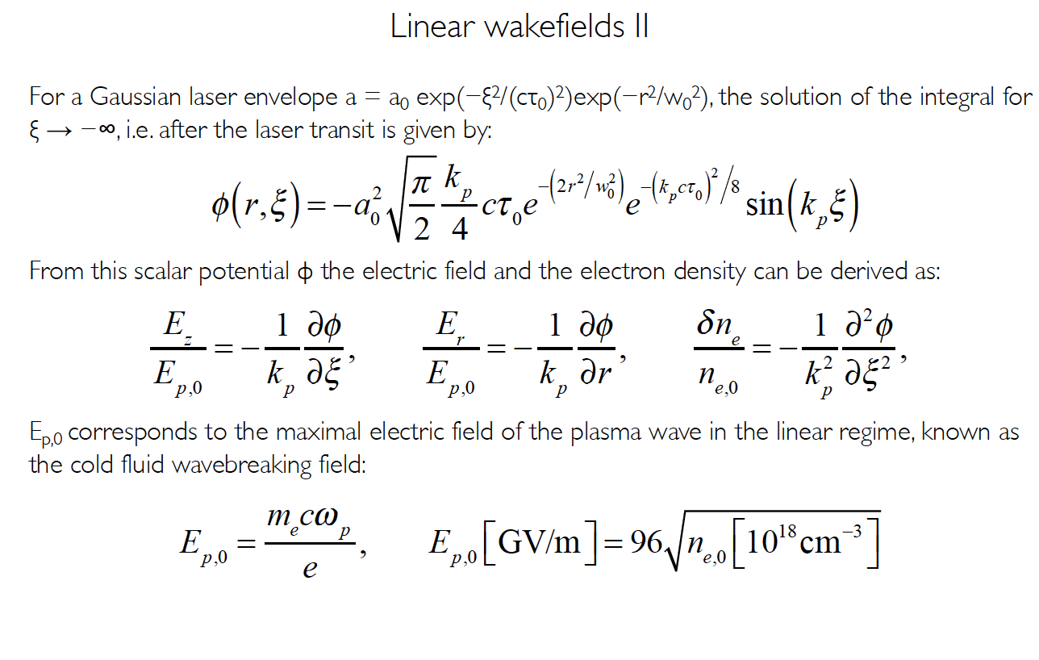
Linear wakefield
Courtesy of Stephan Karsch, CAS 2019

Slide 30
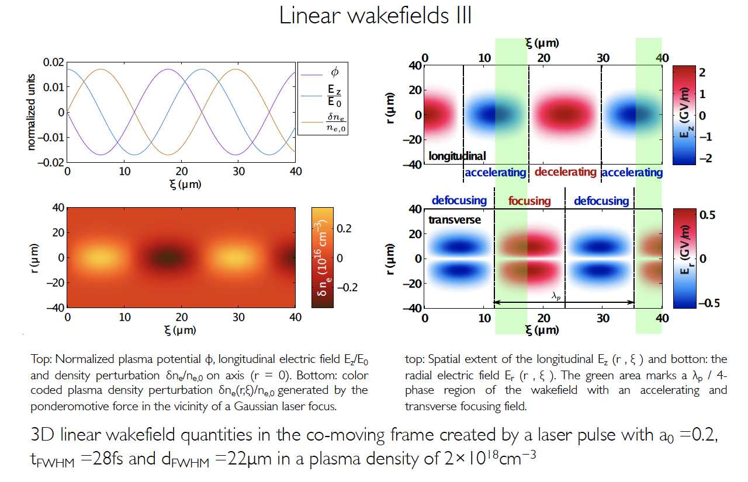
Linear wakefield
Courtesy of Stephan Karsch, CAS 2019

Slide 31
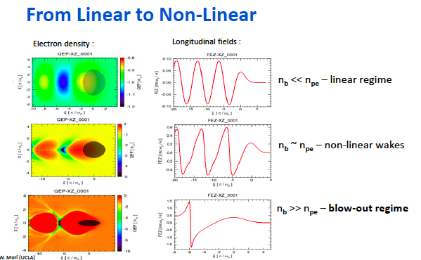
From linear to non-linear
Courtesy of Edda Gschwendtner, CAS 2019

Slide 32
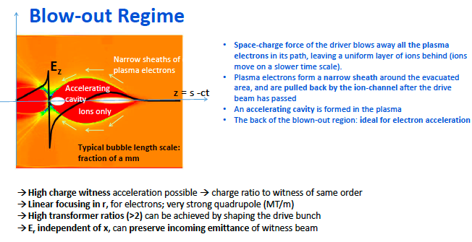
Blow-out regime
Courtesy of Edda Gschwendtner, CAS 2019

Slide 33
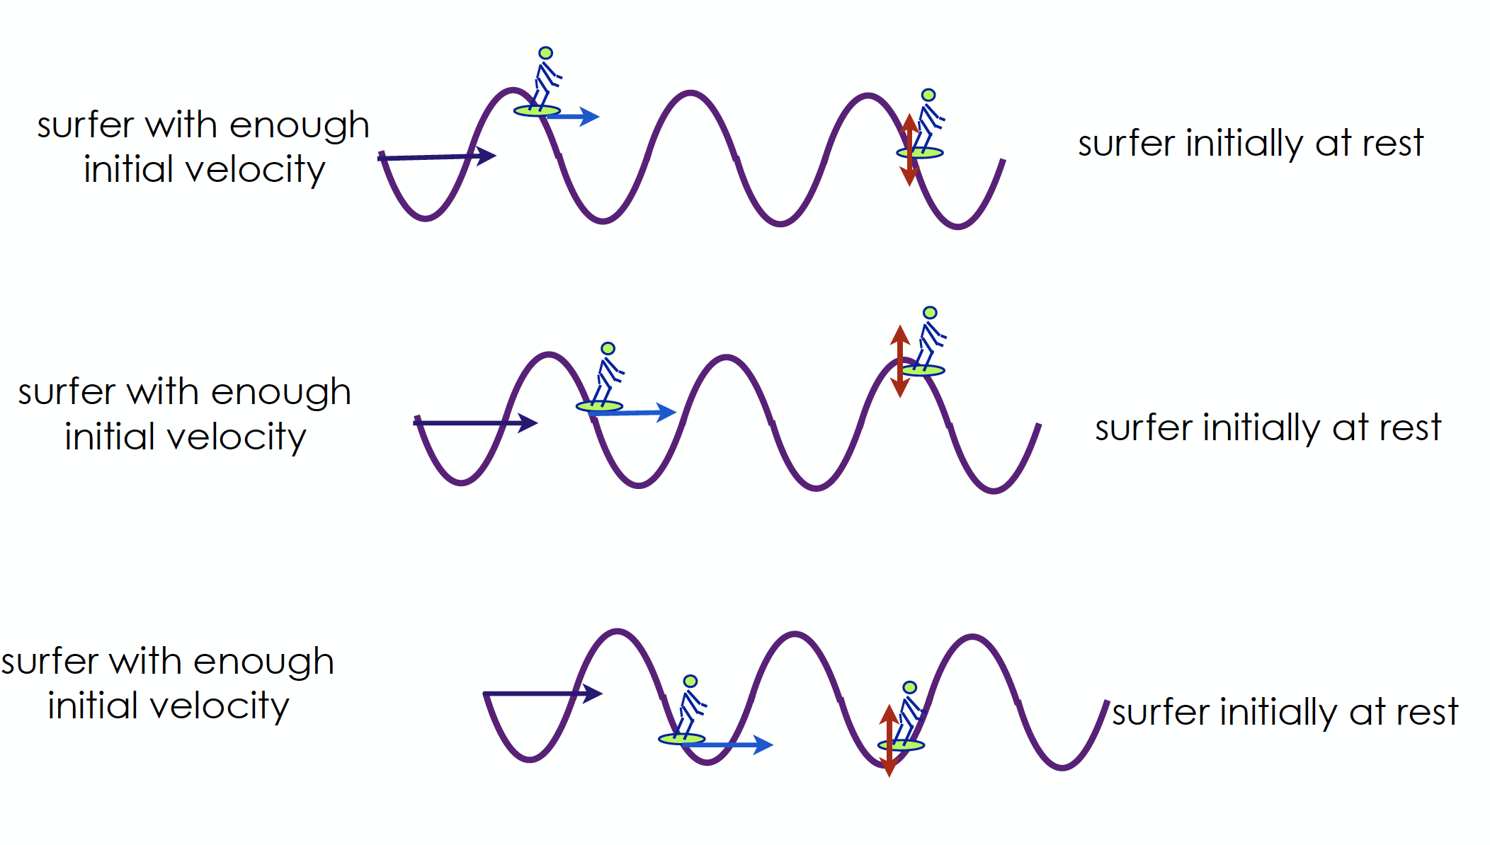
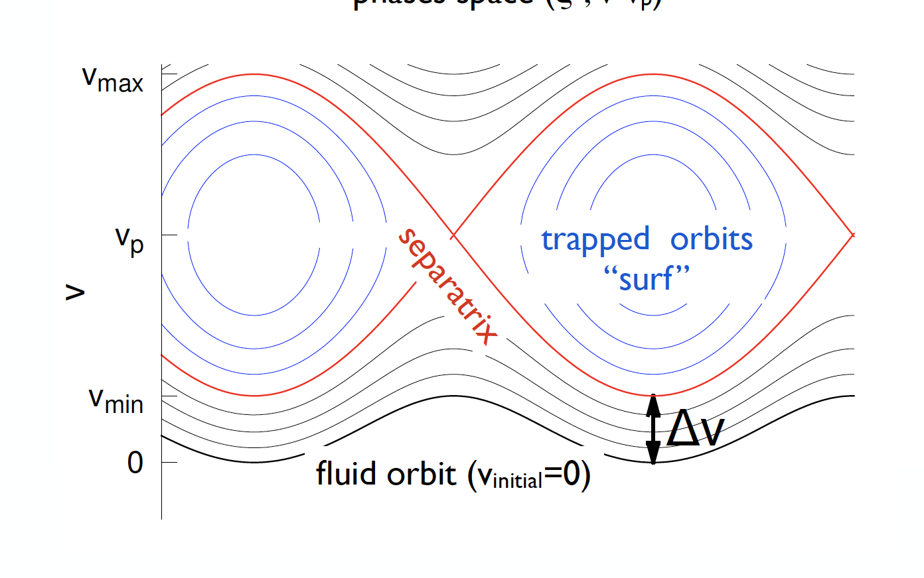
Surfing the wave
Courtesy of V. Malka

Slide 34
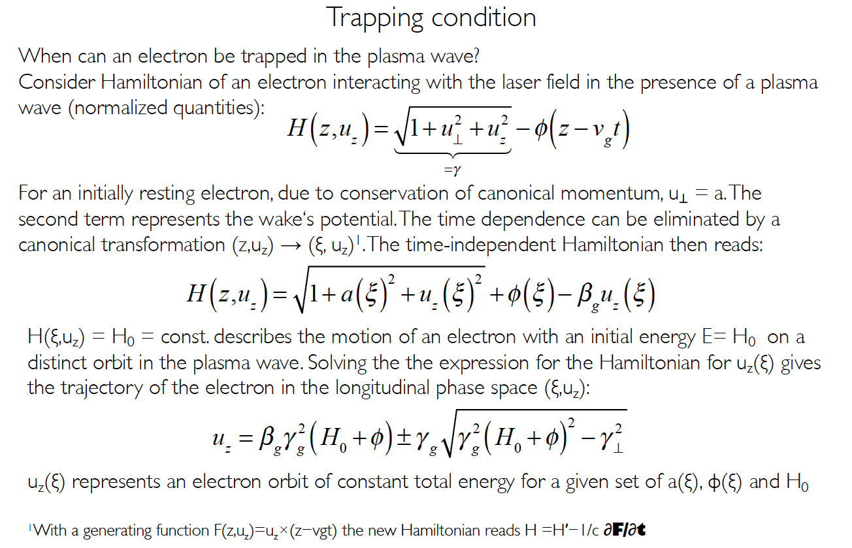
Trapping condition
Courtesy of Stefan Karsch, CAS 2019

Slide 35
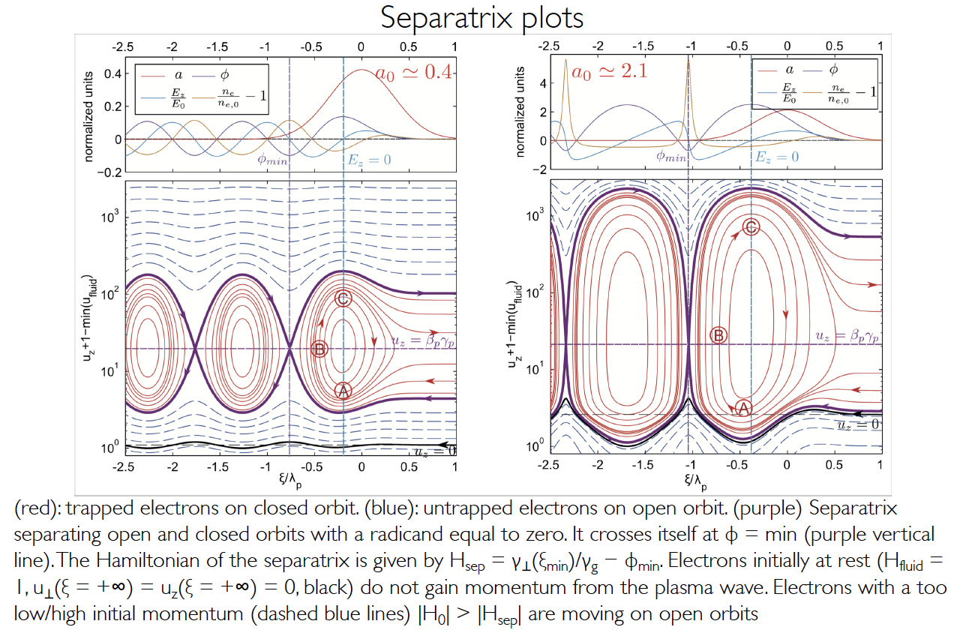
Trapping condition
Courtesy of Stefan Karsch, CAS 2019

Slide 36
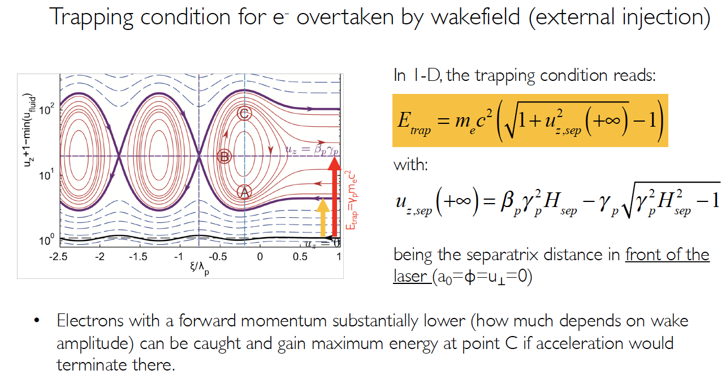
Trapping condition
Courtesy of Stefan Karsch, CAS 2019

Slide 37
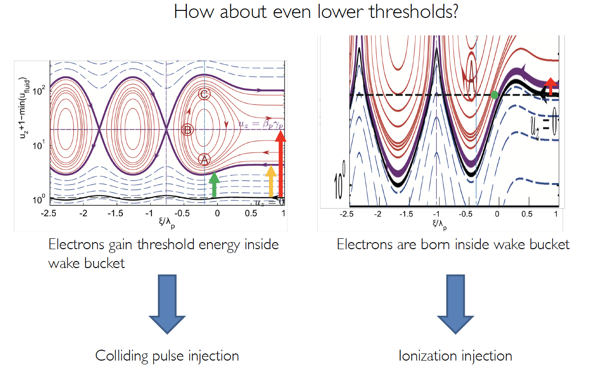
Trapping condition
Courtesy of Stefan Karsch, CAS 2019

Slide 38
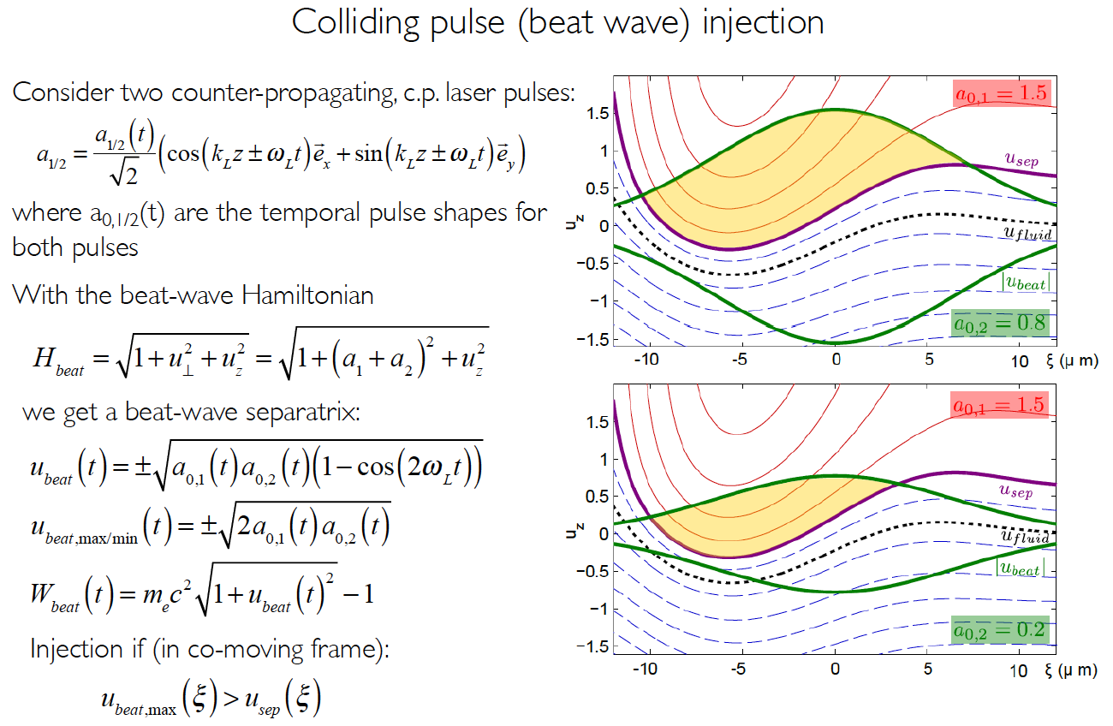
Trapping condition
Courtesy of Stefan Karsch, CAS 2019

Slide 39
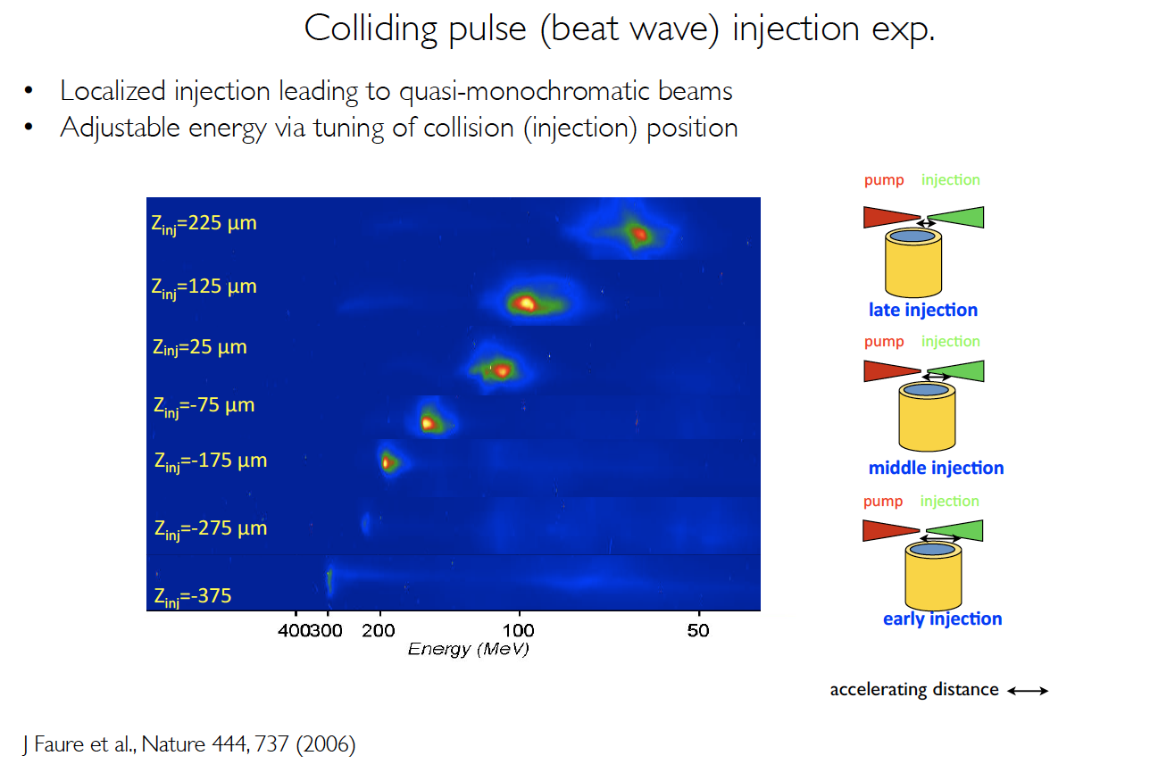
Trapping condition
Courtesy of Stefan Karsch, CAS 2019

Slide 40
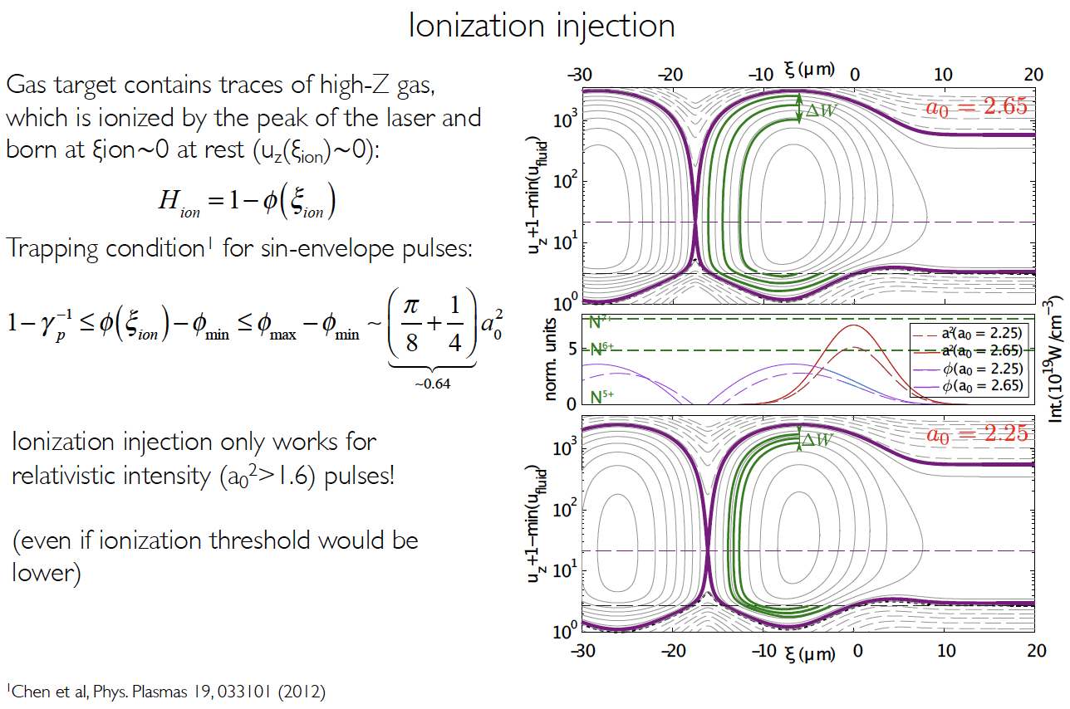
Trapping condition
Courtesy of Stefan Karsch, CAS 2019

Slide 41
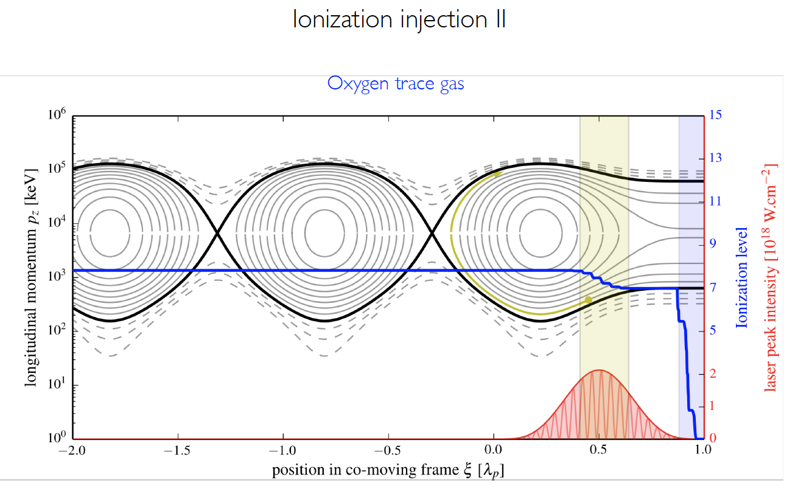
Trapping condition
Courtesy of Stefan Karsch, CAS 2019

Slide 42
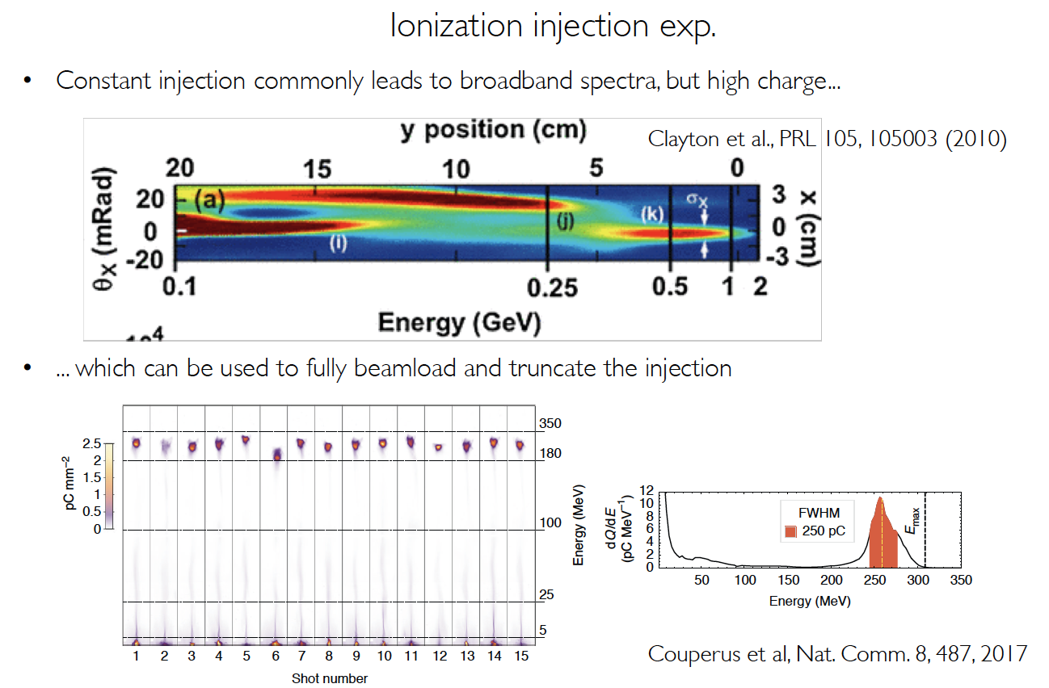
Trapping condition
Courtesy of Stefan Karsch, CAS 2019

Slide 43
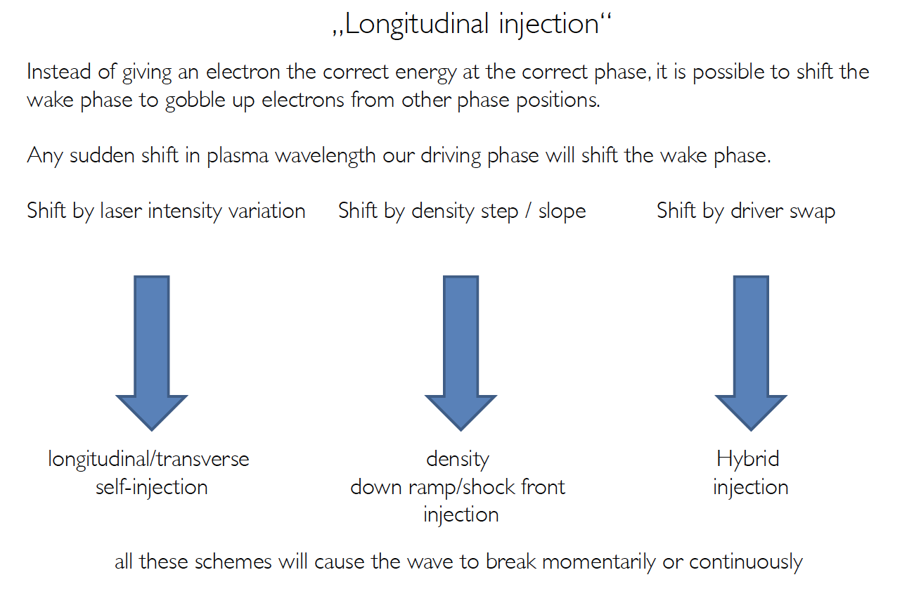
Trapping condition
Courtesy of Stefan Karsch, CAS 2019

Slide 44
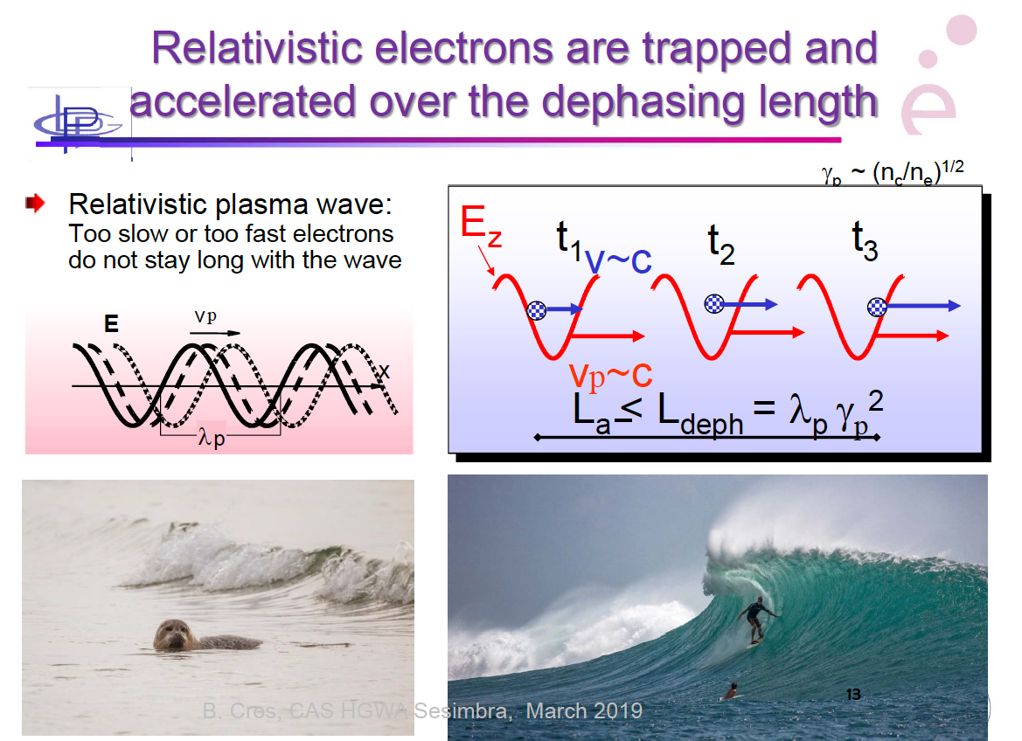
Dephasing length
Courtesy of Brigitte Cros, CAS 2019

Slide 45
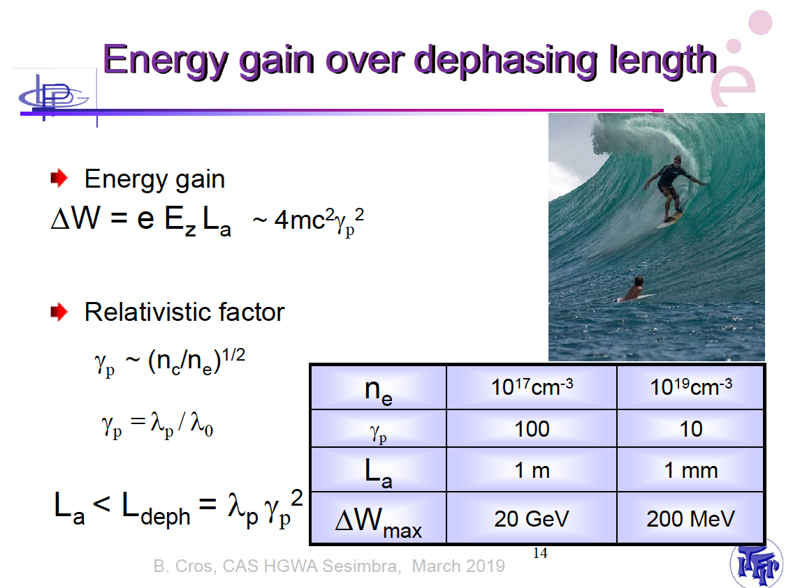
Dephasing length
Courtesy of Brigitte Cros, CAS 2019

Slide 46
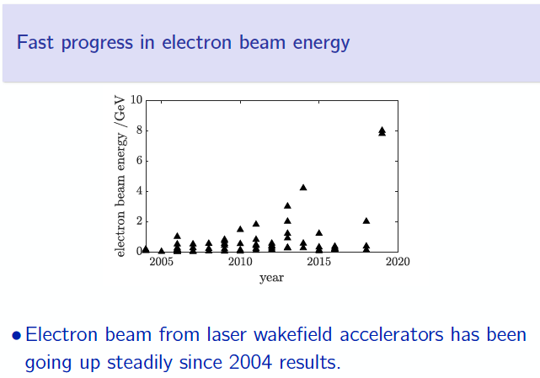
Some experimental results
Courtesy of Stuart Mangles, CAS 2019

Slide 47
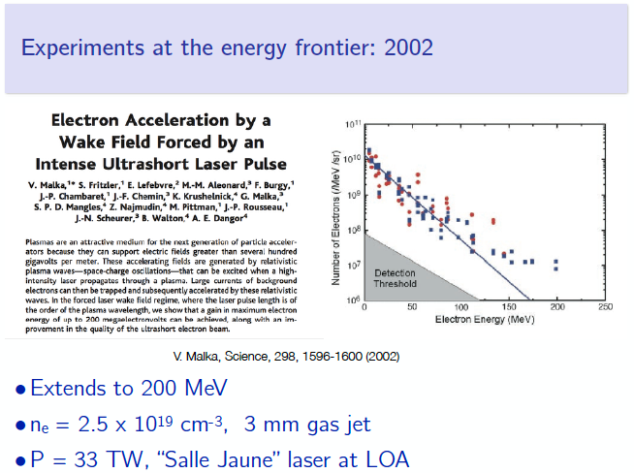
Some experimental results
Courtesy of Stuart Mangles, CAS 2019

Slide 48
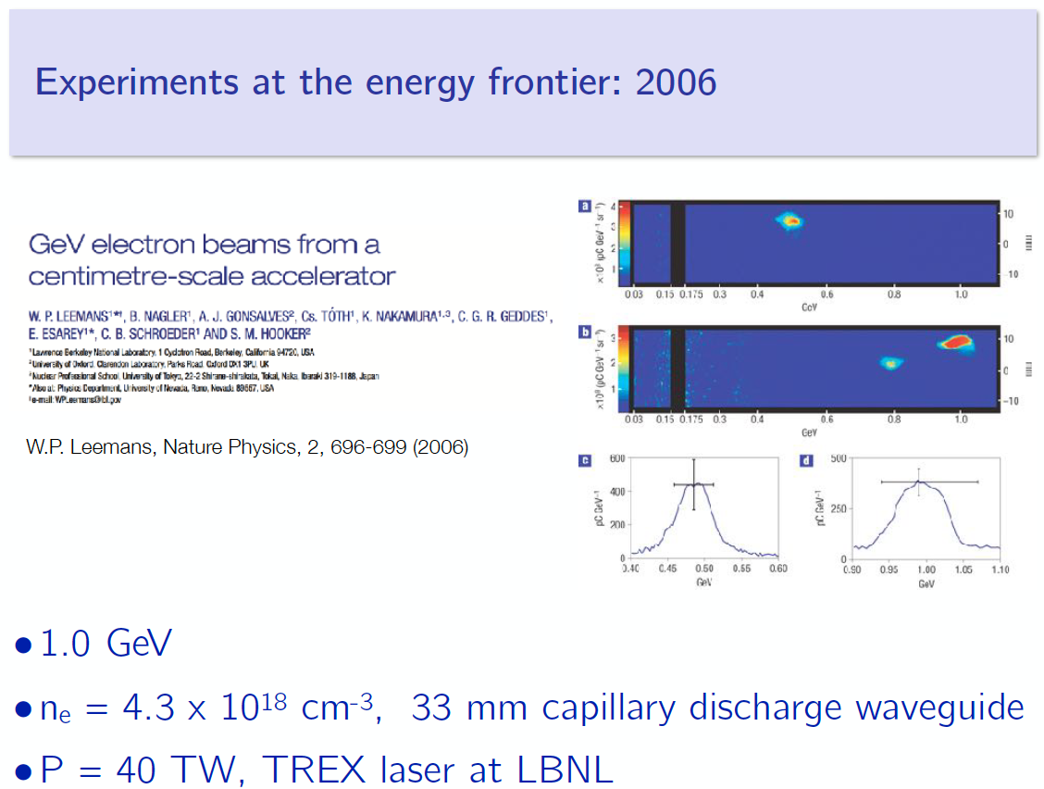
Some experimental results
Courtesy of Stuart Mangles, CAS 2019

Slide 49
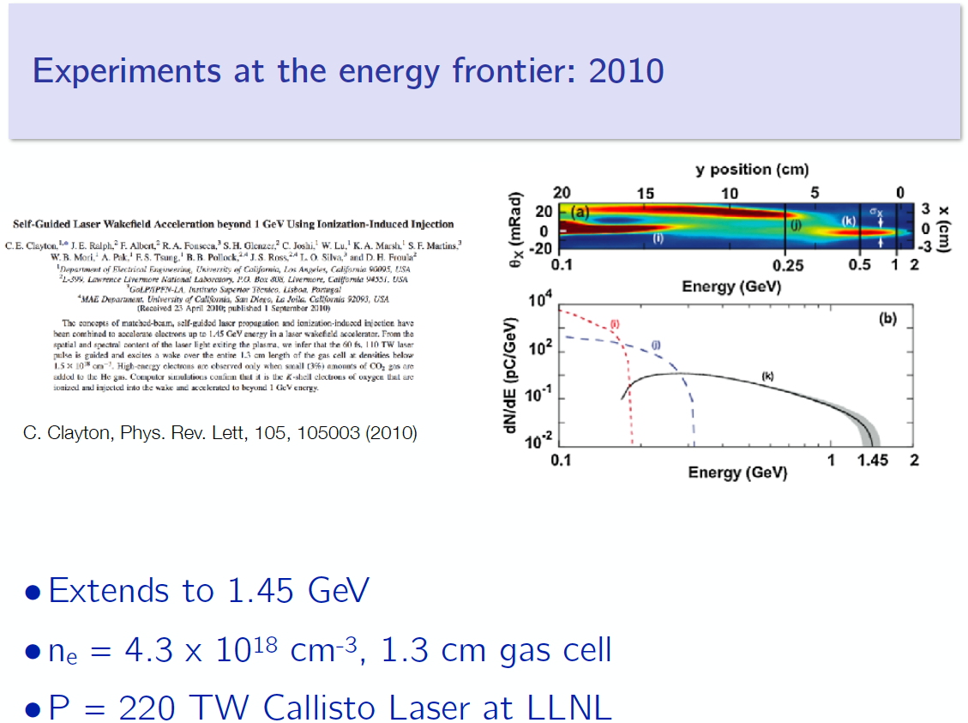
Some experimental results
Courtesy of Stuart Mangles, CAS 2019

Slide 50
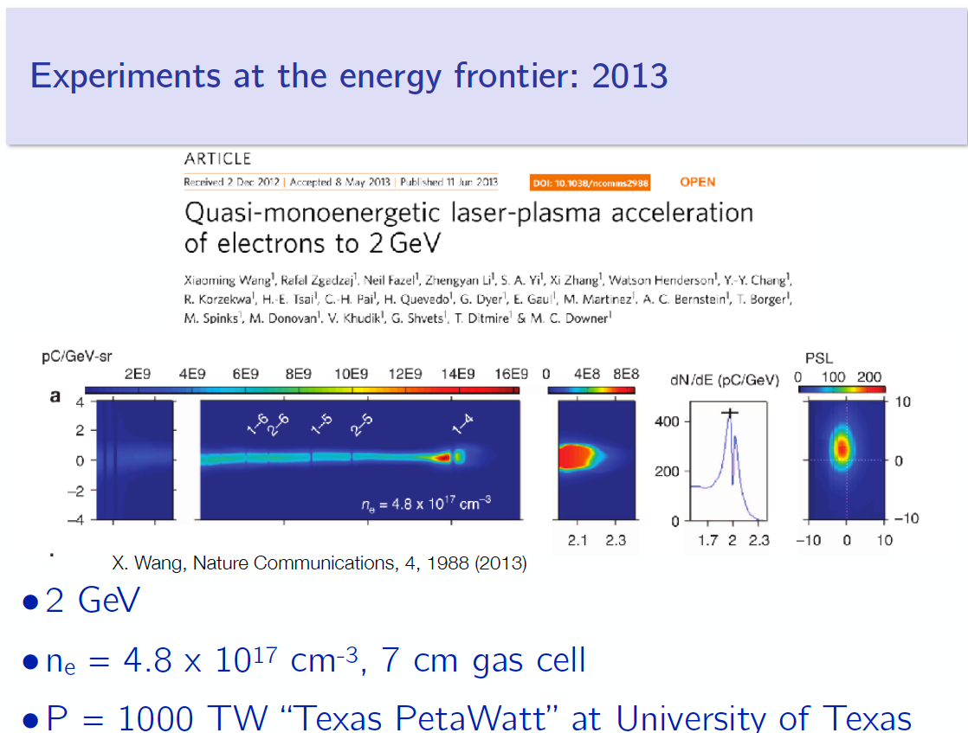
Some experimental results
Courtesy of Stuart Mangles, CAS 2019

Slide 51
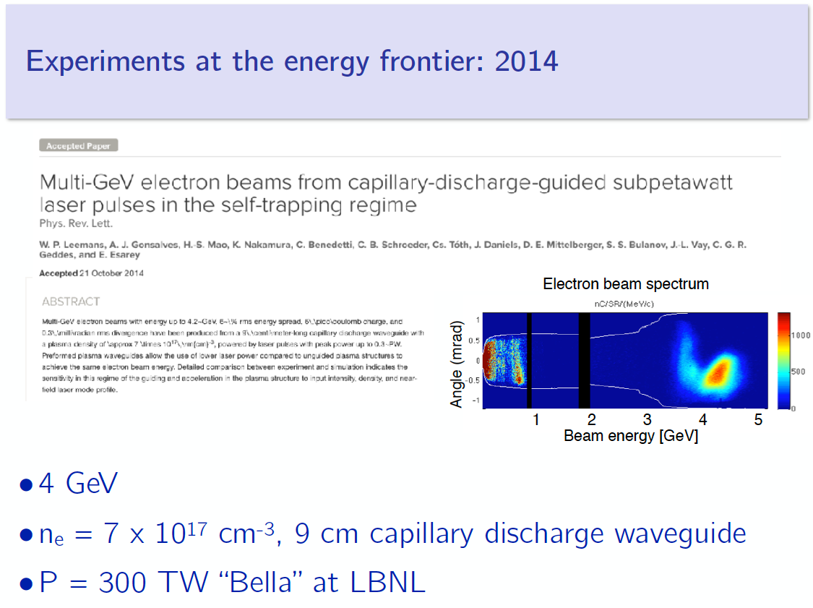
Some experimental results
Courtesy of Stuart Mangles, CAS 2019

Slide 52
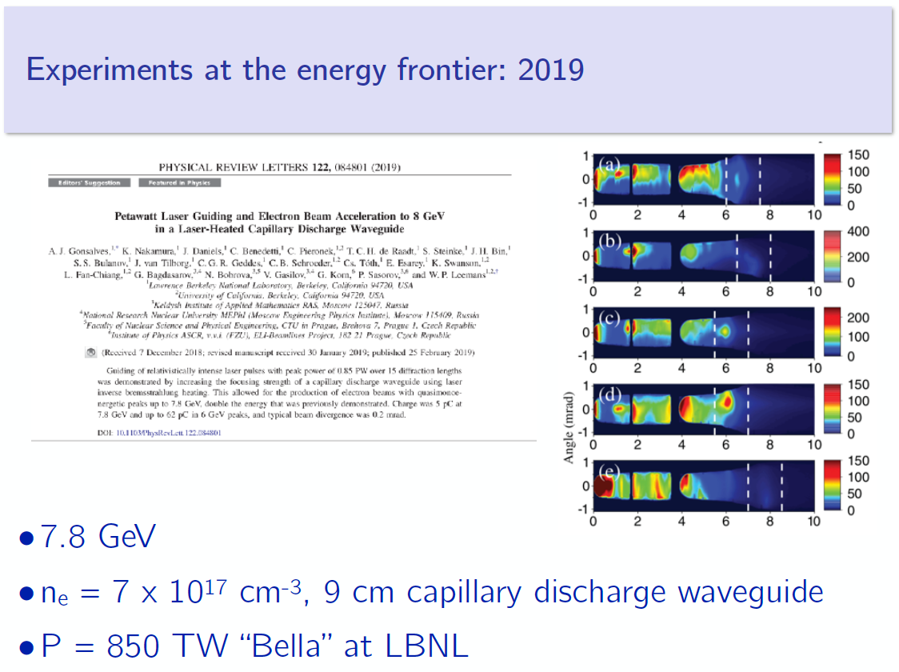
Some experimental results
Courtesy of Stuart Mangles, CAS 2019

Slide 53
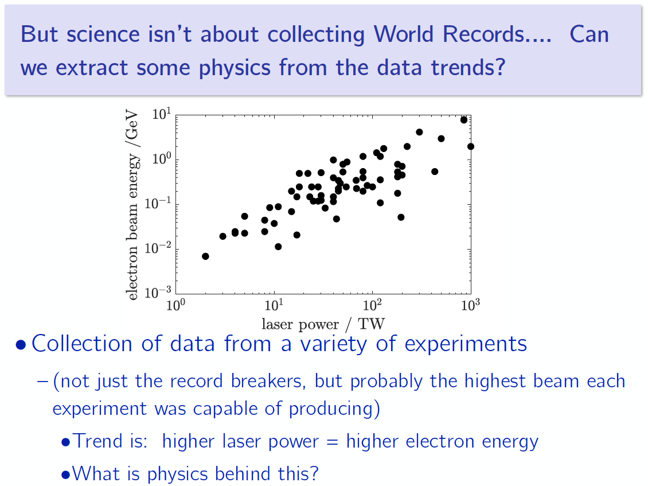
Some experimental results
Courtesy of Stuart Mangles, CAS 2019

Slide 54
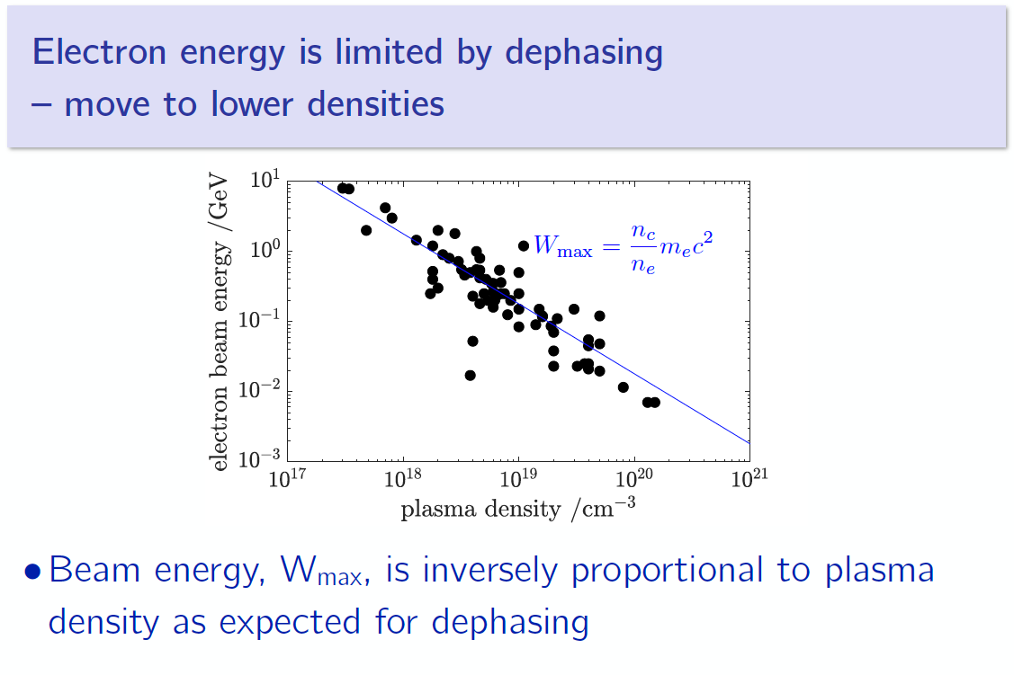
Some experimental results
Courtesy of Stuart Mangles, CAS 2019

Slide 55
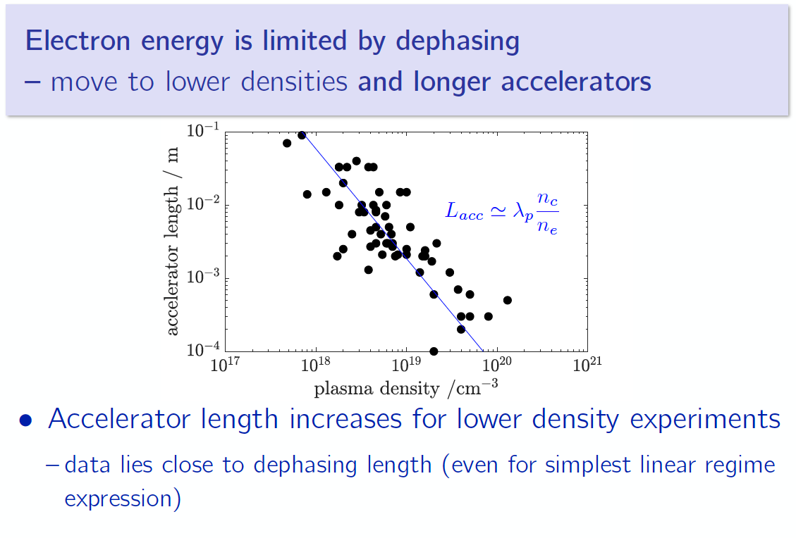
Some experimental results
Courtesy of Stuart Mangles, CAS 2019

Slide 56
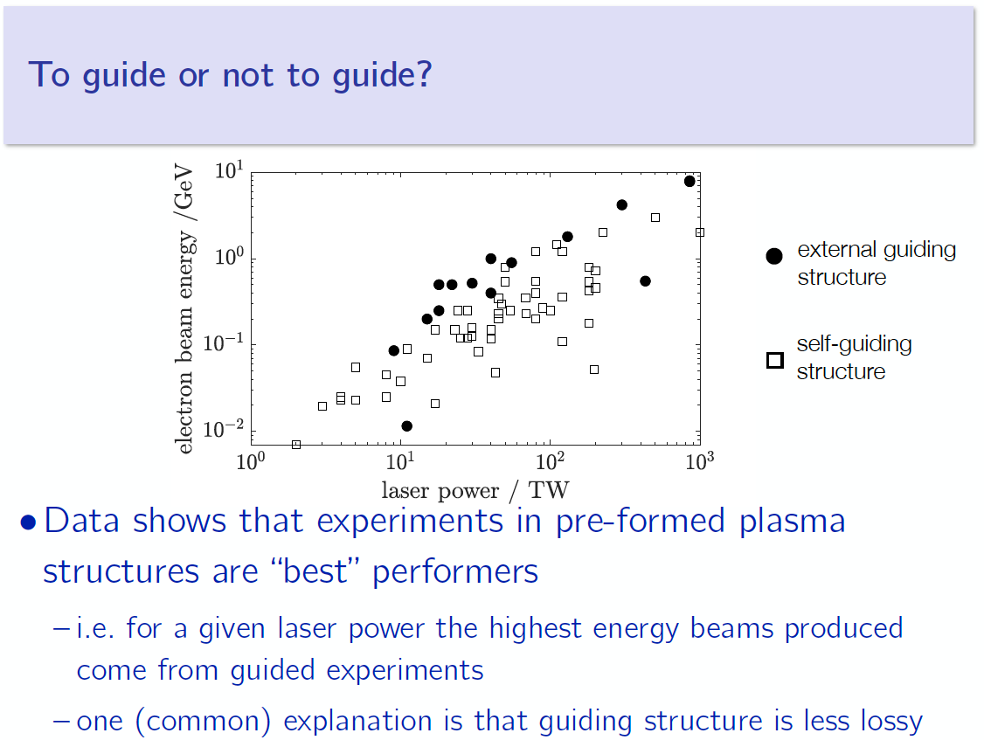
Some experimental results
Courtesy of Stuart Mangles, CAS 2019

Slide 57
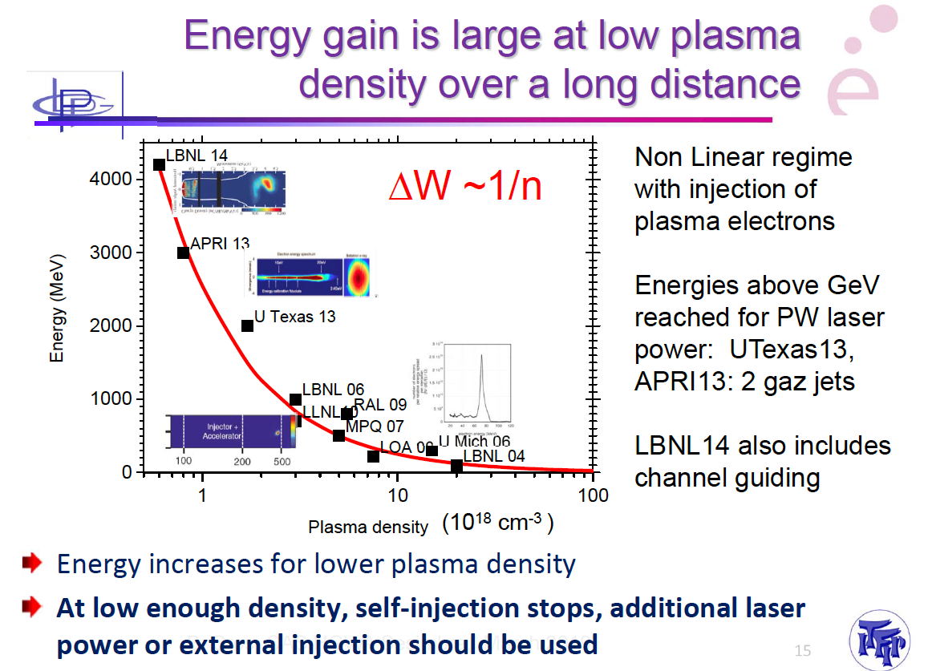
Dephasing length
Courtesy of Brigitte Cros, CAS 2019

Slide 58

Some experimental results
Courtesy of Stuart Mangles, CAS 2019

Slide 59

Multi-stage
Courtesy of Brigitte Cros, CAS 2019

Slide 60
Beam driven plasma acceleration

Slide 61

Beam driven plasma acceleration
Courtesy of Edda Gschwendtner, CAS 2019

Slide 62

Beam driven plasma acceleration
Courtesy of Edda Gschwendtner, CAS 2019

Slide 63

Beam driven plasma acceleration
Courtesy of Edda Gschwendtner, CAS 2019

Slide 64

Beam driven plasma acceleration
Courtesy of Edda Gschwendtner, CAS 2019

Slide 65

Plasma lens
Courtesy of Edda Gschwendtner, CAS 2019

Slide 66
Positron acceleration

Slide 67

Positron acceleration
Courtesy of Edda Gschwendtner, CAS 2019

Slide 68

Positron acceleration
Courtesy of Edda Gschwendtner, CAS 2019

Slide 69

Positron acceleration
Courtesy of Edda Gschwendtner, CAS 2019

Slide 70
PROTON driven plasma acceleration

Slide 71

Protons as a driver
Courtesy of Edda Gschwendtner, CAS 2019

Slide 72

Protons as a driver
Courtesy of Edda Gschwendtner, CAS 2019

Slide 73

Protons as a driver
Courtesy of Edda Gschwendtner, CAS 2019

Slide 74

Protons as a driver
Courtesy of Edda Gschwendtner, CAS 2019

Slide 75
A plasma collider?

Slide 76

A plasma collider proposal
A concept of plasma collider has been proposed.
https://physicstoday.scitation.org/doi/10.1063/1.3099645

Slide 77
Acceleration OF IONS

Slide 78

Acceleration of ions
Courtesy of Vincent Bagnoud, CAS 2019

Slide 79

Acceleration of ions
Courtesy of Vincent Bagnoud, CAS 2019

Slide 80

Acceleration of ions
Courtesy of Louise Willingale, CAS 2019

Slide 81

Acceleration of ions
Courtesy of Louise Willingale, CAS 2019

Slide 82

Acceleration of ions
Courtesy of Louise Willingale, CAS 2019

Slide 83

Acceleration of ions
Courtesy of Vincent Bagnoud, CAS 2019

Slide 84

Acceleration of ions
Courtesy of Louise Willingale, CAS 2019

Slide 85

Acceleration of ions
Courtesy of Louise Willingale, CAS 2019

Slide 86

Acceleration of ions
Courtesy of Louise Willingale, CAS 2019

Slide 87
Outlook
Plasma acceleration is a new technique to accelerate particles with a high gradient.
It is still a research topic.
Performances have been demonstrated but beam quality still has to be improved.
Beams are different from conventional accelerators beams.
Some applications are been considered (FEL, isotope production,…)
Colliders applications have been discussed but are still far away.

Slide 88
More details
You can find a large amount of courses on this topics on the website of the CERN accelerator School 2019: https://indico.cern.ch/event/759579/

