Slide 1
Particle sources:
Electron sources
Nicolas Delerue
IJCLab (CNRS and Université Paris-Saclay)

Slide 2
About me
Researcher in the directorate of the Accelerator division of IJCLab.
Deputy head of the national research group (GdR) dedicated to laser-plasma acceleration.
Main research area:
  Beam diagnostics
  Laser-plasma acceleration
  Compton sources

Slide 3
Electron sources:
Content
Physical processes leading to the emission of electrons
Gun design
Beam dynamics in the gun
Diagnostics
Types of electron guns

Slide 4
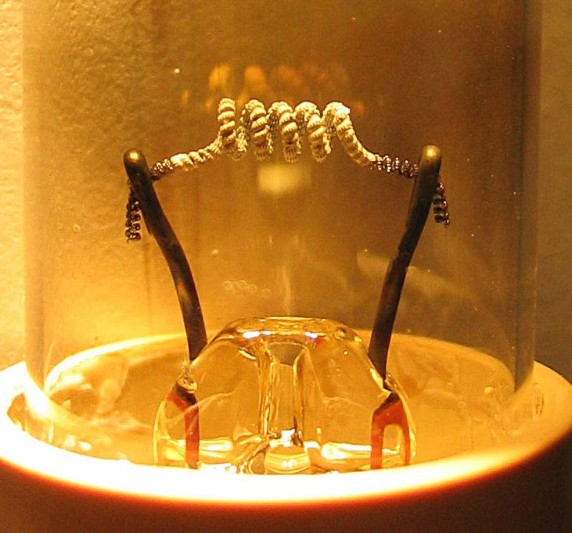
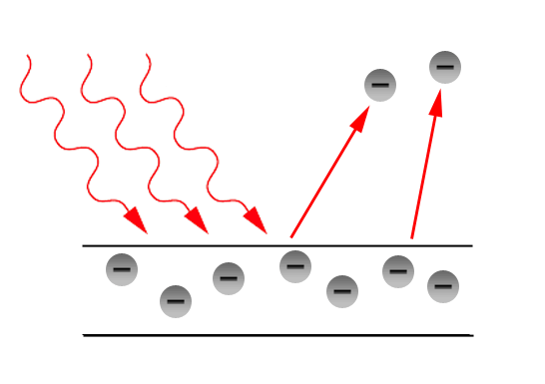
Physical process: extracting electrons
In this first part of the lecture we will see what are the conditions to be met to extract electrons from a metal.

Slide 5
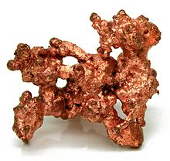
Physical process:
Electrons in metal
Electrons are readily available in metals.
Eg: Copper:
- 29 electrons/atom,
- 9g/cm³ => 0,14mol/cm³
=> 2. x10²⁴ electrons/cm³
However theses electrons are ‘trapped’ in the metals.

Slide 6
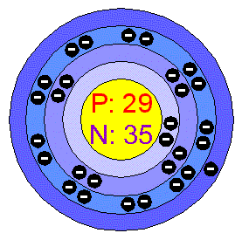
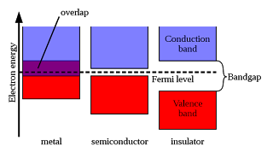
Electrons in metal: energy levels
In a free atom the electrons are located on orbits of increasing energy around the nucleus.
In a solids these orbits are replaced by the conduction band and the valence band.

Slide 7
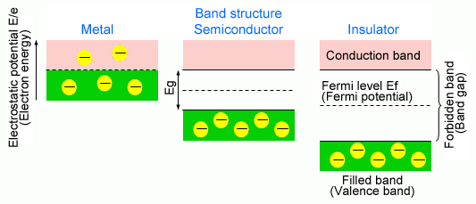
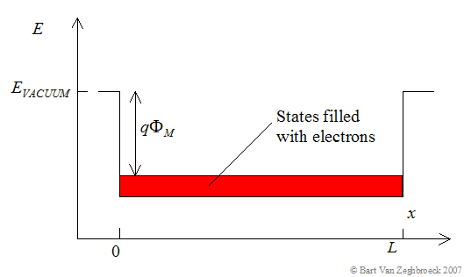
Extracting electrons from metal
The energy needed to free the electron from a solid is called “Work function”.
This work function is different for each material.

Slide 8
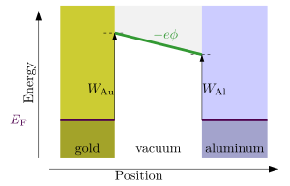
Work function
The work function (W) is the minimum thermodynamic work needed to remove an electron from a solid to a point in the vacuum immediately.
E_F: Fermi energy (energy of the electrons at equilibrium).
electrostatic potential.
This depends on the configuration of the atoms on the surface so the same chemical element with different crystalline configuration will have different work function.

Slide 9
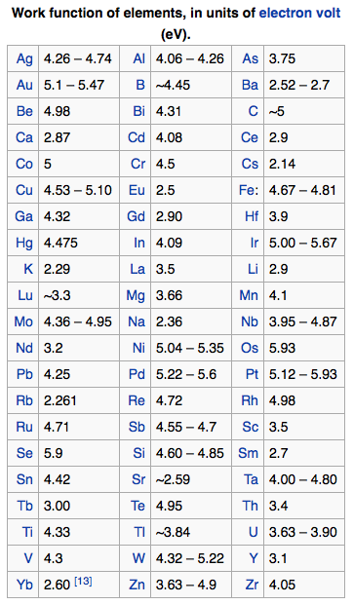
Work function for different materials
Values of work functions are tabulated.
Source: wikipedia

Slide 10
Quizz
Copper has a work function between 4.53 eV and 5.10 eV.
What is the wavelength of a photon with an energy of 5 eV?
(a) 250 mm
(b) 250 um (micrometers)
(c) 250 nm
(d) 250 A (Angstrom)
Reminder: c=3.10⁸ m/s
h=6x10⁻³⁴J.s
1eV=1.6 10⁻¹⁹J

Slide 11
Answer (c)
Copper has a work function between 4.53 eV and 5.10 eV.
What is the wavelength of a photon with an energy of
5 eV?
(a) 250 mm
(b) 250 um (micrometers)
(c) 250 nm
(d) 250 A (Angstrom)
Reminder: c=3.10⁸ m/s
h=6x10⁻³⁴J.s
1eV=1.6 10⁻¹⁹J
As a physicist, you need at least to remember the order of magnitude a visible photon’s wavelength (2eV~620nm).

Slide 12
Fermi-Dirac statistics
Electrons have a spin ½ so they are fermions and follow the Fermi-Dirac statistics.
Distribution (ni) of occupied states of energy (Ei) [Sommerfeld 1927]:
E_F: Fermi energy, k_B Boltzmann constant

Slide 13
Fermi-Dirac statistics at high energy
At high energy the Fermi-Dirac statistics and the Maxwell-Boltzmann statistics tend toward the same value.
To increase the number of electron in the high energy levels you need to heat them!

Slide 14
Extracting electrons from matter
To free the electrons you can give them more energy.
- This can be done by heating
=> Thermionic effect
- This can also be done with a laser
=> Photoelectric effects
Or one can reduce the work function, for example with a strong magnetic field => Schottky effect

Slide 15
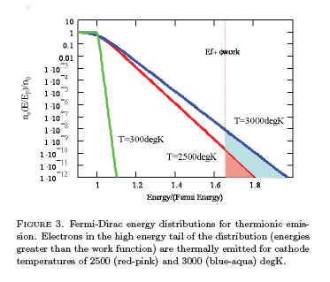
Numerical application
Copper work function: W~5eV
K_B=8.6 10⁻⁵ eV.K⁻¹
=> T~60000K
In fact this would mean that
all atoms emit an electron at the same time.
To get only some atoms to emit electrons a lower temperature is acceptable.
A significant thermionic emission starts at about 2500K.

Slide 16
Density of states for different temperatures
Source:
D.H.Dowell, USPAS

Slide 17
Extracting electrons…
Richardson’s law
We do not need all the atoms to emit electrons.
We only want a certain current.
The current density emitted (J) was studied in 1901 by Richardson.
Lambda_R: correction factor specific to a given material.

Slide 18
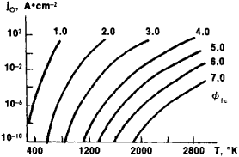
Richardson’s constant
Richardson’s constant is still not completely understood.
Theoretical value : 1200mA.mm⁻² K⁻²
but it has to be corrected for each material.
Source:
http://encyclopedia2.thefreedictionary.com/Richardson's+constant

Slide 19
Numerical application
W=5eV
A=1200A m⁻² K⁻²
K_B=8.6 10⁻⁵ eV.K⁻¹
Cathode area: 1 cm² = 100 mm²

Slide 20
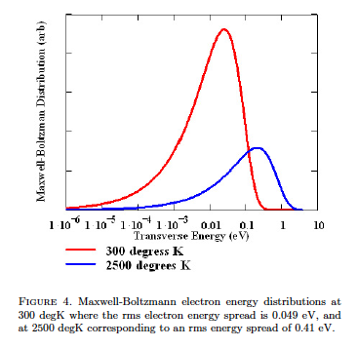
Transverse energy
A hotter cathode gives a larger current.
However electrons above the emission threshold will be emitted with some kinetic energy.
Some of this kinetic energy will be converted in transverse energy.
The product of the transverse beam size by its transverse energy at a waist is called “transverse emittance”.
This will be discussed further later.
Source:
D.H.Dowell, USPAS

Slide 21
Quizz
Let’s consider two metals with different work function.
Both metals are heated to the same temperature so that they emit electrons.
Which metal will emit the highest current?
(a) Electron emission is independent from the work function.
(b) The metal with the highest work function emits more electrons.
(c) The metal with the lowest work function emits more electrons.

Slide 22
Answer (c)
The metal with the lowest work function emits more electrons.
The work function express the work an electron has to do to be emitted.
The lower the work function the more electrons will be emitted (at the same temperature).

Slide 23
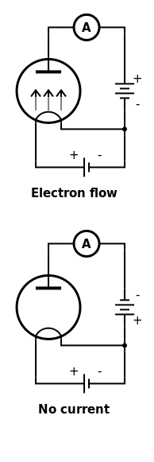
Schottky emission
When a strong electric field (F) is applied the barrier for electrons to escape from the solid is lowered.
=> The work function is reduced.
If the field exceeds 10⁸V/m then the electrons can also tunnel out of the solid.
=> Fowler-Nordheim tunneling (enhanced emission).
This effect (under the name “Edisson effect”) was used in old diode tubes.

Slide 24
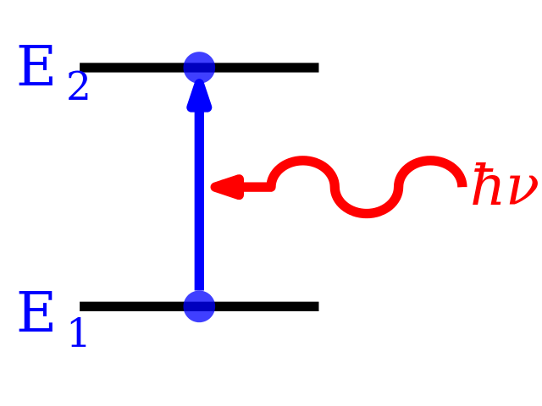
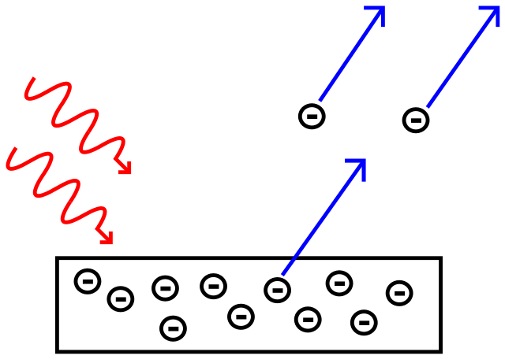
Photoelectric emission
Electrons can also receive energy by absorbing a photon.
If the energy of the photon is sufficient they will be emitted.
This is called photoelectric emission.

Slide 25
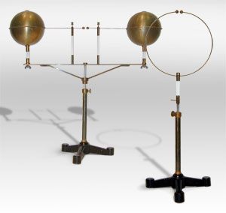
Wavelength for photoemission
Remember:
- Copper work function: 5eV
- 2eV ~620nm
or 5eV ~ 250nm.
The typical wavelength for photoemission is in the Ultraviolet, not in the visible.
The photoelectric effect was historically observed when a cathode was illuminated under UV light and it started to spark.

Slide 26
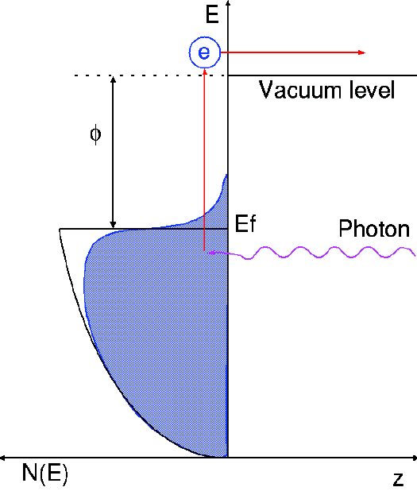
Photo-electric emission
A photon incident on a material will transfer its energy to an electron present in the metal.
If the energy of this electron becomes bigger than the work function of the material, the electron can be emitted.
This is called photo-electric emission.
(image source:
Masao Kuriki, ILC school)‏

Slide 27
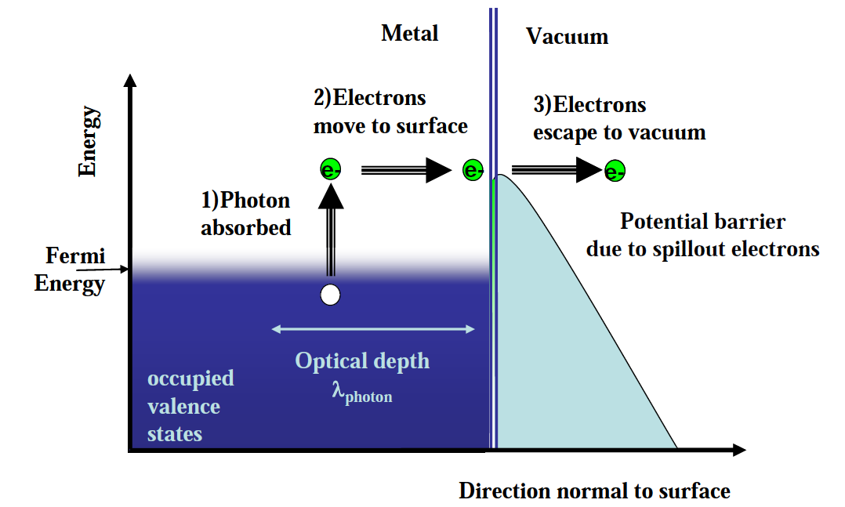
The 3 steps of photo-electric emission
Photo-electric emission takes place in 3 steps:
1) Absorption of a photon by an electron inside the metal. The energy transferred is proportional to the photon energy.
2) Transport of the electronto the physical surface of the metal. The electron may loose energy by
scattering during this process.
3) Electron emission (if
the remaining energy is
above the work function;
including Schottky effect)
The efficiency of this process is
called “quantum efficiency”.

Slide 28
Quantum efficiency
Not all incident photons lead to the emission of an electron.
Typical quantum efficiency is below a few percent, sometimes as low as 10⁻⁵.
As the cathode is used its surface will change and the QE will decrease.

Slide 29
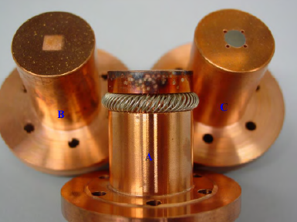
Typical cathode materials
The choice of material is a trade-off between several parameters:
- quantum efficiency
- environmental sensitivity
- damage threshold
- availability in the industry
- easy handling and preparation (safety requirements)
Copper is an easy choice but with a low QE.
Cs2Te has a much higher QE but is more difficult to prepare.
Other materials: Magnesium, Niobium, GaAs:Cs
Note: GaAs:Cs can also produce polarized beams.

Slide 30
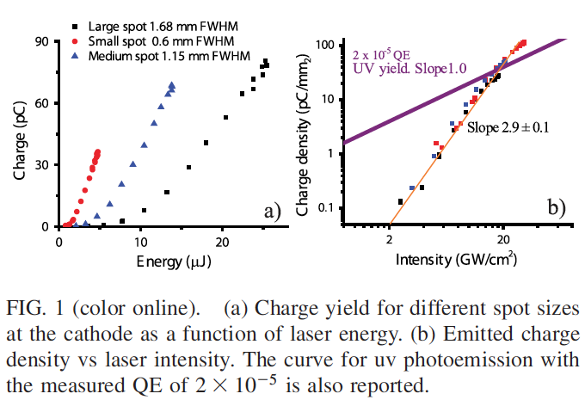

Multiphotonic effect
Laser light conversion efficiency from IR to UV is very low and UV light transport is difficult.
Some groups have suggested that it is more efficient to illuminate a cathode with IR photons rather than converting these photons to UV:
3 IR photons can lead to the emission of an electron like an UV, however these 3 IR photons must interact with the same atom.

Slide 31
Transverse energy
Depending on the incident photon’s energy and the travel to the surface the emitted electron will have more or less remaining kinetic energy after emission.
Once again part of this energy will be converted in transverse energy.
A higher photon energy will lead to a higher beam emittance.

Slide 32
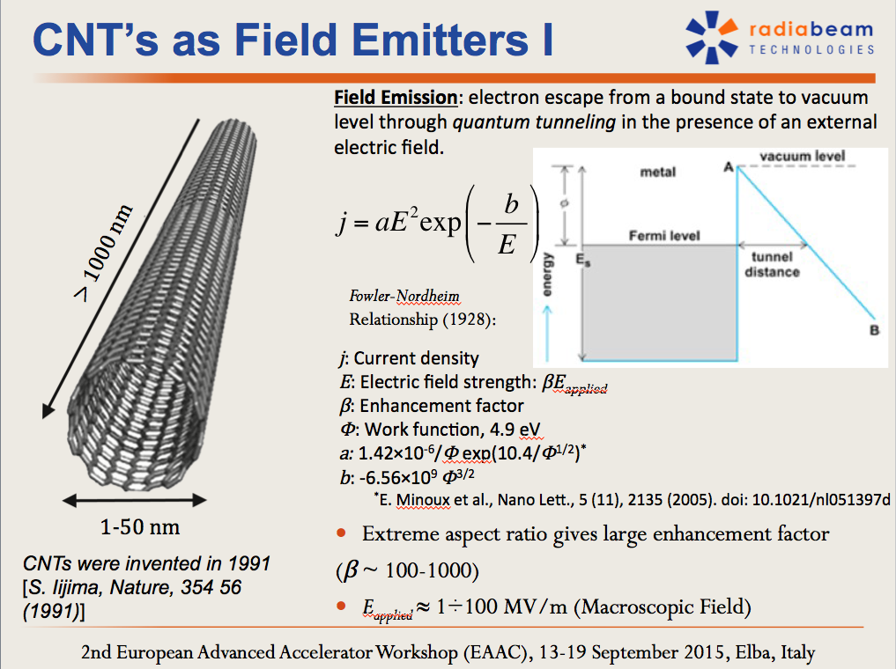
More exotic cathode materials

Slide 33
Quizz
Which phenomena leads to the sparking (electron emission) when a metallic object is placed in a microwave oven?
(a) Thermionic emission (because the object is heated)
(b) Schottky emission (because of the electric field in the oven)
(c) Photoemission (because of the photons emitted by the RF generator of the oven)

Slide 34
Answer (b)
In a microwave oven a very intense electric field can be induced in metallic objects.
This will lead to Schottky emission (sparks).
Note: these sparks also create X-rays…

Slide 35
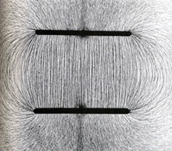
Physical effects summary
Electrons are emitted when their energy exceeds the work function of the material.
3 effects can leads to this:
- Thermionic emission (when the material is heated)
- Schottky emission (lower emission threshold under an intense electric field)
- Photoelectric emission (under illumination by energetic photons)
Material and material properties play an important role in determining the threshold and yield of these emissions.

Slide 36
Designs of electron guns:
Thermionic guns
A thermionic cathode is not sufficient to produce electrons. It must be inserted into a gun.
A thermionic gun must answer several constraints:
- the cathode must be brought to a high temperature.
- there must be a high electric field between the cathode and the exit of the gun (anode).

Slide 37
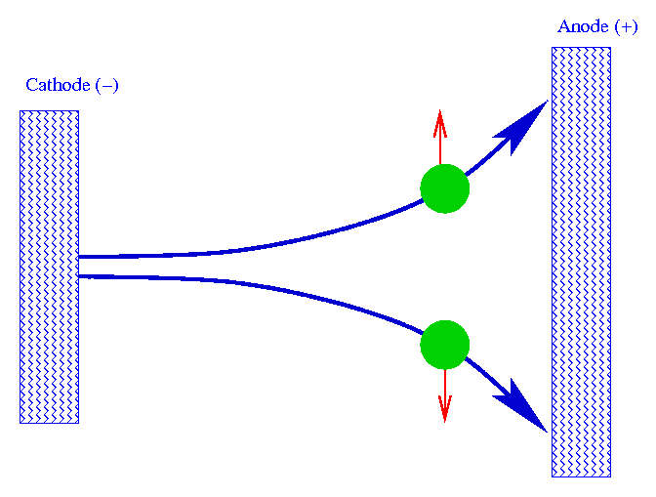
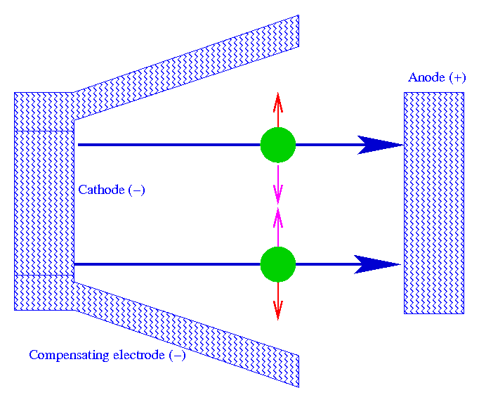
Electrodes geometry (1)
Two emitted electrons repel each other.
If the anode and the cathode are flat the beam will diverge due to the charges emitted.
At low charge this effect will be small but with high current sources this will increase significantly the beam emittance.
To avoid this the shape of the electrode must compensate the space charge forces.

Slide 38
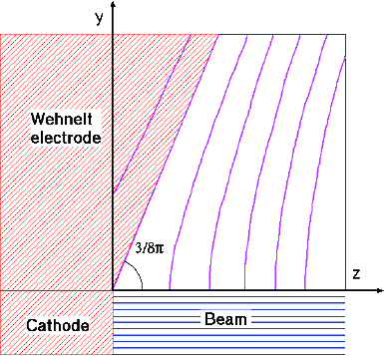
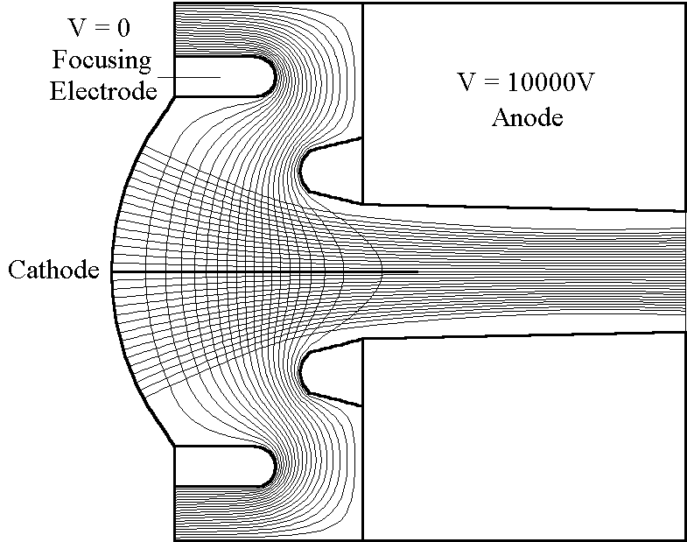
Electrodes geometry (2)
The correct electrode shape will depend on the forces that must be compensated (ie beam current).
By solving Laplace equation it is possible to find the best shape.
(images source:Masao Kuriki, ILC school)‏
(images source: MEBS)‏

Slide 39
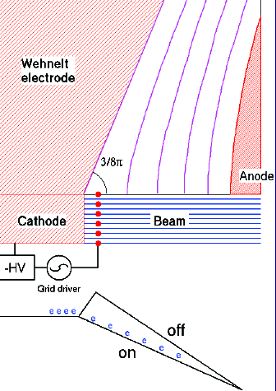
Pierce gun
Thermionic DC Gun
Simplest gun design.
Main features:
  Thermionic cathode
  Emission of the beam is controlled by a HV grid.
  Compensating electrode
Grid control limits pulse length. Typically >1ns.
Operated in space charge limit.
Such design is widely used.
(images source:Masao Kuriki, ILC school)‏

Slide 40
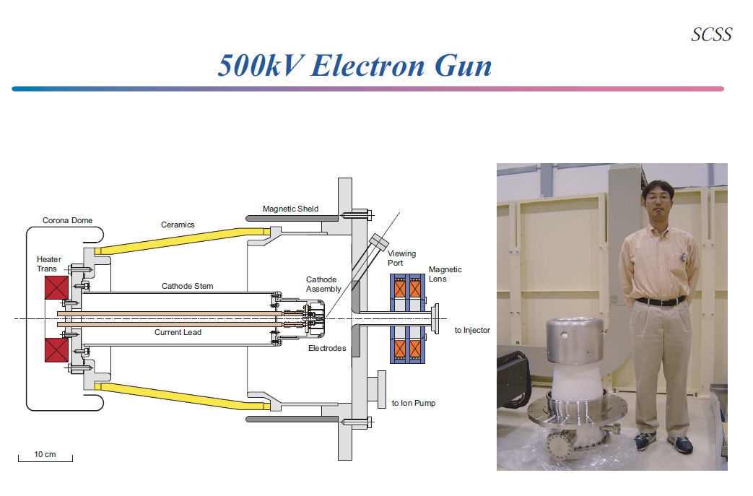
Example of thermionic gun
Spring 8 SCSS thermionic gun.
(images source: T. Shintake, Spring-8)‏

Slide 41
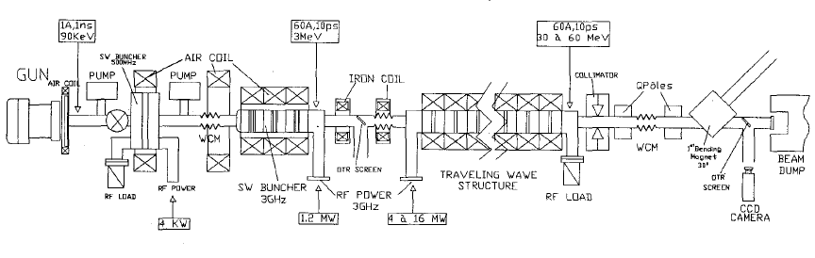
The CLIO Thermoionic gun
3 stages to shape the electrons:
- cathode => 1.5ns bunches
- pre-buncher => 200ps
- buncher => few ps
(and then the main linac structure)

Slide 42
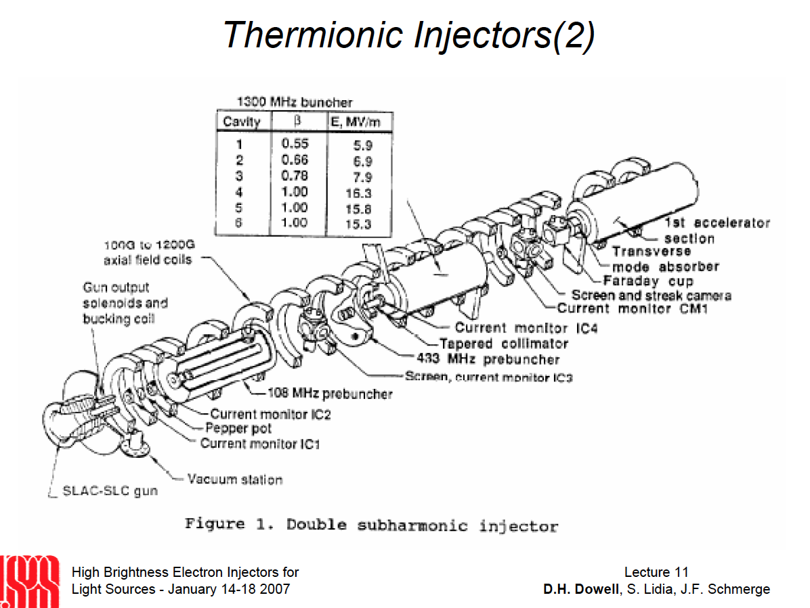

Slide 43
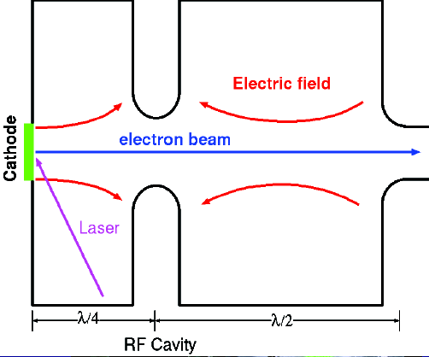
RF Gun
The high voltage of a DC gun can be replaced by a RF cavity.
This can provide much higher accelerating gradients and hence limit the space charge.
RF guns are often coupled with a photo-cathode.
RF gun can generate shorter bunches (and even shorter using short laser pulses).
As the RF wave is reflected on the cathode plane, a RF-gun usually has an half-integer number of cells.
(images source:Masao Kuriki, ILC school)‏

Slide 44
Principle of a RF Photo-gun
Courtesy Jom Luiten, TUV Eindhoven

Slide 45
Principle of a RF Photo-gun
Courtesy Jom Luiten, TUV Eindhoven

Slide 46
Principle of a RF Photo-gun
Courtesy Jom Luiten, TUV Eindhoven

Slide 47
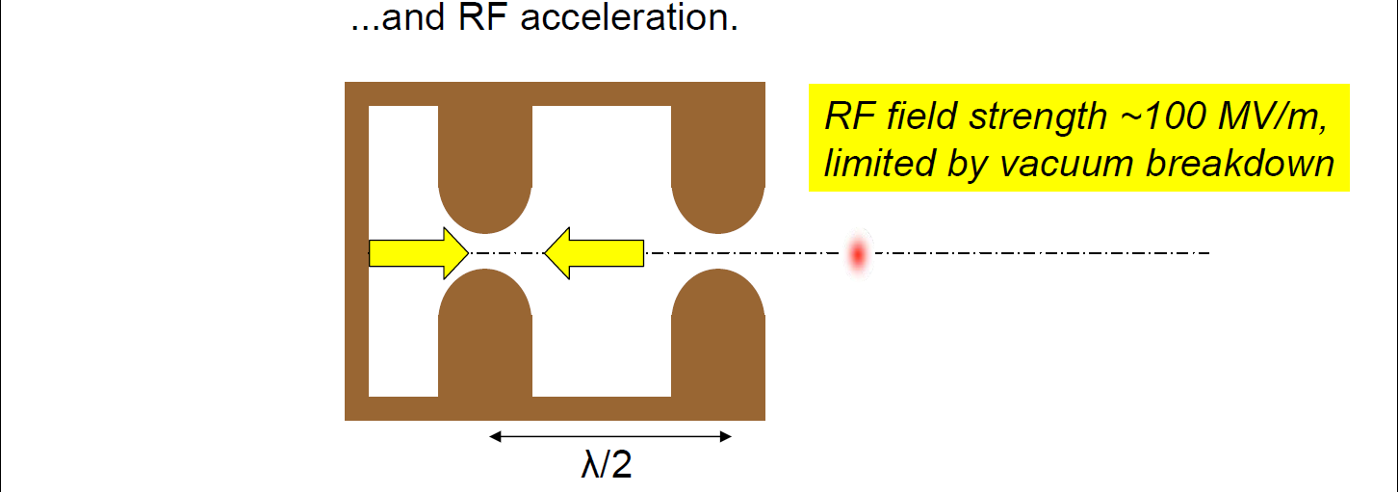
Principle of a RF Photo-gun
Courtesy Jom Luiten, TUV Eindhoven

Slide 48
Quizz
Which laser would give the best quantum efficiency on a Copper-based photo-cathode (W=5 eV)
  A 5GW CO2 laser (wavelength=10 micrometers)
  A 10 kW frequency doubled Nd:YAG laser (wavelength=532nm)
  A 3MW frequency quadrupled Ti-Sapphire laser (wavelength=200nm)

Slide 49
Answer : (c)
QE is independent of the laser power:
it is the photon energy that matters.
Remember that
The shortest the wavelength, the highest the energy. At 200nm a photon carries ~6 eV, so a 400nm photon carries ~3eV.
Note: photons with a wavelength of 532nm (2.33eV) or 10 micrometer (~0.1eV) will have less energy than the work function of the photo-cathode (but escape by tunnel effect is theoretically possible).

Slide 50
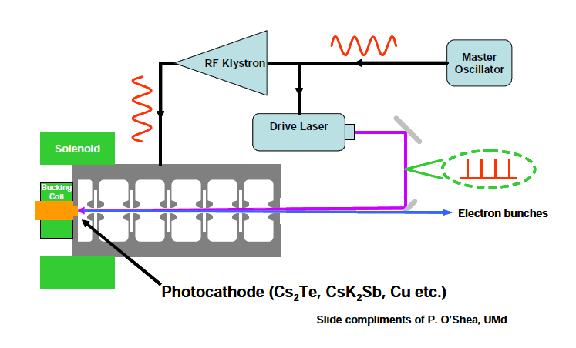
RF photocathode gun

Slide 51
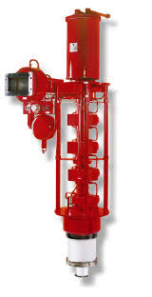
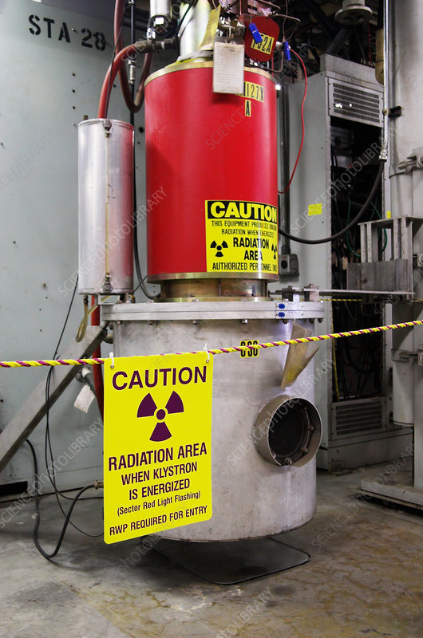
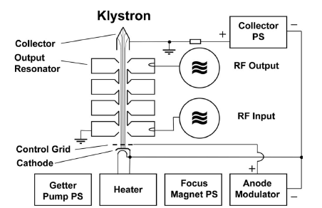
Power amplification: Klystron
A klystron amplifies a milliwatt RF signal to kilowatts or megawatts so that it can be used in RF accelerating cavities.

Slide 52
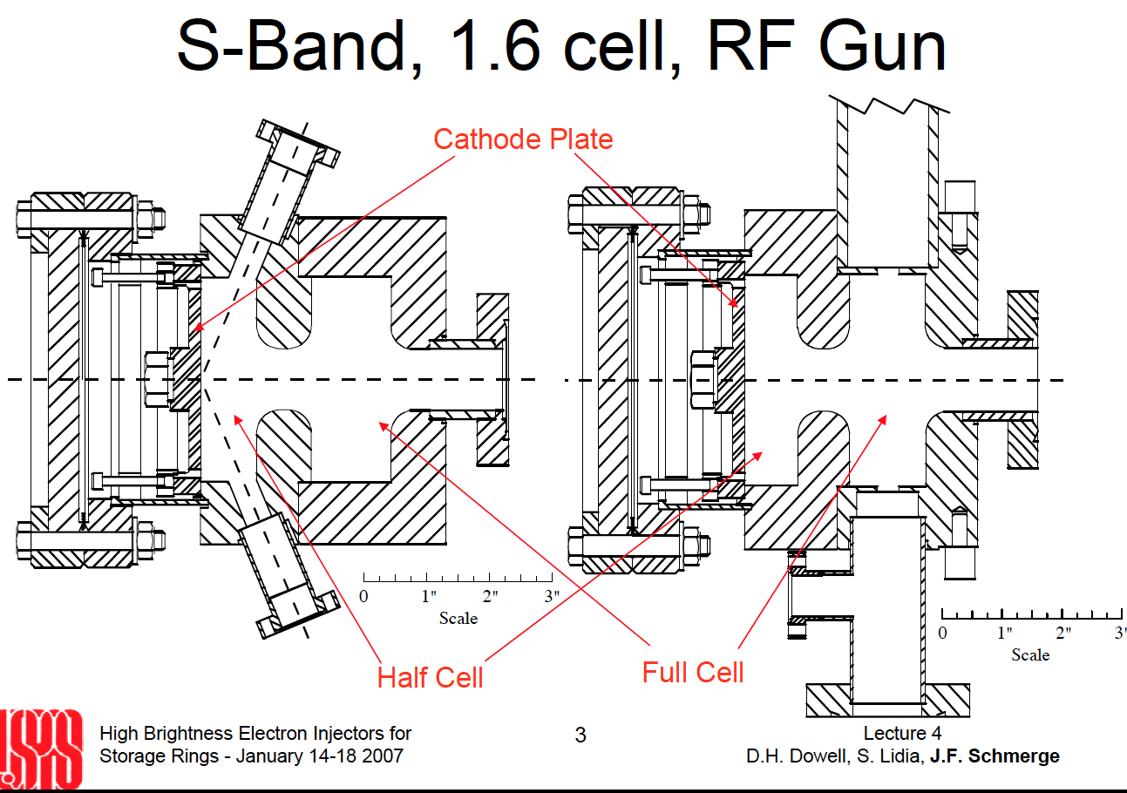

Slide 53
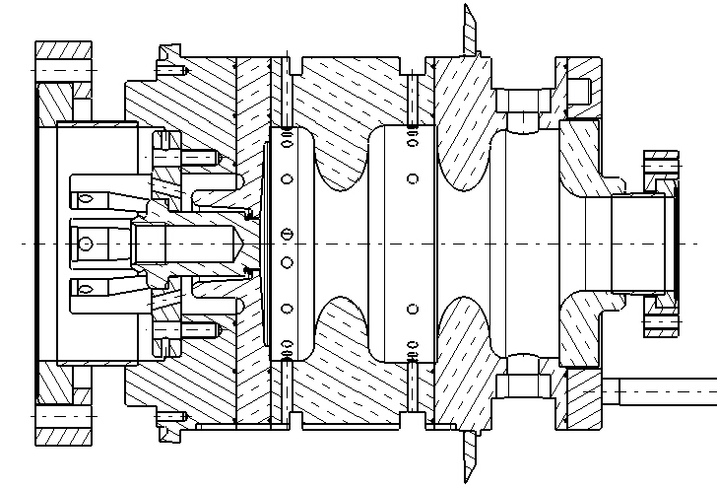
PHIN RF Gun

Slide 54
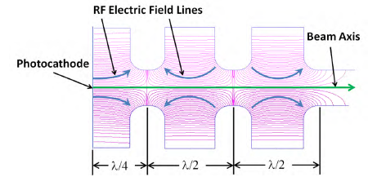
Field line simulations
(SUPERFISH)

Slide 55
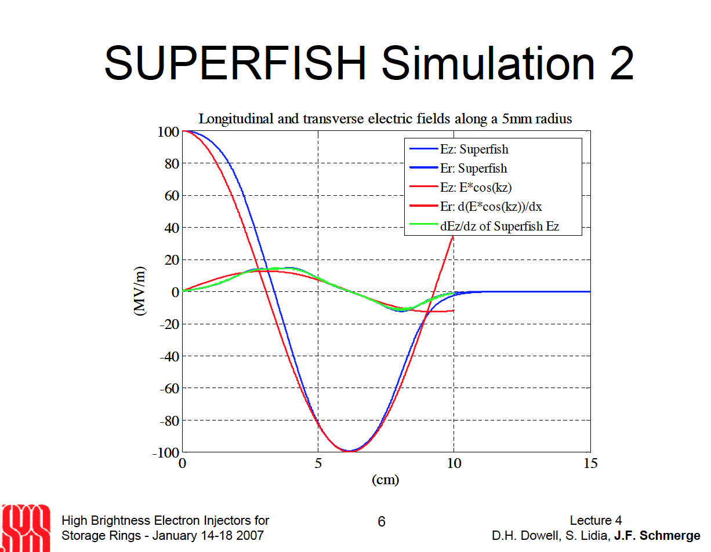

Slide 56
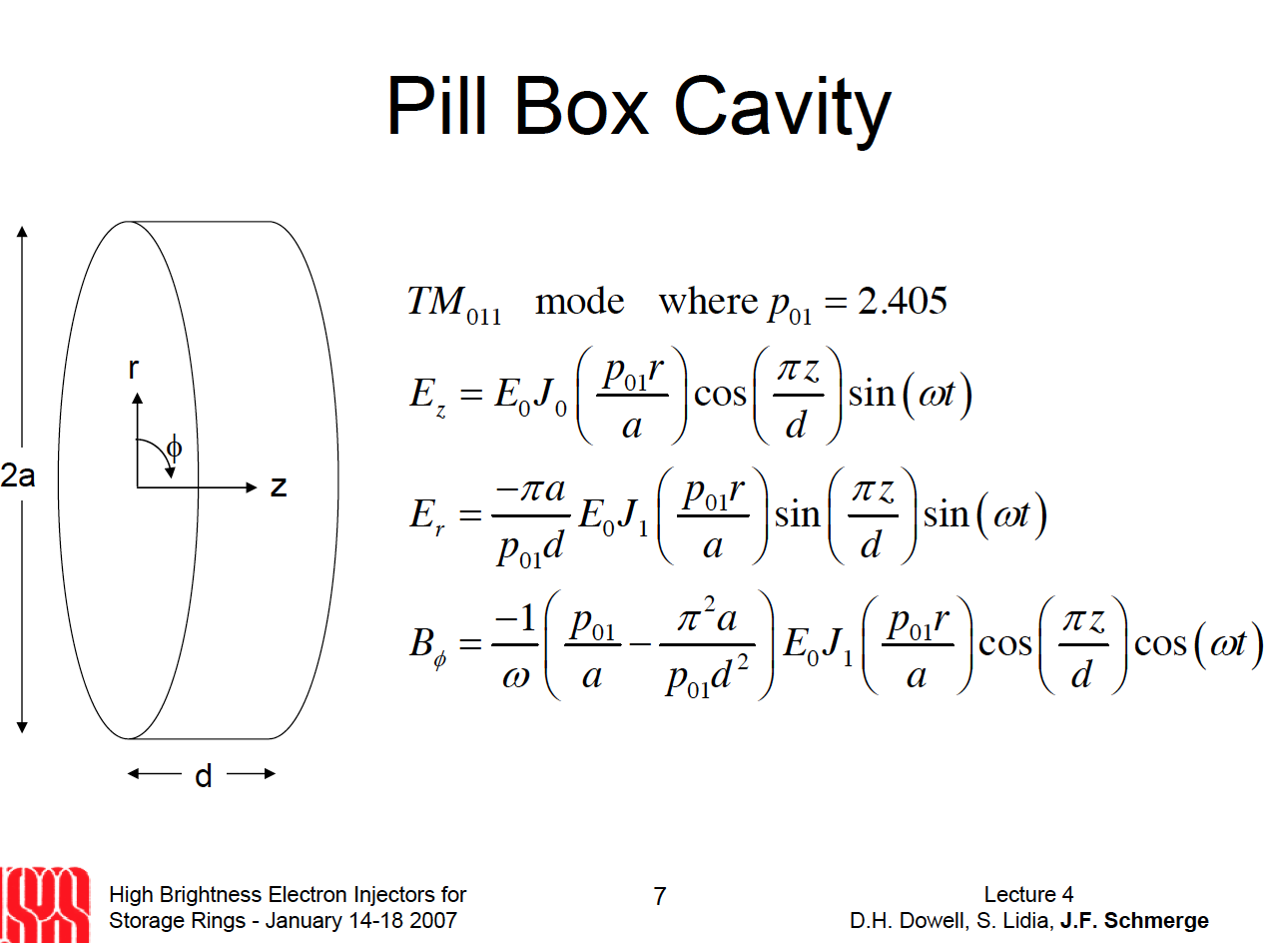

Slide 57
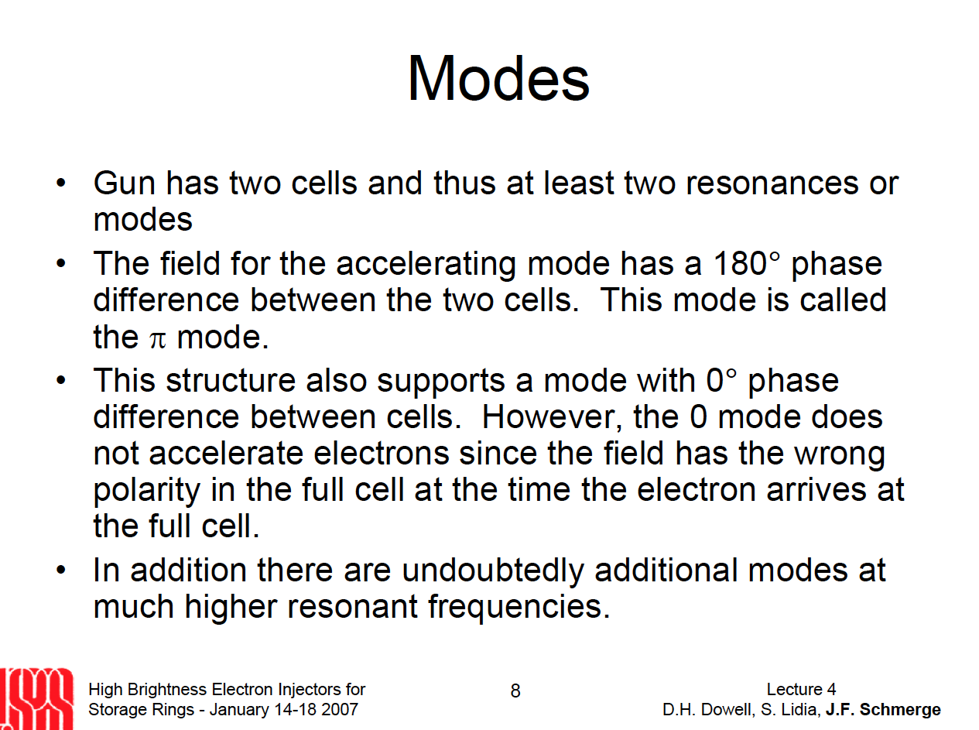

Slide 58
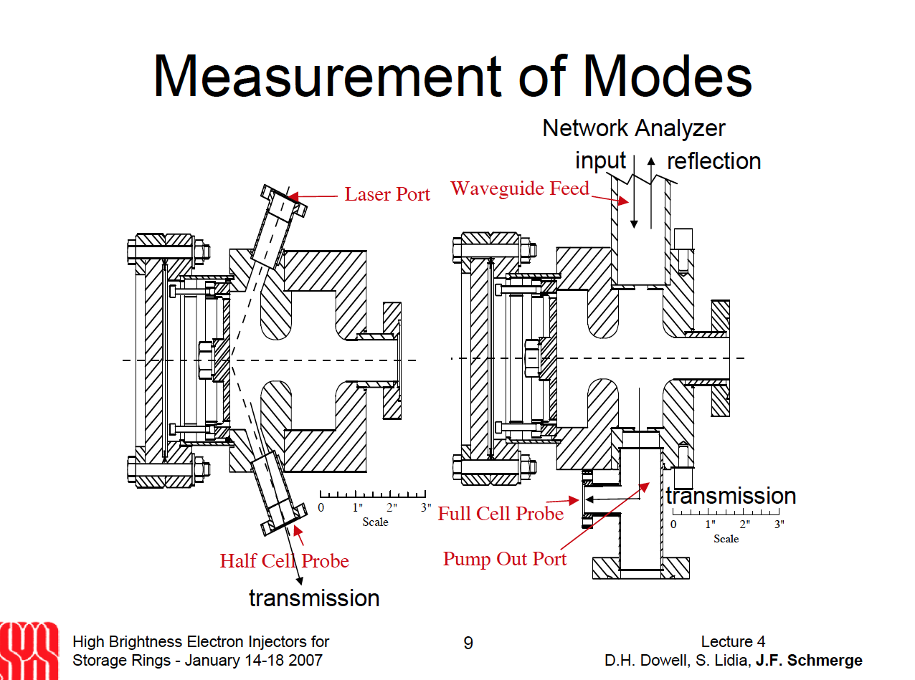

Slide 59
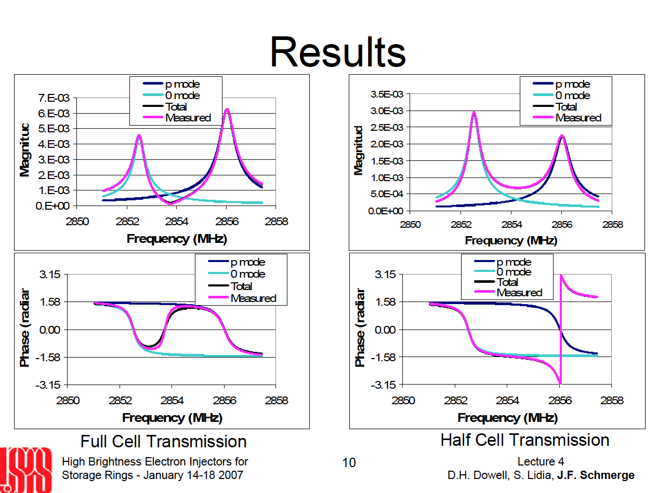

Slide 60
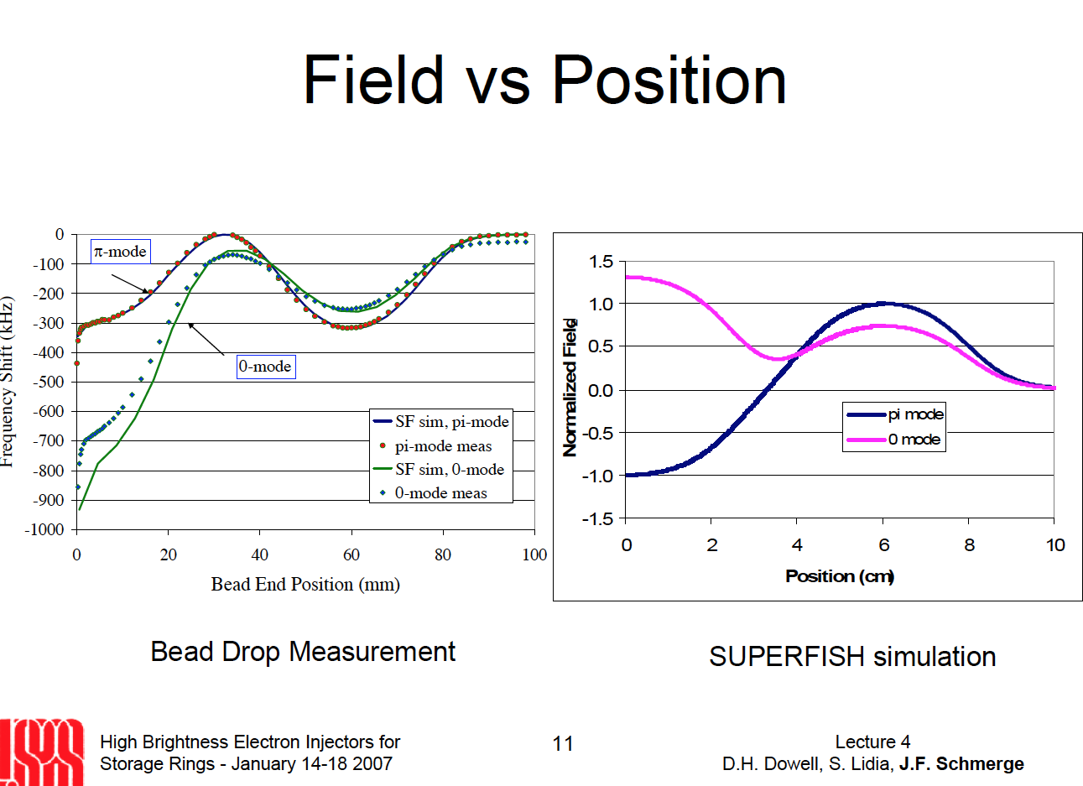

Slide 61
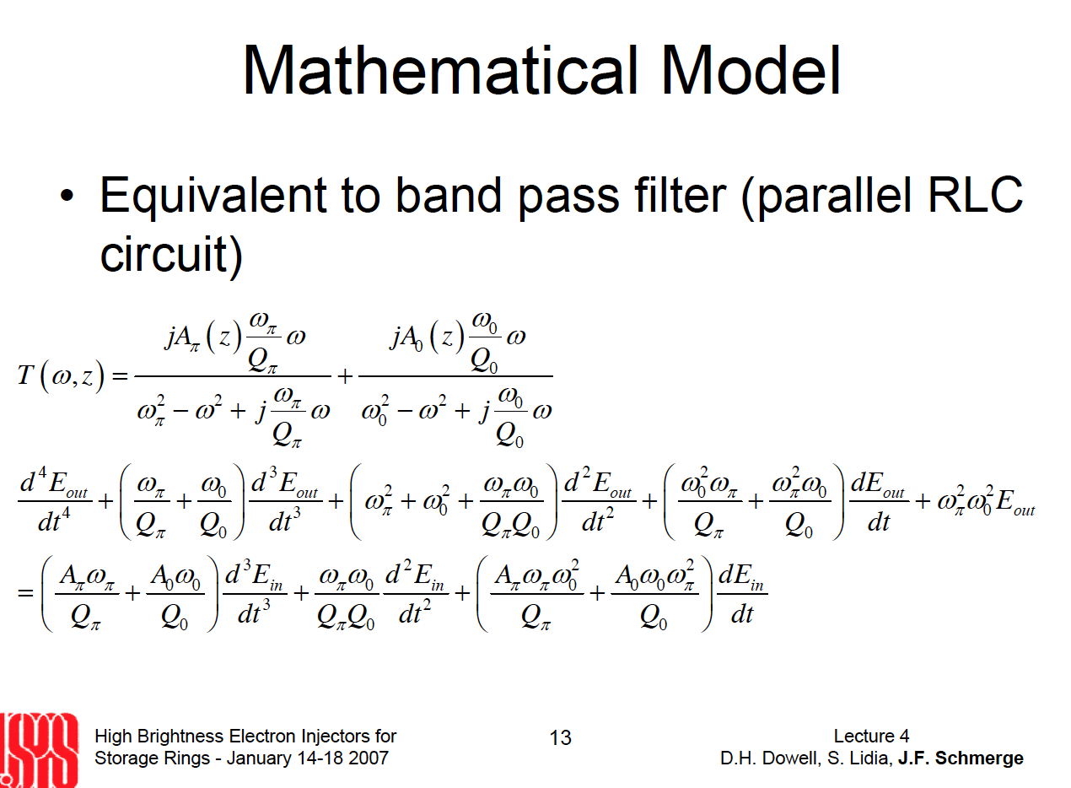

Slide 62
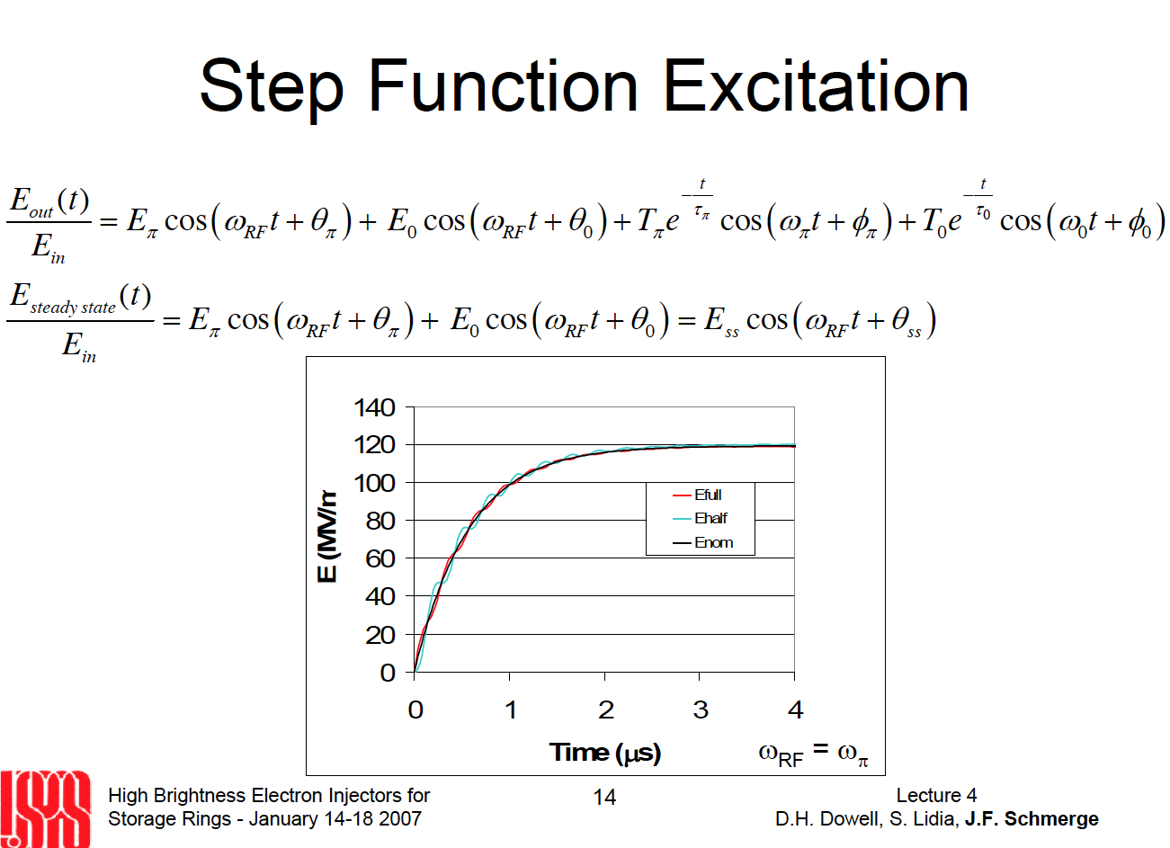

Slide 63
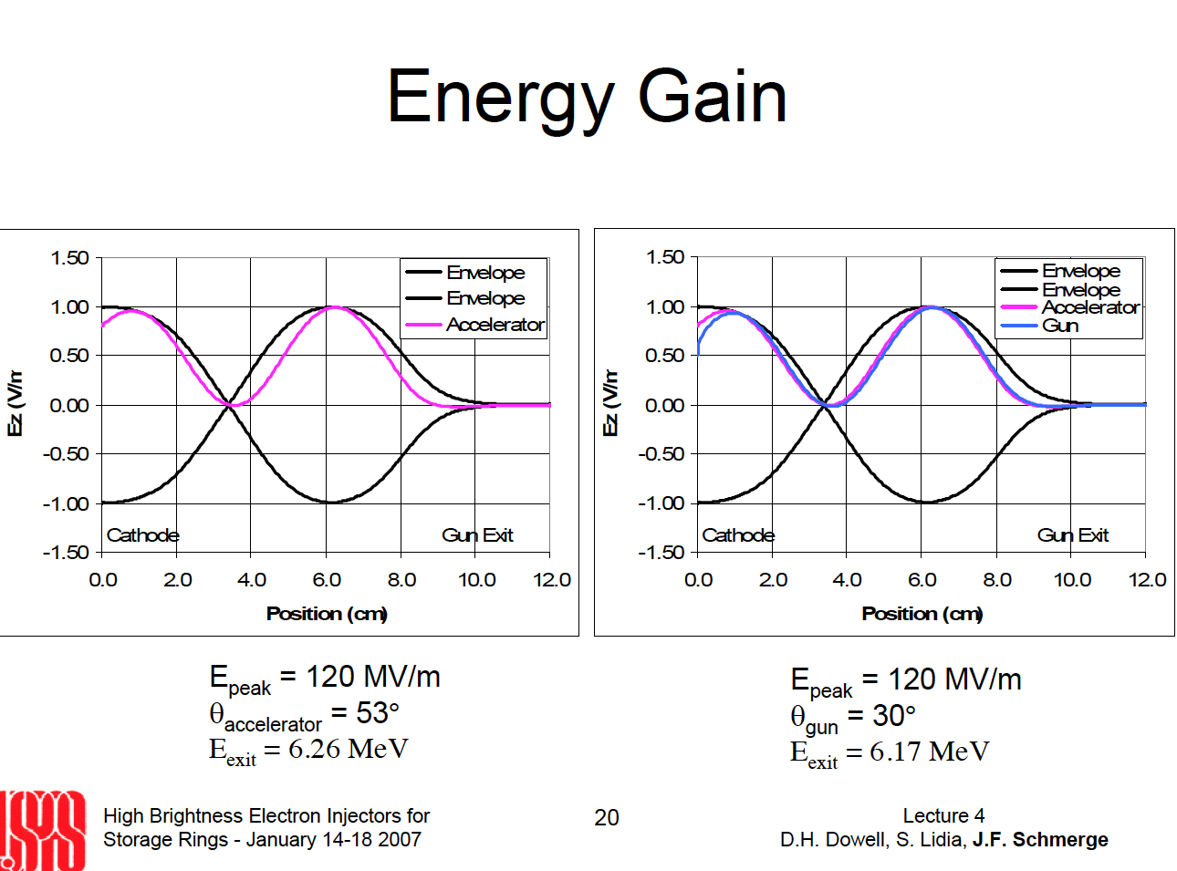

Slide 64
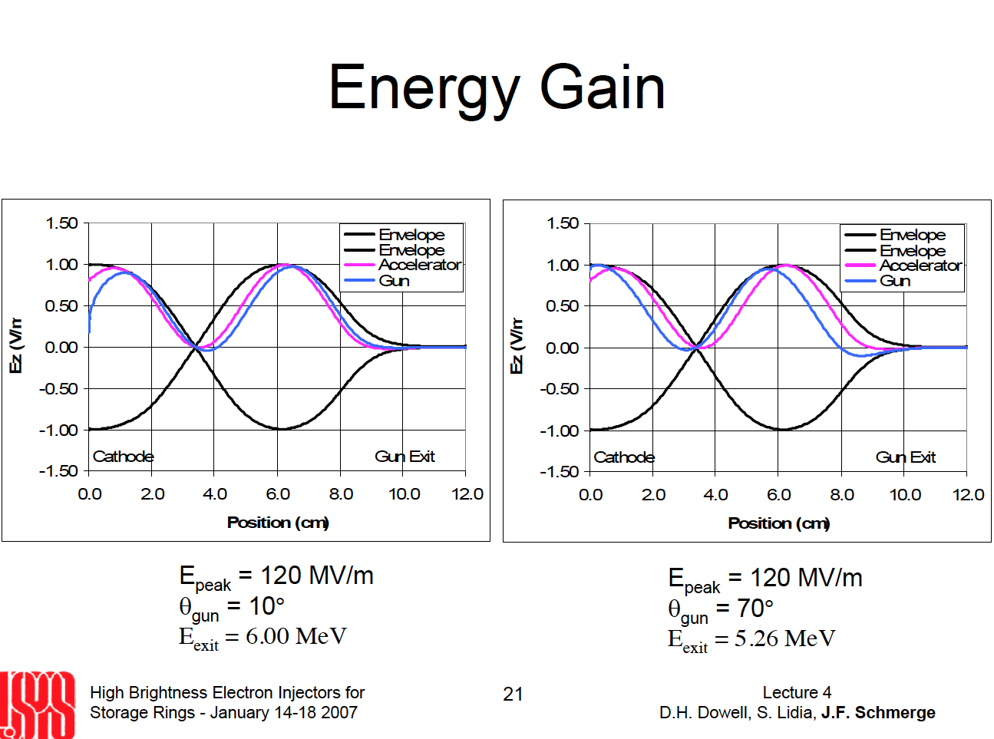

Slide 65
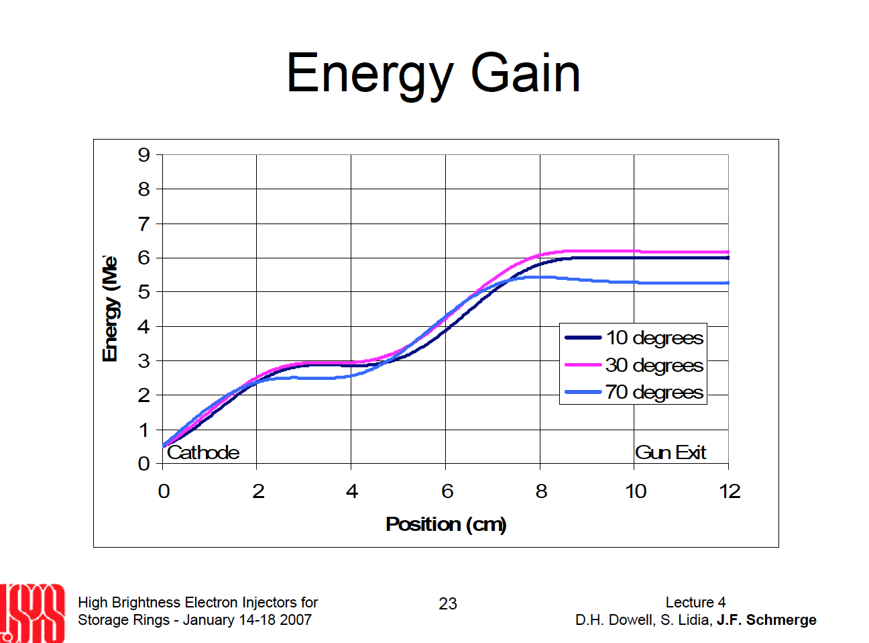

Slide 66


Slide 67


Slide 68


Slide 69


Cavity shape
The cavity shape has an impact on the peak field.
A higher peak field may lead to more breakdowns and limit the maximum acceleration gradient.

Slide 70

Higher order modes
In addition to the TM010 mode of the cavity, higher order mode may be excited.
These higher order mode can cause longitudinal and transverse instabilities.
Special filters are used to remove them.

Slide 71


Slide 72
Quizz
The RF gun built at LAL have a frequency of 2998MHz.
What is the length of a full cell?
(a) 5cm
(b) 50cm
(c) 5m

Slide 73
Answer (a)
One cell is half a wavelength.
At 3GHz one wavelength is about 10 cm.
(c/2998MHz)/2 ~5cm

Slide 74



Examples of quantum efficiencies:
SLAC-TN-05-080
Source: D.T. Palmer,
SLAC-tn-05-080

Slide 75


Quantum efficiency:
DESY XFEL (EPAC’04 MOPKF021)
Material Cs2Te (very high QE)

Slide 76

Source: USPAS 2008

Slide 77

Photocathode preparation and lifetime

Slide 78


Slide 79


Laser technology
Lasers can’t produce UV light (˜ 260nm; ˜5 eV) directly.
The most efficient lasers emit in the near infra-red. For example Ti:Saphire [Ti:Al₂O₃] (800nm;1.5eV) or Nd:YAG (1064nm;1.2eV).
Non linear crystals are then used to triple or quadruple the energy of the photons.
Such laser systems (and frequency conversion) are rather complex and need special skills to operate.
See your laser courses for more about this…

Slide 80


Slide 81


Slide 82


Slide 83


Dark current
Electrons can also be emitted at time when they are not wanted:
- when the grid is “closed” in a thermionic gun
- when there is no laser light in a photogun.
This is called “dark current”.
Dark current particles are often at the wrong phase and therefore at the wrong energy.
The dark current is a source noise and must be removed.
Source: http://journals.aps.org/prstab/abstract/10.1103/PhysRevSTAB.17.043401

Slide 84


Slide 85
RF gun vs Thermoionic injector
In a Thermoionic injector the electrons are bunched in several stages.
In the RF gun the electrons immediately reach the desired pulse length (down to ps).
=> Better compactness
=> Lower emittance
BUT: more complexity (laser, RF,…)

Slide 86
Summary: Gun design
The shape of the electrodes is important in all electron guns:
- it will minimize space-charge
- it will allow to increase the field without breakdowns
Cavity shape are important in RF guns to increase even further the accelerating field.

Slide 87
Beam dynamics in the GUN

Slide 88


Beam dynamics:
Space-charge effect
Let's consider two particles with similar charges travelling in the same direction.
Due to their charge these particles will push each other away (Coulomb's law).
What is the intensity of the force with
which they repel each other?
What is the effect of a full bunch?

Slide 89
Coulomb force between two electrons
Assume d=1micrometre.
f=2 10⁻¹⁶N
This may look small but an electron is not very heavy
f/m=2.5 10¹⁴N/kg
This force is very intense on the scale of the electrons.
Typical charge in a bunch: ~100pC = 6 10⁸ electrons

Slide 90

Avoiding space-charge effects
If there is a second force that cancels the effect of the space-charge the particle will not be deviated.
Let's see how the shape of this electrode is defined...

Slide 91
Electrostatic potential in the beam
Assume steady state
Particle conservation as they propagate
=> Current constant across gap
Electrostatic potential is 0 at source hence, particles are accelerated in the gap.
Hence, by substitution
And thus
(see also Humphries, CPB, sec 5.2)

Slide 92

Electrode design
Electrostatic potential in the beam:
Laplace equation:
Trial function:
Hence the potential
Hence for the source electrode:
And for the extraction electrode:

Slide 93

... and then?
After the anode space charge effects are still present.
It is not possible to use an electrostatic solution anymore.
The compensating field must have a circular symmetry...
This is not easy to achieve!

Slide 94

Compensating solenoid (1)
The solution is to use a compensating solenoid.
Inside the solenoid the field is so that the angular momentum of the particles couples with the field.
BUT at the edge of the solenoid the particles decouple from the field and receive a transverse kick (Busch theorem).

Slide 95

Busch theorem
Canonical angular momentum must be conserved.
In a solenoid charged particles couple their transverse momentum to the field.
At the edge of the solenoid the field suddenly decreases.
To conserve the correct coupling the particles will be deflected toward more intense field (ie the middle of the solenoid)
This will induce a focussing effect.

Slide 96

Compensating solenoid (2)
To achieve the best compensation effect, several small solenoids are much better than a big one (as this maximizes the edge effect).
This can be seen on this picture of the Diamond gun.
Once high energies are reached the particles travel fast enough so that the space charge do not need to be compensated any more.

Slide 97

Quiz
On this image of the CLIC injector the electrons travel from the left to the right.
In which direction does the current flow in the solenoid to compensate the space-charge effect?
a) Clockwise
b) Counter clockwise
c) It does not matter

Slide 98

Answer: a
Busch theorem:
To get a negative transverse kick the second term must be positive.
q is negative.
So the flux must be positive.
The electrons must travel in the direction of the flux.
The current must circulate in a clockwise direction.

Slide 99



Space-charge limitation
(images source:Masao Kuriki, ILC school)‏
Emitted electrons shield the cathode from the anode
=> reduced field
This limits the intensity of the emission.
Child-Landmuir law (potential Vd, area S, distance d)
[This is more complex when the field is not constant]

Slide 100


Space charge limited emission
In the case of a photo-injector the space charge with limit the intensity that can be extracted from the cathode.
The charge extracted from the cathode will also depend on the shape of the laser pulse.

Slide 101

BSA= Laser beam diameter

Slide 102
Quizz:
Why the relation between laser energy and charge is not linear?
(a) Because of space-charge.
(b) Higher laser energy will induce more heating in the cathode and reduce the QE.
(c) There is a trade off between laser energy and RF power.

Slide 103
Answer (a)
Why the relation between laser energy and charge is not linear?
(a) Because of space-charge.
(b) Higher laser energy will induce more heating in the cathode and reduce the QE.
(c) There is a trade off between laser energy and RF power.

Slide 104


Slide 105
Quick introduction to emittance
Remember the perfect gas law: PV=nRT
This is a statistical law that is also valid for particle bunch.
V is the volume term (x*y*z)
P is the pressure term, it corresponds to the kinetic energy of the particles in each plane (x’*y’*z’).
n and R are proportionality terms (R is unit dependent and could be 1 with the correct choice of units).
T is called the temperature for gas…
For a particle beam it is called “emittance”.
You can split the emittance into longitudinal emittance (along z or s) and transverse emittance (along x and y).

Slide 106

Space charge and emittance
Space charge will lead to an increased emittance => lower beam quality.

Slide 107

Emittance compensation
By calculating how the different slices of the beam will propagate in the gun on can minimise the emittance at the exit of the gun.

Slide 108


Transverse dynamics in the gun
The emission from the cathode lasts a finite time.
During that time the RF phase varies.
Hence the head and the tail of the bunch will experience slightly different acceleration.

Slide 109
Longitudinal dynamics in the gun: velocity bunching
After the cathode the electrons are not yet relativistic.
Electrons with more energy will go faster.
Depending on the phase at which the particles will be produced, the bunch at the exit of the gun can be longer, shorter or have the same length than the initial laser pulse.

Slide 110
Summary for beam dynamics
The electrons emitted by the gun interact with each other.
This must be taken into account when trying to optimise the gun.
Space-charge is one of the dominating effect, but the different phases at which the particles are generated must also be taken into account.
All these effects, once understood, can be simulated and, sometimes, mitigated.

Slide 111

Gun conditionning
The gun must be conditionned to accept the full RF power.
During conditionning small impurities and surface defect are burnt out.

Slide 112

History

Slide 113


Slide 114

Examples and classification of injectors

Slide 115

PHIL: Photo injector at LAL:
Overall layout

Slide 116


PHIL: Photo injector at LAL:
The accelerator

Slide 117
PHIL: Photo injector at LAL:
The Gun

Slide 118
Quizz
What do you need to build a photoinjector?
List the main components…

Slide 119

To build a photo injector you need:

Slide 120
Summary
3 effects can be used (or combined) to produce electrons: thermionic, schottky and photoelectric.
Careful design is necessary to reach high electric field.
To reach the best beam for the application one also need to take into account the dynamic of the particles in the gun (and after).
There is a large variety of electron gun (current, emittance, rep. rate,… ) suited to different applications.

Slide 121
Recommended readings
(and credits for some of the material used in this lecture)
USPAS course on particle sources D.H.Dowell et al.
USPAS Course on High Brightness electron injectors, 2007
An Engineering guide to Photoinjectors, T. Rao and D.H.Dowell

Slide 122


Slide 123


Slide 124


Slide 125


Slide 126


Slide 127


Slide 128


Slide 129


Slide 130


Slide 131


Slide 132


Slide 133


