Slide 1
Particle sources:
Ion sources
Nicolas Delerue
IJCLab (CNRS and Université de Paris-Sud)

Slide 2
This lecture
Ions can be extracted rather easily from gas.
We will see how to create the necessary conditions for this and how to actually do it.
We will see that depending on the type of ions different strategies have to be used.
We will then look at the diversity of ion sources that exists.

Slide 3
Content
Reminder on atomic physics
Reminder on plasma physics
Types of ions sources
Applications

Slide 4
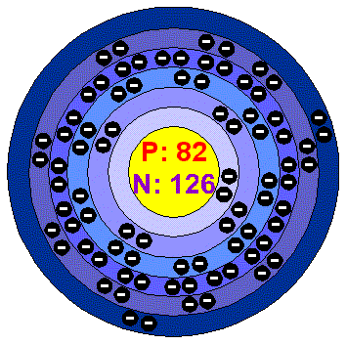
Reminder: atomic physics
An atom is made of a nucleus with a cloud of electrons around.
Atomic physics studies the dynamic of the electrons in this cloud.
For us, one of the most important question will be: how to remove (or add) the right numbers of electrons to an atom as efficiently as possible.

Slide 5
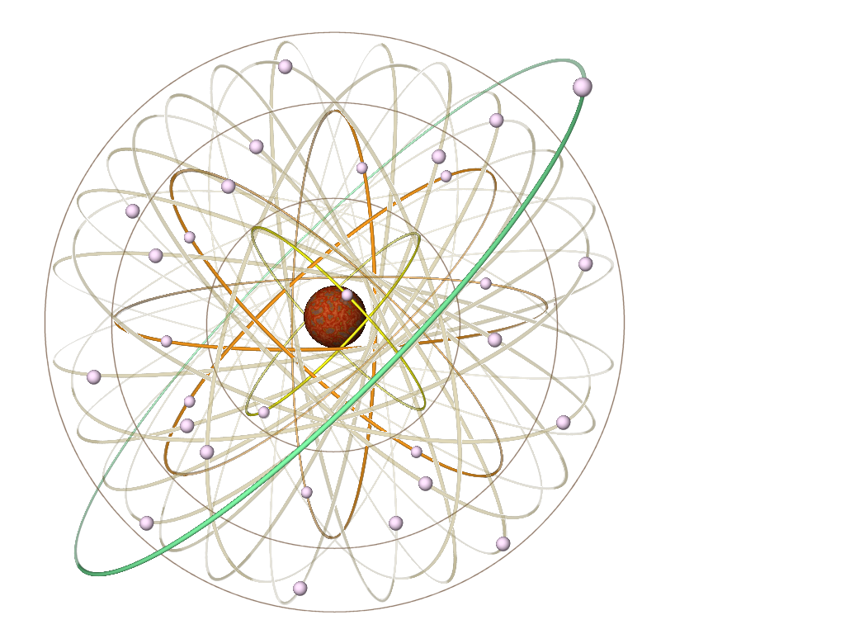
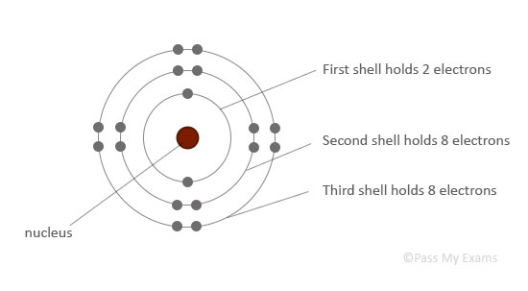
Electrons in atoms
Electrons around a nucleus occupy different energy levels.
The occupancy of each level is limited Pauli’s exclusion principle combined with the degrees of freedom for each level (spin, spin-orbit,…).

Slide 6
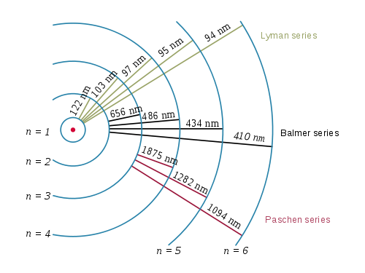
Electron quantum numbers: energy level (n)
To satisfy Pauli’s exclusion principle, there can not be two electrons around the atom with the same quantum numbers.
The first of these quantum number is the energy level of the electron. It is written “n”.
It is this quantum level that will normally define the energy of the electrons.
The energy difference between two levels will define the absorption (or emission) lines of an atom.

Slide 7
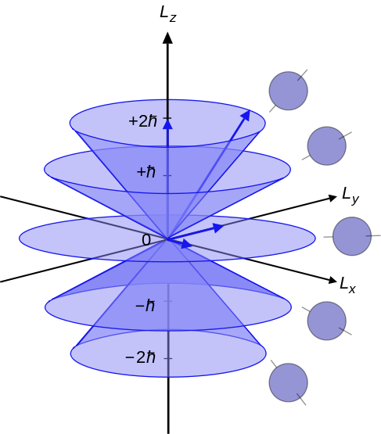
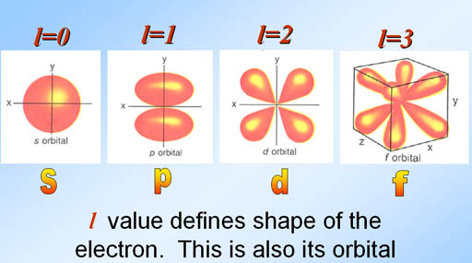
Electron quantum numbers:
Azimuthal quantum number (l)
The azimuthal quantum number describes the shape of the orbital.
l=0, 1,…,n-1

Slide 8
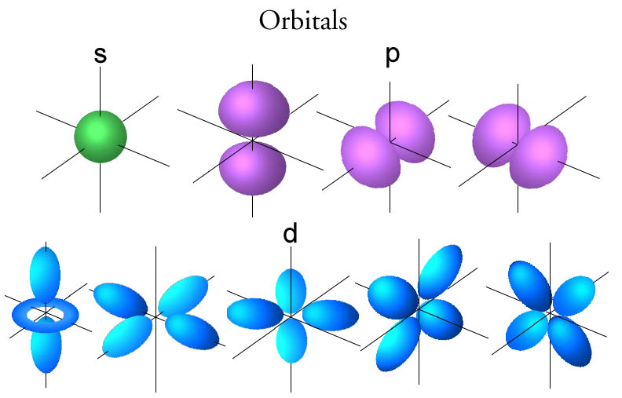
Electron quantum numbers:
Magnetic quantum number (ml)
The magnetic quantum number define on which orbital the electron is (one could say on the “direction” of the orbital).

Slide 9
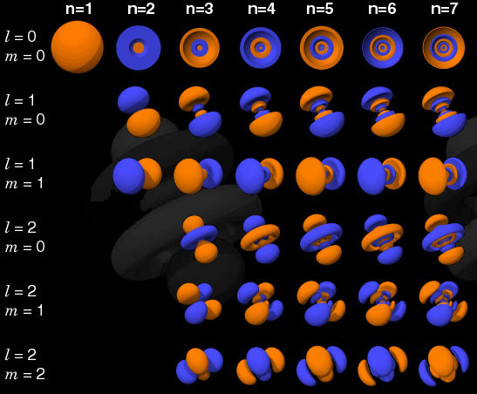
Electron orbitals

Slide 10
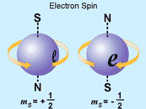
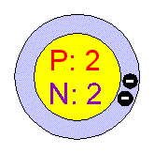
Electron quantum numbers: spin projection (ms)
Electrons can have two different spins:
ms=+1/2 or ms=-1/2
For each energy levels there will therefore be at least space for two electrons.

Slide 11
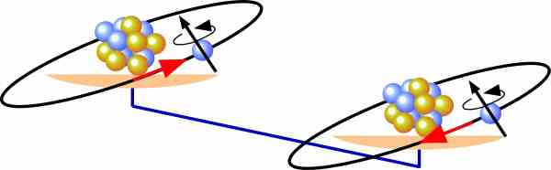
Electron quantum numbers:
Spin-orbit coupling
The combination of the spin and energy level of the electron in an electromagnetic interaction is called “spin-orbit coupling”.
It leads to a splitting of the spectral lines.
The L and S operators no longer commute with the Hamiltonian
=> other set of quantum numbers.

Slide 12
Electron quantum numbers:
Angular momenta numbers
Total angular momentum (j):
Angular momentum projection (mj):
Parity (P):

Slide 13
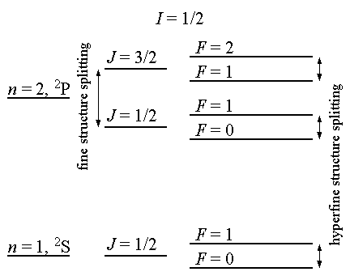
Electron terms
The following notation can be used:
S: total spin quantum number
J: total angular momentum quantum number
L: orbital quantum number (often replaced by a letter:
L=0 => S
L=1 => P
L=2 => D
L=3 => F
…

Slide 14
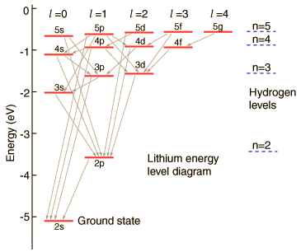
Energy levels: detailed structure

Slide 15
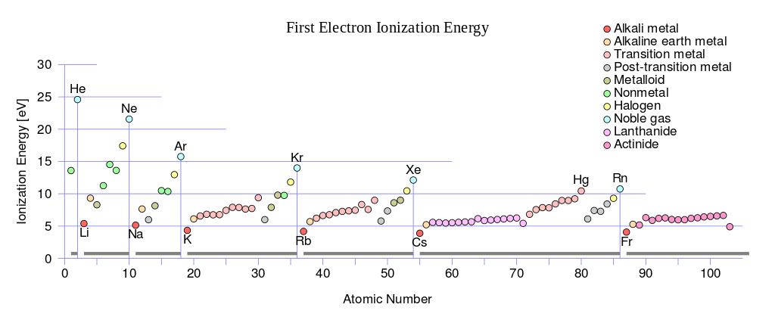
First ionization energy
The first ionization energy is about 5-25 eV.

Slide 16
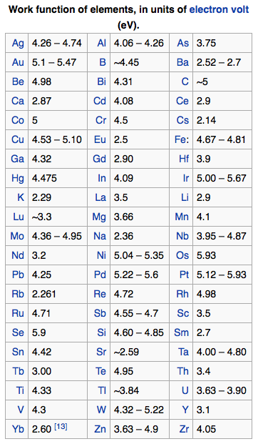
Quizz
What is the difference between the “First ionization energy” and the work function seen earlier today?

Slide 17
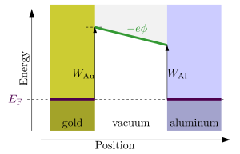
Answer
Work function is a solid state property whereas ionization is a property of gas.
However the values of both are close (about 5eV).

Slide 18
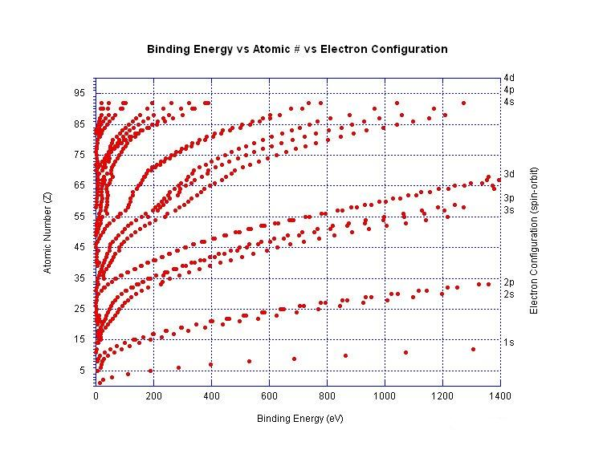
Electron binding energy
Note the difference 2p-2s

Slide 19
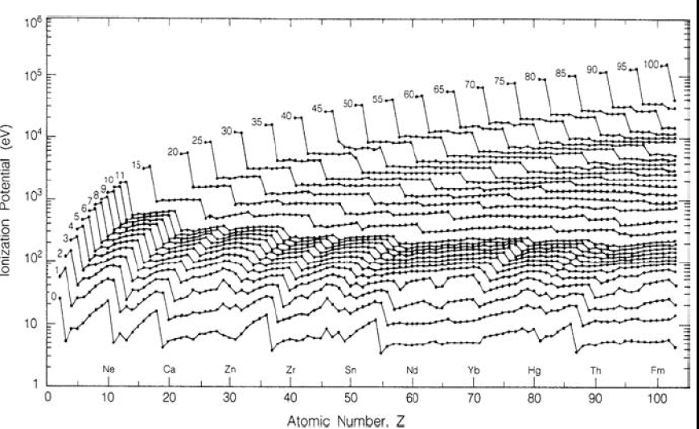
Multiply charged ions

Slide 20
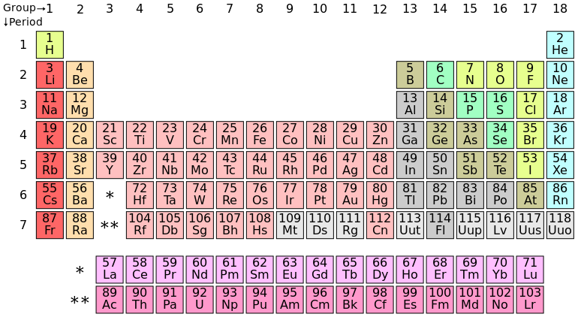
Quizz
In which column of the periodic table is it easier to ionize?
In which one is it harder?

Slide 21
Answer
In which column of the periodic table is it easier to ionize?
=> the first one.
In which one is it harder?
=> The last one

Slide 22
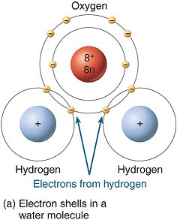
Valence
Only the electrons on the outer shell contribute to the chemical properties of the elements.
This is called valence.
The valence is the lower of the number of electron on the outer shell and the number of electrons needed to complete the shell.

Slide 23
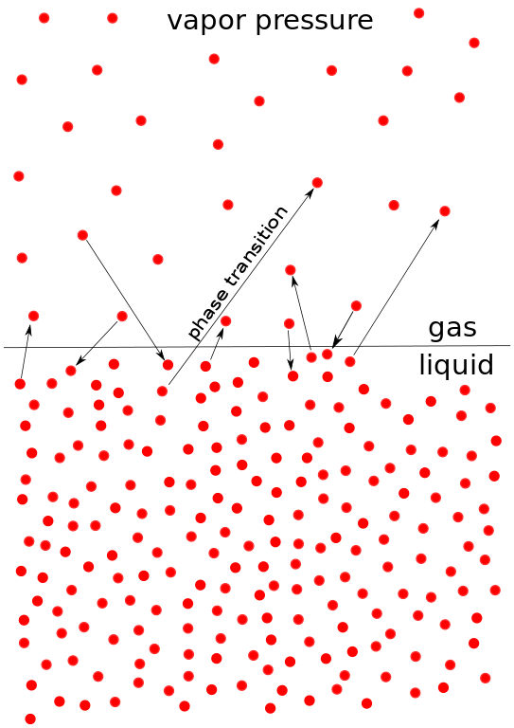
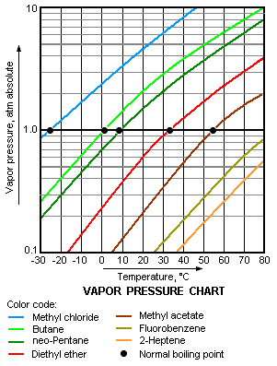
Vapour pressure
A small fraction of all elements is always in the gaseous (vapour) state.
There must be an equilibrium between the vapour state and the condensed states.

Slide 24
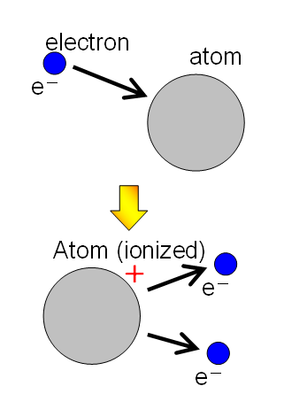
Atomic processes in ions sources: collision with electrons
Impact ionization/capture
Impact excitation
(continuous spectrum)
Note: high cross section!

Slide 25
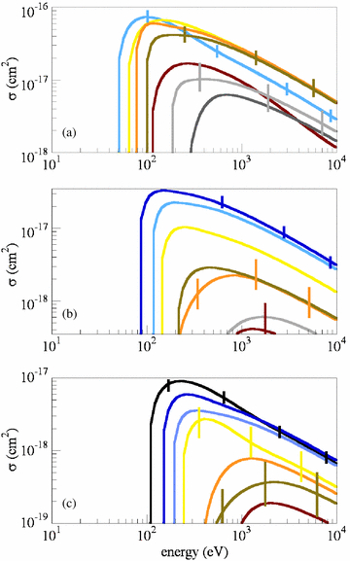
Collision with electrons
The energy threshold for ionization increase for higher ionization states.
Cross sections for (e, 2e) (a) and (e, 3e) (b) and (e, 4e) impact ionization (c) for Xe + (black), Xe + 2, (blue), Xe + 3 (light blue), Xe + 4 (yellow), Xe + 5 (orange), Xe + 6 (light brown), Xe + 7 (dark brown), Xe + 8 (light grey) and Xe + 9 (dark grey). Error bars for cross sections yielding Xe + 4, Xe + 7 and Xe + 9 are shown.
Source:
J. Phys. B: At. Mol. Opt. Phys. 38 No 10 (28 May 2005) L183-L190

Slide 26
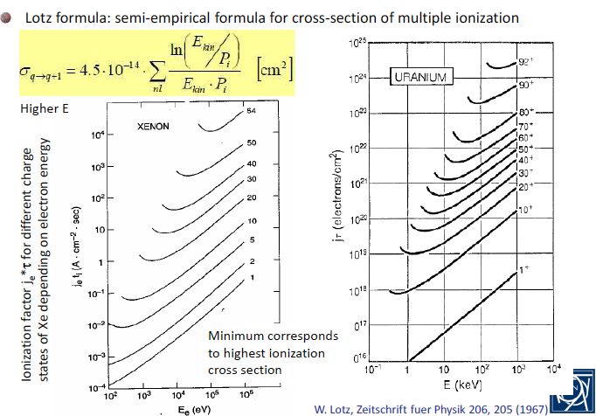
Lotz formula

Slide 27
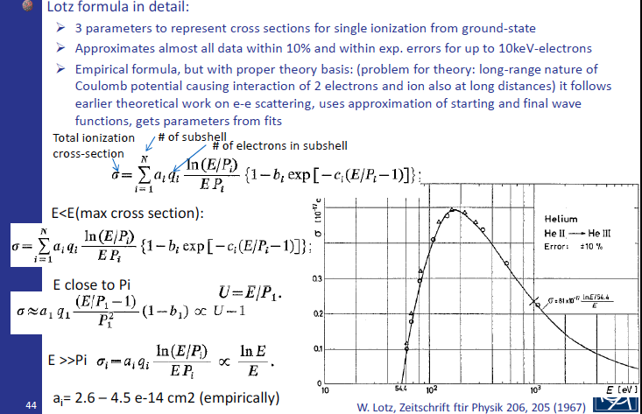
Lotz formula (2)

Slide 28
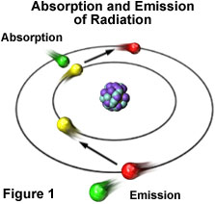
Atomic processes in ions sources: collision with photons
Photo-ionization/Radiative recombination
Excitation
Photo absorption/Bremstrahlung
Note: cross section lower by several orders of magnitude wrt ionization by collision.

Slide 29
Atomic processes in ions sources: charge exchange
In the charge exchange process two ions exchange an electrons:
For this process to take place the right conditions need to be meet.

Slide 30
Ion states equilibrium
All processes enter in competition!
To get the desired ions one needs to find the parameters that will favour that specie.

Slide 31
Quizz
In which of these cases will photo-ionization be selected over impact ionization?
(a) A very high current is needed
(b) To ionize rare gas elements
(c) A specific charge state has to be selected

Slide 32
Answer (c)
In which of these cases will photo-ionization be selected over collision ionization?
(a) A very high current is needed
=> Photo-ionization has a lower yield.
(b) To ionize rare gas elements
=> It will be more difficult to ionize such atoms with both methods.
(c) A specific charge state has to be selected
=> By choosing the wavelength one can be more selective.

Slide 33
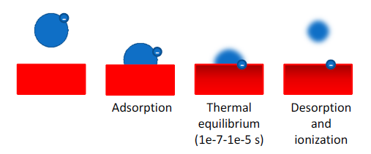
Surface ionization and desorption
If the vapor pressure is sufficiently low some atoms will escape from a solid => desorption.
In some cases the atoms escaping the metal will be charged ions (positively or negatively).
This process can also take place when ions are first adsorbed by the metal.

Slide 34
Saha-Langmuir equation (1)

Slide 35
Saha-Langmuir equation (2)
Notes:
- final charge state depends on equilibrium values.
- several ionisation states possible.
- importance of ionization energy.
- Favours group 1 elements (lower ionisation energy)
- Exists also in a form involving the work function.

Slide 36
Surface ionisation
Element | E_1 (eV) | n1/n0 (T=1000K) | n1/n0 (T=1500K) | n1/n0 (T=2000K)
Cs | 3.88 | 790 | 72 | 20
K | 4.32 | 6.3 | 2.2 | 1.6
Na | 5.12 | 5e-4 | 5e-3 | 1.6e-2
Li | 5.40 | 2e-5 | 6e-4 | 3e-3
Lower ionisation energy leads to more ionised emission.
Higher temperature may reduce ratio of charged ions to neutral atoms (but increase in total emission).

Slide 37
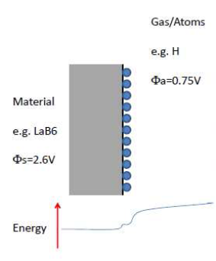
Surface negative ionization
Principle: deposit a layer of atoms with a high electron affinity.
The electrons will be transferred to the atom layer.
Force the emission of the atom layer which takes away part extra electrons at the same time.

Slide 38
Atomic physics summary
Atomic physics is a key element of understanding ion sources.
The atomic shell structure determines the energy required to remove (or add) electrons from (to) an atom.
Several methods of ionization exist (impact ionization, photo ionization, surface ionization…).
The choice depends on the specie to be ionised and the charge state expected.

Slide 39
Quizz
For an ion collider one has the choice between colliding ions A⁺ or A⁻ (A being an unspecified atom).
Based on the Saha-Langmuir equation which charge state (+1 or -1) would you recommend to use?

Slide 40
Answer
Electrons further away from the nucleus are always more loosely bound.
The A⁻ state will therefore be more difficult to produce and more difficult to transport.
It is better to use the A⁺ state (all other parameters being equal).

Slide 41
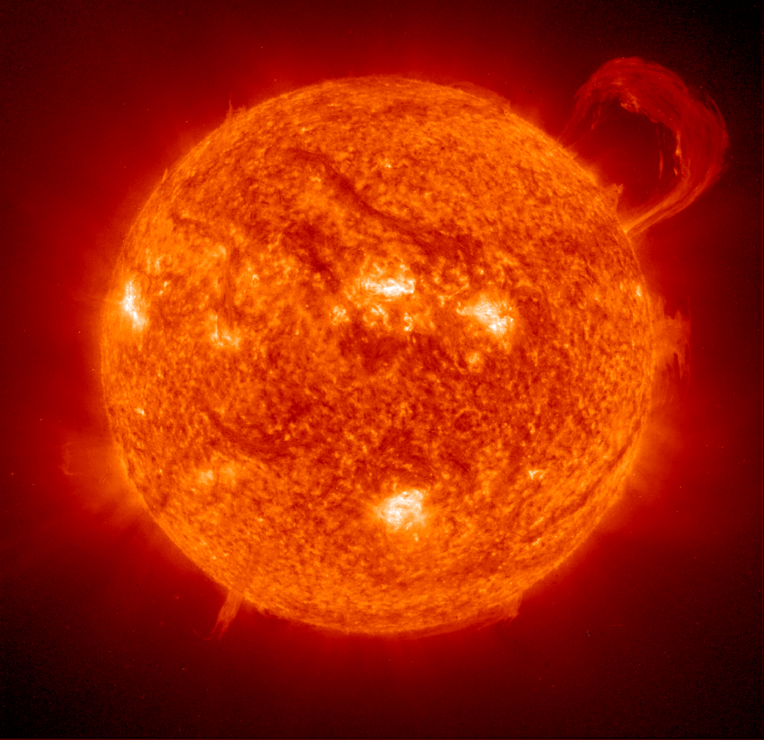
Reminder: plasma physics
In most cases ion sources will involve a “cold” plasma.
Understanding what happens in the plasma is therefore important.
A plasma is ionized matter. Eg: The SUN.

Slide 42
Cold vs hot plasma
A “hot” plasma is a plasma where almost all atoms are ionised.
In a “cold” plasma only a small fraction (~ 1%) of the atoms are ionised. The temperature of the electrons in a cold plasma can still be several thousand K.

Slide 43
Key elements of a plasma
3 constituents:
- charged ions (positively and negatively)
- electrons
- neutrals
Electric conductivity
Quasineutrality within bulk
Sensitivity to electromagnetic fields
Screening of electric field (sheath formation)
Collective phenomena (plasma waves,…)

Slide 44
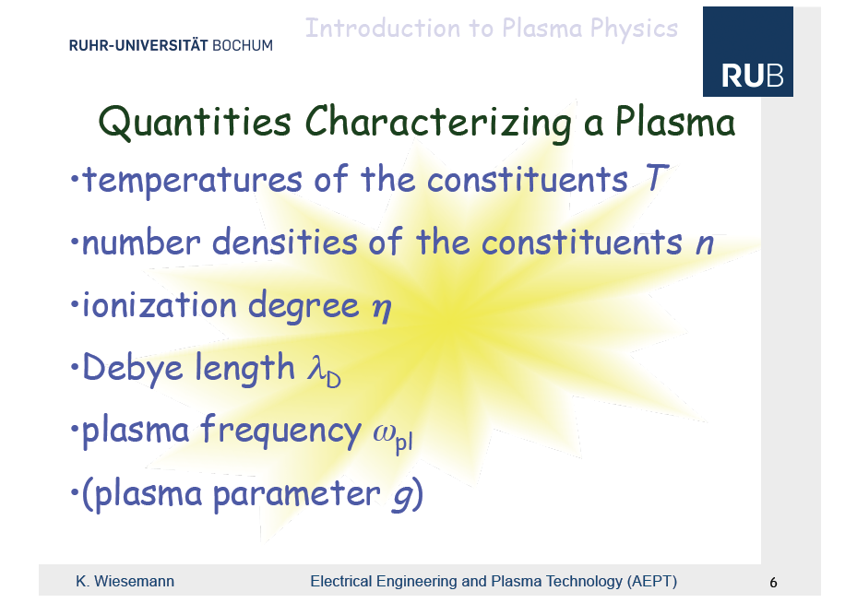

Slide 45
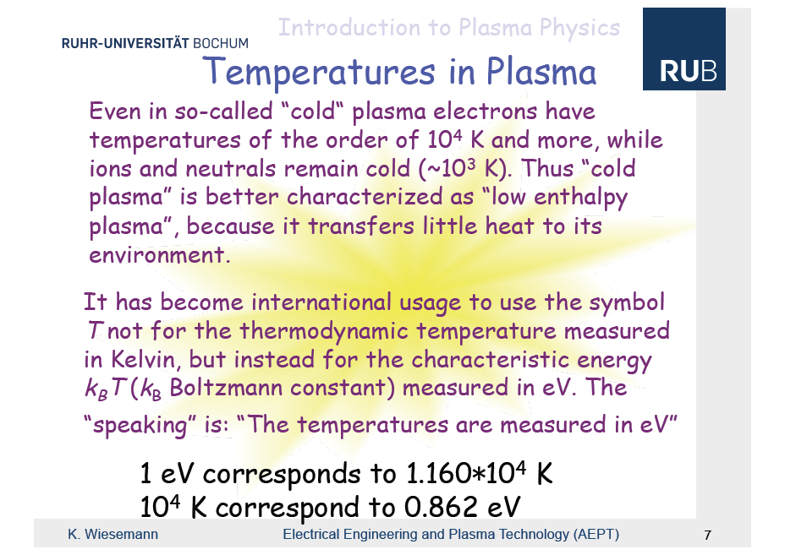

Slide 46
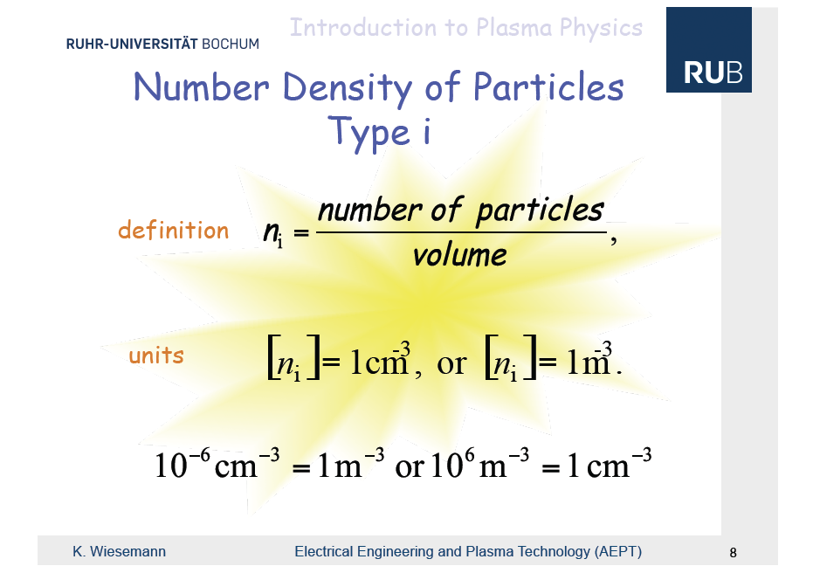

Slide 47
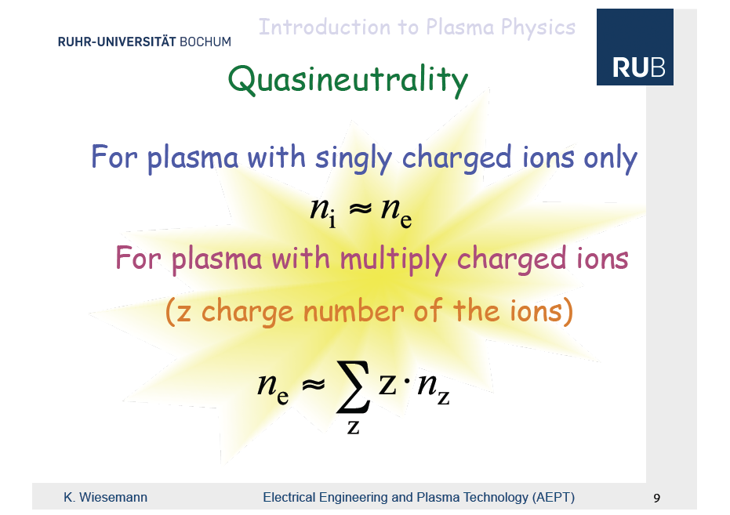

Slide 48
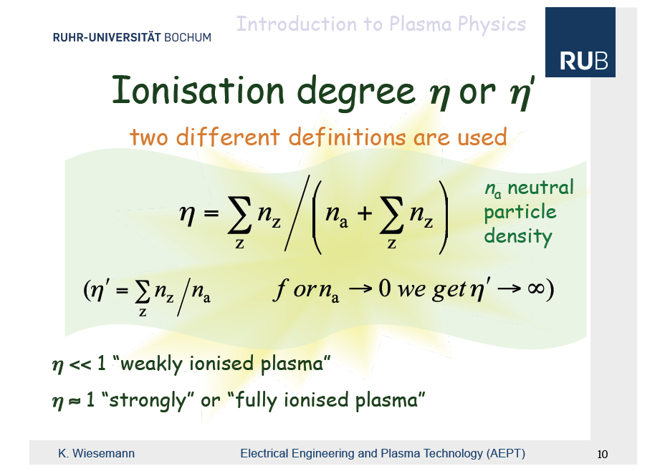

Slide 49
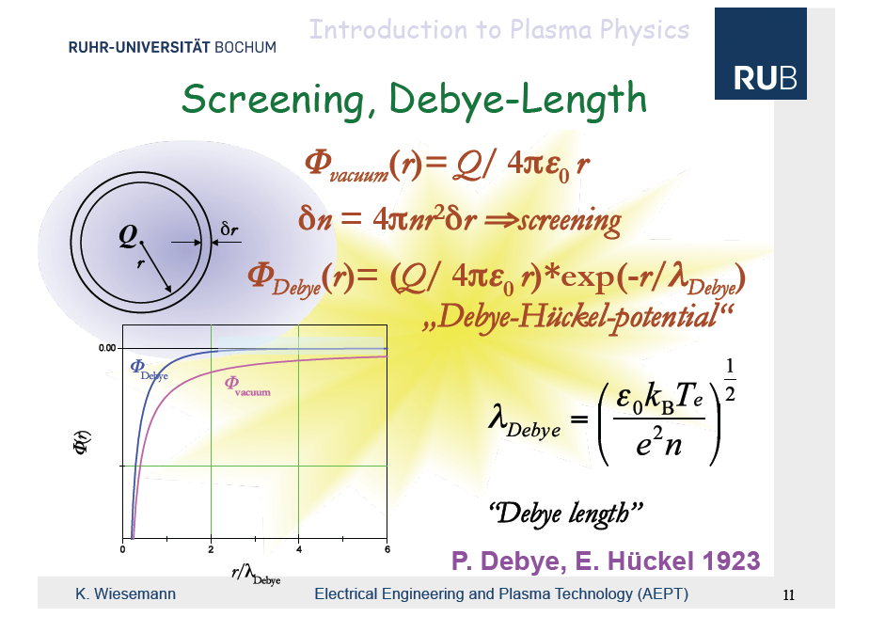

Slide 50
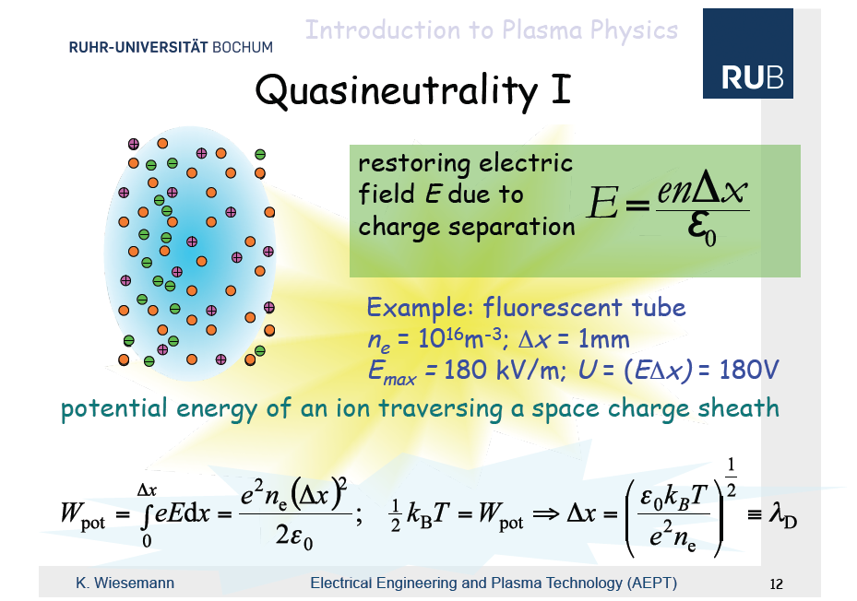

Slide 51
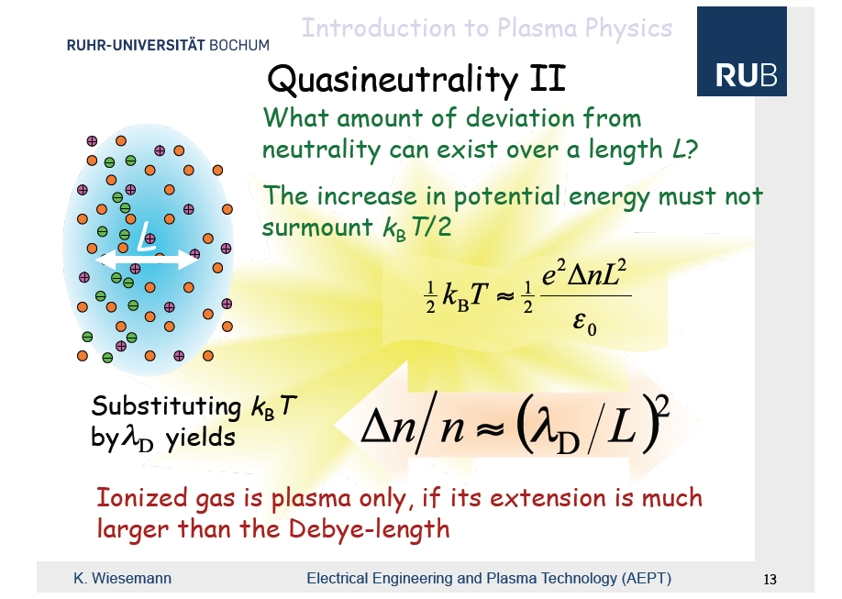

Slide 52
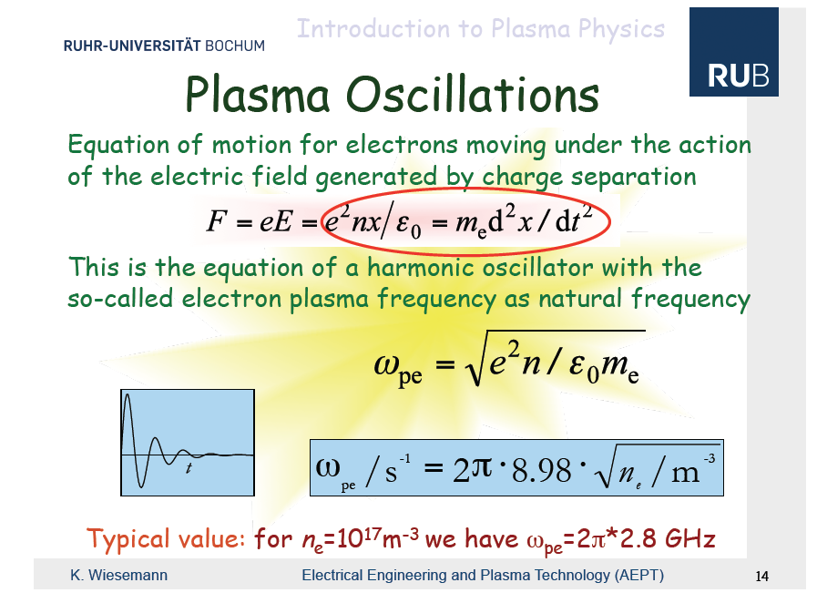

Slide 53
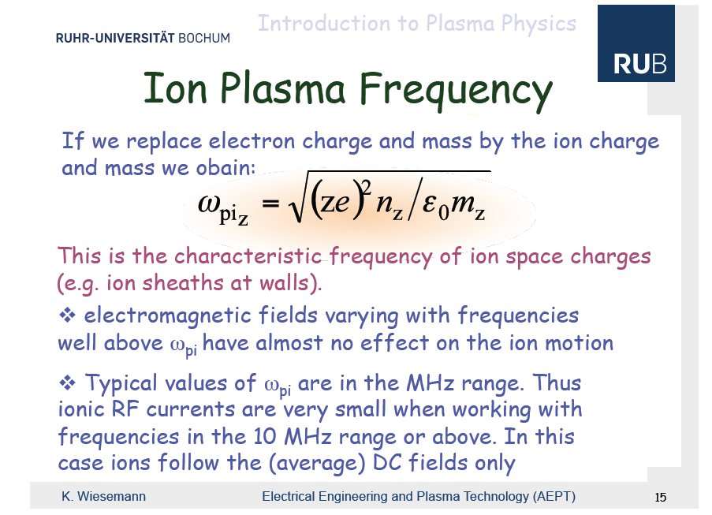

Slide 54
Quizz
Typical value of w_pe are in the GHz whereas w_pi is in the 10s of MHz.
What happens if I excite a plasma with an RF wave of 100 MHz?
The ions will be excited and not the electrons
The electrons will be excited and not the ions
(c) Both the ions and the electrons will be excited
(d) Neither the ions nor the electrons will be excited.
Do you see an application for this (based on what we discussed earlier today)?

Slide 55
Answer (b)
At 100 MHz the frequency is above w_pi
=> ions are not excited.
The frequency is below w_pe
=> electrons are excited.
The electrons will gain kinetic energy and not the ions.
=> There will be collisions and this will trigger impact ionization.
=> This phenomena is used in Electron Cyclotron Resonance (ECR) sources.

Slide 56
Electron distribution:
Druyvesteyn distribution
The electron distribution in a plasma does not follow Maxwell’s distribution.
It is better described by Druyvesteyn distribution.

Slide 57
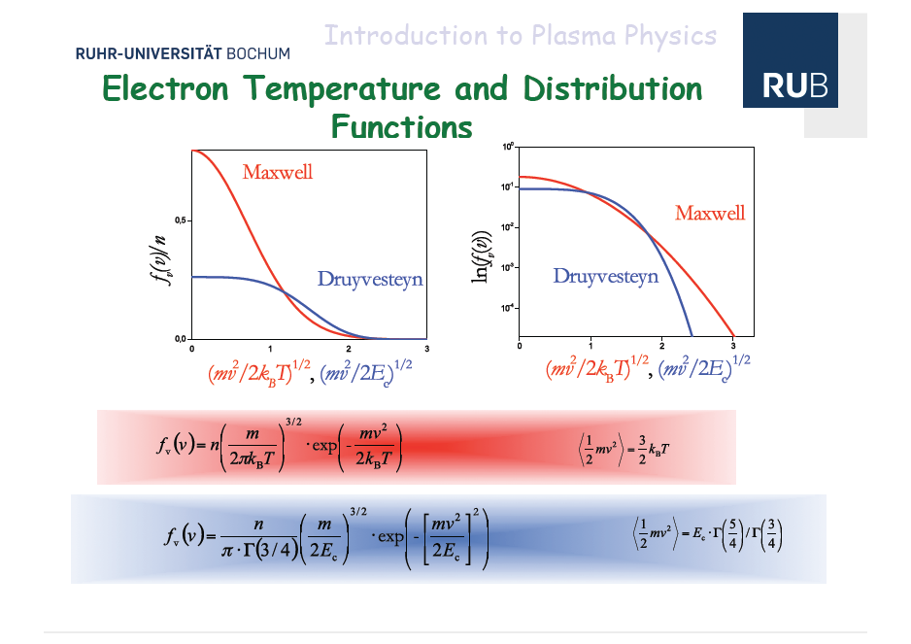

Slide 58
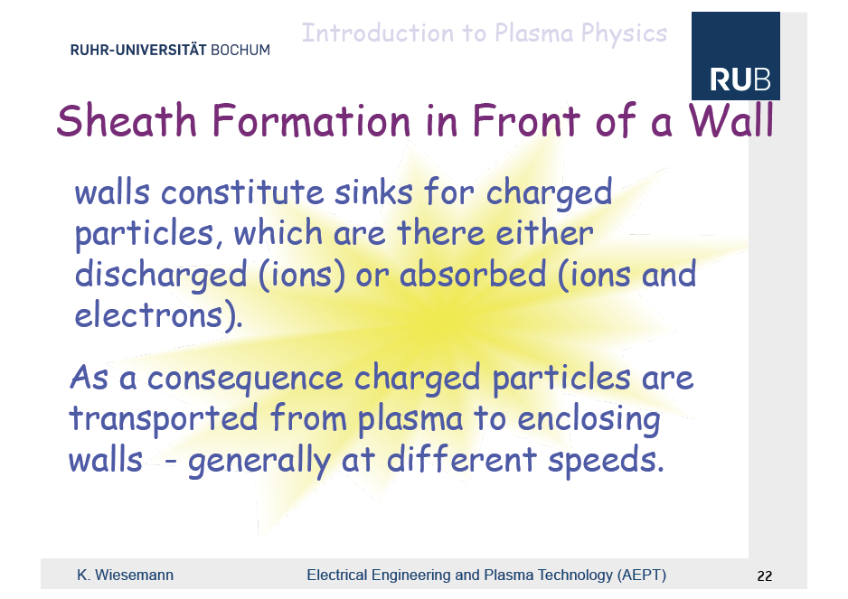

Slide 59
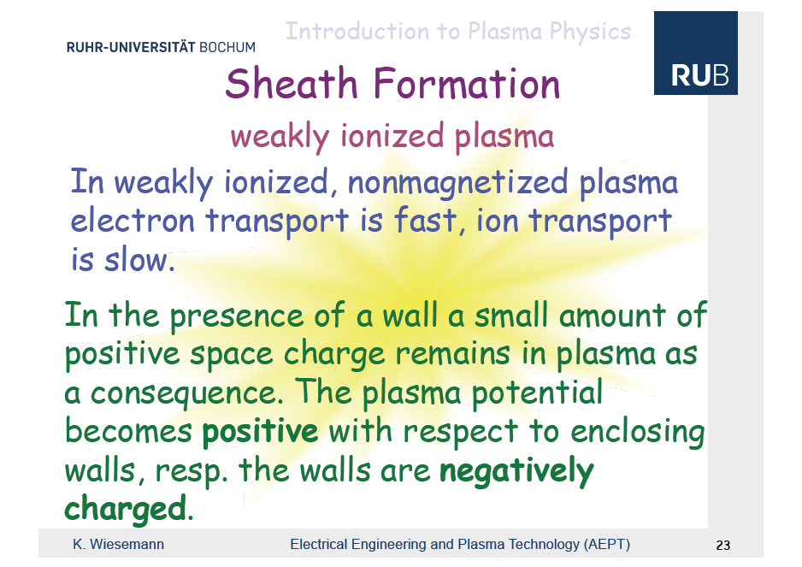

Slide 60
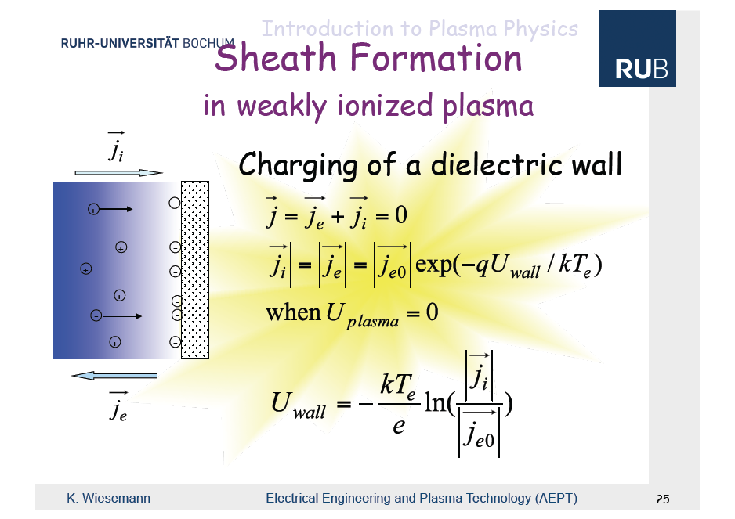

Slide 61
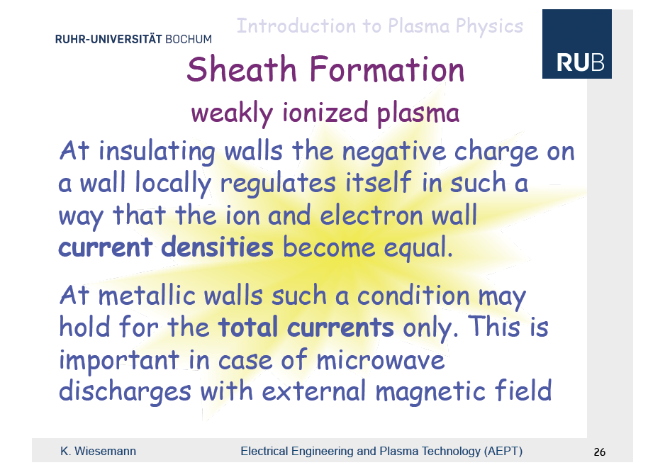

Slide 62
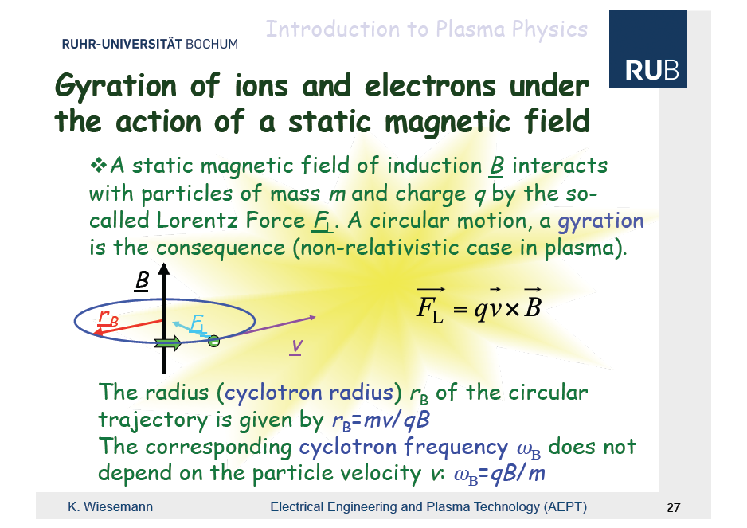

Slide 63
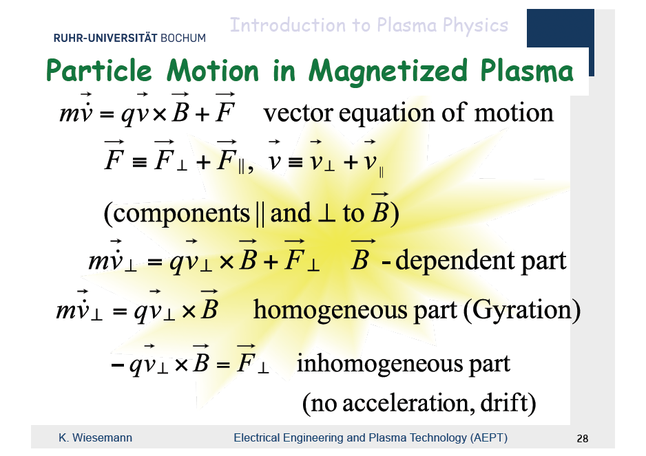

Slide 64
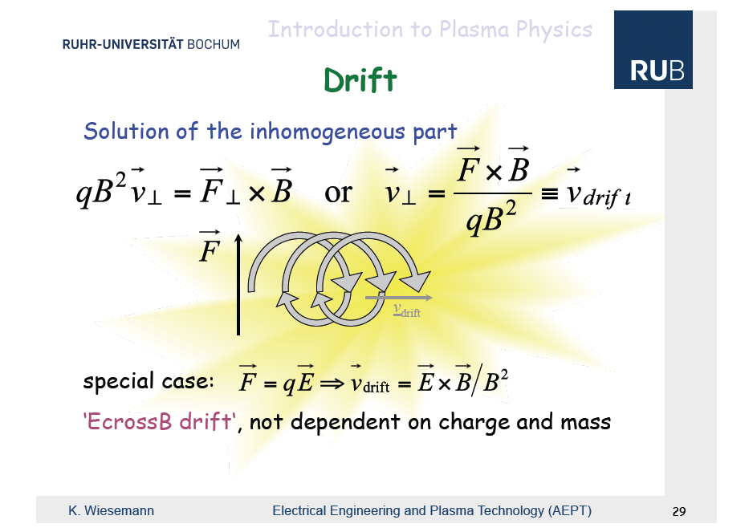

Slide 65
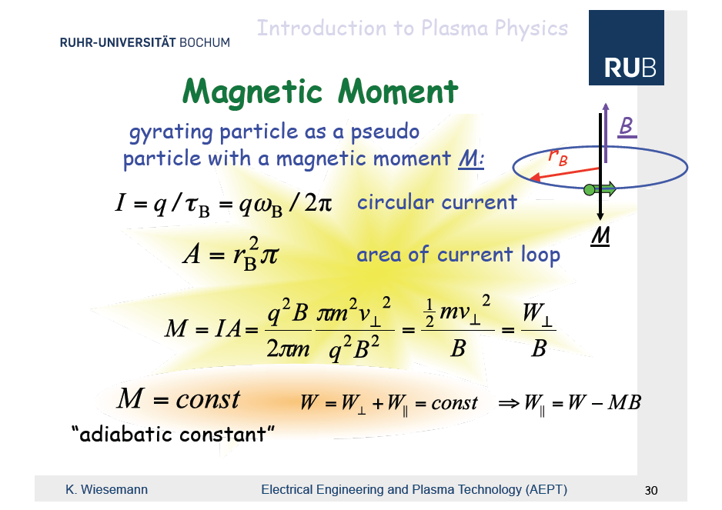

Slide 66
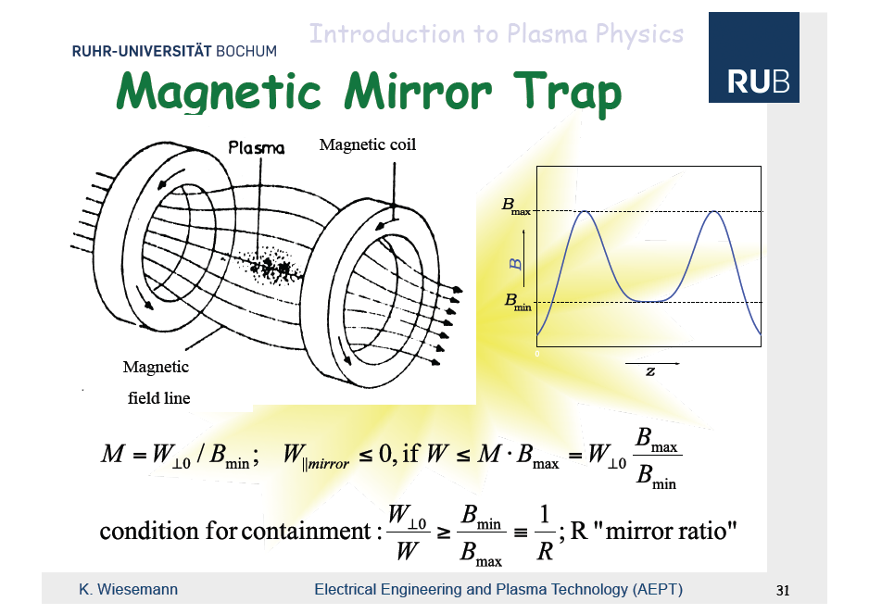

Slide 67


Slide 68


Slide 69
EM Waves propagation in plasma
The propagation of an EM wave in plasma will depend on its frequency.
Some wave will be cut-off by the plasma and will not propagate.
Some will be transmitted.
Some wave with the right frequency may even resonate in the plasma.
=> Cf plasma physics lecture,

Slide 70
Types of IONS SOURCES

Slide 71

Types of ions sources
Now that we have seen the basic physics used in ion sources we will se the different types of ion sources.
Most of the following slides come from Richard Scrivens’ lecture at the CAS in 2012 but some are taken from
other lectures at CAS.

Slide 72


Slide 73


Slide 74


Slide 75


Slide 76


Slide 77


Slide 78


Slide 79


Slide 80


Slide 81


Slide 82


Slide 83


Slide 84


Slide 85


Slide 86


Slide 87


Slide 88


Slide 89


Slide 90


Slide 91


Slide 92


Slide 93


Slide 94


Slide 95


Slide 96


Slide 97


Slide 98


Slide 99


Slide 100


Slide 101


Slide 102


Slide 103


Slide 104


Slide 105


Slide 106


Slide 107


Slide 108


Slide 109


Slide 110


Slide 111


Slide 112


Slide 113


Slide 114


Slide 115


Slide 116


Slide 117


Slide 118


Slide 119


Slide 120


Slide 121


Slide 122


Slide 123


Slide 124


Slide 125
Ion source conclusion
Accelerators require many different types of ion sources.
This can be achieved by relying on different physical processes.
There are different technical implementation to achieve these processes.
=> Ion sources are a very complex topic and there is still a lot of R&D happening.

Slide 126
Other Applications

Slide 127


Slide 128


Slide 129
Summary
Ions for accelerators can be produced through 3 different phenomenon:
- impact ionization
- photo-ionization
- charge exchange
There is a large variety of ion sources design, suited to different ion requirements.

Slide 130
Recommended readings
(and credits for some of the material used in this lecture)
CERN Accelerator School (CAS) on Ion source, June 2012:
http://cas.web.cern.ch/cas/Slovakia-2012/Senec-advert.html
Lectures slides are at
http://lal.delerue.org/teaching/2021_GI/

