Slide 1



The SPIRAL2 accelerator at GANIL-Caen
L. Perrot
IJCLab, Université Paris-Saclay,
luc.perrot@ijclab.in2p3.fr , 01 69 15 71 58

Slide 2


Outline
  General description of SPIRAL-2 facility
  Ion sources and low energy beam transport line (Lignes Basse-Energie)
  The RFQ
  The Medium Energy Beam Transport line (Ligne Moyenne-Energie)
  The superconducting LINAC
  The High Energy Beam Transport line (Ligne Haute Energie)

Slide 3
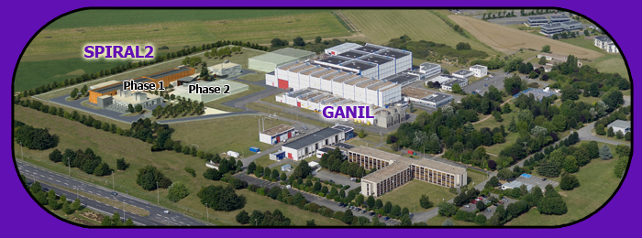
The SPIRAL2 accelerator at GANIL-Caen
What is SPIRAL2
SPIRAL2 (Système de Production d'Ions RAdioactifs en Ligne de 2ème génération) is a project of linear particles for studies in
fundamental nuclear physics and interdisciplinary research
The facility, larger than existing facility at GANIL Caen will produce “exotic” ions beams

Slide 4
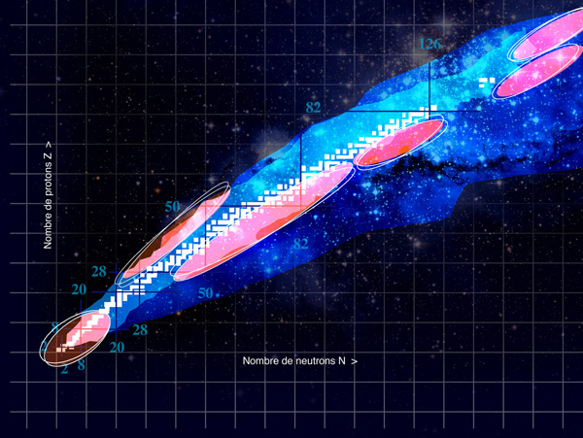
The SPIRAL2 accelerator at GANIL-Caen
Exploration of Terra Incognita
In white : 291 natural nuclides
Sky blue : 2000 nuclides already produced in laboratory
In red : nuclides produce with the SPIRAL2 accelerator

Slide 5
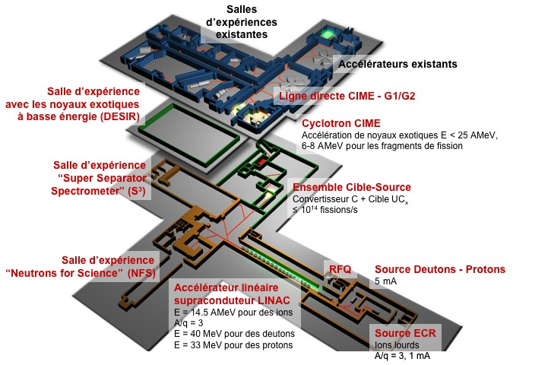
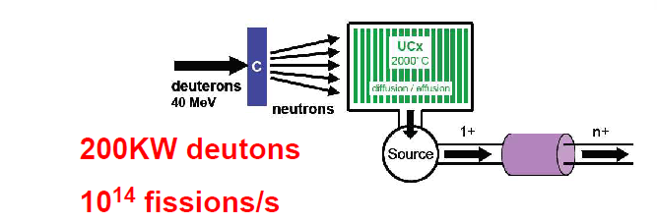
The SPIRAL2 accelerator at GANIL-Caen
SPIRAL2 at GANIL facility
The ISOL method (Isotope On-Line) to produce Rare Isotope Beams

Slide 6
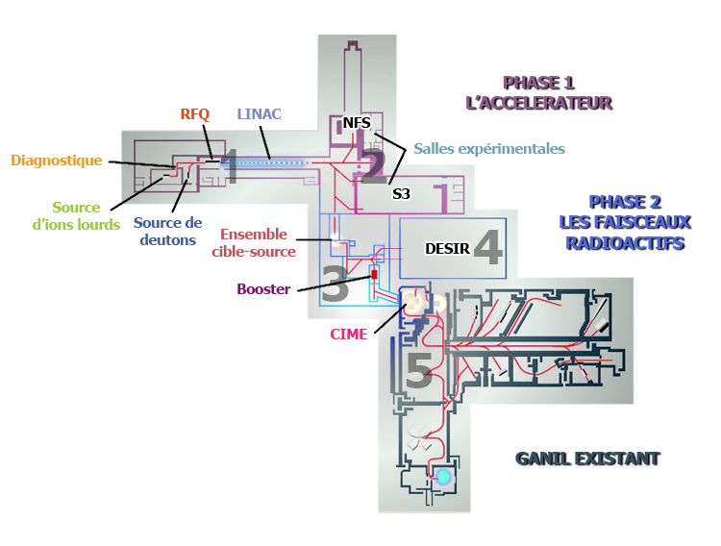

The SPIRAL2 accelerator at GANIL-Caen
Organization and phase
Underground at level $−9.5m$
SP2-phase 1:
in construction since 2008, commissioning started in 2014
133 m
SP2-phase 2:
Postponed since 2013
SP2-phase 1+:
operation will start in 2021
Existing GANIL

Slide 7


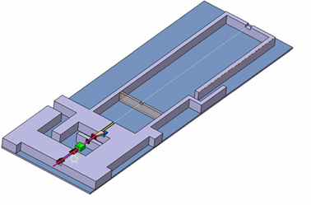



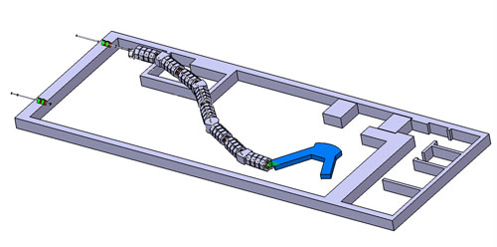
The SPIRAL2 accelerator at GANIL-Caen
new experimental areas
Accelerated Protons and Deuterons by the SPIRAL2 linac can generate a neutrons source extremely intense
NFS (Neutrons For Science) are will use these neutrons for fundamental physics experiments and others applications (ex: cross sections measurements for next reactors generation, fusion …)
Time-of-flight area
SPIRAL2 linac accelerate stable ions at very high intensity.
By nuclear reactions, it will produce extremely rare isotopes like very heavy, super heavy elements or deficient neutrons nuclides.
S3 (Super Séparateur Spectromètre) is design for accept these high intensity and provide a precise separation degree in order to reject the contaminants and permit the identification of the interest nucleus.
Target
Spectrometer
Detection

Slide 8
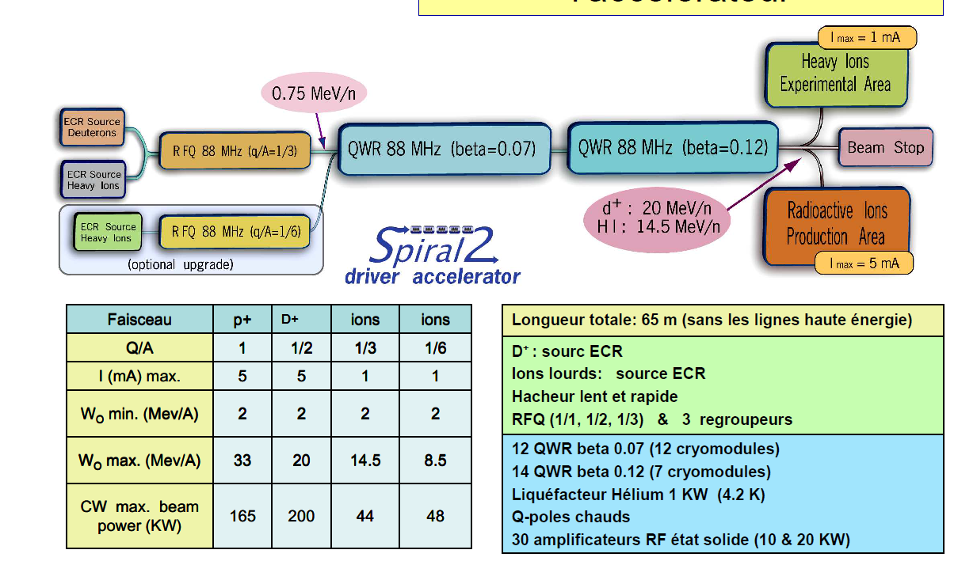
The SPIRAL2 accelerator at GANIL-Caen
linac and produced beams
Notes:
Hacheur = chopper

Slide 9
The SPIRAL2 accelerator at GANIL-Caen
ION sources and low energy beam lines
Low Energy Beam Transport lines (LEBT)
LEBT = LBE (in French)

Slide 10


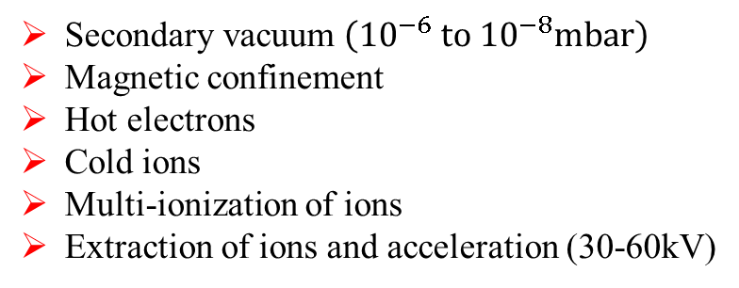
The SPIRAL2 accelerator at GANIL-Caen
ECR ion sources
ECR = Electron Cyclotron Resonance
Atoms ;
Metallic vapors
PLASMA
$$\vec{E}$$
Accelerated ions beam
HF power
vacuum
Magnetic field lines
Plasma Chamber
$$ω_{RF}=ω_{ce}=\frac{eB}{m_{e}}$$
ZONE ECR
Secondary vacuum $\left({10}^{−6} \text{to} {10}^{−8}\text{mbar}\right)$
Magnetic confinement
Hot electrons
Cold ions
Multi-ionization of ions
Extraction of ions and acceleration (30-60kV)

Slide 11
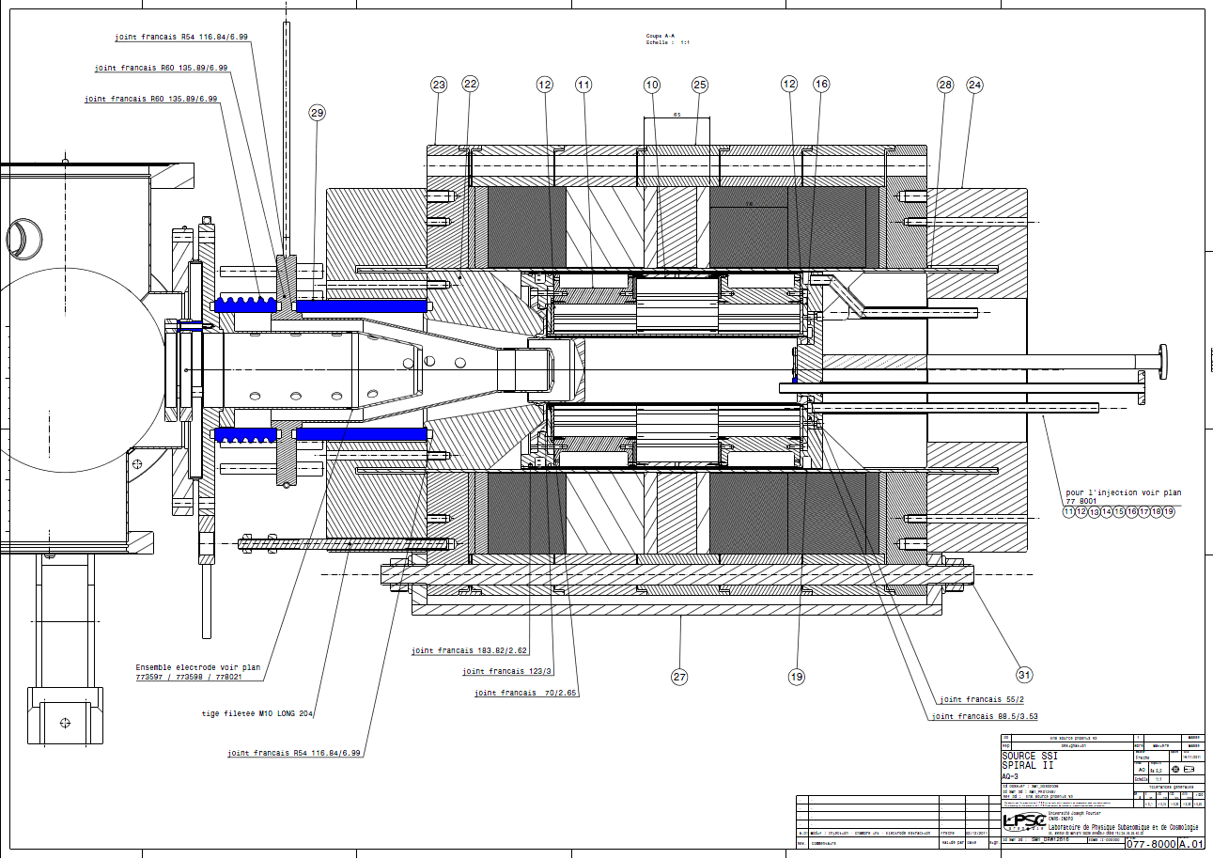
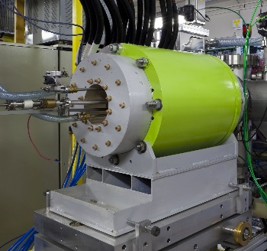
The SPIRAL2 accelerator at GANIL-Caen
SPIRAL2 Q/A=1/3 ion source
Polariser
60kV
High voltage
Plasma
optimization
2T magnetic field
Ions
acceleration
  Plasma confinement
High Frequency : 18GHz
Atoms Injection
Plasma density
Chemical element
Chauffage des électrons

Slide 12
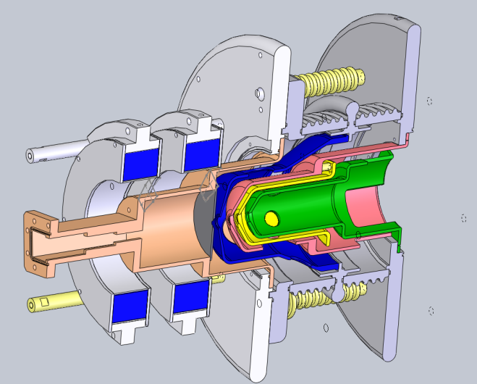
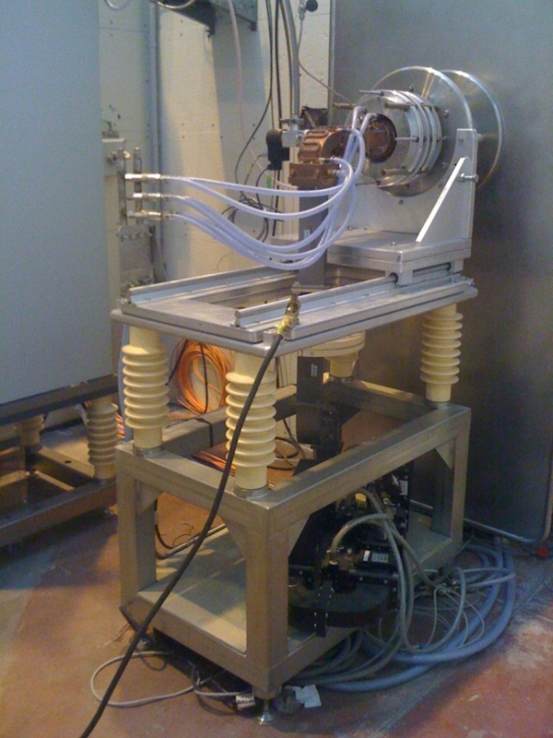
The SPIRAL2 accelerator at GANIL-Caen
SPIRAL2 deuteron ion source
Operational since 2009 (CEA-Saclay)
2kW 2.45GHz magnetron Pulsed or CW mode
Up to 50kV bias potential
0,15 to 10mA Proton/Deuteron beams

Slide 13
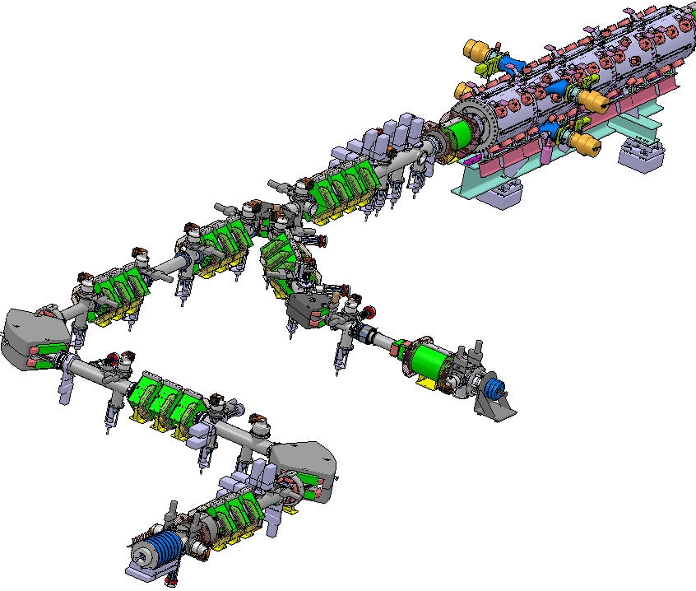
The SPIRAL2 accelerator at GANIL-Caen
LEBT configuration
Why LEBT ?
  Collection of beams from the 2 sources,
  Selection of ion needed,
  Ensure a good transport,
  Adaptation to entrance of RFQ
Lines Configuration
~ 16 m
Beam level : 1500mm
Standard aperture of beam pipes ~ ∅160mm
~ 5 m

Slide 14
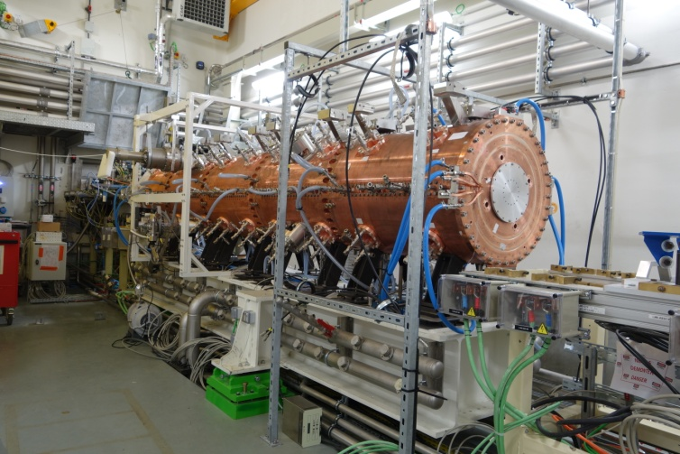
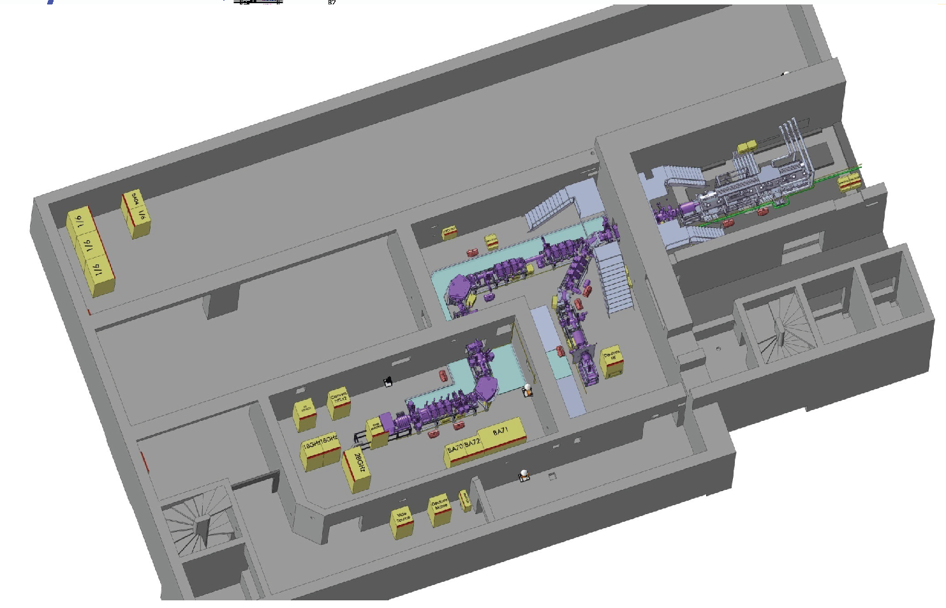
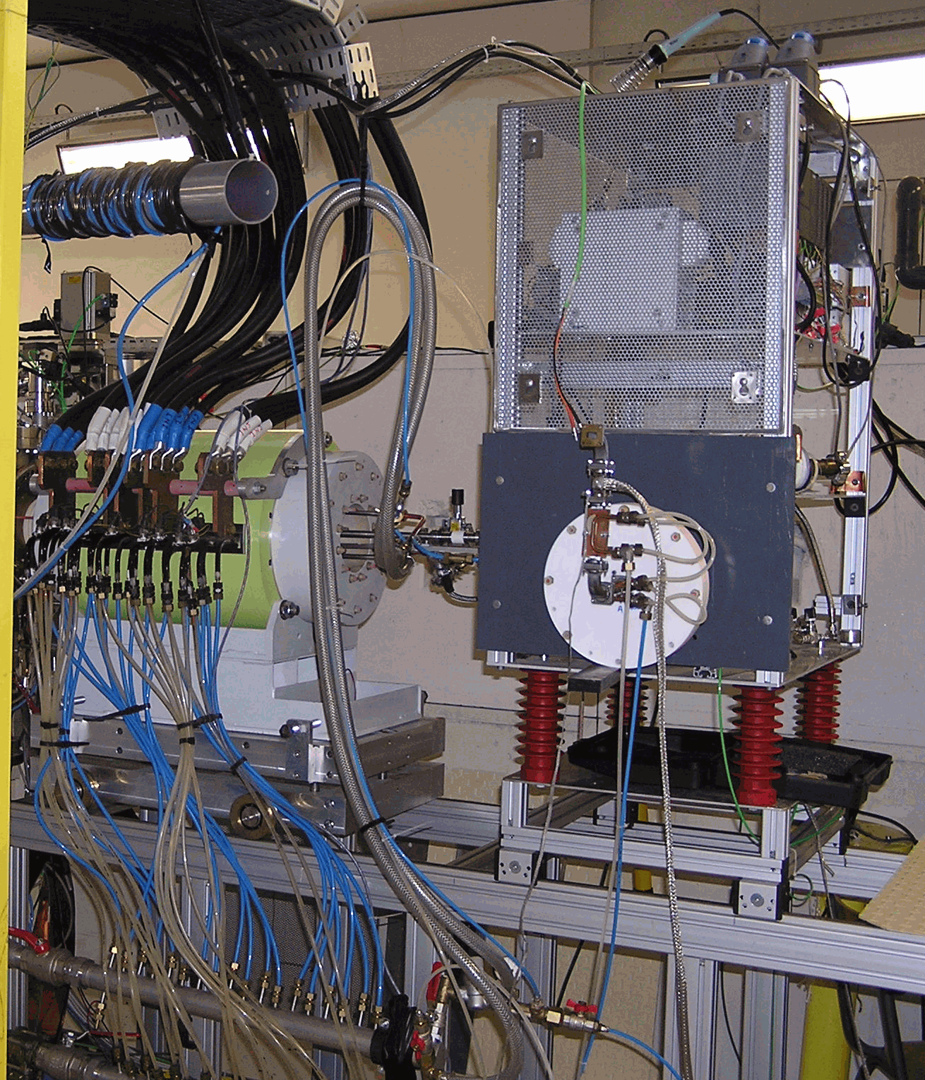
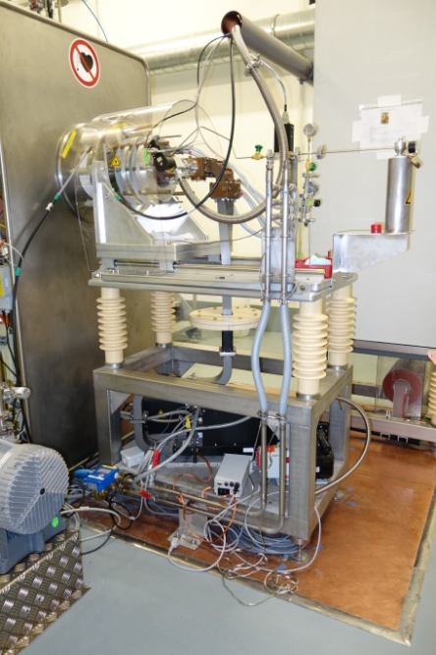
The SPIRAL2 accelerator at GANIL-Caen
implantation and access
Local n°4
Heavy ions A/Q=6 ?
Level -2
Room n°5
RFQ
Room n°3
injector
LBEC
Room n°1
LBE2
LBE1
Future
Source H+/D+ (40 kV)
LINAC access by stairs or elevator
Room n°2
Access to sources by stairs or elevator
Ions source with A/Q=3 (60 kV)

Slide 15
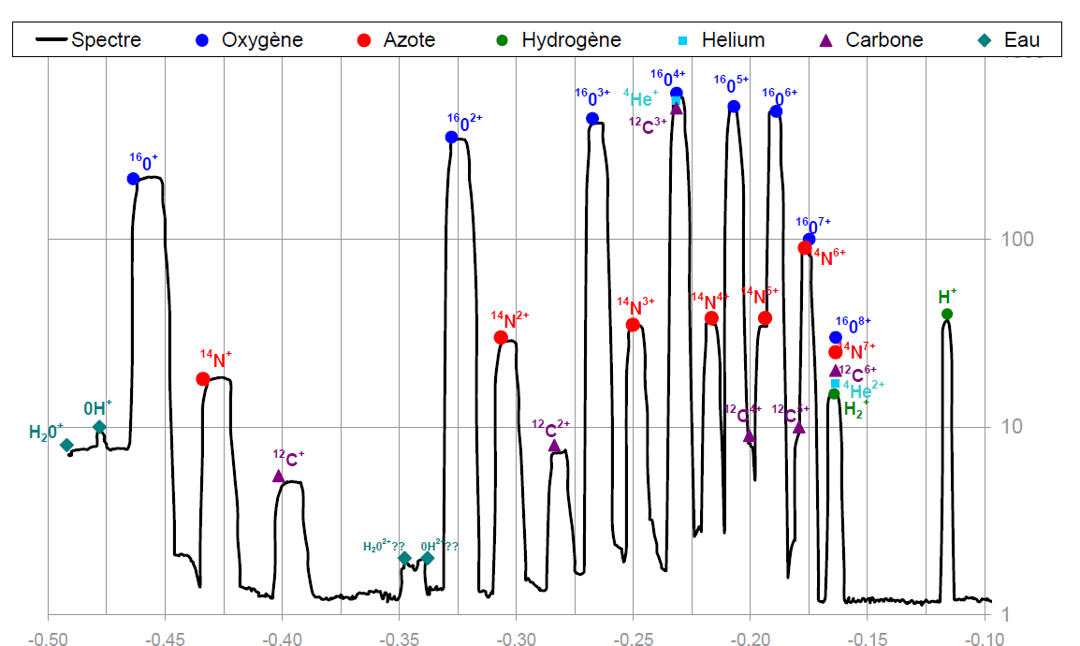

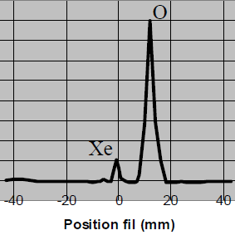
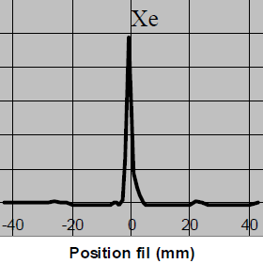
The SPIRAL2 accelerator at GANIL-Caen
ions selection coming from source
Ex. spectre en Oxygène issu de Phoenix V2
Protons/Deuterons (LBE2): simple magnetic separation
  Dipole LBE2-D11 (with water cooled vacuum chambers)
Heavy Ions (LBE1): spectrometer like
  Dipole LBE1-D11 (with water cooled vacuum chambers)
  Optical system Object / Image (resolving power better than 1/100)
  Selection slits (cooled)
Beam profile measurement
on LBE1-PR13

Slide 16
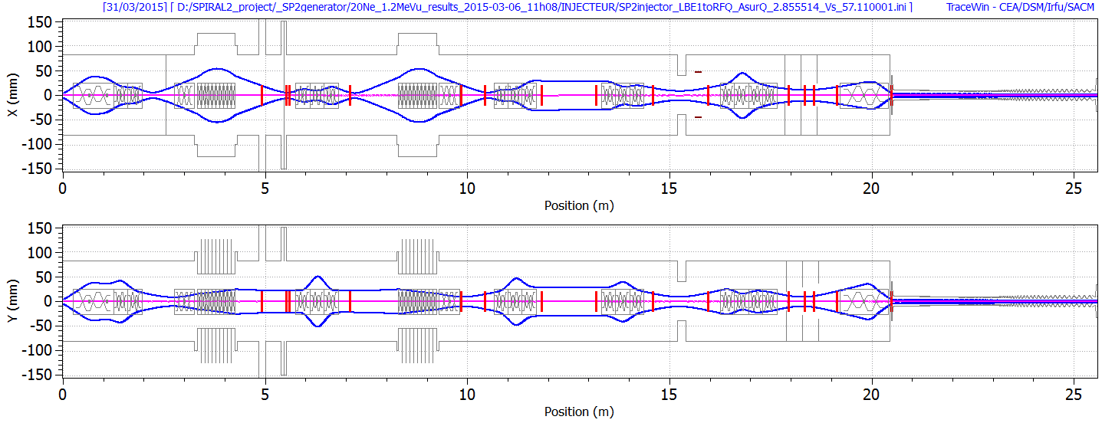
The SPIRAL2 accelerator at GANIL-Caen
Beam transportation up to RFQ
Transmission optimization and emittance preservation
Give a stable and well adapted beam to RFQ entrance
Magnetic transport : dipoles, solenoids, quadrupoles…
Key role of beam instrumentation (diagnostics, slits …)
LBE1-SOL11
LBE1-D11
LBE1-D12
LBEC-SOL11
RFQ
LBE1-Q11/13
LBE1-Q14/16
LBE1-Q21/23
LBE1-Q24/26
LBEC-Q31/34
CF
PR
EM
AF
DCCT
Fentes
Ex. beam transport in LBE1+LBEC+RFQ (envelopes at √6 RMS, ~95%)

Slide 17
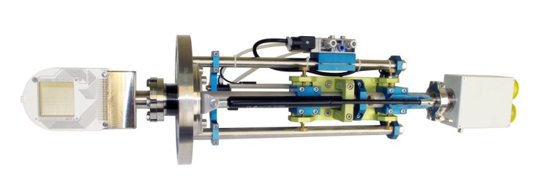
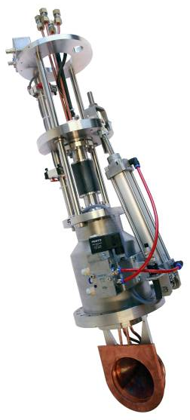
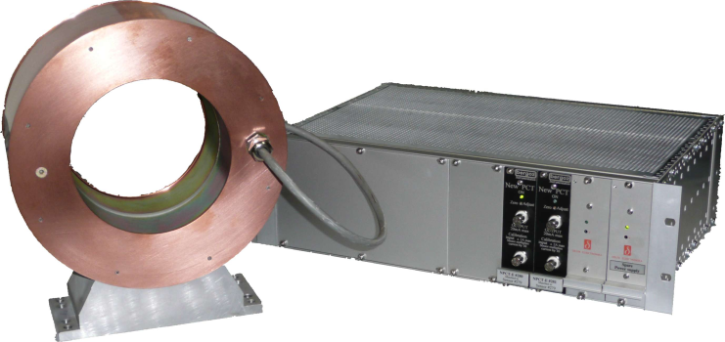
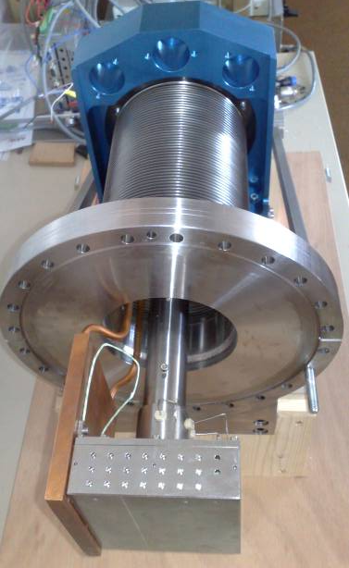
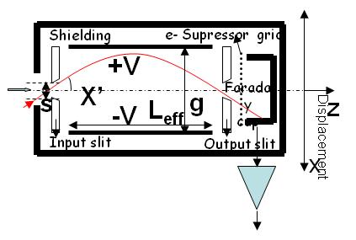
The SPIRAL2 accelerator at GANIL-Caen
Beam transportation up to RFQ
Profiler
Secondary emission monitor
47 Tungsten wires ø 150 μm
Maximum beam size: 80 mm
Imax: 0.1-1 mA cw
Emittance-meter
Allison scanner
Max. diameter beam: 80 mm
Max measurable angle: ± 100mrad
H.V. max: 2.8 kV
Max Beam power: 300 W
DCCT
Shielding : (µ-métal + Armco + copper)
B.W.: 0 – 10 kHz ; Noise: 1 µA / Hz ^{½}
C.W. + Low Duty Factor Pulsed Mode Operation
Faraday Cup
Water cooled
P max: 1,2 kW ( 250°)
P density max: 2120 W/Cm²

Slide 18
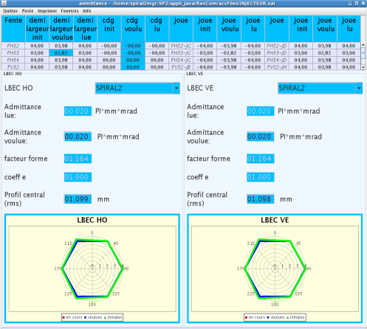
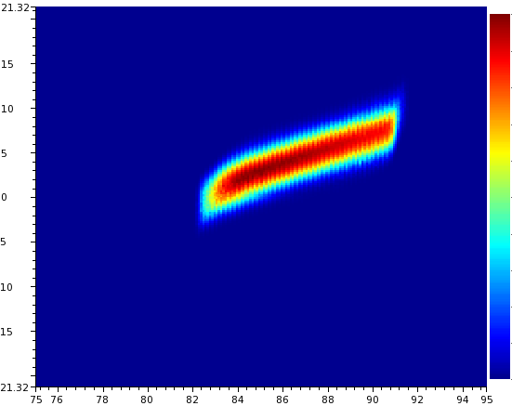

The SPIRAL2 accelerator at GANIL-Caen
Beam power control
Crucial role for a high power machine
  Protection machine, safety, radioprotection
  Commissioning machine
  Power increasing on targets
Control of the peak current
  From I_{min} (typically 100 µA)
  to I_{max} (6.5 mA)
  Controled by a system to 3 slits in horizontal and vertical axis
  Coupling with definition of beam emittances: when I ↓, ε ↓
Phases of the power increasing during the commissioning
Software dedicated to emittances definition
Measurement of $50μA$ Deuterons beam at Saclay

Slide 19
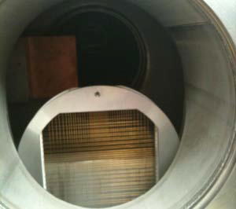
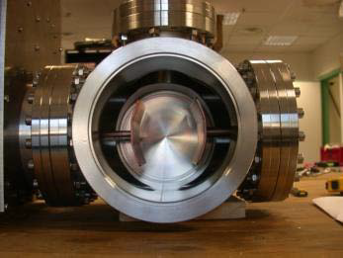
The SPIRAL2 accelerator at GANIL-Caen
Beam power control
Crucial role for a high power machine
  Protection machine, safety, radioprotection
  Commissioning machine
  Power increasing on targets
Control of duty cycle
  Using electrostatic : provide a pulsed beam
  V and f max : 10 kV, 1.5 kHz
  Duty cycle : typically for the first linac beams : 0.1%
  (500µs @2Hz)
Phases of the power increasing during the commissioning
Hacheur (chopper) electrodes
Beam profiler and associated “scrapper”

Slide 20
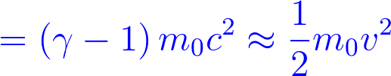
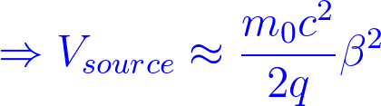

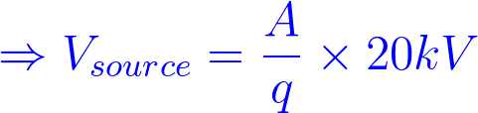

The SPIRAL2 accelerator at GANIL-Caen
Produced beams
Type
  LBE1+LBEC: heavy ions with A/q = 3 max (ex: ¹²C⁴⁺, ¹⁶O⁶⁺, ²⁰Ne⁷⁺, ⁴⁰Ar¹⁴⁺, ⁵⁸Ni¹⁹⁺)
  LBE2+LBEC: Deuterons, Protons, H₂⁺
Energy
  Ions speed must be adapted to first modulations of RFQ
  Required source potential
  Ex. Protons: 20.15 kV, Deuterons: 40.27 kV, ¹⁶O⁶⁺: 53.31 kV, ¹²O⁴⁺: 59.99 kV
  LEBT beam energy

Slide 21
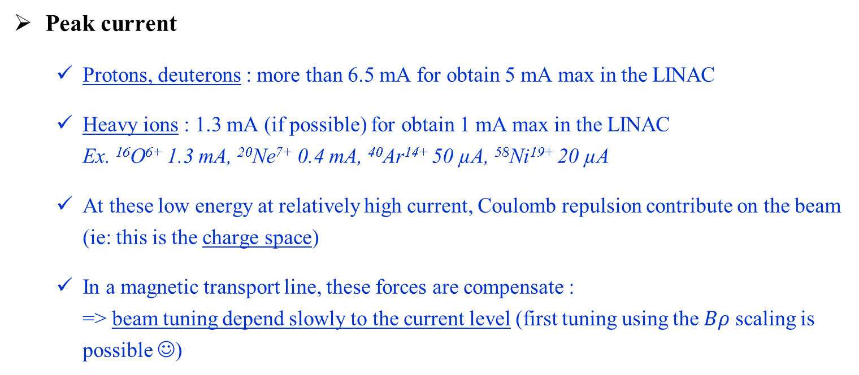
The SPIRAL2 accelerator at GANIL-Caen
Emittances and Peak Current
Emittances
  Transverses: 0.1 à 0.3 π.mm.mrad (Normalized RMS emittance)
  200 à 500 π.mm.mrad (Marginal emittance not normalized)
  Longitudinal: Continuous beam
Peak current
  Protons, deuterons : more than 6.5 mA for obtain 5 mA max in the LINAC
  Heavy ions : 1.3 mA (if possible) for obtain 1 mA max in the LINAC
  Ex. ¹⁶O⁶⁺ 1.3 mA, ²⁰Ne⁷⁺ 0.4 mA, ⁴⁰Ar¹⁴⁺ 50 µA, ⁵⁸Ni¹⁹⁺ 20 µA
  At these low energy at relatively high current, Coulomb repulsion contribute on the beam (ie: this is the charge space)
  In a magnetic transport line, these forces are compensate :
  => beam tuning depend slowly to the current level (first tuning using the $Bρ$ scaling is possible ☺)

Slide 22
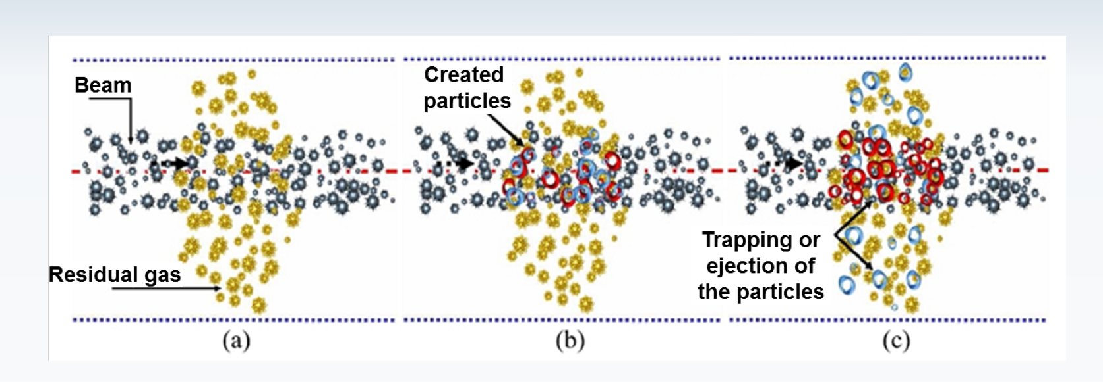
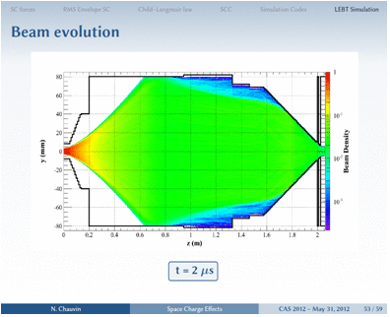
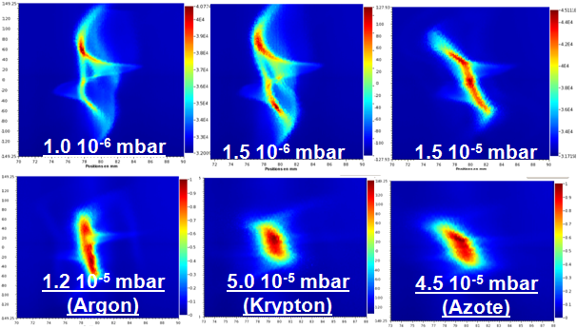
The SPIRAL2 accelerator at GANIL-Caen
Space charges compensation
Compensation phenomena
  Residual gas ionisation
  Electron trapping by the beam
  (@potential positif)
  Neutralization of space charges forces
Not well controlled aspects
  Compensation level (close to 100%)
  Transients aspects in pulsed mode (the neutralization is not instantaneous)
  High contribution of the residual gaz nature (type) and pressure level
Emittances measurement at RFQ SPIRAL2 entrance (by D. Uriot)
Calculation of the transcient compensation (by N. Chauvin)

Slide 23
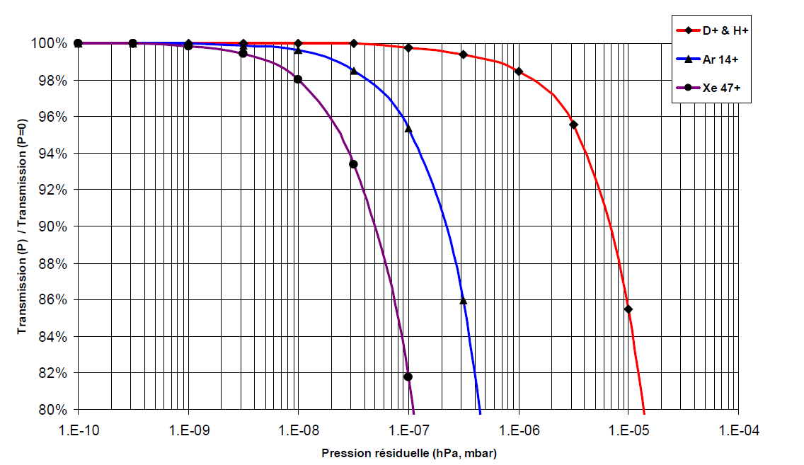
The SPIRAL2 accelerator at GANIL-Caen
Vacuum pressure
Sufficiently good
in order to suppress losses by electronic capture
Not to good
For decrease the time of the increasing of the compensation
(and ameliorate the emittances)
0
1.2 10⁻⁵ mbar
(Argon)
200µs
400µs
600µs
800µs
Transmission (calculation) and transients compensation (Deuterons case)
as a function of the residual gas pressure
Vacuum level have to be carefully choose
  Between 10⁻⁶ and few 10⁻⁵ mbar for Protons/Deuterons particles
  Between 10⁻⁸ and few 10⁻⁷ mbar for working with heavy ions

Slide 24
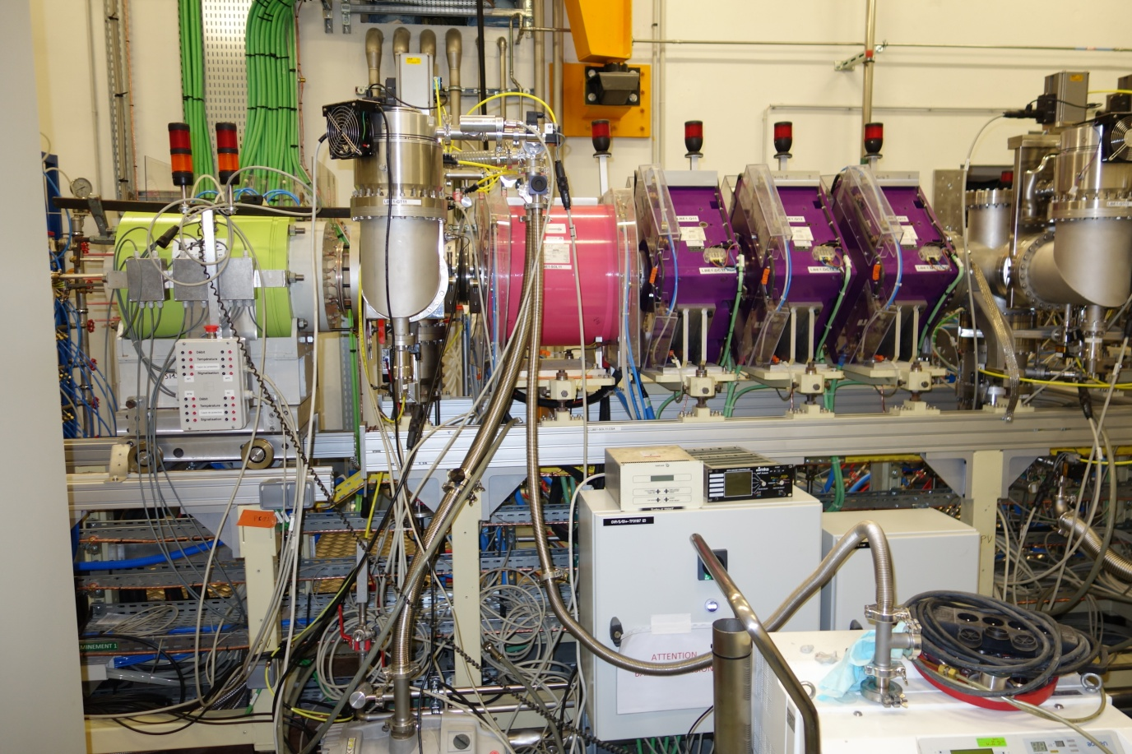
The SPIRAL2 accelerator at GANIL-Caen
LBE1 description (1/6)
LBE1
(ions A/q=3)
to RFQ
Source
LBE1-SOL11
Solenoid + quadrupole triplet (& steerers)
CF
LBE1-Q11/12/13
LBE1-CF11
Source A/q=3
PHOENIX V2 (18 GHz)
60 kV max – 1.3 mA max

Slide 25
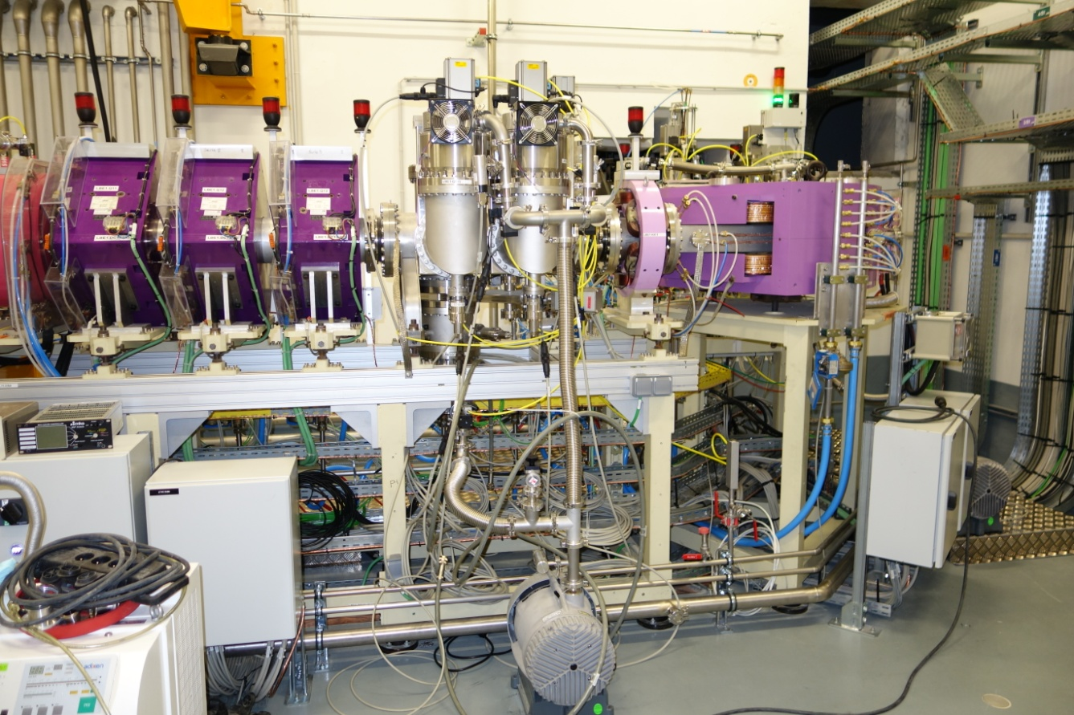
The SPIRAL2 accelerator at GANIL-Caen
LBE1 description (2/6)
LBE1
(ions A/q=3)
to RFQ
LBE1-FH12
Solenoid + quadrupole triplet (& steerers)
LBE1-D11
LBE1-Q11/12/13
LBE1-HX11
CF
Cleaning slit
Hexapole
90° dipole
(ρ = 60 cm, α=26.565°)
Source A/q=3
PHOENIX V2 (18 GHz)
60 kV max – 1.3 mA max

Slide 26
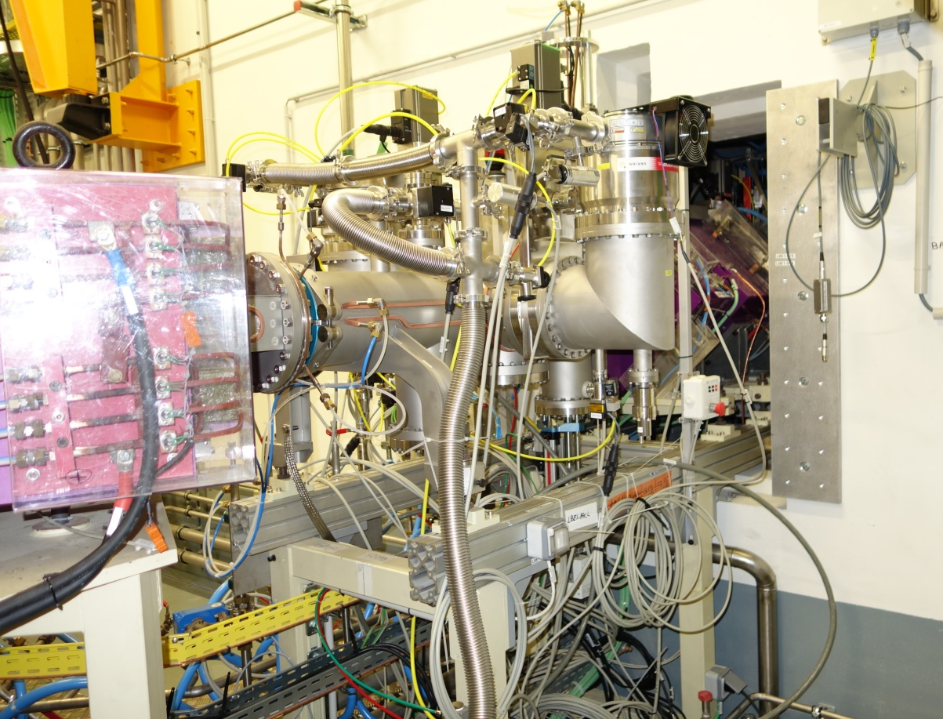
The SPIRAL2 accelerator at GANIL-Caen
LBE1 description (3/6)
LBE1
(ions A/q=3)
Achromatic double-deviation
double-focusing dipoles + quadrupole triplet (& steerers)
to RFQ
LBE1-CF13
LBE1-Q14/15/16
Selection slit
LBE1-FH12
CF
Solenoid + quadrupole triplet (& steerers)
PR
PR
CF
Cleaning slit
LBE1-PR13
Hexapole
LBE1-PR12?
90° dipole
(ρ = 60 cm, α=26.565°)
LBE1-D11
Source A/q=3
PHOENIX V2 (18 GHz)
60 kV max – 1.3 mA max

Slide 27
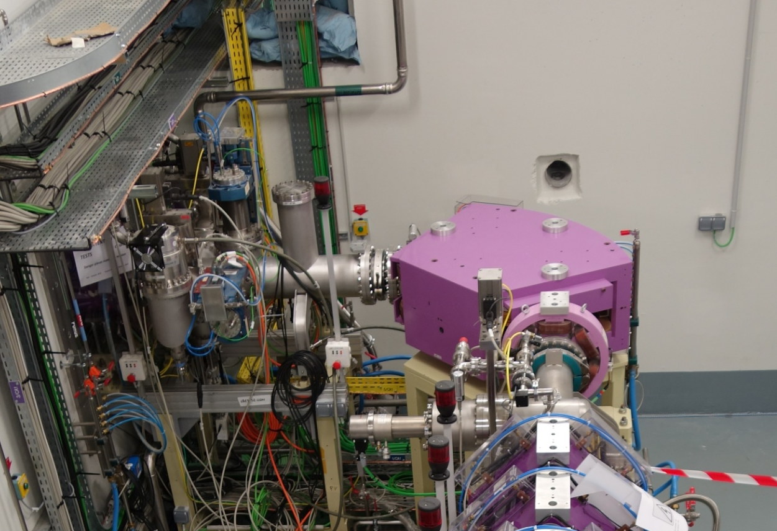
The SPIRAL2 accelerator at GANIL-Caen
LBE1 description (4/6)
90° dipole
(ρ = 60 cm, α=26.565°)
Hexapole
LBE1
(ions A/q=3)
Achromatic double-deviation
double-focusing dipoles + quadrupole triplet (& steerers)
AF
to RFQ
EM
PR
Emittance-mètres
LBE1-AF11
LBE1-D12
Selection slit
CF
Solenoid + quadrupole triplet (& steerers)
PR
PR
CF
Cleaning slit
LBE1-HX12
Hexapole
LBE1-PR14
90° dipole
(ρ = 60 cm, α=26.565°)
Source A/q=3
PHOENIX V2 (18 GHz)
60 kV max – 1.3 mA max

Slide 28
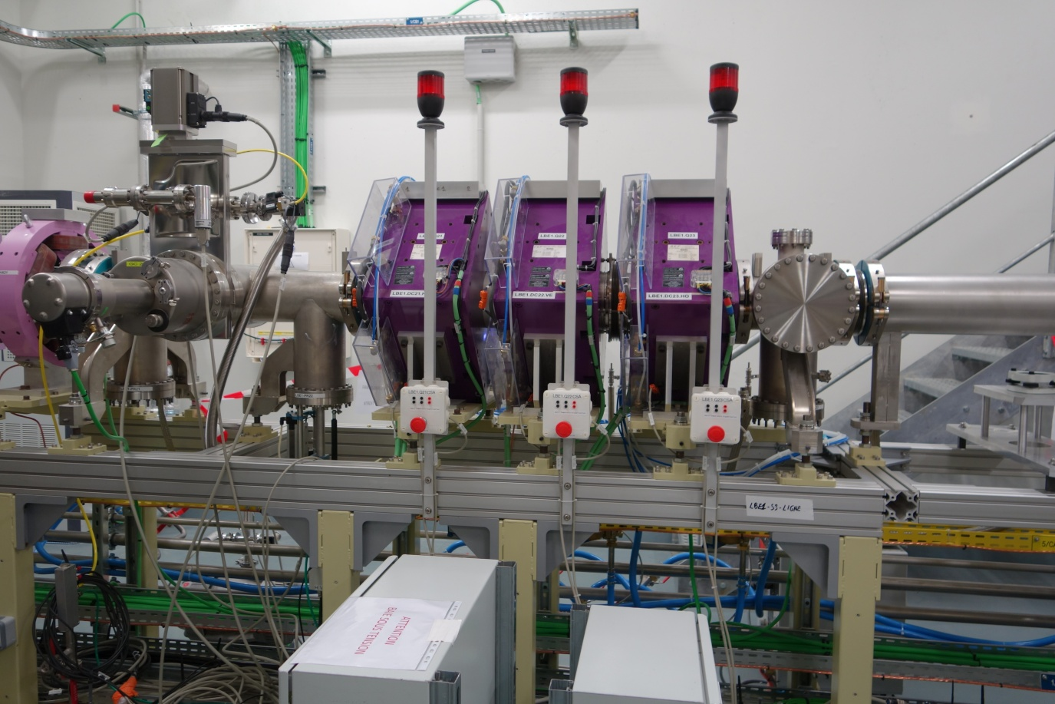
The SPIRAL2 accelerator at GANIL-Caen
LBE1 description (5/6)
90° dipole
(ρ = 60 cm, α=26.565°)
Hexapole
Quadrupole triplets (& steerers)
LBE1
(ions A/q=3)
PR
Achromatic double-deviation
double-focusing dipoles + quadrupole triplet (& steerers)
AF
to RFQ
EM
PR
Selection slit
CF
LBE1-PR22
Solenoid + quadrupole triplet (& steerers)
PR
PR
CF
Cleaning slit
Hexapole
LBE1-HX12
LBE1-Q21/22/23
90° dipole
(ρ = 60 cm, α=26.565°)
Source A/q=3
PHOENIX V2 (18 GHz)
60 kV max – 1.3 mA max

Slide 29

The SPIRAL2 accelerator at GANIL-Caen
LBE1 description (6/6)
90° dipole
(ρ = 60 cm, α=26.565°)
Hexapole
Quadrupole triplets (& steerers)
LBE1
(ions A/q=3)
PR
PR
AF
PR
Achromatic double-deviation
double-focusing dipoles + quadrupole triplet (& steerers)
AF
to RFQ
EM
PR
LBE1-Q23
Selection slit
CF
Solenoid + quadrupole triplet (& steerers)
PR
LBE1-AF21
PR
LBE1-PR24
CF
Cleaning slit
Hexapole
90° dipole
(ρ = 60 cm, α=26.565°)
LBE1-Q24/24/26
Source A/q=3
PHOENIX V2 (18 GHz)
60 kV max – 1.3 mA max

Slide 30
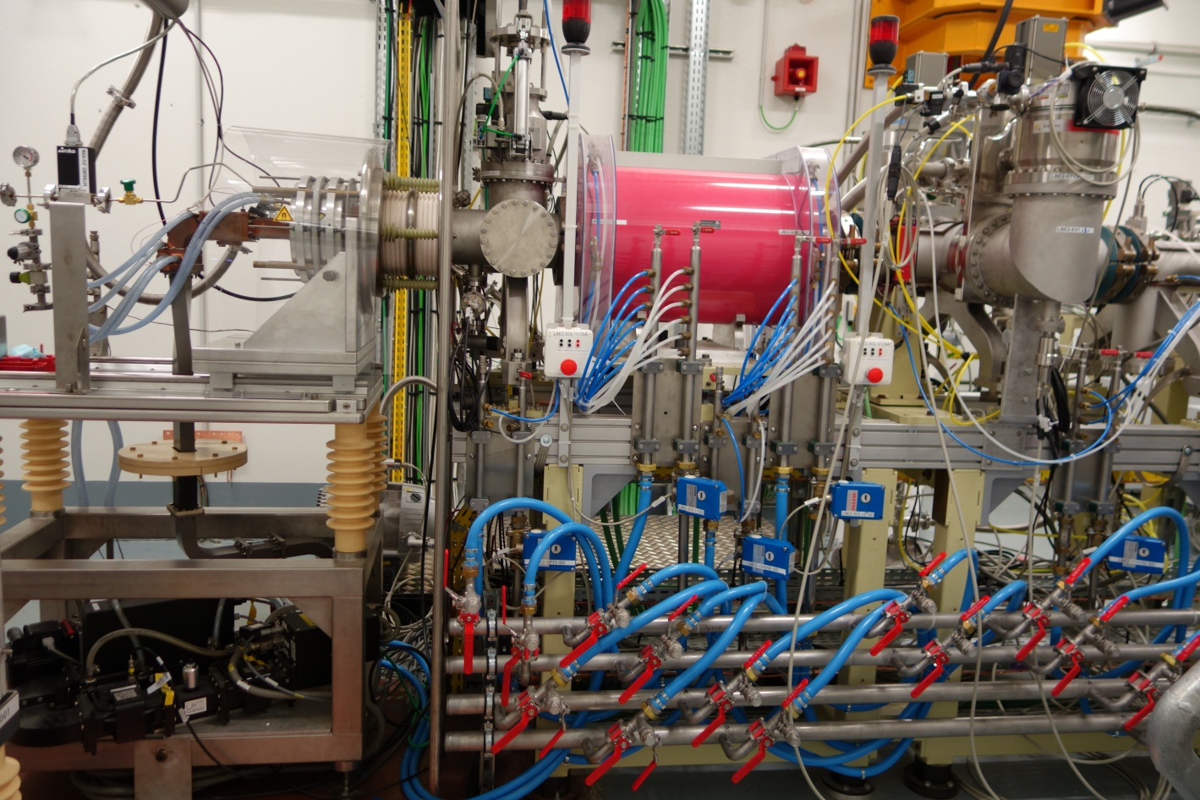
The SPIRAL2 accelerator at GANIL-Caen
LBE2 + LBEC description (1/4)
LBE2
(H+, D+)
to RFQ
LBEC
(H+, D+, A/q=3 ions)
Source
LBE2-SOL11/12
Double-coil solenoid + steerers
CF
LBE2-CF11
LBE2-DC11 (HO+VE)
H+/D+ source
ECR 2.45 GHz
40.3 kV max – 6.5 mA max

Slide 31
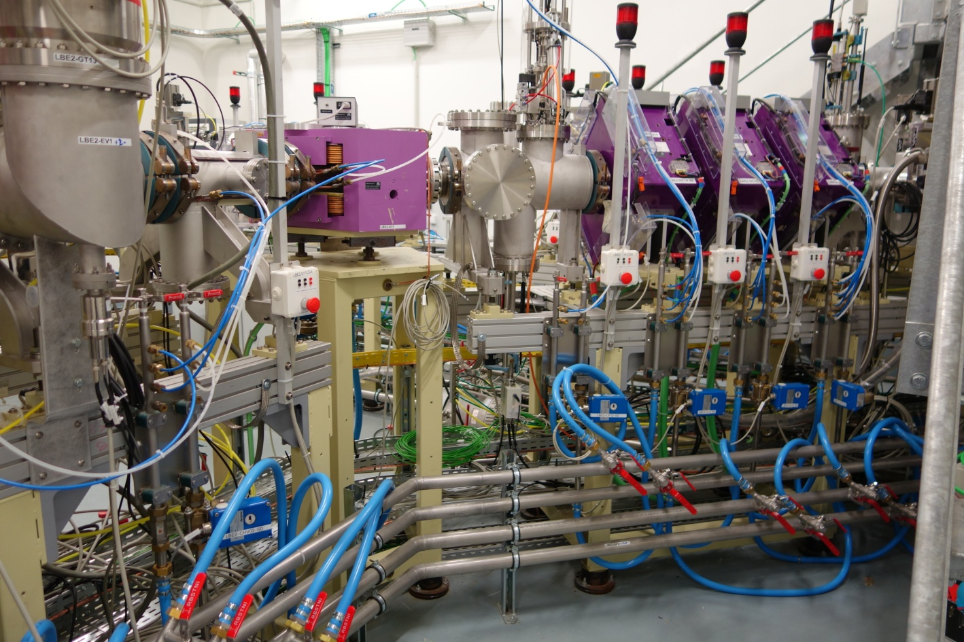
The SPIRAL2 accelerator at GANIL-Caen
LBE2 + LBEC description (2/4)
LBE2
(H+, D+)
to RFQ
LBEC
(H+, D+, A/q=3 ions)
Achromatic double-deviation
dipoles + quadrupole triplet
(& steerers)
PR
CF
LBE2-D11
45° dipole
(ρ = 50 cm, α=0°)
Double-coil solenoid + steerers
CF
LBE2-PR12
LBE2-Q14/15/16
H+/D+ source
ECR 2.45 GHz
40.3 kV max – 6.5 mA max
LBE2-CF12

Slide 32
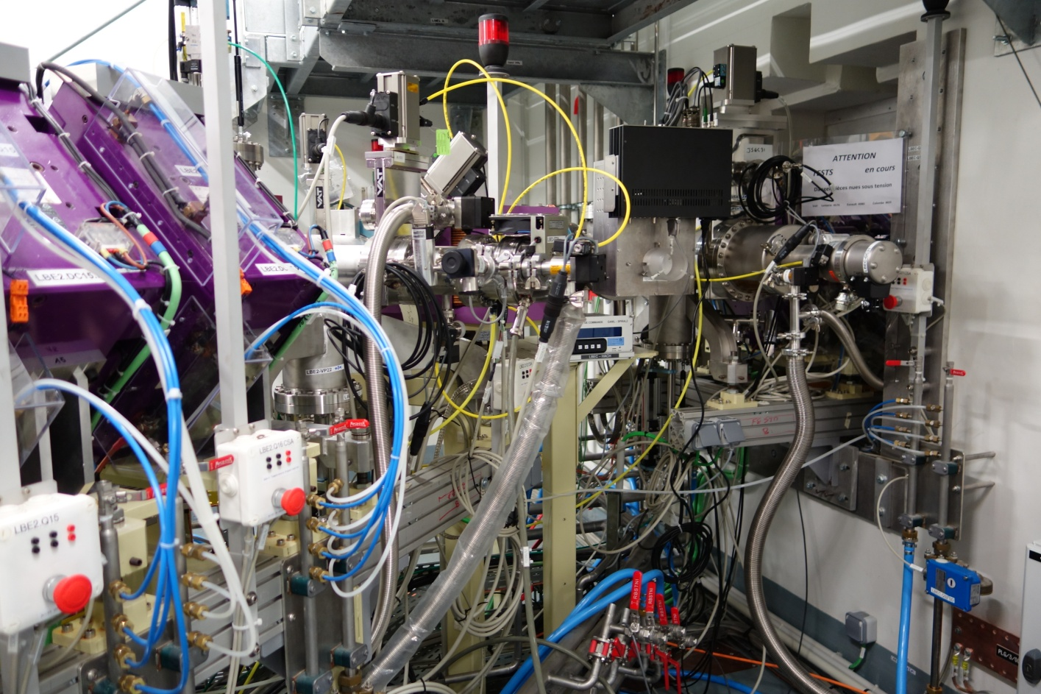
The SPIRAL2 accelerator at GANIL-Caen
LBE2 + LBEC description (3/4)
45° dipole
(ρ = 50 cm, α=0°)
10 kV slow chopper
LBE2
(H+, D+)
Quadrupole quadruplet (& steerers)
to RFQ
LBEC
(H+, D+, A/q=3 ions)
PR
PR
Achromatic double-deviation
dipoles + quadrupole triplet
(& steerers)
PR
CF
LBE2-PR13
Hacheur
LBEC-Q31/32/33/34
45° dipole
(ρ = 50 cm, α=0°)
Double-coil solenoid + steerers
CF
LBE2-D12
H+/D+ source
ECR 2.45 GHz
40.3 kV max – 6.5 mA max
LBE2-Q15/16
LBEC-PR31

Slide 33
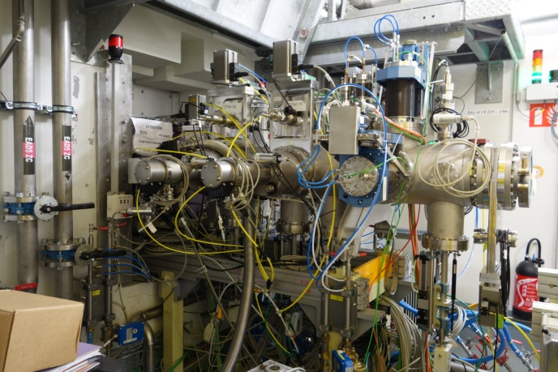
The SPIRAL2 accelerator at GANIL-Caen
LBE2 + LBEC description (4/4)
45° dipole
(ρ = 50 cm, α=0°)
10 kV slow chopper
LBE2
(H+, D+)
Quadrupole quadruplet (& steerers)
Double-coil solenoid
PR
EM
PR
to RFQ
LBEC
(H+, D+, A/q=3 ions)
PR
PR
PR
PR
CF
DCCT
Achromatic double-deviation
dipoles + quadrupole triplet
(& steerers)
3-slit system
PR
CF
LBEC-FH32/33/34
LBEC-FV32/33/34
Emittance-mètres
LBEC-CF34
45° dipole
(ρ = 50 cm, α=0°)
Double-coil solenoid + steerers
CF
LBEC-SOL31/32
H+/D+ source
ECR 2.45 GHz
40.3 kV max – 6.5 mA max
LBEC-PR32
LBEC-PR33
LBEC-PR34
LBEC-PR35

Slide 34
The SPIRAL2 accelerator at GANIL-Caen
The SPIRAL2 RFQ
RFQ

Slide 35
The SPIRAL2 accelerator at GANIL-Caen
Why a RFQ is needed ?
What we have to put between the source and the LINAC for :
#1 : obtain a good transmission of the LINAC (I_{LINAC} = I_{Source})
#2 : obtain a good efficiency of the LINAC (energy gain per cavity)
?

Slide 36
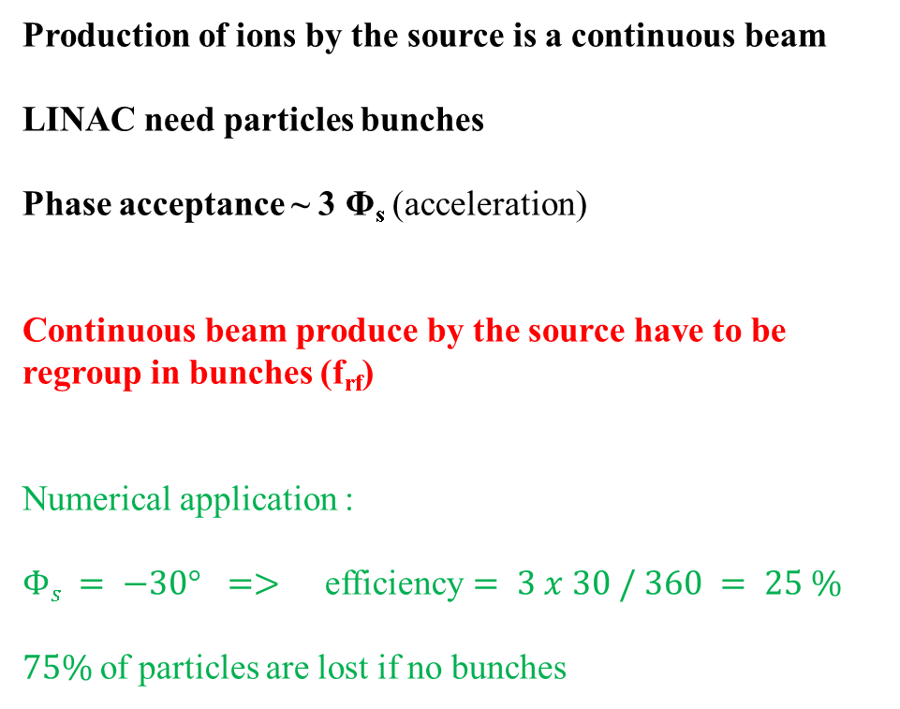
The SPIRAL2 accelerator at GANIL-Caen
#1 : a good transmission of the LINAC
Production of ions by the source is a continuous beam
LINAC need particles bunches
Phase acceptance ~ 3 Φ_{s} (acceleration)
Continuous beam produce by the source have to be regroup in bunches (f_{rf})
Numerical application :
$Φs = −30°$ $=>$ efficiency $= 3 x 30 / 360 = 25 \%$
$75\%$of particles are lost if no bunches

Slide 37
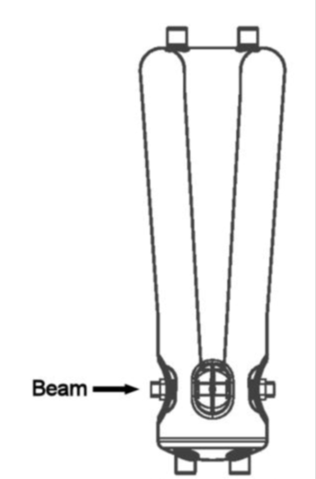


The SPIRAL2 accelerator at GANIL-Caen
#2 : a good acceleration in the LINAC
Particles must be in synchronism with the accelerating field in order to have a maximum energy gain per cavity.
Ions speed is imposed by the geometry and the frequency of the LINAC cavities
Numerical application :
$88 MHz$=> $λrf = 3.4 m$ $dz = 10 cm$
$β = 0.06$ => $W Protons = 1.6 MeV$
dz

Slide 38

The SPIRAL2 accelerator at GANIL-Caen
Ideal system between source and LINAC
-1- Efficient bunching at the RF frequency
Set of “bunching cavities” at $frf$ (adiabatic bunching, $ρ > 95\%$)
-2- Acceleration at high energy ($Vacc > 1 MV$)
Set of “accelerating cavities” at $frf$ (LINAC)
-3- Radial focalization in order to don’t lose particles
-1- + -2- = RF structure => Radio-Frequency Quadrupole (RFQ)
First publication : I.M. Kapchinskiy, V.S. Tepliakov, Prib. Tekh. Eksp. 2, 19-22 (1970)
At Los Alamos : R.H. Stokes, K.R. Crandall, J.E. Stovall, and D.A. Swenson, “ RF Quadrupole beam dynamics”, PAC79
In Europe (LNS-Saclay) : J-L. Laclare, M. Olivier et all, design in 1982 => 1st beam in 1984

Slide 39







The SPIRAL2 accelerator at GANIL-Caen
Few aspects of RFQ
The electric field oscillate at the RF frequency
⇒Transport of the particles in a series of focusing and defocusing quadrupoles
Alternating focusing
No $Ez$ longitudinal component ⇒ No acceleration
Electrodes modulation des électrodes in order to create a longitudinal component $Ez(z)$
⇒ Continuous series of “cavities”
⇒ Radial focusing
+ Progressive bunching of the beam
+ Acceleration of bunches

Slide 40



The SPIRAL2 accelerator at GANIL-Caen
5 sections of the RFQ (1/5)
Section 1 – Radial adaptation at the entrance (“Radial Matching section”)
Make a beam with small dimensions $(rmax \sim 5 mm)$
Progressive adaptation of the beam at the RF focalisation (as a function of time)
Acceptances without radial adaptation
Acceptances with radial adaptation

Slide 41



The SPIRAL2 accelerator at GANIL-Caen
5 sections of the RFQ (2/5)
Section 2 – Shaper section « Mise en forme des paquets »
Almost no acceleration $(Φs \sim −90°)$
Very slow increasing of the modulation for start the adiabatic bunching
Particles of group at the center of the bucket
Good emittance / little halo
Notes:
Mise en forme des paquets (“Shaper section”)

Slide 42



The SPIRAL2 accelerator at GANIL-Caen
5 sections of the RFQ (3/5)
Section 3 – Adiabatic bunching or “Gentle buncher section”
Progressive acceleration until nominal acceleration rate
Progressive variation of phase $Φs (−90° => −30°)$ and modulation (1.1 => 2.0)

Slide 43


The SPIRAL2 accelerator at GANIL-Caen
5 sections of the RFQ (4/5)
Section 4 – Acceleration or “accelerating section”
Constant parameter for the maximum accelerating rate $Φs=−30°$, $modulation=2$, $V=Vmax$

Slide 44



The SPIRAL2 accelerator at GANIL-Caen
5 sections of the RFQ (5/5)
Section 5 – Exit matching section
Taking into account of the fringed fields (champ de fuite) at the exit of the RFQ (radial and longitudinal effects)

Slide 45

The SPIRAL2 accelerator at GANIL-Caen
Parameters of the SPIRAL2 RFQ
Shaper section
Gentle Buncher section
Accelerating section

Slide 46

The SPIRAL2 accelerator at GANIL-Caen
Beam calculation of the SPIRAL2 RFQ
Gentle Buncher section
Shaper section
Accelerating section

Slide 47






The SPIRAL2 accelerator at GANIL-Caen
From prototype to operation
Prototype
Careful attention must be taken :
To obtain tension law and the good frequency
Cooling
Manufacturing tolerances $(±65µm)$ and assembly $(±100µm)$
Final RFQ : Assembling

Slide 48





The SPIRAL2 accelerator at GANIL-Caen
From prototype to operation
On site …
Ready for beam !

Slide 49
The SPIRAL2 accelerator at GANIL-Caen
The Medium energy beam transport (MEBT)
Ligne Moyenne Energie (LME)
Notes:
Medium energy beam transport (MEBT)= Ligne Moyenne-Energie (LME)

Slide 50


The SPIRAL2 accelerator at GANIL-Caen
General view of the MEBT
RFQ
LINAC
7.7 m
LME
LBEC
LME
LINAC
RFQ
LBE1
LBE2
Notes:
Medium energy beam transport (MEBT)= Ligne Moyenne-Energie (LME)

Slide 51




The SPIRAL2 accelerator at GANIL-Caen
Beam characteristics after the RFQ
RFQ exit:
Beam : bunched (88 MHz)
Speed : $β = 0.04$
Current : $100 µA \text{to} 5 mA$
Power : up to 7 kW
Particles : Protons, Deuterons, heavy ions
Mass/charge ratio A/q : 1 to 7
Energy : 0.75 MeV/A
Duty cycle : 0.1% à 100%
Z is the beam direction (longitudinal axis)
Face vue
Example: Deuterons
at 5 mA
Profile vue
Y
Y
X
Z
Notes:
Cycle utile = duty cycle

Slide 52

The SPIRAL2 accelerator at GANIL-Caen
Beam characteristics : time structure
Y (mm) = vertical axis
Structure needed for acceleration in LINAC
Z (mm) = longitudinal axis
Bunch frequency : 88 MHz (⇒88e6 pulse/sec) ⇒ time between pulses=12ns or 130 mm or 360°
The duty cycle is the ratio over 1sec when the beam is On
=1 second
At Spiral2 the duty cycle : 0.1% to 100%, macro pulse length 1ms to 1s
88000 pulses

Slide 53





The SPIRAL2 accelerator at GANIL-Caen
Relation in the longitudinal plane
At SPIRAL2 : f=88 MHz ⇒ T=12ns or 130 mm or 360°
Y (mm) = vertical axis
Beam is known by :
$\overline{E}$, charge $q$ and frequency $f$ in Hz
Bunch length is define by quantities :
$σ_{z} (m)$,
$σ_{φ} (degrés)$ (phase length)
$σ_{T} \left(s\right)$ (time length)
We have :
$σ_{z} \left(m\right)=\frac{σ_{φ} (degrés)×βλ}{360}$ with $λ=\frac{c(m/s)}{f}$
$σ_{z} \left(m\right)=\frac{σ_{φ} ×βc(m/s)}{360×f}$ and $σ_{T} \left(s\right)=\frac{σ_{φ} (°)}{360×f}$
And standard deviation in energy $σ_{E}$is the longitudinale divergence : $σ_{z′} \left(rad\right)=\frac{σ_{E}\left(MeV\right)}{\overline{E}×γ\left(γ+1\right)}$
$σ_{a}$is the standard deviation = $\sqrt{\frac{1}{n}\sum_{i=1}^{n}{{\left(a_{i}−\overline{a}\right)}^{2}}}$ where a is an uniform law
Z (mm) = longitudinal axis
Ex : deuterons beam at 40 MeV

Slide 54

The SPIRAL2 accelerator at GANIL-Caen
Beam characteristics : phase space
Phase spaces, emittances: ε
X’
Y’
W
X Y Z
Horizontal Vertical Longitudinal
Large transverse divergence + space charge
Example : One particle with 5 mm, 50 mrad → after z=10cm, position is 10 mm

Slide 55

The SPIRAL2 accelerator at GANIL-Caen
MEBT structure
Main elements
10 quadrupoles with horizontal or vertical steerer
3 rebuncher
3 sets of vertical and horizontal slits
3 sets of beam profilers (vertical and horizontal)
1 device for transverse emittance measurement
1 DCCT (beam current)
1 rapid Faraday cup
1 FCT (current and phase extension measurement)
7 location for pumping system
Electromagnetic dipole
Beam stopper
Rapid chopper (bunch suppressor)
Focusing devices
Acceleration
Diagnostics
Pumping device
Bunch selector

Slide 56

The SPIRAL2 accelerator at GANIL-Caen
MEBT diagnostics

Slide 57

The SPIRAL2 accelerator at GANIL-Caen
MEBT functions
The 6 main functions of the MEBT :
1 – Provide focusing and maintain the beam bunched at the RFQ exit
2 – Ensure a possible upgrade of the accelerator with future A/Q=6 beam line
3 – Maintain beam bunched for the LINAC
4 – Cleaning the beam
5 – Provide bunch selection
6 – Beam matching for the LINAC

Slide 58

The SPIRAL2 accelerator at GANIL-Caen
1 - Get the beam from the RFQ

Slide 59
The SPIRAL2 accelerator at GANIL-Caen
2 - upgrade of the accelerator with future A/Q=6 beam line
1/6
LME

Slide 60



The SPIRAL2 accelerator at GANIL-Caen
2 - upgrade of the accelerator with future A/Q=6 beam line
Futur RFQ 1/6
Futur source
1/6
LINAC
RFQ 1/3
Source
Proton / deuton
Source
1/3

Slide 61



The SPIRAL2 accelerator at GANIL-Caen
3 - Maintain beam bunched for the LINAC
RF buncher principle
$$Ez(t)$$
Staying in the linear part of the accelerating field
For E=0 : speed is constant
Arrive in advance, particle is slowing-down
Arrive late, particle is accelerate
RF field in a cavity
t
Y
z
Bunch length in mm (eq to time)

Slide 62


The SPIRAL2 accelerator at GANIL-Caen
4 - Cleaning the beam
X’
X’
X’
X’
X
X
X
X
Transport
Example with 6 slits
X’
X

Slide 63


The SPIRAL2 accelerator at GANIL-Caen
4 - Cleaning the beam
Adjustment of the cleaning slits using the various beam intensity diagnostics (DCCT, FCT and Faraday cup).
Dissipate power on each slits do not exceed 150 W.
1W lost in the LINAC cost ~1kW in cryogenic consumption + structures activation

Slide 64



The SPIRAL2 accelerator at GANIL-Caen
5 - Provide bunch selection
Dipole
Beam stopper
Chopper

Slide 65




The SPIRAL2 accelerator at GANIL-Caen
5 - Provide bunch selection
Needed for physics experiments : keep 1 bunch over 1000 or 10000
+V
R
E
-V
-V
R
~7 ns
~4.5 ns
Need a device to carry out this feature :
Rise time : 7 ns
Phase speed : beam, 4% de c
Use a magnetic dipole and electric field switch in order to realize the 999/1000 suppression bunches

Slide 66



The SPIRAL2 accelerator at GANIL-Caen
5 - Provide bunch selection
Beam power deposition : 7kW
Controlled using thermocouples

Slide 67
The SPIRAL2 accelerator at GANIL-Caen
6 - Beam matching for the LINAC
The LINAC is a focusing channel almost quasi periodic.
We can adapt the channel to the beam or adapt the beam to the channel.
At Spiral2, the second method have been choose. This is the most simple way for variable currents and also because there is various beams to accelerate.
Postulate
Beam is considered adapt in a periodic channel if beam parameters are identical at the entry and at the exit of a period (~section of acceleration)
It exist for One set (q/A, current, ε) only one beam at the entrance which valid the first condition
A beam is 3 dimensions (X, Y , Z) & 3 divergences (X’, Y’, Z’)
⇒ 6 parameters → 6 independent tuning
⇒ 4 quadrupoles and 2 re-bunchers of the MEBT will provide the adapted beam for the LINAC.
Difficulty : the space charge introduce coupling between X, Y, Z dimensions
⇒In space charge condition, matching of the 3 planes (X, Y, Z) must be done at the same time.

Slide 68
The SPIRAL2 accelerator at GANIL-Caen
The Supra-conducting LINAC
LINAC
Notes:
Medium energy beam transport (MEBT)= Ligne Moyenne-Energie (LME)

Slide 69



The SPIRAL2 accelerator at GANIL-Caen
the SPIRAL2 LINAC
Need to accelerate : Protons to A/q=7 ions
Variable energy : from 2 MeV/A to 33 MeV/A
⇒ Cavities with independent phase
High intensity :
Short cryomodules
Periodic and continuous structure
Repartition of diagnostics : fair and square
14.5 m, 12 cryomodules A (12 cavities) =CMA
15.5 m,7 cryomodules B (14 cavities) =CMB
Notes:
Régulière=fair and square

Slide 70



The SPIRAL2 accelerator at GANIL-Caen
Period of the LINAC
Diagnostic cross between 2 quadrupoles
5 first period are mounted with BEM (beam extension monitor)
Period #
Period #
Period #
Period #
Turbo molecular
Pump
BPM
Beam Position Monitor

Slide 71
The SPIRAL2 accelerator at GANIL-Caen
Characteristics of the SPIRAL2 cavities
Cavity | A | B
Number of cavity | 12 | 14
∅ cavity diameter (mm) | 238 | 380
∅ Beam pipe diameter (mm) | 38 | 44
f [MHz] | 88.05 | 88.05
β_{optimum} | 0.07 | 0.12
E_{peak}/E_{acc} | 5.36 | 4.76
B_{peak}/E_{acc} (mT/MV/m) | 8.70 | 9.35
L_{acc} [m] | 0.24 | 0.40
V_{acc} at 6.5 MV/m & β_{opt}(MV) | 1.55 | 2.66
G [Ω] | 22 | 37
r/Q [Ω] | 600 | 515
Q₀ (P_{cav}=10W @ 6.5 MV/m) | 3.5 10⁸ | 1,4 10⁹
lattice
1940 mm
lattice
1190 mm

Slide 72





The SPIRAL2 accelerator at GANIL-Caen
Field distribution in cavity
Cavity A and B: quarter of wave
E
B
$$λ/4$$
L_{acc}
≈ 800 mm (A et B)
$$Lgap = {βλ}/2$$
110 mm for type A
190 mm for type B

Slide 73



The SPIRAL2 accelerator at GANIL-Caen
Power coupler of cavity
Power coupler function :
Transmission of the RF power of the RF source to the beam
Ensure the thermic transition between ambient temperature (300 K) to the cavity temperature (few K)
Establish a barrier between cavity vacuum and outside
Definition of an external coupling coefficient $Qext$ :
$$Q_{ext}=\frac{ωW}{P_{ext}}=Q_{0}\frac{P_{CAV}}{P_{ext}}$$
$W$ : energy RF stored in the cavity
$P_{ext}$ : supplied power to the cavity (10kW)
⇒ $Q_{ext}$ fixed by the cavity parameters and the beam
$$Q_{ext}=\frac{V_{acc}}{\left(r/Q\right)I_{b}\cos{Φ_{S}}}$$
$V_{acc}$ : acceleration potential of the cavity
$I_{b} ,Φ_{S}$ : beam current and synchronism phase
The coupling $Qext$ is adjusted by the penetration antenna in the cavity
Order of magnitude : $104−106$ (high gradients)
Notes:
Puissance fournie = supplied power

Slide 74






The SPIRAL2 accelerator at GANIL-Caen
Power coupler of cavity
Same design for both types of cavities
$Qext=6.5 105$ (CMA) and $Qext=1.0 106$ (CMB), are obtained by ajustement of the antenna penetration
Hollow antenna
Ceramic window (without TiN)
Port of pumping
Electrons Pickup
Cooling circuit of the ceramic (air)
Notes:
Antenne creuse = hollow antenna
Port de pompage = port of pumping

Slide 75



The SPIRAL2 accelerator at GANIL-Caen
Cryo-module : CMA / CMB
CMA
Cryogenic circuits
CMB
Thermal screen
Plunger
Cryostat
helium buffer
Support rods
Vacuum chamber
Thermal screen
Beam valve
Magnetic shielding
Beam axis
Power couplers
Notes:
Plongeur = plunger

Slide 76




The SPIRAL2 accelerator at GANIL-Caen
Cryo-module A : CMA
Separated vacuum chamber - cavity
Static losses $<11 W$
$PCAV < 10 W/cavity (Eacc 6.5 MV/m)$

Slide 77

The SPIRAL2 accelerator at GANIL-Caen
Cavities : Chemical preparation
HPR (High Pressure Reactors)
Chemical attack : $150μm$
Rinsing 100 bars (SB ISO4)
Drying (SB)
Notes:
Rinçage=Rinsing
Séchage=Drying

Slide 78





The SPIRAL2 accelerator at GANIL-Caen
Cryo-module A (CMA) – Assembly in clean room
Assembling of coupler on the cavity
Cavity implantation in the vacuum chamber in the clean room
Systematic counting of dusts of the piece mounting on cavities
Notes:
Poussière=dust

Slide 79




The SPIRAL2 accelerator at GANIL-Caen
Cryo-module A (CMA)
Assembly outside the clean room
Next steps of the assembly are done outside the cleaning room
CMA
CMB
CMA
CMA
CMB
Bottom view of the CMB open

Slide 80



The SPIRAL2 accelerator at GANIL-Caen
Cryo-module – Transportation on site
Protection weather in Normandy
Sensors of shocks
Spring mounting
Notes:
Montage sur ressorts = Spring mounting

Slide 81




The SPIRAL2 accelerator at GANIL-Caen
Cryo-module – on site at SPIRAL2
Notes:
Montage sur ressorts = Spring mounting

Slide 82
The SPIRAL2 accelerator at GANIL-Caen
Beam tuning steps – Increase the power
Phase #1: Channel definition :
  Transverse focusing
  Field law and synchronism phase of cavities
Phase #2: Tuning of the structure (at 1st order) :
  Transverse position
  Field and phase of cavities
Phase #3: Beam tuning (2nd order) :
  Transverses and longitudinal sizes
Phase #4: Power increasing :
  Power increase with the increasing of the duty cycle
→ Without beam
→ Minimum power
→ Minimum power at nominal current
Phase | Peak current | Pulse length | Frequency | Average current | Average power (40 keV / 40 MeV)
#2 | 50 μA | 200 µs | 1 Hz | 10 pA | 0.4 mW / 0.4 W
#3 | 5 mA | 200 µs | 1 Hz | 1 µA | 40 mW / 40 W
#4 | 5 mA | CW |  | 5 mA | 200 W / 200 kW
Example : Deuterons beam

Slide 83


The SPIRAL2 accelerator at GANIL-Caen
Beam tuning steps – Phase #1
Quadrupoles gradients calculation in order to create continuous transverse focusing.
Synchronism phases and cavities accelerating field calculation
→ Continuous longitudinal focusing
→ Check if desired acceleration is sufficient
→ Maximization of the longitudinal acceptance
In practice : very hard because everything is coupled and machine stability impose rules. We use simulation tools which give optimization of these calculations.
For each particle species and energies, calculation have to be reproduce independently to the beam current
Phase #1: Channel definition :
  Transverse focusing
  Field law and synchronism phase of cavities
Phase #2: Tuning of the structure (at 1st order) :
  Transverse position
  Field and phase of cavities
Phase #3: Beam tuning (2nd order) :
  Transverses and longitudinal sizes
Phase #4: Power increasing :
  Power increase with the increasing of the duty cycle
Optimized machine for ions to A/q=5

Slide 84
The SPIRAL2 accelerator at GANIL-Caen
Beam tuning steps – Phase #2 : Phase and RF field
Ex: Deuterons at 20 MeV/A
Ex: Deuterons at 2 MeV/A
Phase #1: Channel definition :
  Transverse focusing
  Field law and synchronism phase of cavities
Phase #2: Tuning of the structure (at 1st order) :
  Transverse position
  Field and phase of cavities
Phase #3: Beam tuning (2nd order) :
  Transverses and longitudinal sizes
Phase #4: Power increasing :
  Power increase with the increasing of the duty cycle
6.5 MV/m
More difficult

Slide 85
The SPIRAL2 accelerator at GANIL-Caen
Beam tuning steps – Phase #2 : Phase and RF field
Cavity # being tuned
Cavity detuned
Cavity detuned
Hypothesis:
Calculation done using field-maps are correct
Time of Flight measurements are sufficiently precise
Beam loading suppress by the cavities detuning
The beam is bunched correctly
Phase #1: Channel definition :
  Transverse focusing
  Field law and synchronism phase of cavities
Phase #2: Tuning of the structure (at 1st order) :
  Transverse position
  Field and phase of cavities
Phase #3: Beam tuning (2nd order) :
  Transverses and longitudinal sizes
Phase #4: Power increasing :
  Power increase with the increasing of the duty cycle
BMP1 BMP2
Beam energy measurement , v = (t₂ –t₁ )/d
Theoretical energy
Measured energy
Need new adjustments
Steerers
Quadrupoles
Desired energy
W_{input}
ϕ_{s}*
RF Phase

Slide 86




The SPIRAL2 accelerator at GANIL-Caen
Beam tuning steps – Phase #2 : Beam loading
Beam is decelerated in a switched-off cavity by the potential induced by the “beam loading”.
Phase #1: Channel definition :
  Transverse focusing
  Field law and synchronism phase of cavities
Phase #2: Tuning of the structure (at 1st order) :
  Transverse position
  Field and phase of cavities
Phase #3: Beam tuning (2nd order) :
  Transverses and longitudinal sizes
Phase #4: Power increasing :
  Power increase with the increasing of the duty cycle
→ A switched-off cavity for any reason must be detunes in frequency
Precision Time Of Flight : $\frac{∆E}{E}$ = 2.10⁻³
Induced potential by the beam loading at 5 mA
Notes:
Décélération du faisceau dans une cavité éteinte par la tension induite par le « beam loading ».
Une cavité éteinte pour X raison doit être désaccordée en fréquence.

Slide 87


The SPIRAL2 accelerator at GANIL-Caen
Beam tuning steps – Phase #2 : transverse position
Phase #1: Channel definition :
  Transverse focusing
  Field law and synchronism phase of cavities
Phase #2: Tuning of the structure (at 1st order) :
  Transverse position
  Field and phase of cavities
Phase #3: Beam tuning (2nd order) :
  Transverses and longitudinal sizes
Phase #4: Power increasing :
  Power increase with the increasing of the duty cycle
Compensation of the misalignments
Compensation of the cavities steering
Steps :
From cavity 1 up to cavity 24
  Detuning cavity 1 à 24
  Tuning $φ_{S}$ , $Eacc$ of the cavity
  Alignment of the first period
  Put nominal values fields of the quadrupoles f(Bρ)
Orbit correctors (steerers)
B_{x} & B_{y}
BPM
Beam position monitor

Slide 88


The SPIRAL2 accelerator at GANIL-Caen
Beam tuning steps – Phase #3 : matching-Mismatching
Phase #1: Channel definition :
  Transverse focusing
  Field law and synchronism phase of cavities
Phase #2: Tuning of the structure (at 1st order) :
  Transverse position
  Field and phase of cavities
Phase #3: Beam tuning (2nd order) :
  Transverses and longitudinal sizes
Phase #4: Power increasing :
  Power increase with the increasing of the duty cycle
Beam is matched
Beam is mismatched
Effect of the mismatching :
→ Emittances growth
→ Halo formation
→ Beam losses
→ Decrease of the performances for the physics experiments
Notes:
Adaptation/Désadaptation = Matching/Mismatching
Augmentation d’émittances = émittance growth

Slide 89



The SPIRAL2 accelerator at GANIL-Caen
Beam tuning steps – Phase #3 : Theoretical aspects
4 Quadrupoles to adjust
Phase #1: Channel definition :
  Transverse focusing
  Field law and synchronism phase of cavities
Phase #2: Tuning of the structure (at 1st order) :
  Transverse position
  Field and phase of cavities
Phase #3: Beam tuning (2nd order) :
  Transverses and longitudinal sizes
Phase #4: Power increasing :
  Power increase with the increasing of the duty cycle
Entry
Exit
Rebunchers to adjust
Period
Get close beam at the entrance and at the exit of the period

Slide 90



The SPIRAL2 accelerator at GANIL-Caen
Beam tuning steps – Phase #3 : Methodology
Beam extension Monitor = BEM
Phase #1: Channel definition :
  Transverse focusing
  Field law and synchronism phase of cavities
Phase #2: Tuning of the structure (at 1st order) :
  Transverse position
  Field and phase of cavities
Phase #3: Beam tuning (2nd order) :
  Transverses and longitudinal sizes
Phase #4: Power increasing :
  Power increase with the increasing of the duty cycle
Tuning of the last LME quadrupole double (LME-Q26, LME-Q27), first quadrupole doublet of LINAC (LINA-Q01 & LINA-Q02) and 2 rebunchers of the LME (LME-GR2 et LME-GR3)
Criteria : sizes $({σ_{X}}^{2}−{σ_{Y}}^{2}, z)$ are constant at each period
Measurement to ${σ_{X}}^{2}−{σ_{Y}}^{2}$ over 5 periods (from 2 to 7) using the Beam Position Monitors (BPM)
Measurement to $z$ over 4 periods (from 2 to 6) using the Beam Extension Monitors (BEM)
This method isn’t based on the direct beam sizes but on discrepancies over One period
⇒ Suppression of the uncertainties on emittances, systematic errors of the diagnostics
Notes:
Regroupeur=rebuncher
Variations=écarts=discrepancies

Slide 91





The SPIRAL2 accelerator at GANIL-Caen
Beam tuning steps – Phase #3 : Beam Position monitor
Current induction on the 4th electrodes when the beam pass through
Phase #1: Channel definition :
  Transverse focusing
  Field law and synchronism phase of cavities
Phase #2: Tuning of the structure (at 1st order) :
  Transverse position
  Field and phase of cavities
Phase #3: Beam tuning (2nd order) :
  Transverses and longitudinal sizes
Phase #4: Power increasing :
  Power increase with the increasing of the duty cycle
Dipolar momentum of BPM : $D≈\frac{X_{C}}{R}$
Size coupling negligible
Quadrupolar momentum of BPM : $Q≈\frac{{X_{C}}^{2}}{R^{2}}+\frac{{σ_{x}}^{2}−{σ_{y}}^{2}}{R^{2}}+…$
Coupling with the slow position (1/10)
Amplitude signal at same order than dipolar momentum
Crucial diagnostic
Phase measurement : Using time of flight technic, dedicated to cavities tuning, $Eacc$ et $s$
Position measurement : beam alignment along LINAC
Quadrupolar momentum measurement : transverse matching of the beam in the LINAC
Notes:
BPM = beam position monitor = diagnostique de mesure de position du faisceau

Slide 92


The SPIRAL2 accelerator at GANIL-Caen
Beam tuning steps – Phase #3 : LINAC matching
Probable situation of a initial tuning of the LINAC
Iterative process
Apply values to elements which have to be adjust
Measurement of sizes $_{x}2−_{y}2$
Measurement of bunch length $z$
Calculation of a general criteria
Determination of the new values set

Slide 93

The SPIRAL2 accelerator at GANIL-Caen
Beam tuning steps – Phase #3 : LINAC matching

Slide 94

The SPIRAL2 accelerator at GANIL-Caen
Aspects of the losses – Transverse beam profiles
Calculation for 400.000.000 particles

Slide 95

The SPIRAL2 accelerator at GANIL-Caen
Aspects of the losses – longitudinal beam profile
Calculation for 400.000.000 particles

Slide 96
The SPIRAL2 accelerator at GANIL-Caen
Aspects of the losses – beam power
BEAM POWER ?
Deuterons beam : 40 MeV, 5 mA = 200 kW
1 kg of Copper
Melted in 3 seconds !

Slide 97



The SPIRAL2 accelerator at GANIL-Caen
Aspects of the losses
Losses : statistic results
Longitudinal acceptance (Deuterons)
Average power lost (W)
Confidence level power lost (W)
Losses control : Using the beam loss monitor
Losses minimization : Increase the acceptance

Slide 98


The SPIRAL2 accelerator at GANIL-Caen
Phase spaces at the exit of the LINAC
Linear scale
Logarithmic scale

Slide 99
The SPIRAL2 accelerator at GANIL-Caen
The High Energy Beam Transport lines
HEBT
Notes:
High energy beam transport (HEBT)= Ligne Haute Energie (LHE)

Slide 100

The SPIRAL2 accelerator at GANIL-Caen
Implantation of HEBT
NFS = Neutrons For Science = experimental hall
LINAC
AF-LINAC
= Beam dump
= Arrêt Faisceau
S3 = Super Separator Spectrometer = experimental hall
3 lines (totale length = 54.5m) :
LHE1 : from LINAC to Beam-dump. L=21.3m.
LHNFS : from dipole LHNFS-D11 to neutrons converter. L=14m.
LHS3N : from dipole LHE2-D11 to target area of Super Separator Spectrometer S3. L=19.2m.

Slide 101



The SPIRAL2 accelerator at GANIL-Caen
Implantation of HEBT

Slide 102

The SPIRAL2 accelerator at GANIL-Caen
HEBT : name of the elements
The synoptic (overview diagram) give a complete vision of the elements of the lines. This is a very useful object :
Magnetic element : quadrupoles, dipoles, steerers
Beam diagnostics : beam profiler (EMS), losses rings, current diag (ACCT-DCCT), ToF diag, Segmented collimator, beam-dump, beam loss monitor (BLM)
Vacuum valves : isolations and quick valves
NFS
LINAC
AF-LINAC
S3

Slide 103


The SPIRAL2 accelerator at GANIL-Caen
transport up to the beam-Dump
From LINAC exit up to the beam-dump
3 sub sections :
LINAC beam matching
  4 quadrupoles + One set of X – Y steerer
  2 EMS + 1 ToF + 1 ACCT-DCCT + 1 ring losses + 1 BLM
One triplet
3 quadrupoles + One set X – Y steerer
2 EMS + 1 ring losses + 1 BLM
beam matching to beam-dump
4 quadrupoles + One set of X – Y steerer
3 EMS + 1 ACCT-DCCT + 1 ring losses + 1 BLM
1 segmented collimator or clover (4 current measurement)
27 thermocouple sensors fixed on the beam-dump
Notes:
Trêfle=clover

Slide 104


The SPIRAL2 accelerator at GANIL-Caen
transport up to the NFS exp. Area
From LINAC exit up to NFS : 4 sub sections
LINAC beam matching
  4 quadrupoles + One set of X – Y steerer
  2 EMS + 1 ToF + 1 ACCT-DCCT + 1 ring losses + 1 BLM
One triplet
3 quadrupoles + One set X – Y steerer
2 EMS + 1 ring losses + 1 BLM
Left-left deflection
2 dipoles + 3 quadrupoles + 1 steerer Y
1 EMS + 1 ring losses + 1 BLM
Matching to NFS + neutrons converter hall
  4 quadrupoles + 2 steerers Y + 1 steerer X
  3 EMS + 1 Faraday cup
  2 target points (irradiation and converter)
High limitation for NFS :
$Pmax=2kW$ in Deuterons at 40MeV

Slide 105


The SPIRAL2 accelerator at GANIL-Caen
Few words about NFS exp. Area
NFS wil use ligth particles : Deuterons (40MeV) and Protons (10MeV-33MeV) : $0.4Tm<Bρ<1.3Tm$
$Pmax=2kW$ ($Imax=50μA$ Deuterons at 40MeV) using source peak current reduction (for irradiation experiments) or bunch suppressor of the MEBT (rate 1/100 or more)
Beam sizes : 1 to 4mm RMS
Need a bunched beam on neutrons converter for the neutrons time of flight experiments
Primary beams are stopped in target or in a beam stopper
Neutrons collimator
Beam
HEBT
Rejection dipole + beam stopper
Chamber of the neutrons converter
Chamber of irradiation targets

Slide 106


The SPIRAL2 accelerator at GANIL-Caen
transport up to the S3 exp. Area
From LINAC exit up to S3 : 4 sous-sections
LINAC beam matching
  4 quadrupoles + One set of X – Y steerer
  2 EMS + 1 ToF + 1 ACCT-DCCT + 1 ring losses + 1 BLM
Right-right deflection
2 dipoles + 3 quadrupoles + 1 steerer Y
2 EMS + 1 ring losses + 1 BLM
1 jeu de fentes horizontal
left-left deflection
2 dipoles + 3 quadrupoles + 1 steerer Y
1 EMS + 1 ring losses + 2 BLM
Matching to + target room
  4 quadrupoles + 2 steerers Y + 1 steerer X
  4 EMS + 1 MIGR VE + 2 PFE + 1 Faraday cup
2 target modules (stables or actinides)

Slide 107

The SPIRAL2 accelerator at GANIL-Caen
Few words about S3 exp. Area
S3 will use heavy ions with A/q=3 at energy from 2MeV/u up to 14.5MeV/u : $0.6Tm<Bρ<1.65Tm$
Beam sizes on targets : $σx,y=0.5 × 0.5 \text{to} 2.5mm$ (Gaussian) or $σx = 0.5mm \text{(}\text{G}\text{aussi}\text{a}\text{n}\text{)}× Δy =10 mm$
Tuning of the primary beam will be very complex, completely linked to the S3 tuning.
For super heavy nuclides experiments : Energy of the primary beam will be 5-6MeV/u. But S3 spectrometer need to be tune at 1MeV/u (energy of the products).

Slide 108






The SPIRAL2 accelerator at GANIL-Caen
Magnetic elements and current alimentation
2 types of quadrupoles :
  Type 1 (G=13T/m, I_{max}=280A) : N=10
  Type 2 (G=10T/m, I_{max}=370A) : N=18
Steerer : B_{max}=245G, I_{max}=10A
5 dedicated to horizontal plane
10 dedicated to vertical plane
6 rectangular dipoles : $θ=45°$, $ρ=1.5m$
B_{max}=1.68T, I_{max}=670A,
Gap=80mm, useful zone=60mm
Auxiliary coil : I=10A, V=15V
Connect to a commutation grid for the alimentation (safety aspects)
RMN field measurement of dipole
Notes:
Zone de bon champ=useful zone
Bobine=coil

Slide 109




The SPIRAL2 accelerator at GANIL-Caen
HEBT beam diagnostics
Beam profilers (EMS) : formed by 2 grid of wires
16 EMS in HEBT and around NFS +S3 targets locations
2 types : 1mm step and variable steps between wires, $φ_{wires}= 70μm$
Need to use the slow beam chopper of the LEBT in order to modulate the beam intensity with its energy (risk of wires melting)
Beam Loss Monitor (BLM) : 6 systems
Device to control and monitor the beam losses in the HEBT structures
locate around 1m to the beam line as clse as possible to the maximum of the transverse beam envelops in HEBT
Notes:
EMS=Emission secondaire
Hacheur=slow chopper

Slide 110






The SPIRAL2 accelerator at GANIL-Caen
HEBT beam diagnostics
Beam energy using Time of Flight technic :
Located after the LINAC in the matching section
2 pick-up devices at around 2m distances
Use during beam tuning and optimization
Beam current measurement :
2 devices :
  At the beginning of the HEBT
  At the end of HEBT close to the beam-dump
Measurement of total and transmission current
Measurement of beam power $P=I×E$
Ring losses : DI
Normal working condition $I=0$
Intercept beam ($I>0$) in case of mismatching or misalignment
6 DI in HEBT (1 in each sub-sections except matching sections NFS et S3)
Horizontal and vertical aperture of the ring depend to HEBT implantation
For 10W losses = 250nA for Deuterons beam at 40MeV
For $I>Ithreshold$ on a ring, beam must be switched off

Slide 111









The SPIRAL2 accelerator at GANIL-Caen
The SPIRAL2 beam-dump
Using : tuning of the LINAC and HEBT, beam qualification at the beginning of experiment, beam retuning during experiment
Design to stop a Deuterons beam to 40MeV and 5mA (P=200kW)
Internal part see by the beam optimize to maximize a flat power deposition
Match a beam to $σx=σy=14mm$ at beam-dump entry
Segmented collimator located 1m before the bean-dump (4 sectors in Copper). Small halo beam fraction interception for injection optimization of the beam in the beam-dump
Demineralized water cooling
1) + 2)
2) + 3)
5)
100nA (4W of intercept D)
4)
6)

Slide 112


ED-PHENIICS
Thanks you for your attention

