Slide 1

SUPERCONDUCTIVITY and CRYOGENICS for accelerators
D. LONGUEVERGNE
04/06/2024

Slide 2
OUTLINE
  Why superconductivity for acceleration ?
  Superconductivity : models and limitations
  Superconducting materials (properties and what they are good for)
  Cryogenics
  Operation of an accelerator (from perturbations to failures)
  Beam losses

Slide 3
OUTLINE
  Why superconductivity for acceleration ?
    Magnets
    Accelerating Cavities
  Superconductivity : models and limitations
    History
    2 fluids model (London theory)
    Ginsburg-Landau theory
    Type of superconductors
    BCS theory (Bardeen Cooper Schrieffer)
  Superconducting materials (properties and what they are good for)

Slide 4
WHY SUPERCONDUCTIVITY for ACCELERATION ?
In a particle accelerator, there are 2 types of major components :
    The focusing and bending components
    All along the acceleration, the particles have to be guided and focused (magnetic and electric fields).
    More information in course « beam transverse dynamics » (J. Michaud)
    Due to limitation of room temperature magnets (saturation of iron < 2T), superconducting technology is required especially for heavy particles and at very high energy.
    The accelerating components
    All accelerators use either a static or an oscillating electric field to accelerate.
    Room temperature RF technology is easier to build but shows many constraints because of power dissipations. Superconducting technology is compulsory for CW high current applications.

Slide 5
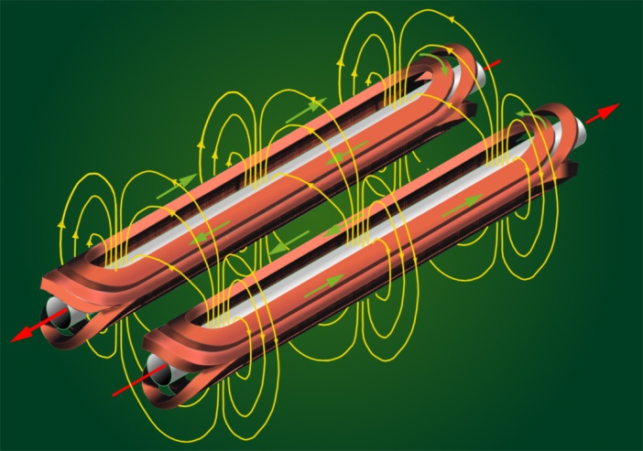
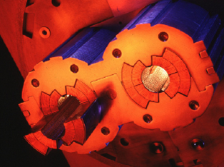
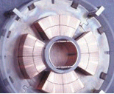
WHY SUPERCONDUCTIVITY for MAGNETS ?
Superconducting magnet is required for high energy or high current applications
    Reduction of radius of curvature and power consumption
    With room temperature magnets, the LHC circumference would be 120 km and the power consumption impossible to handle
    Bigger beam pipe aperture as B ∝ I₀/aperture for dipole , I₀/aperture² for quadrupoles
    Bigger transverse acceptance
    Less beam losses, Less contraints for alignment.
http://www.lhc-closer.es/1/4/6/1

Slide 6
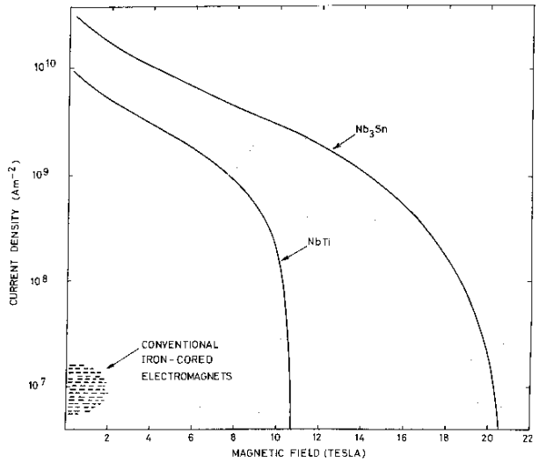
WHY SUPERCONDUCTIVITY for MAGNETS ?

Slide 7
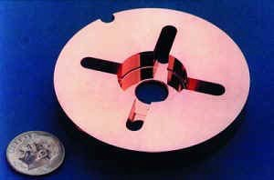
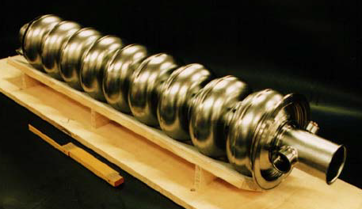
WHY SUPERCONDUCTIVITY for ACCELERATION ?
Superconducting RF is compulsory for CW high-current operations :
for a given Vacc, NC, P_{RF} ∝ ω^{-1/2} , for SC, P_{RF} ∝ ω
Lower frequency ⇒ Larger longitudinal acceptance
Larger structure ⇒ Larger transverse acceptance
      Reduced beam losses
Energy efficiency is better : P_{cryo} + P_{RF-SC} < P_{RF-NC}
For SC cavities P_{RF-SC} ~ 10 W (Qo ~ 5E9) @ 6.4 MV/m
To accelerate : P_{RF} ~ 10W + P_{beam}, Pcryo ~ (10W+10W)*500 ~ 10 kW => IN TOTAL : P_{lost} ~ 10.01 kW
For NC cavities P_{RF-NC} ~ 100 kW (Qo ~ 5e5) @ 6.4 MV/m
To accelerate : P_{RF-NC} ~ 100 kW + P_{beam}, Pcooling ~ 100 kW => IN TOTAL : P_{lost} ~ 200 kW
Higher accelerating gradient achievable in CW
(in practice… not in theory) as P_{RF} ∝ Eacc².
      Reduced linac length
  - If CW => low accelerating gradient
  (RFQ : Eacc ~ 0.3 MV/m, 100kW on 4m)
  - If High gradient => low duty cycle (< 10%)
NLC, 11.4 GHz
NC
SC
1m
NC = Normal conducting
SC = Superconducting
Elliptical cavity, 1.3 GHz

Slide 8
WHY SUPERCONDUCTIVITY ?
    For NC cavities, power dissipation is the main constraint. Design is optimized to limit dissipations
    For SC cavities, power dissipation is less a constraint. Design is more free to optimize other parameters (acceptance, stability, …).
    BUT SC technology is a complementary solution because it has its own weaknesses :
        For magnets :
        Huge magnetic forces requires very stiff mechanical structures (training of magnets)
        Huge magnetic energy released if a quench happens (can quench if small displacement of wires of few microns!!)
        Very slow to ramp up or decrease field (magnetization)
        Need to be housed in a “cryomodule” ⇒ complex design
        Careful with energy deposition because of synchrotron radiation
        For cavities :
        Very sensitive (quench, Q-switch, surface resistance, trapped magnetic flux, Q-disease,…).
        More expensive (materials, larger structures)
        Need more time to mature a design as more complex
        Need to be housed in a “cryomodule” ⇒ complex design

Slide 9
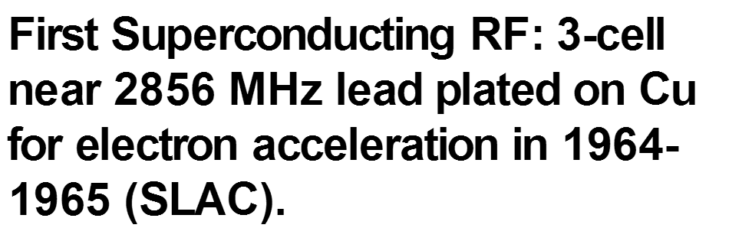
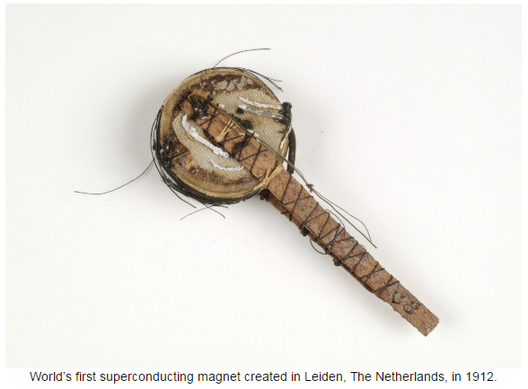
Superconductivity : history
  Some history :
    1868 : Discovery of Helium. Astronom Jules Janssen (France) noticed the yellow spectral emission lines of a new element in the chromosphere during a sun eclipse. Observed also in 1870 by J. N. Lockyer and named this new element from the sun : Helium as reference to the greek name of sun : “helios”.
    1877 : Oxygen (90K) and nitrogen (77K) liquified by Louis Cailletet (France) and Raoul Pictet (Switzerland)
    1893 : James Dewar invented the dewar vase.
    1895 : Helium is discovered on earth by sir W. Ramsay (England)
    1898 : Hydrogen (20K) liquified by Sir James (England)
    1908 : Kamerlingh Onnes liquified Helium
    1911 : Kamerlingh Onnes discovered superconductivity of mercury while studying the electrical behaviour of metals at low temperature.
    1933 : Walther Meissner discovered the Meissner effect : perfect diamagnetism
    1935 : “Two fluids model” by F. London
    1950 : Ginzburg-Landau theory
    1957 : BCS theory (Bardeen, Cooper and Schrieffer)
    1987 : Discovery of Y-Ba-Cu-O, first material with Tc > 77K

Slide 10
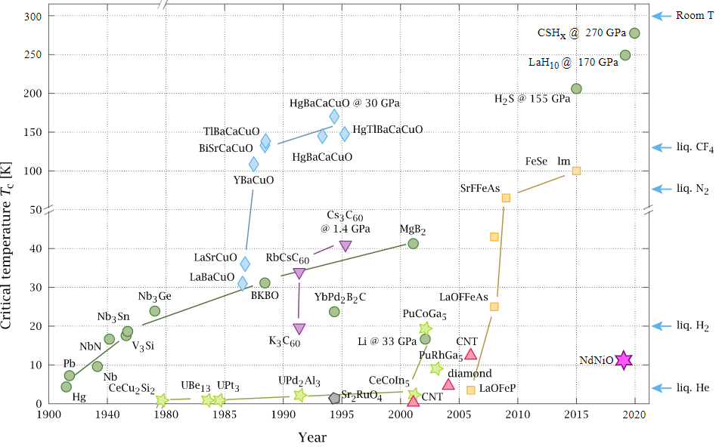
Superconductivity : history
O. Gingras. "La supraconductivité non-conventionnelle du ruthénate de strontium: corrélations électroniques et couplage spin-orbite". Université de Montréal, Faculté des Arts et des Sciences. Montréal, Canada, 2022.

Slide 11
Superconductivity : « the 2 fluids model »
  Phenomenological approach based on analogy with superfluidity (validity : T << Tc)
  Coexistence of normal and superconducting (“frictionless”) electrons N = n_{s}(T)+ n_{n}(T)
  2 fluids model ⇒ σ = σ_{n} + _{i}σ_{s} ⇒ solving the equation of propagation in a conducting material :
 | Normal conducting electron | Superconducting electron
Electronic density | N_{n} | N_{s}
Current-Electric field relation
For a sinusoidal electric field
Conductance
Maxwell équations

Slide 12
Superconductivity : « the 2 fluids model »
  Surface resistance defined as Zs = Rs+i·Xs
  Interesting results : - Skin depth does not depend on frequency!
  - Rs is bigger for good conductors (metals)!
  This model does not explain existence of a critical magnetic field and its temperature dependence!
      To know the behaviour close to phase transition, we need another model
 | Normal conductor | Superconducting material (T<< Tc)
Electronic density | N_{n} | N=N_{n}+N_{s} with N_{n} << N_{s}
Skin depth
Surface resistance

Slide 13
Superconductivity : Ginzburg-Landau theory
  Phenomenological approach based on second order phase transition of free energy
  Validity : for T ~ Tc
  The superconducting state is stable
  ⇒ Its free energy is lower than the normal state.
  Superconductivity can be broken by magnetic field
  ⇒ Critical magnetic Hc can be defined
  Complex superconducting order parameter is defined by :
  For T ∼ Tc, Ψ is small, the free energy can be expanded in a taylor series :
  With α₀, m* and β are phenomenological parameters >0, Tc is the temperature of phase transition.
  Here appears that temperature and magnetic field impact directly the difference of free energy and thus the stability of the superconducting phase.
With

Slide 14
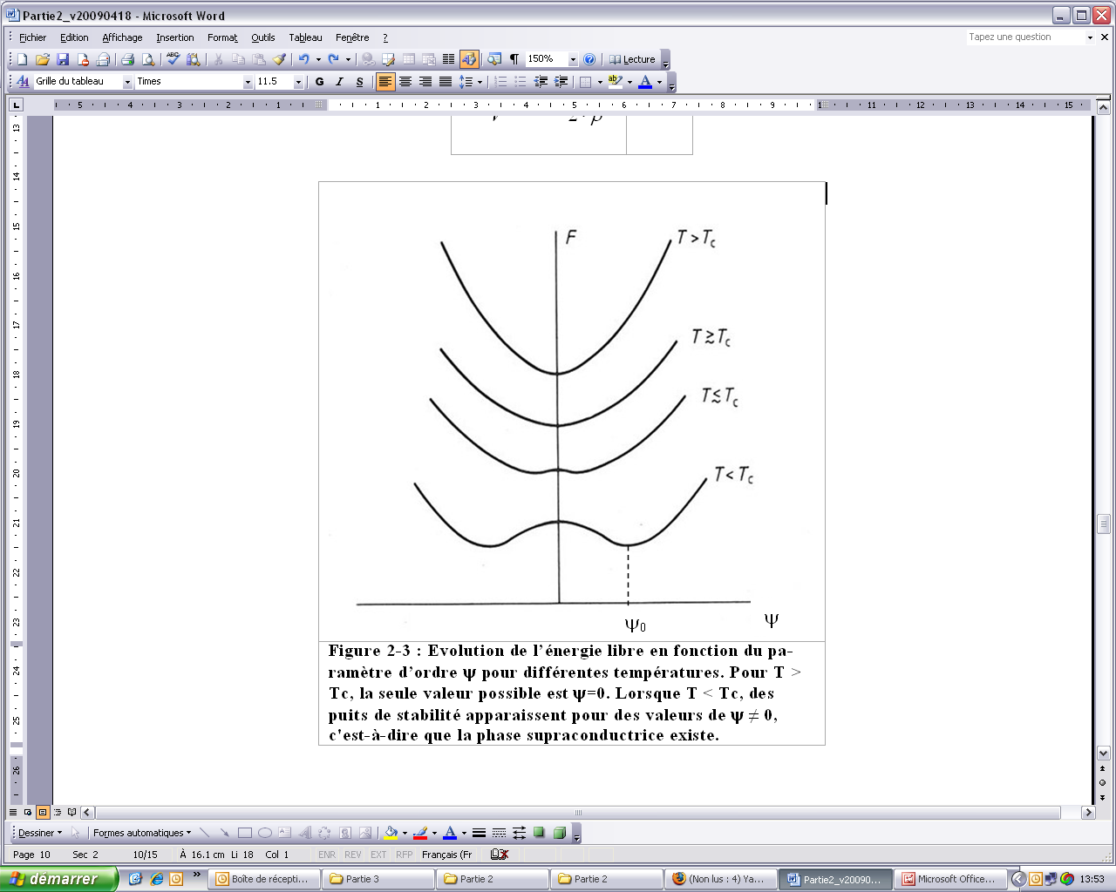
Superconductivity : Ginzburg-Landau theory
  If we assume no magnetic field, the equation simplifies as :
  If α(T)>0 ⇒ T>Tc ⇒ Fs>Fn, superconducting phase cannot exist as Ψ can only be 0
  If α(T)<0 ⇒ T<Tc ⇒ Fs<Fn, superconducting phase can exist as Ψ ≠ 0
              For T~ Tc,
              Very close to the empirical formula
              Ginzburg-Landau equations predicted 2 new parameters :
                Penetration depth of magnetic field
                Coherence length : ~ penetration depth of superconductivity

Slide 15
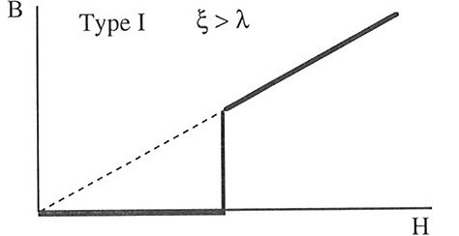
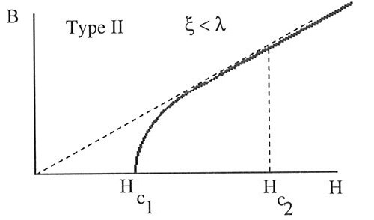
Superconductivity : Type of superconductors
  A parameter κ, independent of temperature, can be defined as the ratio between λ and ξ
  For 0< κ<1/√2, normal and superconducting phase can’t coexist in the material TYPE I
            ⇒ Meissner effect is total
  For κ> 1/√2, normal and superconducting phase can coexist (energetically favorable) above a field Hc₁ in the material TYPE II ⇒ Meissner effect is partial
Hc

Slide 16
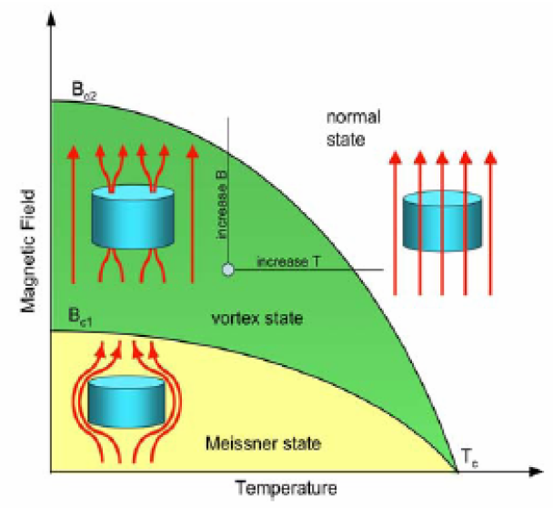
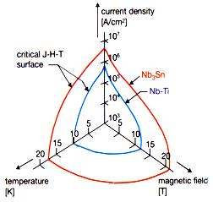
Superconductivity : Type of superconductors
  Solving Ginzburg-Landau equations shows that the normal zones are cylindrical and are called vortices with a elementary magnetic flux

Slide 17
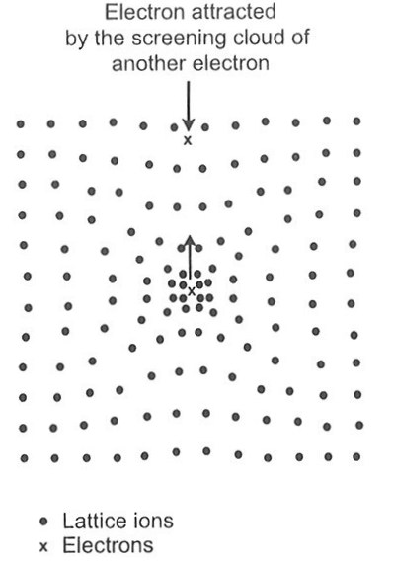
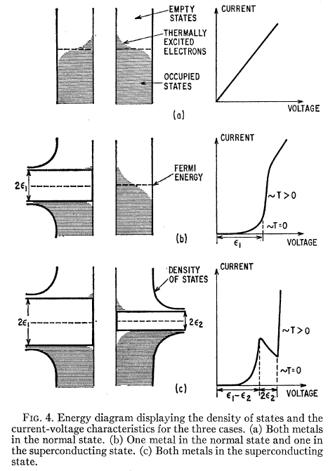
Superconductivity : BCS THEORY
  Theory based on quantum mechanics made up by Bardeen, Cooper and Schrieffer (1957)
  Superconductivity comes from the interactions between conduction electrons and vibrations of atoms (phonons).
  Nothing to do with nature of atoms but with their arrangements (crystal structure)
  An electron creates a positive screening cloud around itself (attraction of positive ions of the lattice) that creates an attractive force for another electron
      2 electrons are paired : Cooper pair (opposite spin and momentum)
  To break a Cooper pair, a finite energy of is required
  The bigger the normal resistivity, the bigger the electron-phonon interaction, the bigger the pairing energy.
Normal conductor
Superconductor
2Δ

Slide 18
Superconductivity : BCS THEORY
  BCS theory predicted the following formula for the surface resistance of a superconductor :
  Depend on material properties.
  Depend on temperature (probability of a Cooper pair to be broken by thermal agitation)
  To be compared to London formula :
2Δ

Slide 19
Superconducting materials : what is used today ?
Material | Hc (mT) | Hc1(mT) | Hc2 (T) | Tc (K)
Sn | 31 | / | / | 3.72
Hg | 41 | / | / | 4.15
Pb | 80 | / | / | 7.2
Nb | 200 | 170 | 0.4 | 9.2
NbTi | ? | 10 | 15 | 10
Nb3Sn | 540 | 50 | 30 | 18
MgB2 | 430 | 30 | 3.5 | 40
NbN | 230 | 20 | 15 | 16.2
YBaCuO | 1400 | 10 | 100 | 93
Best for cavities (Bc1 matters)
Best for magnets (Bc2 matters)

Slide 20
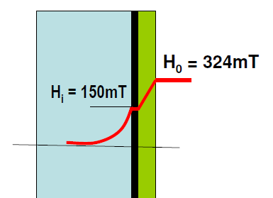
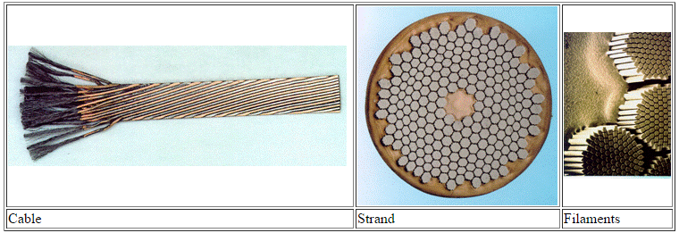

Superconducting materials
  Cavities :
    Best material : Bulk Niobium : mechanical and physical properties
    are optimal. Metal => high formability and workability.
    New materials : MgB2, Nb3Sn, … alloys can’t be worked easily
    => thin layer deposition on Niobium or multilayer (SIS).
  Magnets :
    Rutherford cable : NbTi filaments embedded in a copper matrix
    Heat and current extraction. Example : LHC magnets :
    New material : Nb3Sn to achieve 15 T but very brittle!
  http://lhc-machine-outreach.web.cern.ch/components/cable.htm
In LHC :
1200 magnets
7600 km of cable
36 strands per cable
6400 filaments per strands
Total length of filaments
10 times the distance between earth and sun !!!
0.825 mm
6 um

Slide 21
OUTLINE
  Cryogenics
    What’s the right temperature of operation?
    Cryostats and interfaces
  Operation of an accelerator (from perturbations to failures)
    Perturbation during operation (focus on accelerating cavities)
    Failures during operation
    Beam losses

Slide 22
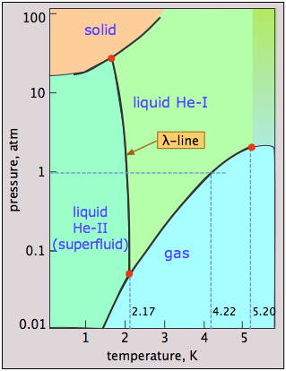
CRYOGENICS ( what’s the right T° ?)
    Superconductivity requires to operate cavities (Nb) and magnets (NbTi) below 9.2K and 10K : only liquid helium at 4.2 K :
    BUT :
      Very low latent heat of vaporization and very expensive to liquefy (> 25 €/L today from a company)
      Critical field depend on temperature :
      ⇒ Hc(4.2K) = 0.8H₀
      Surface resistance depend on frequency and temperature :
      Power dissipation is limited by heat
      exchange coefficient :
      high power dissipations may require to
      operate with superfluid helium < 2K.
Element | T_{liq} (K)
Helium | 4.2
Hydrogen | 20.4
Neon | 27.1
Nitrogen | 77.4
Oxygen | 90.2
RBCS (nΩ) | 4.2K | 2.2K | 2K | 1.8K | 1.5K
1300 MHz | 600 | 33 | 15 | 6.5 | 1.2
700 MHz | 174 | 9.5 | 4.3 | 1.9 | 0.35
352 MHz | 44 | 2.5 | 1 | 0.48 | 0.09
88 MHz | 3 | 0.15 | 0.07 | 0.03 | 0.006

Slide 23
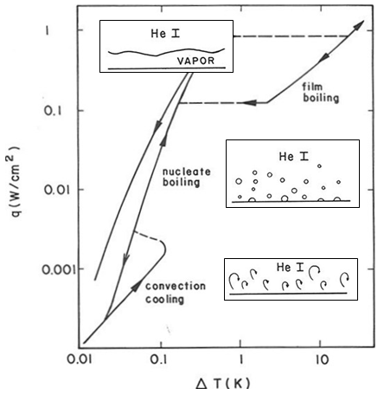
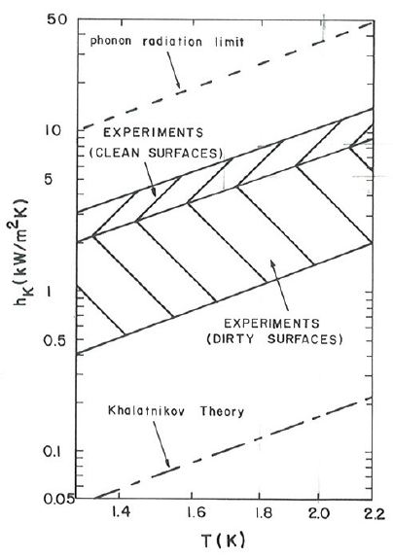
CRYOGENICS
Normal helium
Superfluid helium
~100 W/m²/K
~ 5000 W/m²/K
S. W. Van Sciver, “Helium cryogenics”, Plenum press, 1986

Slide 24
OUTLINE
  Cryogenics
    What’s the right temperature of operation?
    Cryostats and interfaces
  Operation of an accelerator (from perturbations to failures)
    Perturbation during operation (focus on accelerating cavities)
    Failures during operation
    Beam losses

Slide 25
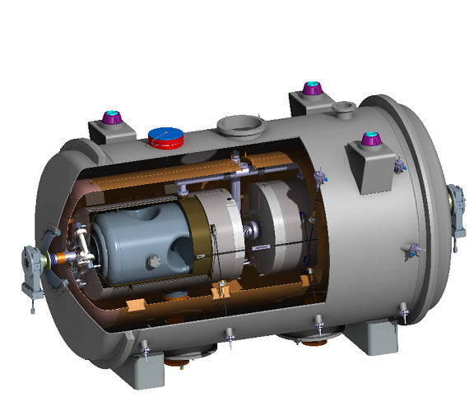
MAIN COMPONENTS in a CRYOMODULE
ESS Spoke Cryomodule
Vacuum vessel
  Interface (valves, beam pipe)
  Thermal Insulation
  Limiting convection losses
Cryogenic piping (supply and exhaust)
Superconducting cavity
Vacuum vessel
Supporting components
  Supporting and positioning
  the cold mass
  Limiting conduction losses
Beam
Thermal shields
  Thermal Insulation (80K)
  Limiting radiation losses
2K
MAIN COMPONENTS
Cryogenic piping
  Cryogenic environment
  Ensuring supply of Lhe and
  degassing of GHe
300K
Magnetic shield
  Reduction of earth
  magnetic field
Thermal shield
Magnetic
shield
Cold mass (cavities, magnets)
Supporting components : support + alignment
Frequency tuning system
RF power coupler

Slide 26
CRYOGENICS (thermal insulation)
300K vacuum tank
Heat sink
Piping, wiring
50-80K shield
+ MLI (30 layers)
1.5-4K cold mass
+ MLI (10 layers)
Mechanical support
Beam tube
Current leads
Power coupler
Radiation
Conduction

Slide 27
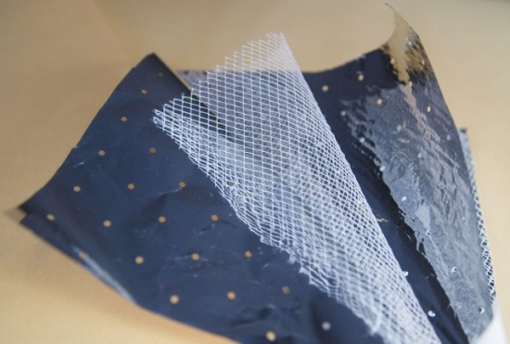
CRYOGENICS
        Superconducting structures cooled by helium have to be isolated in “cryomodules” :
    Limit heat losses by reducing :
      Conduction : ↑ thermal resistivity (material), ↓ surface area, ↑ length , liquid nitrogen heat sinks.
      Convection : under vacuum
      Radiation : liquid nitrogen shield, multi-layer insulation (MLI) : multiple high reflective foils (aluminized mylar) separated by low conduction spacer (bridal veil)
    ⇒ Do not disturb magnet or cavity operation :
      Thermal stability : constant and homogeneous temperature of cavity or magnet even with power losses.
      Interfaces : RF and electrical feedthrough, instrumentation.
      Mechanical stability : keep alignment although thermal contractions, pressure forces, low mechanical vibration transmission.

Slide 28
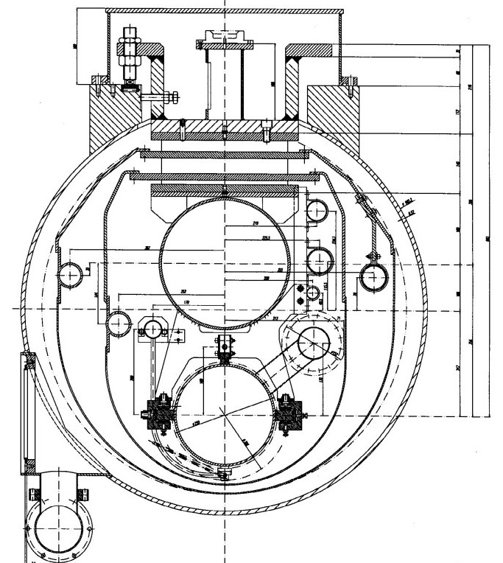
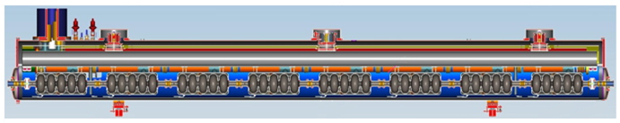
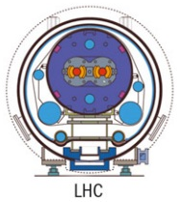
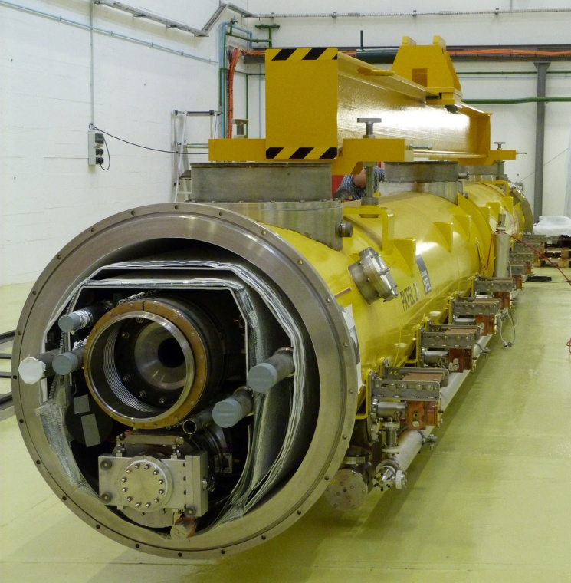
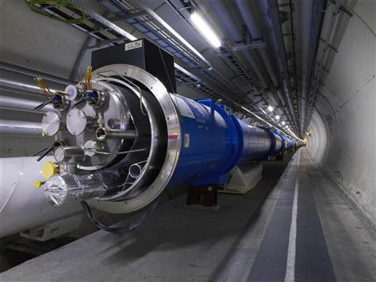
CRYOGENICS ( high energy cryomodules)
Support post
Vacuum vessel
GRP
Invar rod
2 phase
pipe
Sliding support
XFEL
70K shield
Coupler port
4K shield
Cavity
XFEL
LHC

Slide 29
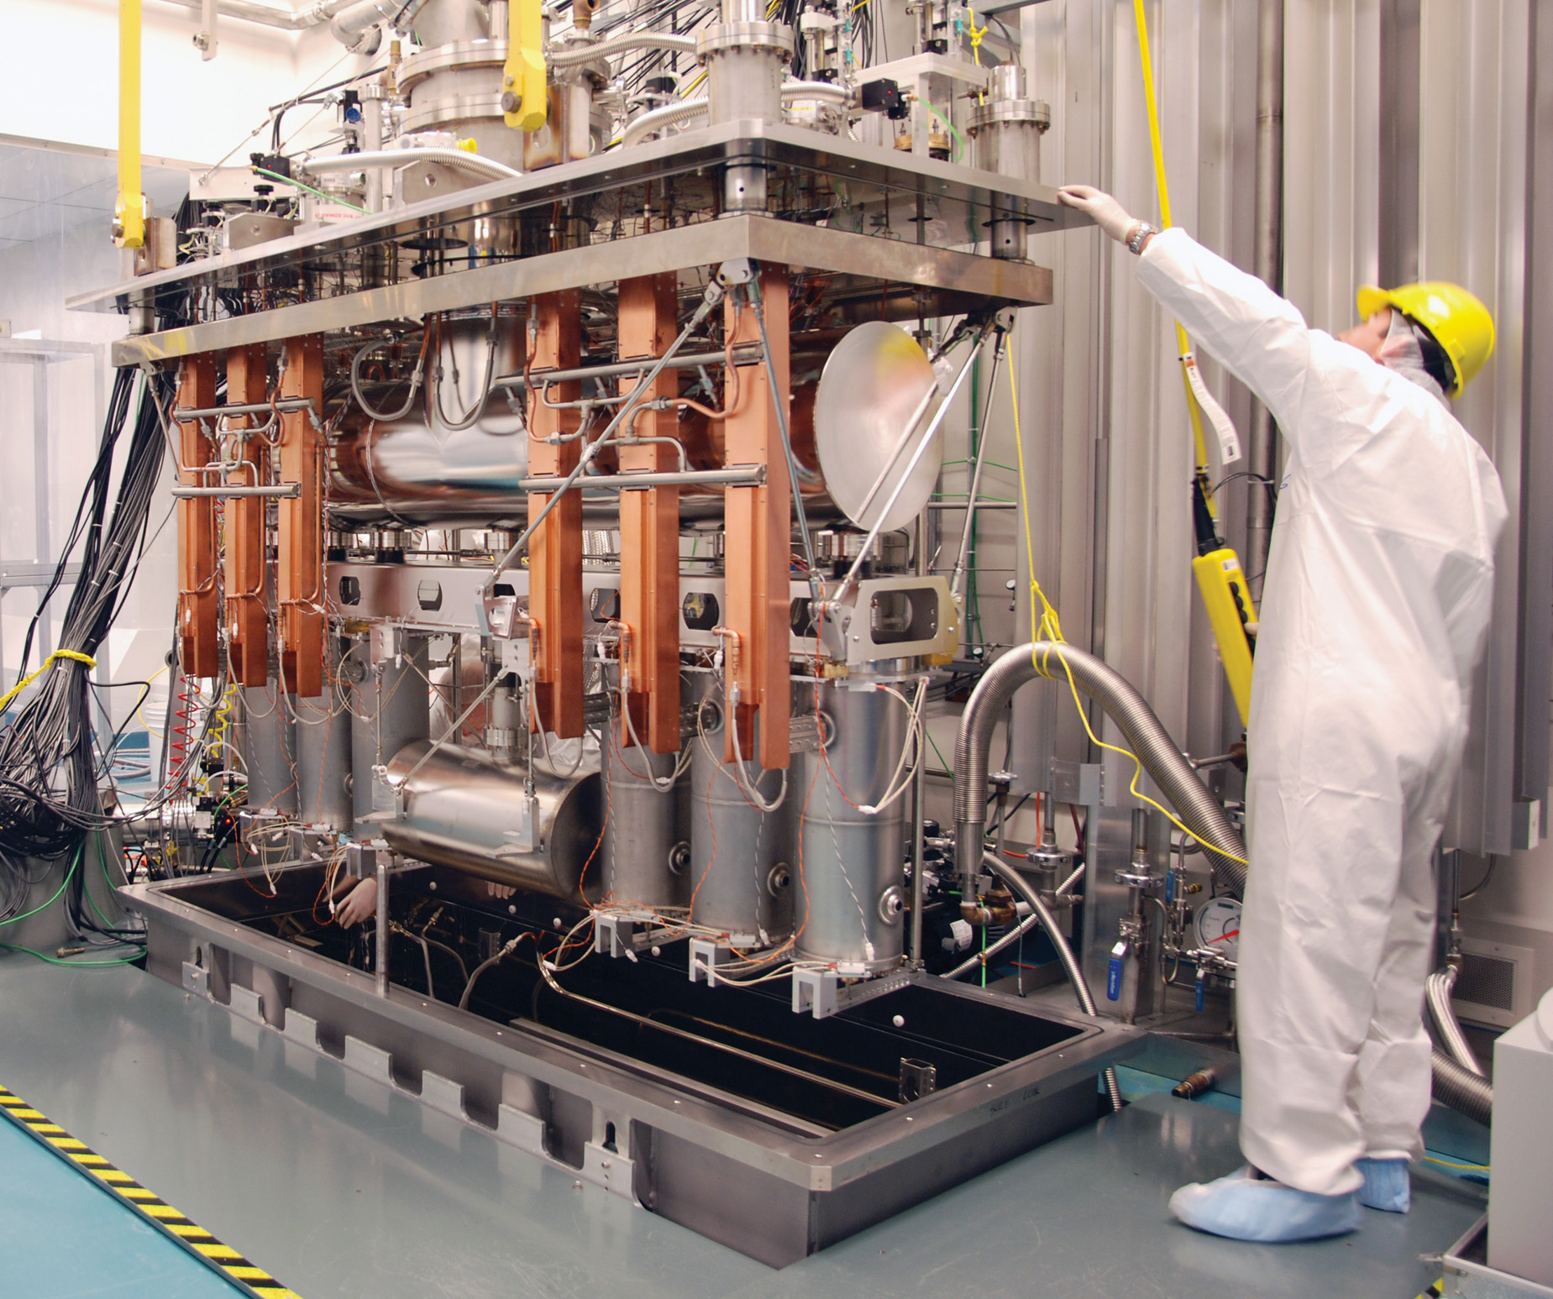
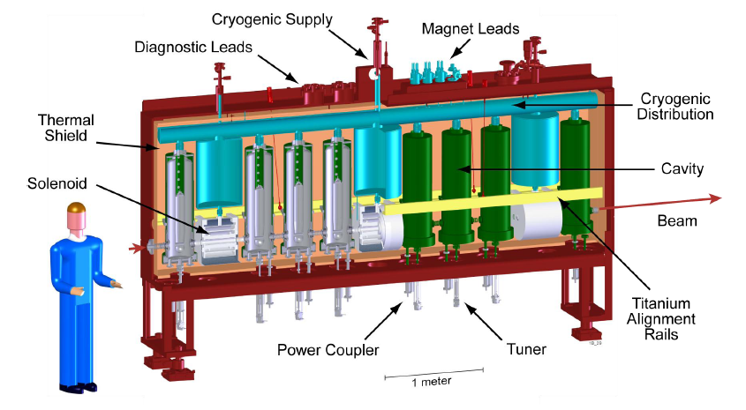
CRYOGENICS ( low energy cryomodules)
FRIB Cryomodule
ISAC2 cryomodule @ TRIUMF
https://frib.msu.edu/

Slide 30

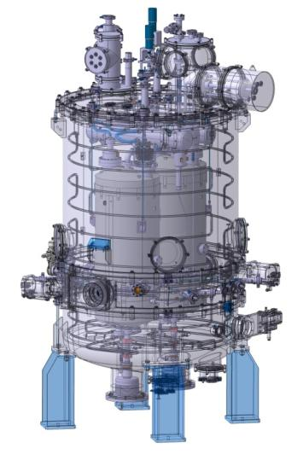
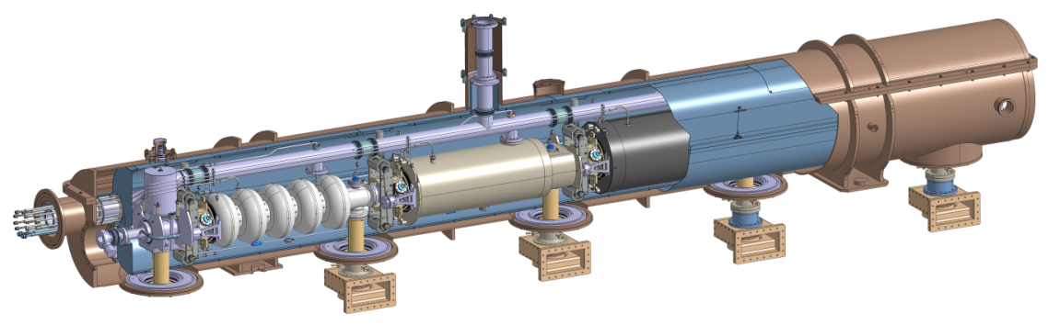
VACUUM VESSEL
Examples of vacuum vessel studied at IJCLab:
SPIRAL2 Cryomodule B:
ESS Spoke Cryomodule:
∅1,3m
2,8m
MAIN COMPONENTS
2,8m
∅1,16m
SPL Short test Cryomodule:
∅0,8m
~ 7m

Slide 31
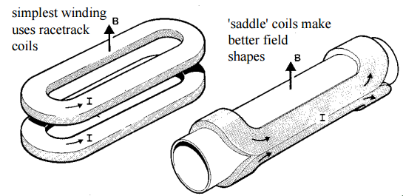
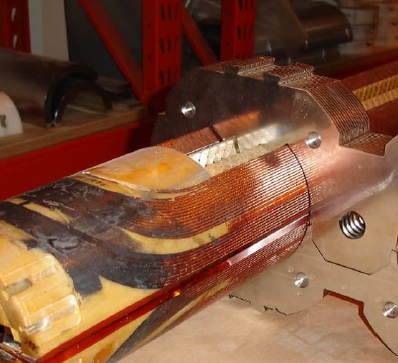
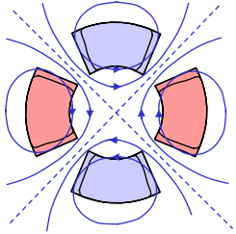
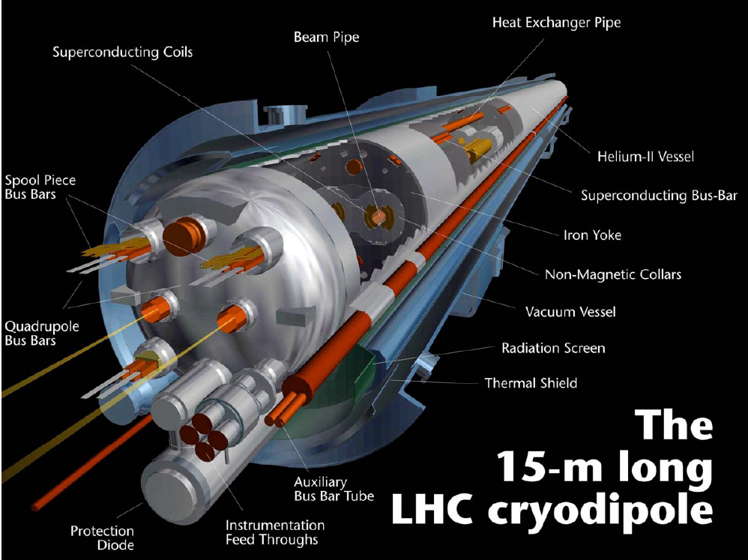
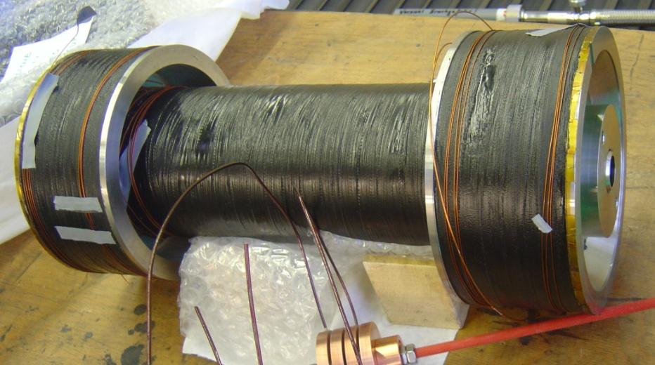
CRYOGENICS :Superconducting magnets
DIPOLES
QUADRIPOLES
SOLENOID+BUCKLING COILS

Slide 32
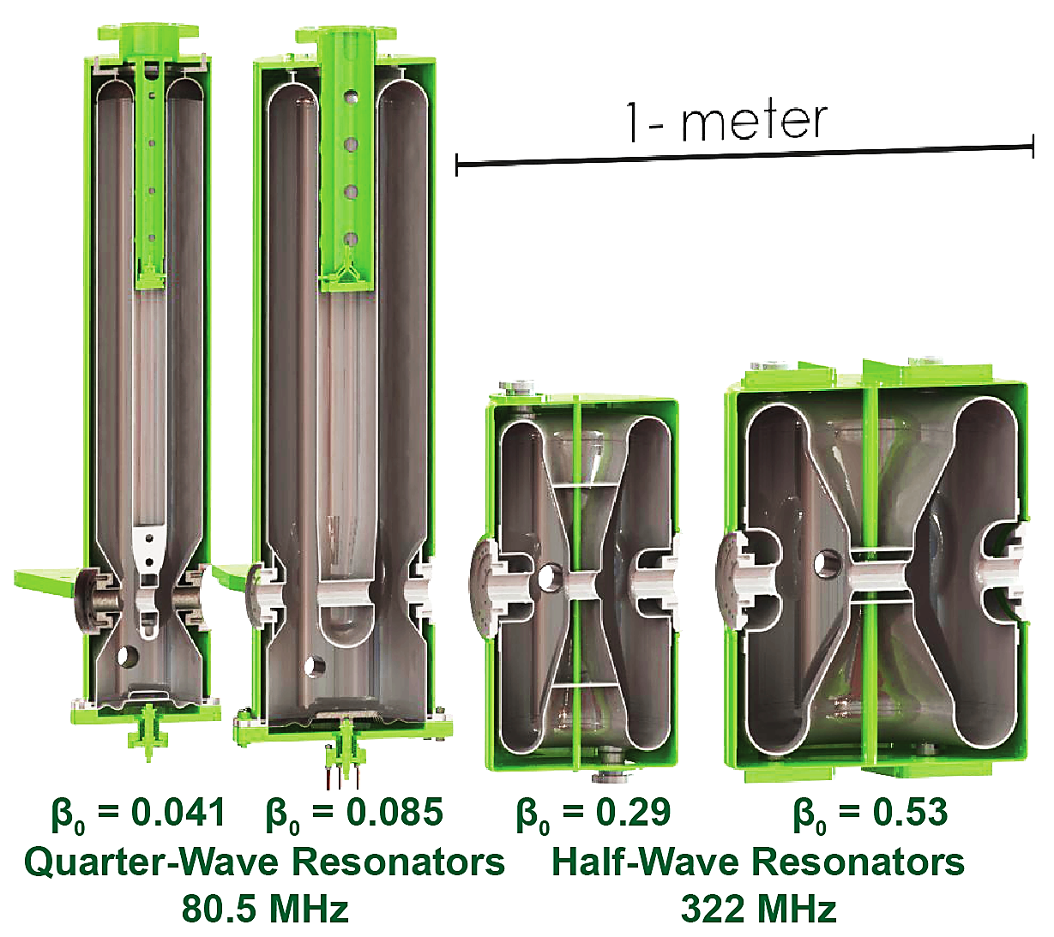
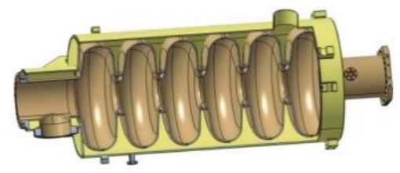
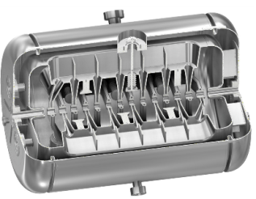
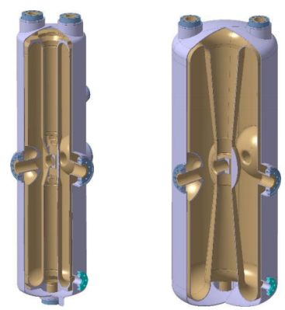
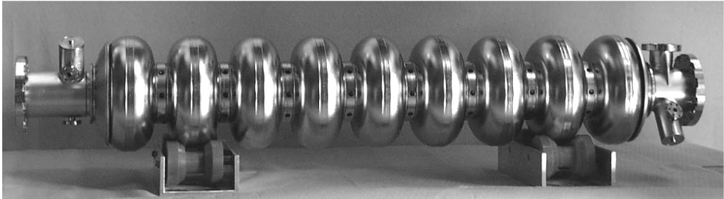
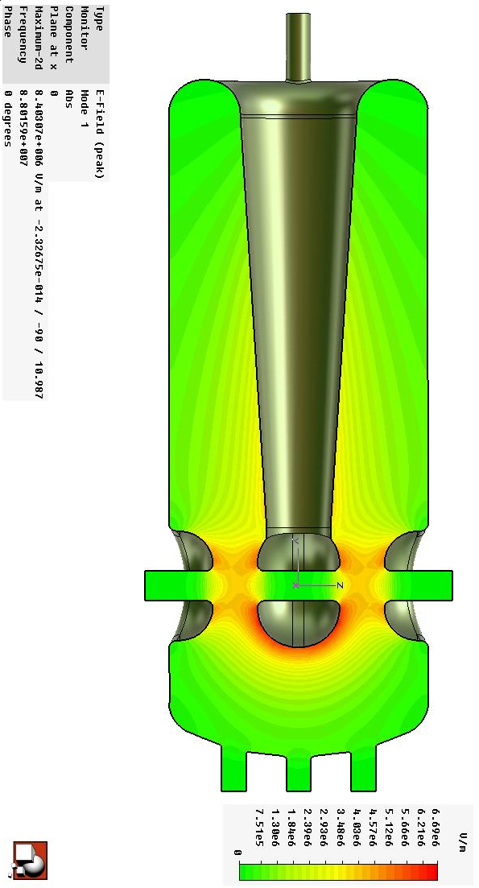
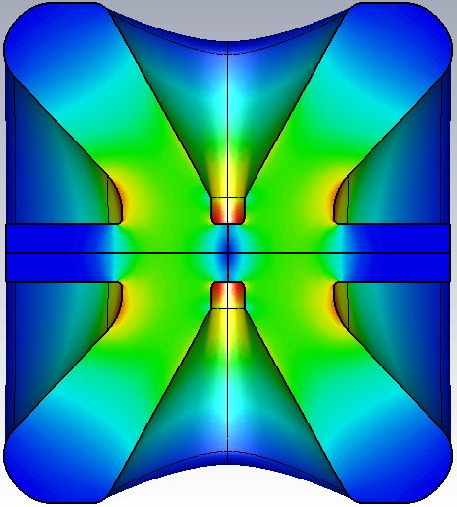
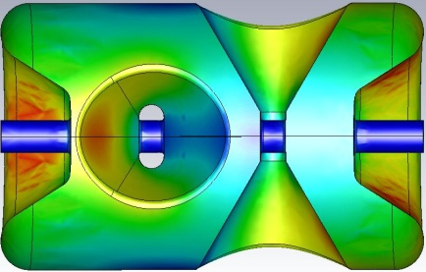
CRYOGENICS :Superconducting cavities
  Particle velocity (β) ⇒ Cavity frequency (Fo)
0.03
0.15
0.3
0.65
1
β
Quarter-Wave resonators
(80-150 MHz)
Half-wave resonator (150-400 MHz)
Elliptical cavity (700-3000 MHz)
2K
CH resonator
(200-350 MHz)
ESS β=0.67, 700 MHz
4K
IAP β=0.07, 215MHz
R_{BCS} (nΩ) | 4.2K | 2K | 1.5K
1300 MHz | 600 | 15 | 1.2
700 MHz | 174 | 4.3 | 0.35
352 MHz | 44 | 1 | 9E-2
88 MHz | 3 | 7E-2 | 6E-3
SARAF β=0.091, 176MHz
β=0.181, 176MHz
XFEL β= 1, 1.3 GHz
SPIRAL2, β=0.12, 88 MHz
ESS β=0.5, 352 MHz
MYRRHA β=0.37, 352 MHz

Slide 33
Operation of an accelerator (from perturbations to failures)
    Perturbation during operation (focus on accelerating cavities)
      Frequency perturbations (microphonics, Lorentz detuning)
      Multipacting
      Field emission
      Quench
    Failures during operation
      Type of failures
      Statistics
    Beam losses

Slide 34
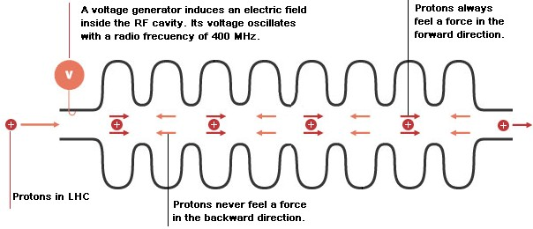
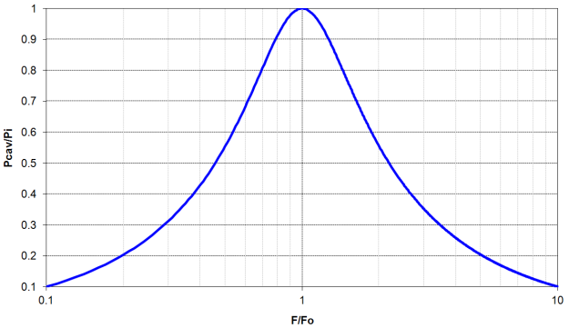
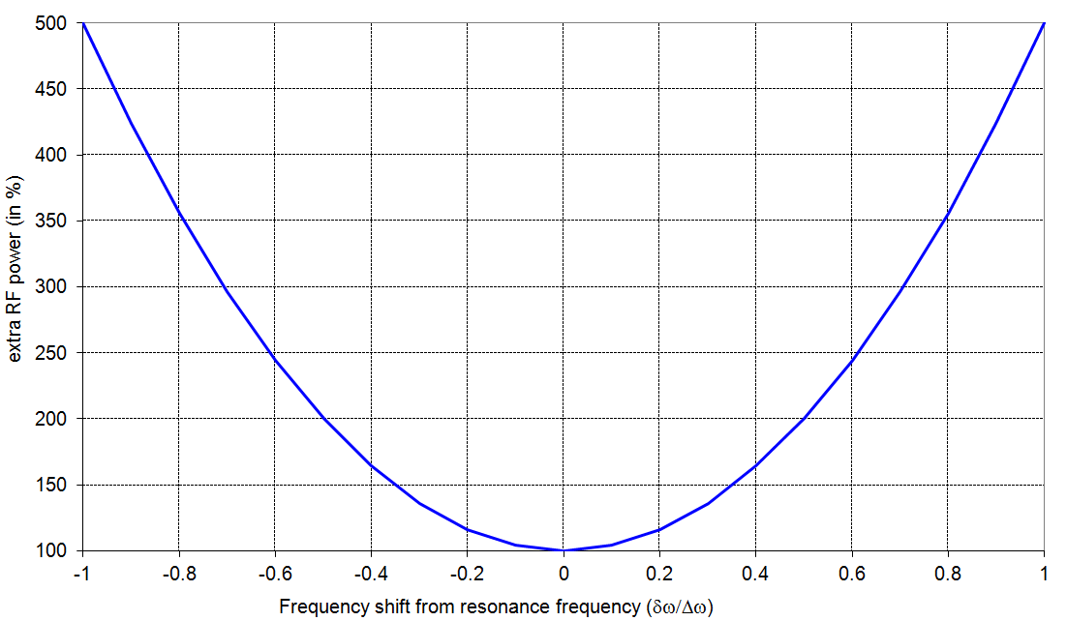
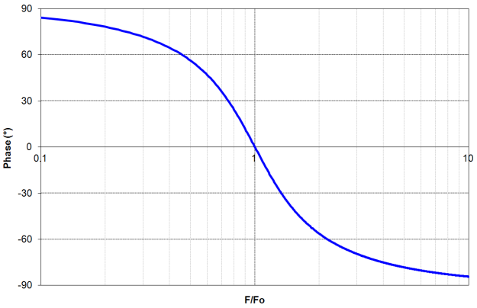
PERTURBATIONS : frequency perturbations
  The frequency of RF cavities have to be
  exactly synchronized to beam frequency
  (bunched beam, see longitudinal beam
  dynamics).
  ⇒ Master oscillator.
  RF power is generated at fixed frequency
  But cavity is a resonator (second order filter)
  with a resonance frequency F₀ subject to perturbations.
  ⇒ F₀ has to be tuned permanently to match RF frequency
amplitude
Additional RF power required versus cavity detuning
phase

Slide 35
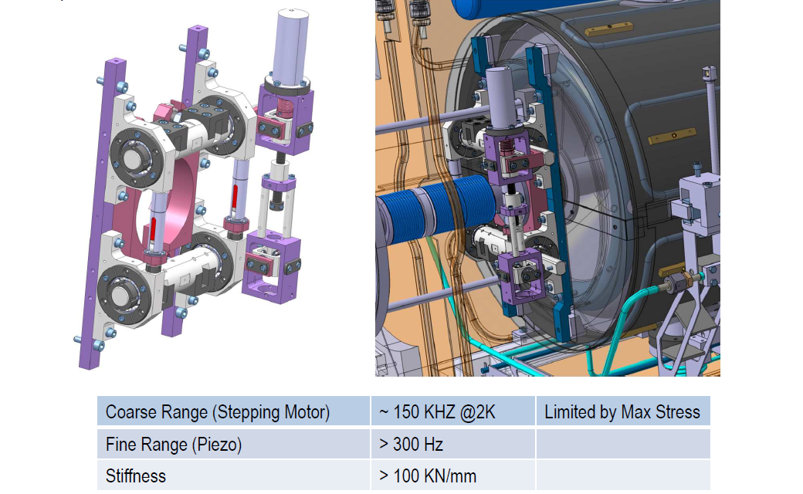
Example of frequency tuner system
Piezo-electric actuators
Stepping motor

Slide 36
PERTURBATIONS : frequency perturbations
  RF regulation loop to compensate several type of frequency perturbations :
      Static or very slow perturbations : fabrication errors, thermal contraction, pressure forces, Lorentz forces (CW), …
      ⇒ Compensated by frequency tuning system (motor)
      Dynamic perturbations : mechanical resonance (microphonics), Lorentz forces (pulsed operation), …
      ⇒ Compensated by frequency tuning system (piezo) and RF regulation loop (LLRF)
Vibration sources | area | Frequency range
Primary pumping system | Close to cryostat | 50 Hz
Turbo pump | Close to cryostat | kHz
Valves / motors | Cryostat | pulse
Helium boiling | Cavity | Depends on dissipations
Lorentz forces (pulsed) | cavity | RF pulse
Human activity | Environment | Tens of Hz

Slide 37






PERTURBATIONS : frequency perturbations
  Microphonics : resonance frequency perturbations caused by mechanical resonance of cavity
Frequency detuning (Hz)
67 Hz
230 Hz
355 Hz
420 Hz
480 Hz
Mechanical frequency (Hz)
Example of mechanical resonance of quarter wave resonator for Spiral2

Slide 38


PERTURBATIONS : frequency perturbations
  Lorentz forces : Mechanical deformation caused by electromagnetic pressure radiation
Example of lorentz forces on 1-cell elliptical cavity

Slide 39



PERTURBATIONS : Multipacting
  Multiplication of electrons in resonance with RF field
  RF power goes into electron avalanche instead of charging up the cavity
  Requirements to meet resonance conditions
      Geometry
      Field distribution
      Coefficient of secondary electron emission

Slide 40



PERTURBATIONS : Multipacting
  Observed as a “barrier” when Q₀ versus accelerating gradient is plotted.
  Can be processed with time by increasing RF power.
Eacc = 0,103 MV/m
Eacc = 1,3 MV/m
Accelerating gradient (MV/m)
Spiral2 cavity

Slide 41


PERTURBATIONS : Field emission
  Electrons are extracted from the surface by the electric field (tunnel effect).
  For a perfect flat surface, no emission up to few GV/m
  But because of surface defects, pollution ⇒ Enhancement of electric field
  Electron emission is thus possible as low as few MV/m.
  The electron current follows the Fowler & Nordheim
  quantum theory

Slide 42



PERTURBATIONS : field emission
  Observed as a rapid decrease of the Q₀ versus accelerating gradient.
  What are the induced limitations :
      X-rays emission by brehmsstrahlung : safety problems
      Local heating can provoke early quench
      Additional dissipation in helium bath
  Can be avoided by extensive cleaning of cavity (High pressure rinsing, clean room assembly)
  Can be processed by simple increasing RF power or by injecting He gas to favor emission
Spiral2 cavity

Slide 43

PERTURBATIONS : quench
  Superconducting properties are lost because of :
        A too high magnetic field (Hc1 for cavities, Hc2 for magnets)
        A too high temperature
        A too high current density
  Quench can happen at lower magnetic field or temperature than theoritical one because of
        Surface defect : local enhancement of magnetic field
        Surface pollution : local heating (field emission, resistive defect, vortices…)
        Filament motion under magnetic forces
  Structures (cavity or magnet) can be “trained” to push away the quench if possible
        For cavities not so dangerous as no energy is stored but careful in case of high current beams
        For magnets, the quench can be really destructive

Slide 44



accident : example LHC in 2008
Courtesy of R. Schmidt, CERN
  A superconducting wire had a defect and quenched.
  Electrical arc punctured helium circuit and degraded isolation vacuum ⇒ helium boiled off quickly and huge pressure wave destroyed about 30 magnets

Slide 45

Failures during operation
  Several type of failures : operation error, equipment failure, external (electrical supply), experiments
  And at different stages of acceleration :
        At low energy, minor damages as beam power and stored energy is low.
        At high energy, minor damages if protection system is fast enough
              severe damages if protection too slow, not well dimensioned or inexistent
Machine protection system shut off beam in less than 30 µs
Spallation Neutron Source, Oak Ridge

Slide 46

Failures during operation : LHC example

Slide 47


BEAM LOSSES
  Continuous beam losses :
  Due to residual gas stripping, intra-beam stripping, misalignment of components, beam shaping and handling (collimation, chicane, chopper, …)
        Safety problems (activation), maintenance delays, slow pollution in RF cavities, …
        Reduced with beam cleaning (collimation), bigger apertures, CW operations (compared to pulsed operations), components adjustment, …
        1W/m is usually the upper limit.
Courtesy of J. L. Biarrotte

Slide 48

BEAM losses : examples
  Occasional beam losses (accident):
  RF or magnetic regulation loop perturbations, ion source fluctuations, interlocks, cavity or magnet failure, …
        Can cause severe damages with high power beams (beam tube melting, leak, pollution, explosion, …)

Slide 49


BEAM losses : examples
Spiral2 (GANIL) :
200 kW (CW)
SNS (Spallation Neutron Source, USA) :
1 MW (average)
ESS (European Spallation Source, Sweden):
5 MW (average)
LHC (Large Hadron Collider) :
4 TW (average)

Slide 50

BEAM losses : example LHC
Courtesy of R. Schmidt, CERN
Energy stored in LHC beam : 360 MJ enough to melt 5.6 tons of gold
  Beam losses have to be maintained very low
  In case of excessive beam losses, detection has to happen very quickly and beam has to be dumped immediately
9 GJ stored in dipole magnets enough to melt 45 tons of gold.

Slide 51
HOPE YOU ENJOYED KNOWING MORE ABOUT SUPERCONDUCTIVITY AND CRYOGENICS FOR ACCELERATORS
THE END

Slide 52



Example of 120°C baking : SPIRAL2 QWR @ IPNO
After 72h drying → 48 h baking @ 120°C
“Forced” air flow inside the helium vessel + heater on the cavity bottom
Cavity wrapped in a foil blanket
Input
~120°C
Output
~110°C
Heater
~110°C
Heater (not shown) glued onto the copper cap

Slide 53

The MYRRHA spoke cryomodule (6)

Slide 54


PERTURBATIONS : Q-disease or 100K effect
  When a cavity was cooled down or warmed up too slowly, the quality factor (i.e power dissipation) could fall of one order of magnitude.
  The hydrogen trapped in Niobium precipitates in an ordered phase (β), which shows no superconducting properties ⇒ surface resistance is degraded
  Hydrogen sources : surface treatment (chemical etching), residual gas in atmosphere.
  If fast cool down, no time to precipitate (<1h between 150K-50K)
  Solution to avoid Q-disease : high temperature degassing at 600°C during 6h.
        but expensive and time consuming.
Spiral2 cavity

Slide 55



Slide 56


Slide 57

Superconductivity : history
From « The rise of the Superconductors », P.J. Ford, G.A. Saunders, CRC Press, 2005

Slide 58


Example : cryogenic piping of a cryomodule

Slide 59
Thermal contractions and stresses
Temperature field in an assembly ➔ Thermal contractions and stresses
2-4K
After the cool down, the temperature field in a cryomodule:
50-80K
300K
String of cavities
Thermal shield
MECHANICAL ASPECTS
➔ Some thermal contractions appear on all components:
With different temperatures
With different materials
String of cavities at 2/4K: niobium, titanium, stainless steel...
Thermal shields at 50/80K: copper, aluminium
Cryogenic lines from 2K to 300K: stainless steel, aluminium...
Supports from 2K to 300K
➔ Theses contractions can create some high thermal stresses.
Solving problem of stresses will depend on the type of connection between the components according to their function:
- Supporting,
- Transferring cryo fluid
- Vacuum circuit

Slide 60

CRYOGENICS (thermal contractions)
Cavity Sliders
ΔZ
ΔZ
Invar Rods
Table Slider
DX : 0.1 mm
DX : 0.4 mm
DX : 3,5 mm
Fixed Point
Mobile Point
LHC : total thermal contractions are 80m over the 27 km.

Slide 61


CRYOGENICS :Superconducting cavities
SPOKE
CAVITY
Frequency tuning system
Helium tank
Power coupler
ELLIPTICAL
CAVITY

