Slide 1
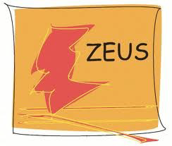

Precise proton structure and QCD measurements at HERA
V. Aushev
LAL, Orsay, July 10, 2012

Slide 2
Outline
e-p collider HERA;
Proton under the HERA microscope: physics highlights;
Between past and future of e-p physics: new results from ZEUS;
HERAPDF;

Slide 3
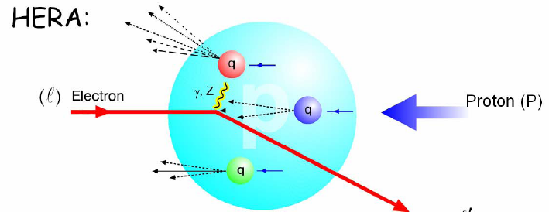
1992-2012: 20 years of DIS at HERA
Data taking at HERA ended in the summer of 2007: end of an era of research at the world’s only e-p storage ring facility in which particles with different masses are brought to collision;
Future ( > 2020 ):
EIC@JLAB
eRHIC@BNL
LHeC@CERN
One of possible physics objectives could be the e-p physics book.
Today: at least an occasion to take a backward look at this era and look ahead at what HERA still has to offer.

Slide 4
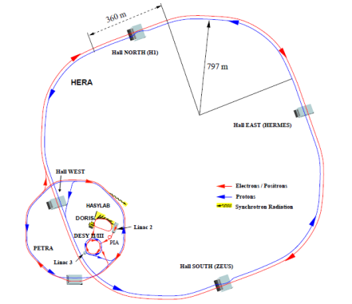
1980s: ambitious plan
1971: Bjorn Wiik’s ground-breaking
idea - construct a huge electron microscope for viewing protons.
But this idea slipped into the background:
in 1970^{s} physicists were obtaining a wealth of
exciting results from e+e- experiments.
However, once it became clear in the late 1970s
that CERN plans LEP,
DESY decided to adopt the idea
of the super electron microscope instead.
1980: first project study and proposal;
1984: groundbreaking ceremony;
1985: boring machine begins digging the tunnel;
1990: completion of HERA;
1991: first electron-proton collisions;
1992: research begins at HERA - experiments H1 and ZEUS;
HERA was the first facility of its kind, the most complicated accelerator project: accelerate electrons and protons separately and have then collide ;

Slide 5
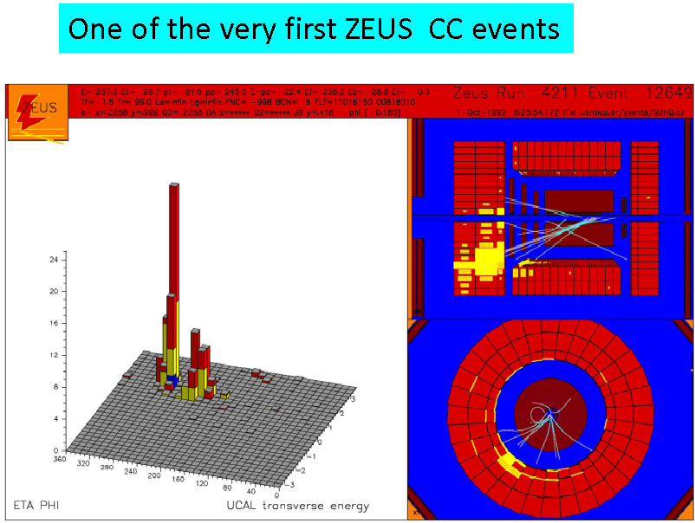
In 1992, the first two HERA experiments went into operation:
ZEUS in the South Hall and H1 in the North Hall.
These detectors were optimized for:
• Neutral and Charged Currents at high Q2;
• Exotics (leptons, missing Et, multi-jets…);
• Photoproduction studies;

Slide 7
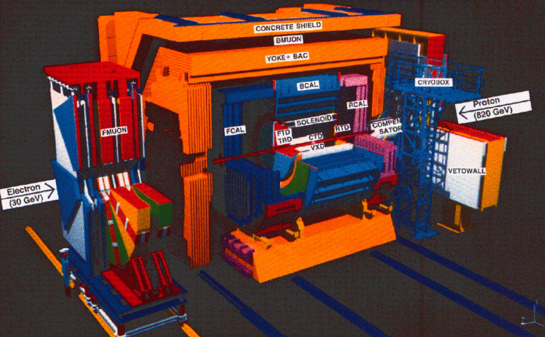
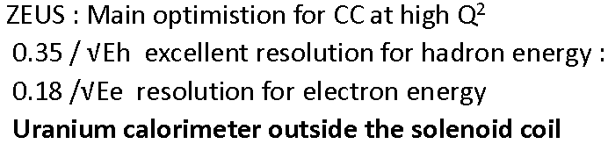

Slide 9
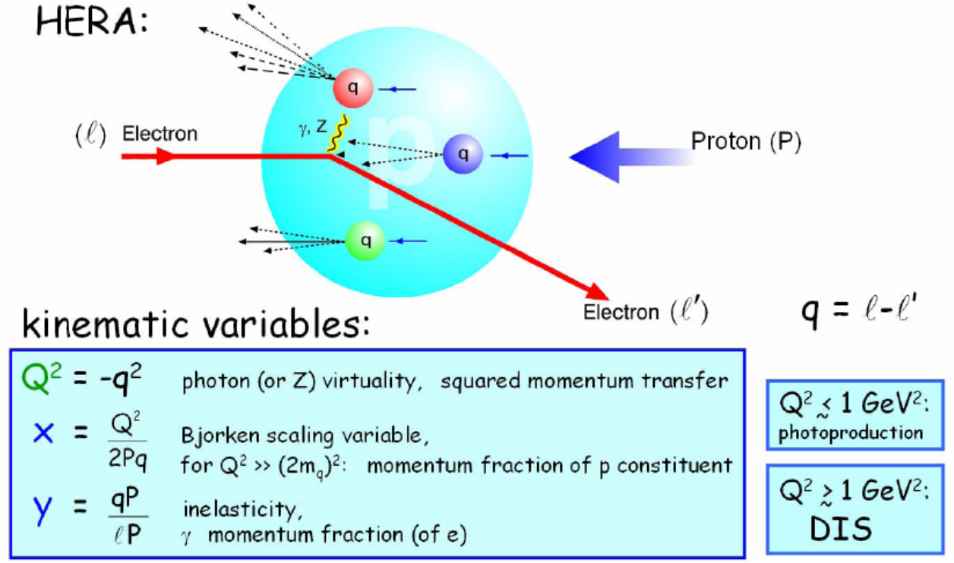

Slide 10
HERA physics highlights
Today many of the insights gained with HERA belong to our fundamental knowledge of how the world is put together.

Slide 11
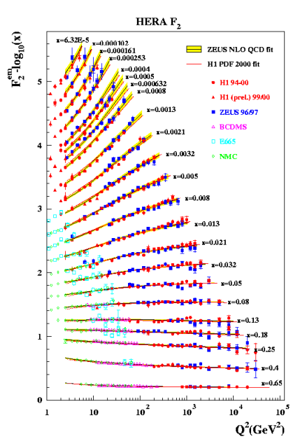
HERA physics highlights: Structure function F2(x, Q2)
Measured the structure function F2 over a range that spans four orders of magnitude of the kinematic parameters x and Q2 – two to three orders of magnitude more than were accessible to earlier experiments.

Slide 12
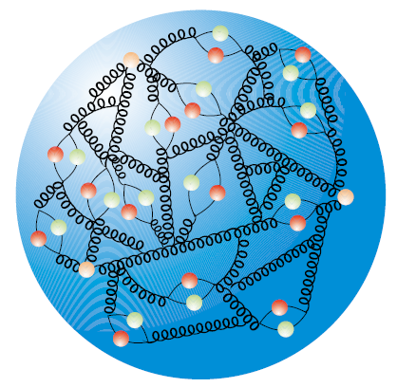
HERA physics highlights
HERA provided totally new insights
into the workings of the proton
Super electron microscope HERA makes the proton’s detailed structure
visible: three valence quarks and whole “sea” of gluons and short-lived quark-antiquark pairs.
The smaller the momentum fractions x are to which the HERA microscope is set, the more quark-antiquark pairs and gluons
are seen in the proton.

Slide 13
HERA physics highlights: electroweak force
H1 and ZEUS directly observe the effects of (theoretically predicted) electroweak unification: first step toward the grand unification of the fundamental forces of nature.

Slide 14
HERA physics highlights: weak interactions are "left-handed"
Event rates disappear when extrapolating to completely right-handed electrons, Pe = +1. Opposite for positrons, with the cross section approaching zero for lefthanded polarization.

Slide 15
HERA:
collaborations continue to finalize and publish their data analyses at high rate: 5 years after the end of HERA data taking - still a unique place to perform precision QCD studies; the relevance of these experimental results on the proton structure is appreciated as input for LHC analyses.
ZEUS today:
attractive and lively collaboration, many young people:
15 PhD, 13 MSc and 7 BSc (+9 BSc starting);
producing important physics results: ~50 ongoing analyses;
New results from ZEUS

Slide 16
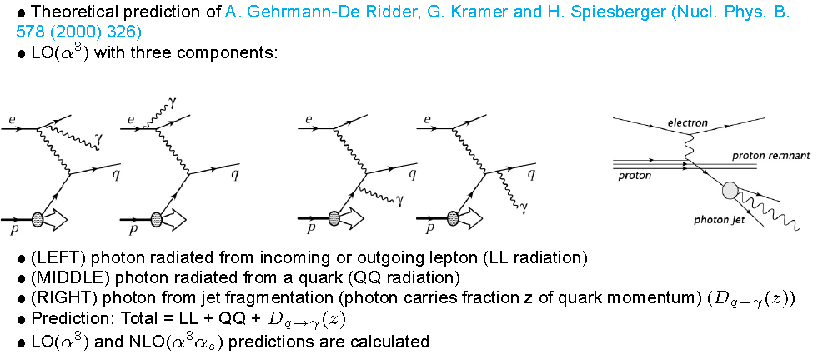
Isolated Photons + Jets in DIS
Predictions from GKS:

Slide 17
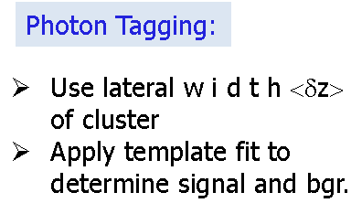
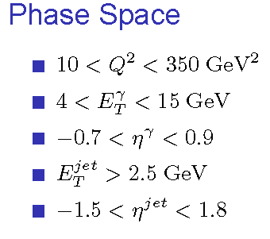
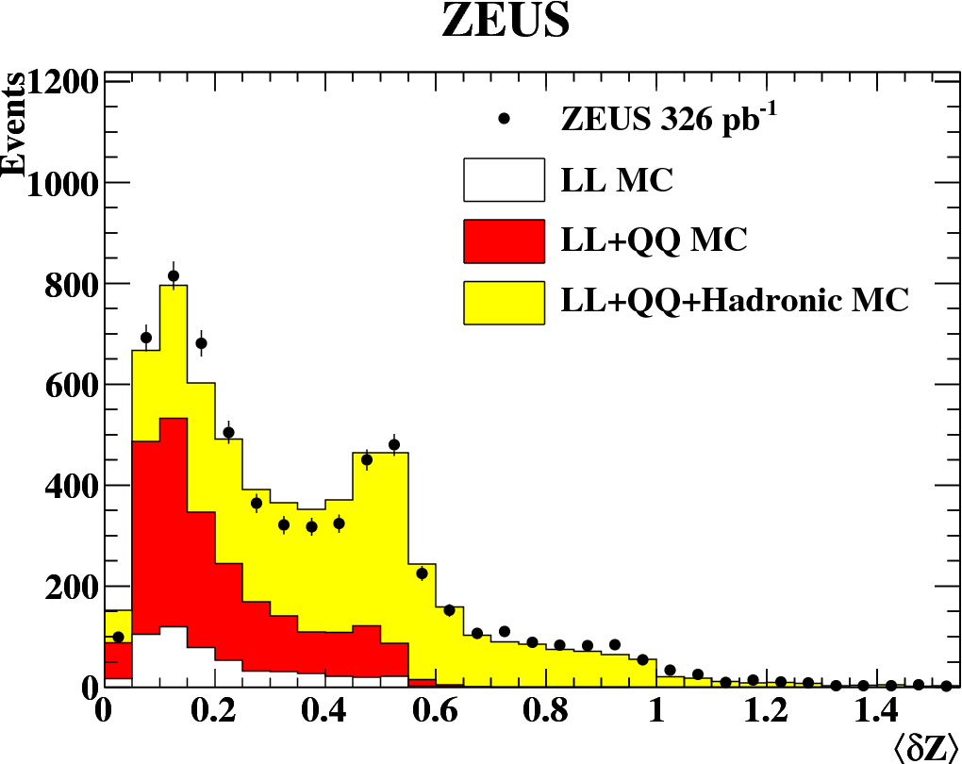


Isolated Photons + Jets in DIS

Slide 18
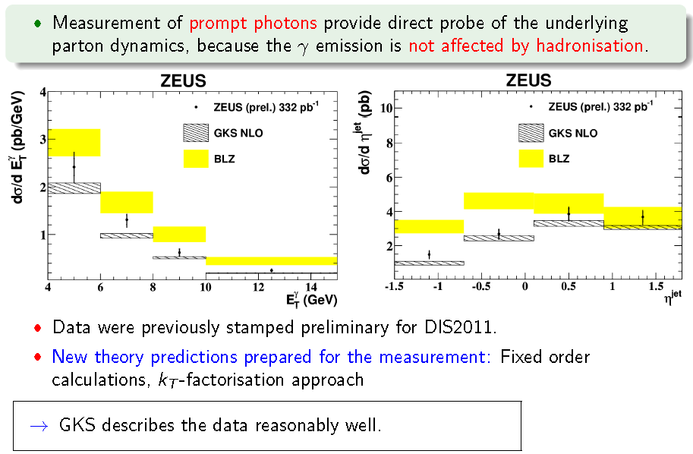
Prompt Photons + Jets in NC DIS

Slide 19
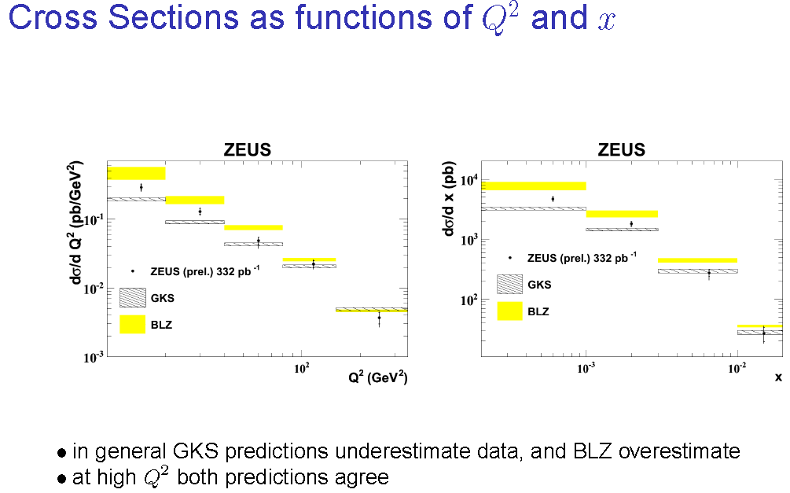
Isolated Photons + Jets in DIS

Slide 20
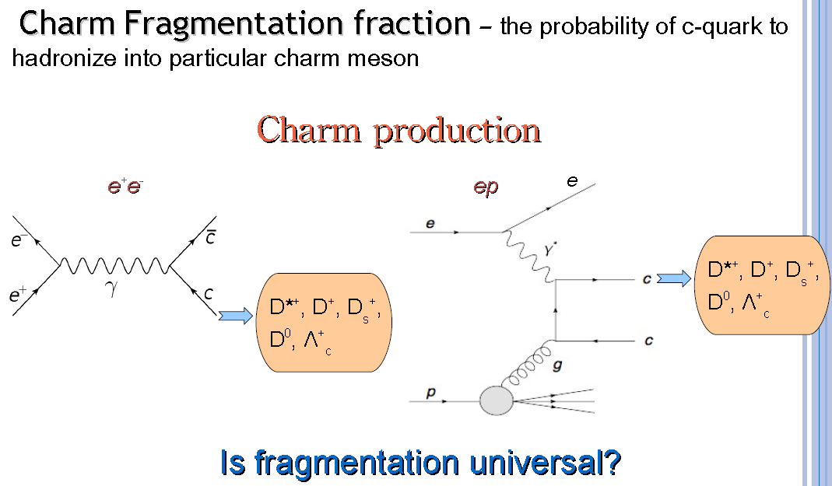
Charm Fragmentation Fractions: motivation

Slide 21
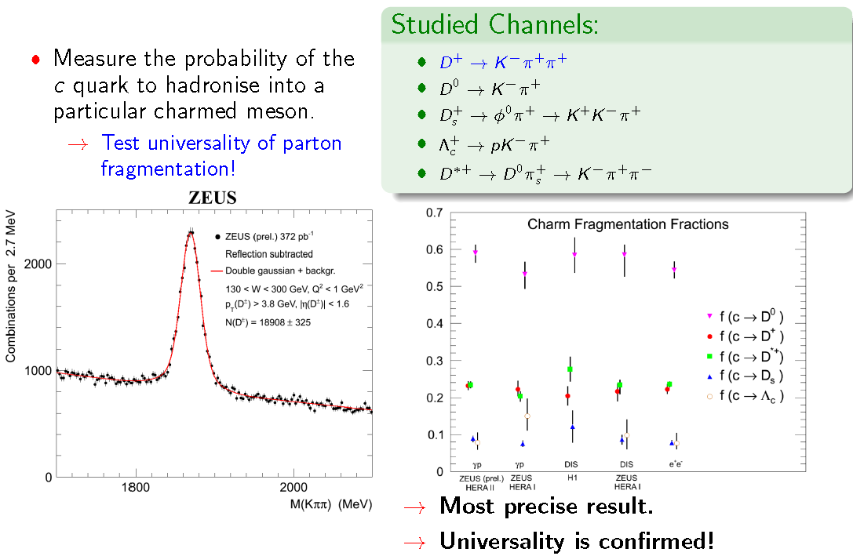
Charm Fragmentation Fractions in PHP

Slide 22
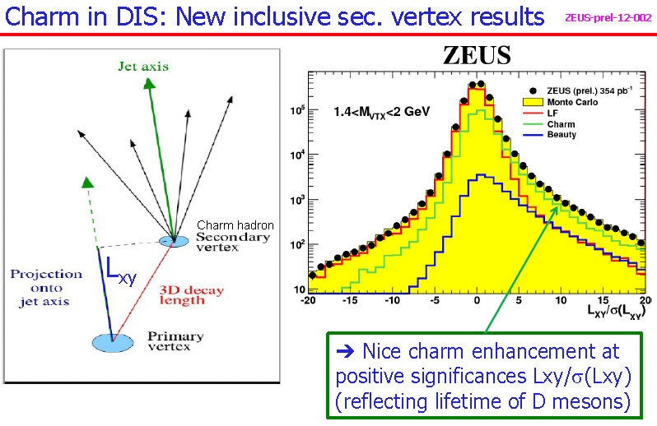

Slide 23
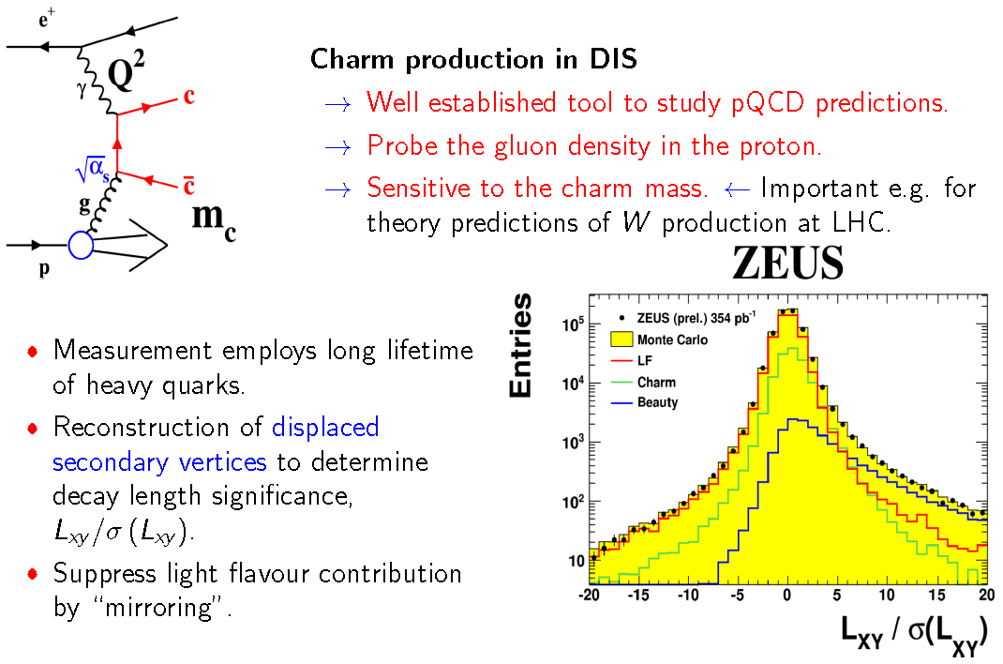
Charm Production using Secondary Vertices

Slide 24
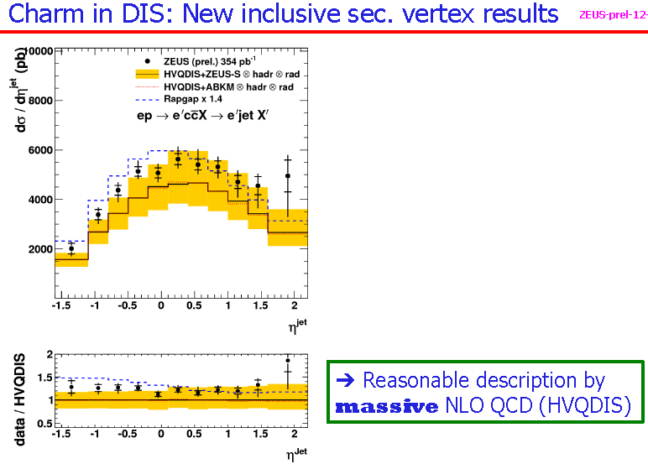

Slide 25
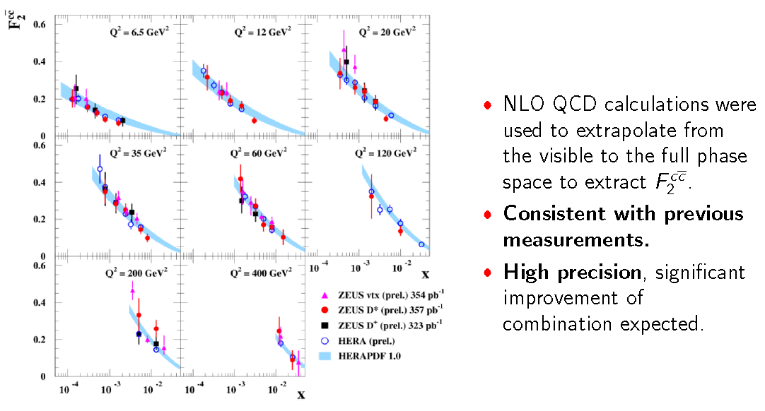
Charm Production using Secondary Vertices - charm contribution to DIS: F2cc

Slide 26
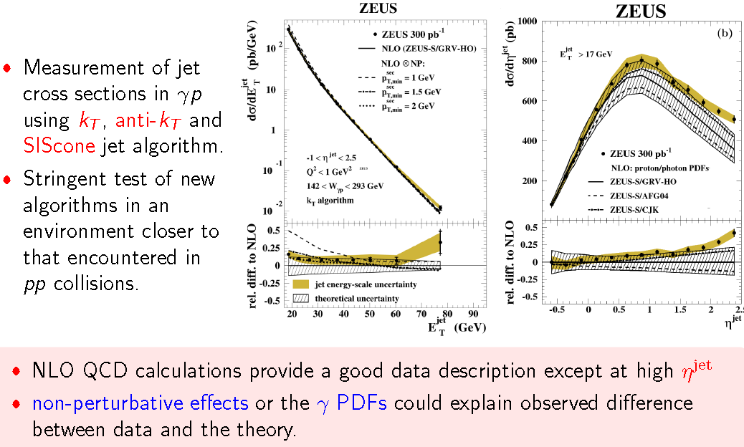
Inclusive Jet Production in PHP

Slide 27
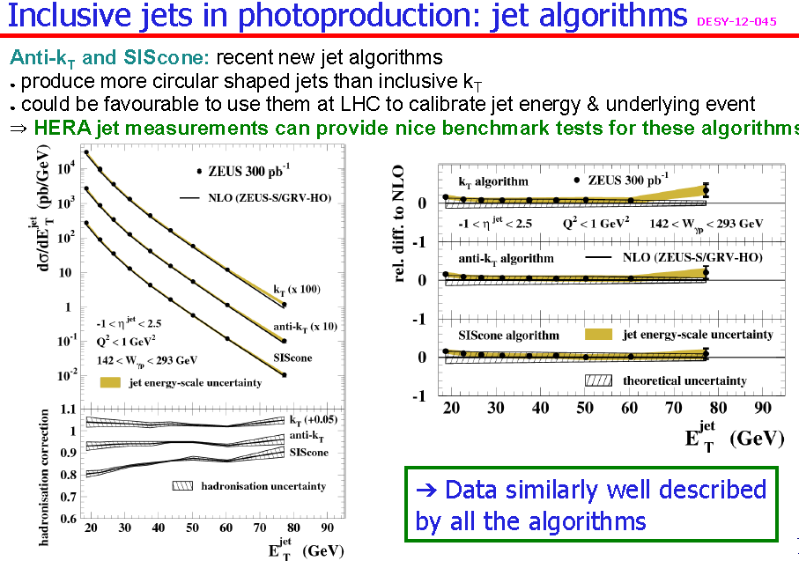

Slide 28
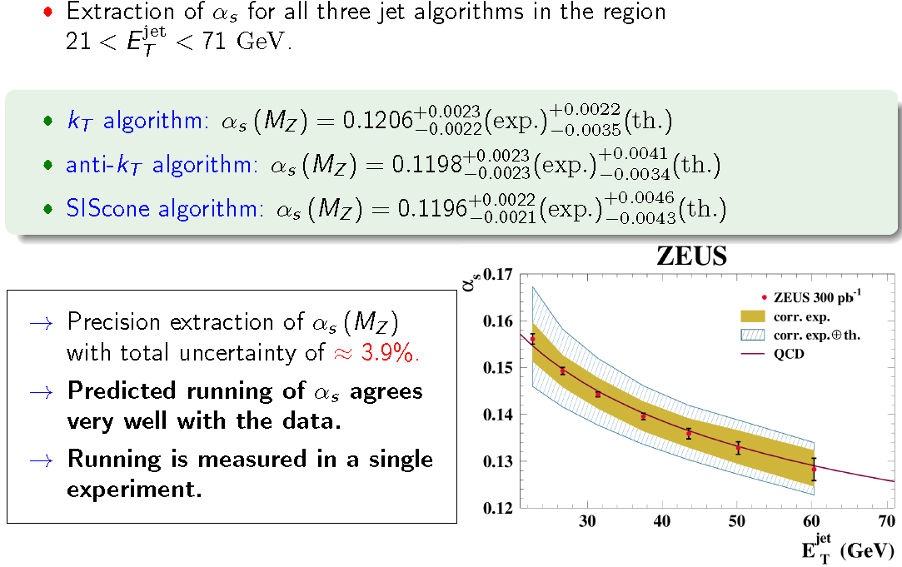
Inclusive Jet Production in PHP

Slide 29
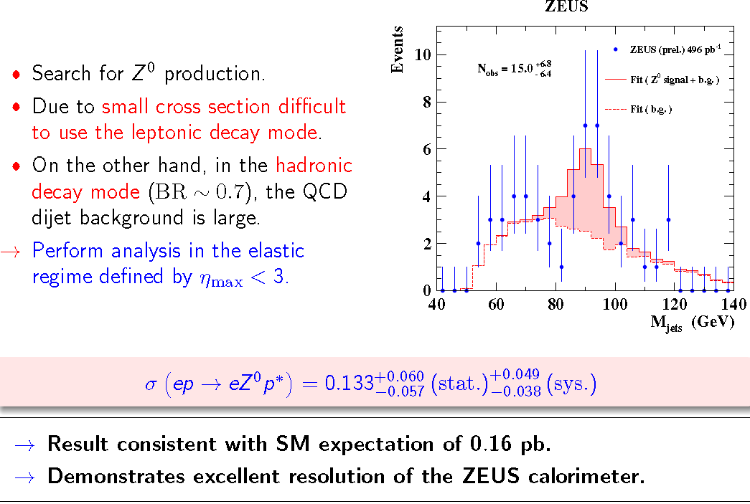
Search for Elastic Z0 Production

Slide 30
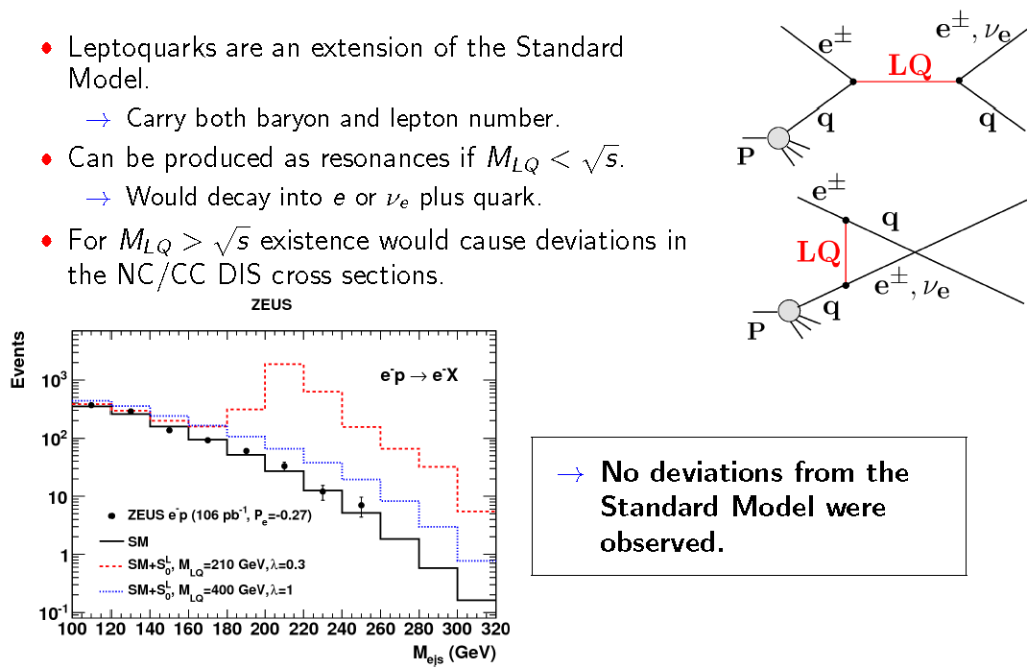
First Generation Leptoquarks

Slide 31
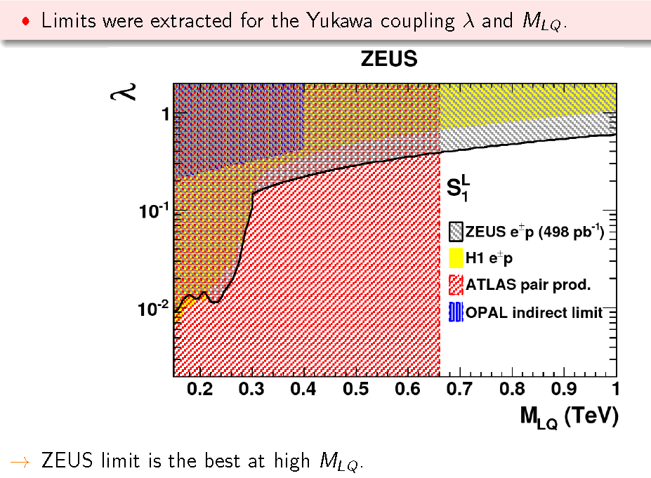
First Generation Leptoquarks

Slide 32
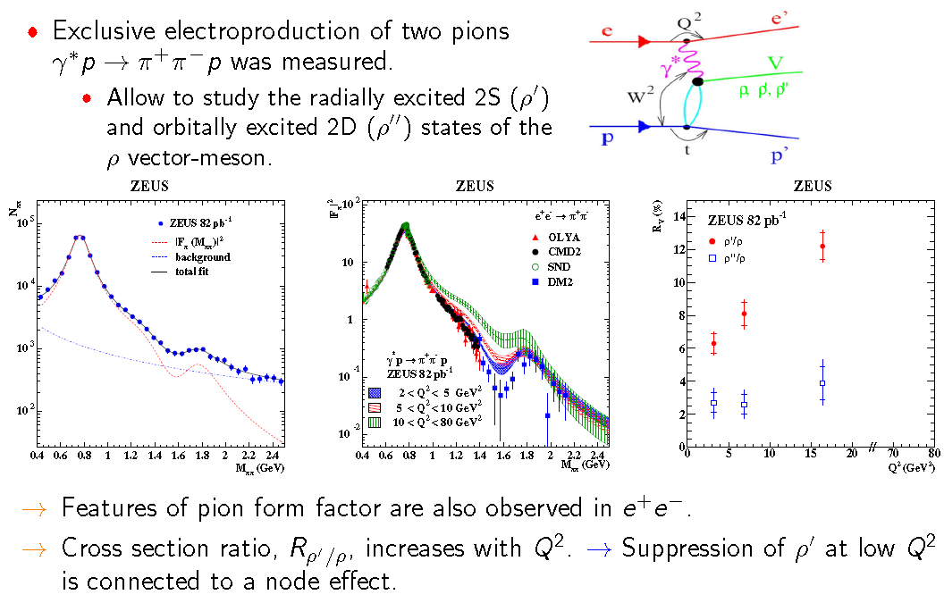
Exclusive Electroproduction of Two Pions

Slide 33
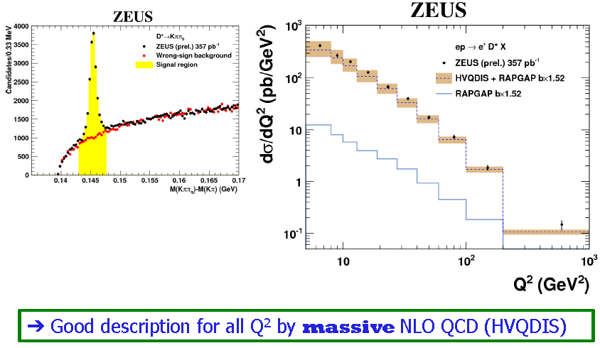
D* Production in DIS and F2cc Measurements

Slide 34
HERAPDF: precise measurement of parton distribution functions (quarks and gluons)

Slide 35
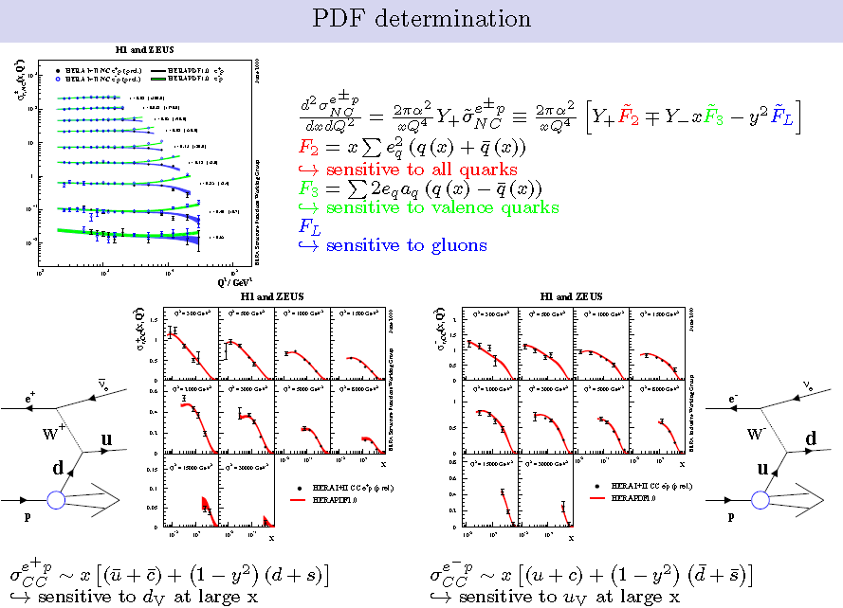
Proton structure measurements at HERA

Slide 36
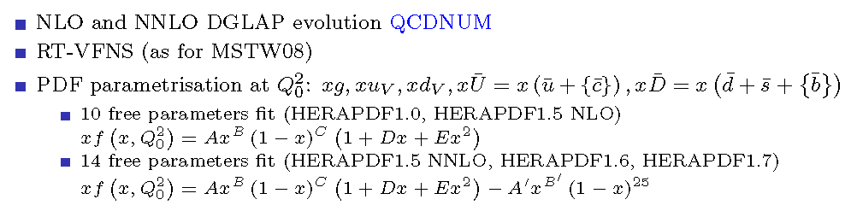

Slide 37
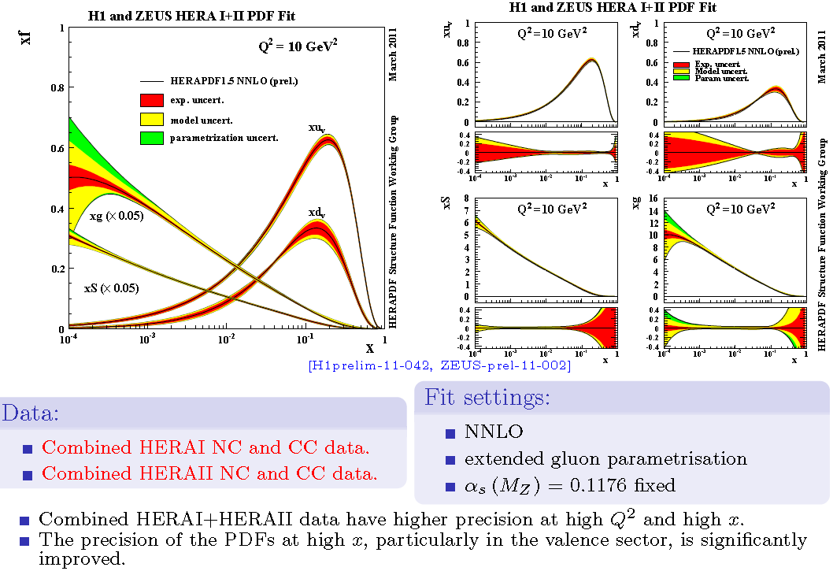
HERAPDF 1.5 NNLO

Slide 38
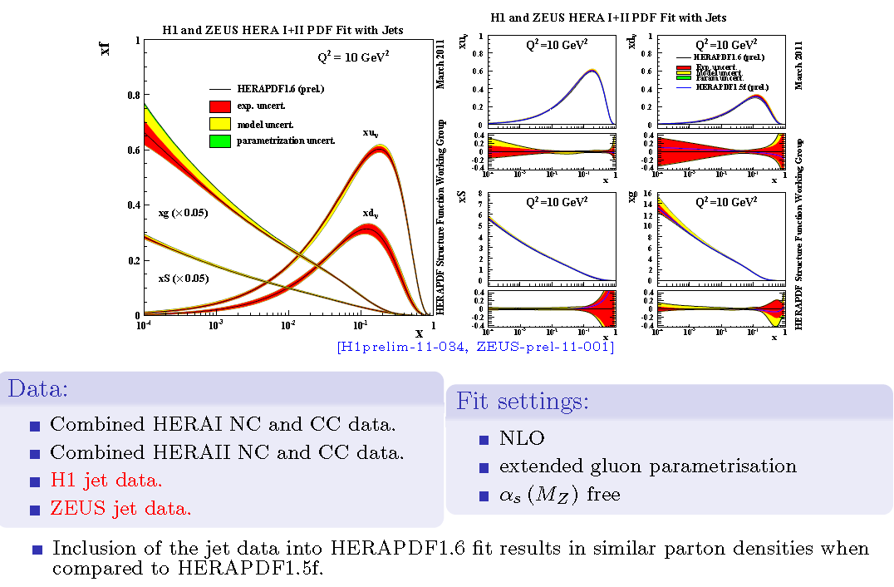
HERAPDF 1.6

Slide 39
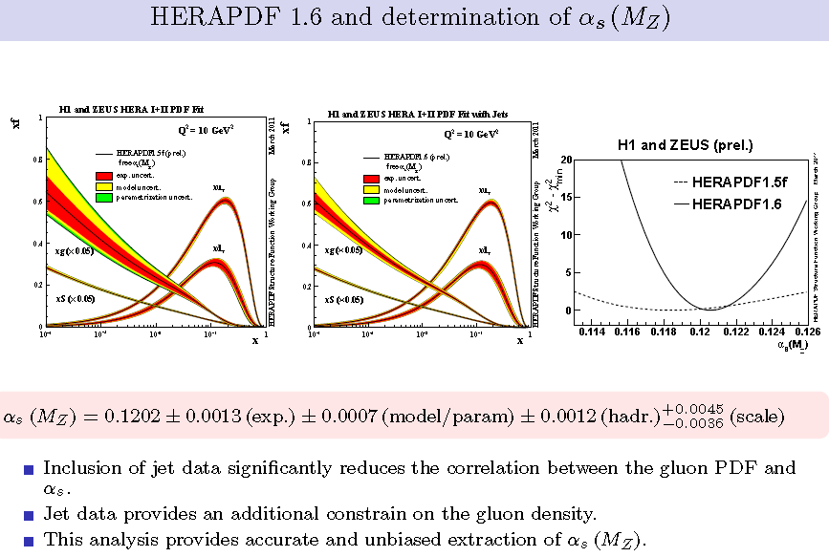

Slide 40
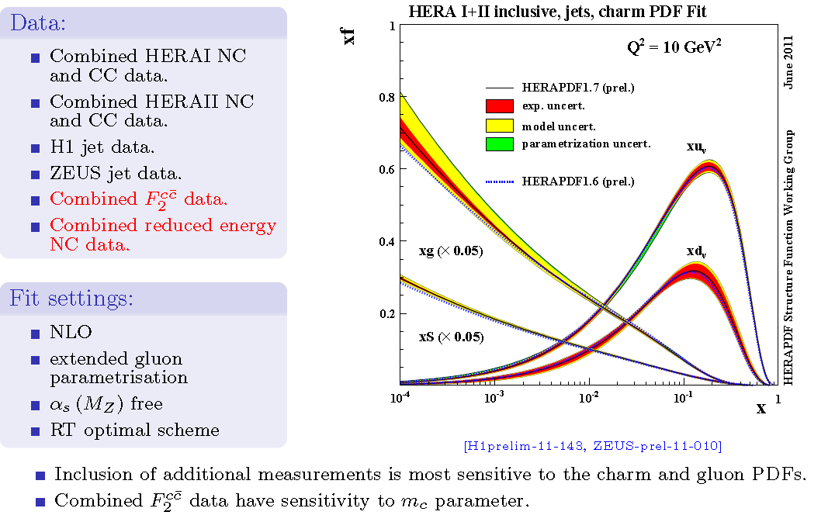
HERAPDF 1.7

Slide 41
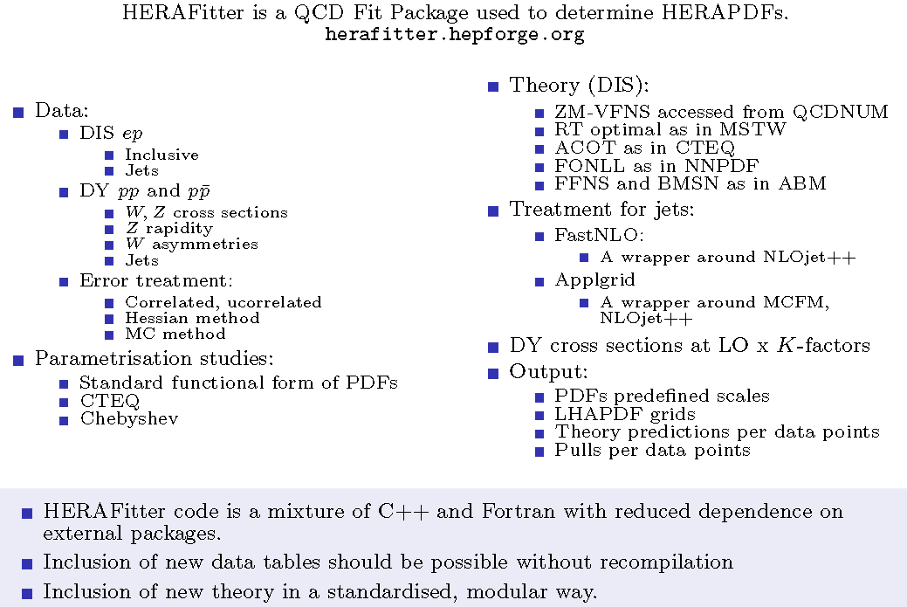
HERAFitter project

Slide 42
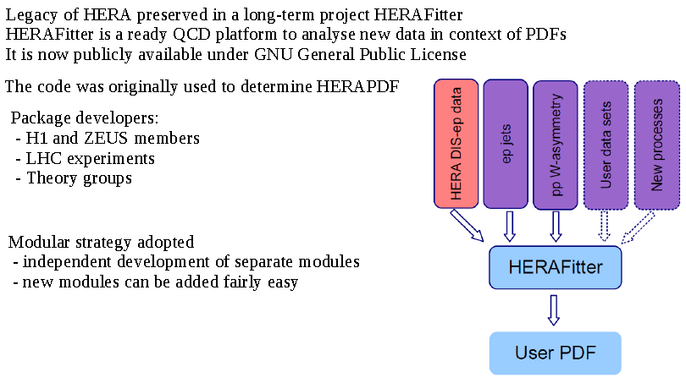
HERAFitter Platform

Slide 43
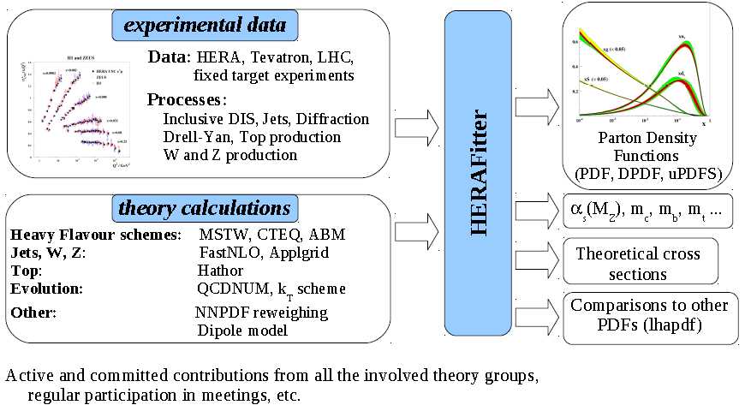
HERAFitter Platform

Slide 44
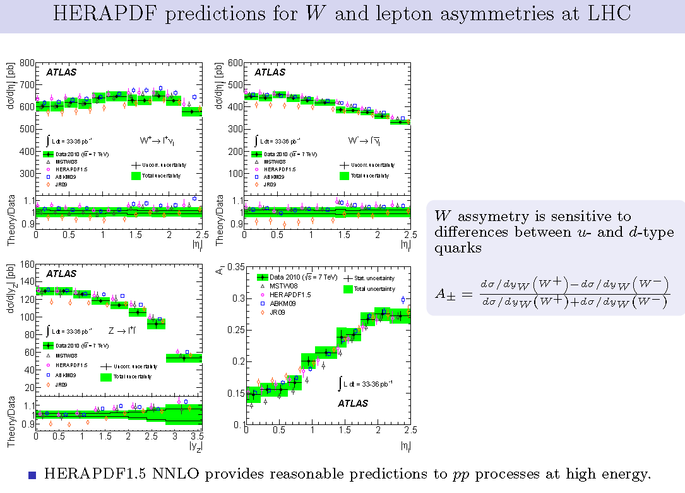
Parton distribution functions HERAPDF verified by successful predictions for ATLAS

Slide 45
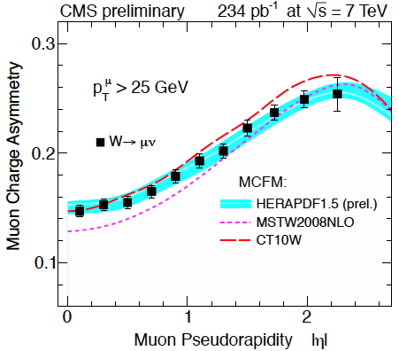
Successful HERAPDF1.5 Predictions for CMS

Slide 46
Conclusions
New precision results still coming in: jets, isolated photons, vector mesons, diffraction, charm and beauty etc.;
HERA provides an ideal QCD laboratory to probe the underlying theory as well as the structure of the proton;
A legacy from HERA: precise measurement of parton distribution functions (quarks and gluons) in kinematic range of interest for LHC;

